Slide 1

ANALYSIS OF RESIDENTIAL NEIGHBORHOODS
IN MADRID, SPAIN
Author: Raúl Castellanos

Slide 2
Discovering residential neighborhoods is valuable for families
All cities (especially the biggest ones) have different type of neighborhoods. Some of them are more suitable for tourist, other ones for shopping and some of them for setting a family.
Families need to know which are the most suitable neighborhoods for living in a new city
Madrid is the capital city of Spain. It has more than 100 neighborhoods with a total population
of 3.334.730. It is pretty difficult for a new family that arrives to the city to know where to start living.
- The objective of this Project is to differentiate which are the residential neighborhoods in this city.

Slide 3
Data acquisition and cleaning
Information of every neighborhood in Madrid, such as the name and the Per Income Capita from: https://www.madrid.es/portales/munimadrid/es/Inicio/El-Ayuntamiento/Estadistica/?vgnextfmt=default&vgnextchannel=8156e39873674210VgnVCM1000000b205a0aRCRD.
Geograpghical coordinates of every neighborhood using the Geopy library.
Information of public schools in the city from : https://datos.madrid.es/portal/site/egob/

Slide 4
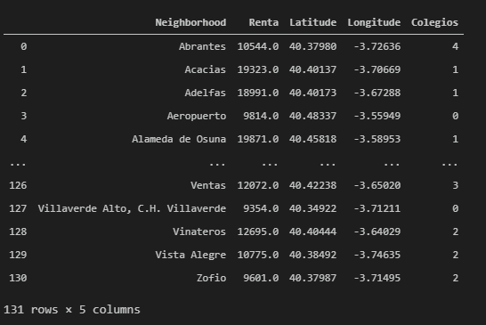
Methodology
Collect the Madrid city data in dataframes:
Using FourSquare API we will find all venues for each neighborhood.
Cluster the neighborhoods according to its venues.
Visualize the cluster and comparing to public schools distribution

Slide 5
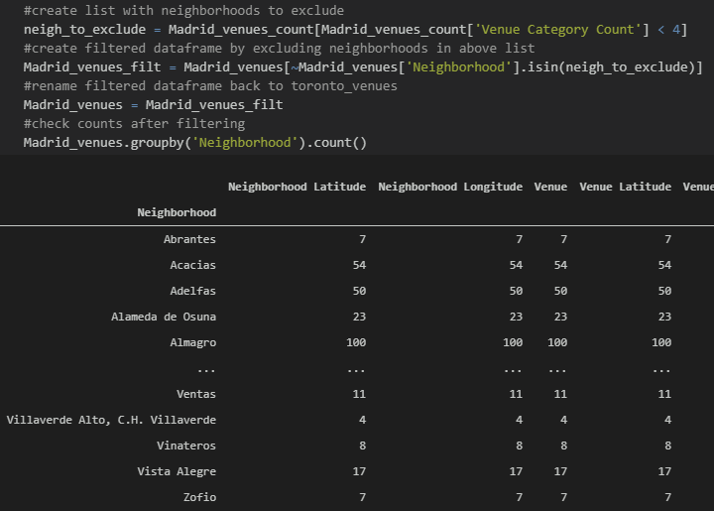
Methodology
Collect the Madrid city data in dataframes:
Using FourSquare API we will find all venues for each neighborhood:
Cluster the neighborhoods according to its venues.
Visualize the cluster and comparing to public schools distribution

Slide 6
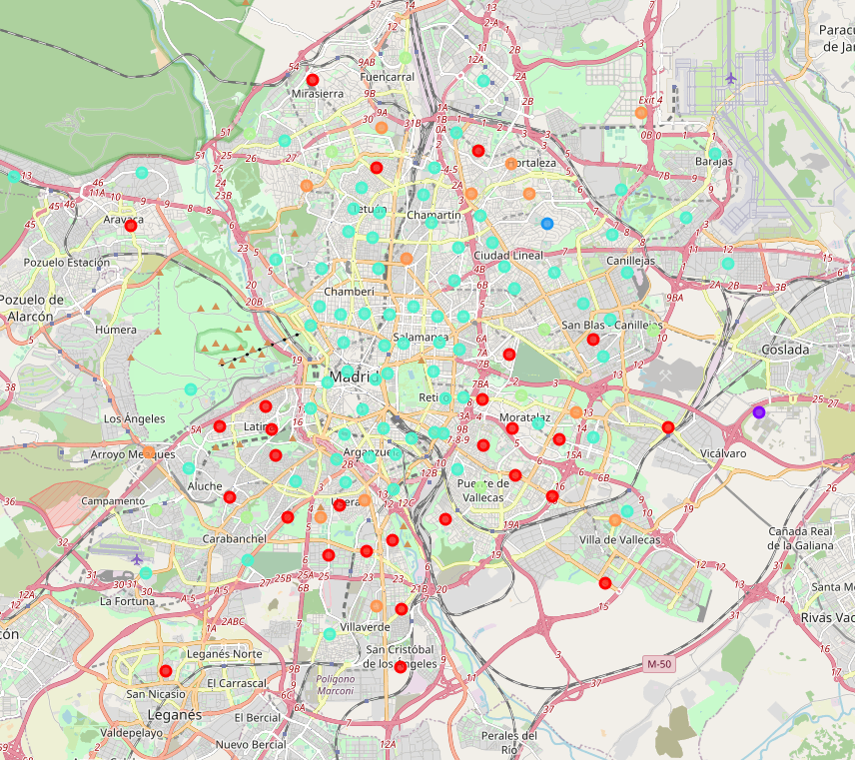
Methodology
Collect the Madrid city data in dataframes:
Using FourSquare API we will find all venues for each neighborhood.
Cluster the neighborhoods according to its venues:
Visualize the cluster and comparing to public schools distribution

Slide 7
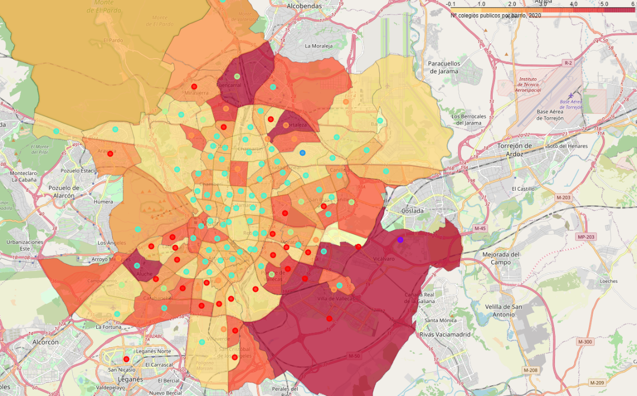
Methodology
Collect the Madrid city data in dataframes:
Using FourSquare API we will find all venues for each neighborhood:
Cluster the neighborhoods according to its venues.
Visualize the cluster and comparing to public schools distribution:

Slide 8
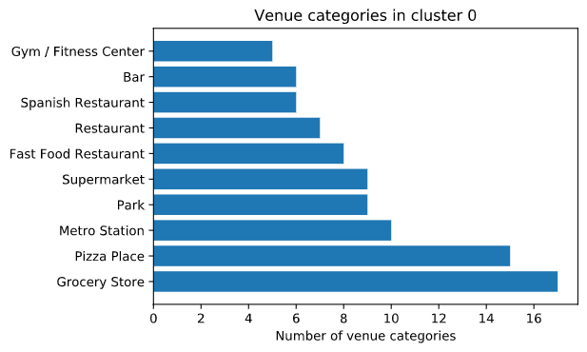
RESULTS
Most suitable residential neighborhoods:
🔵 Cluster 0: Residential
Plenty of useful services for a family like:
Grocery stores
Metro stations
Parks
Supermarkets
Gyms

Slide 9
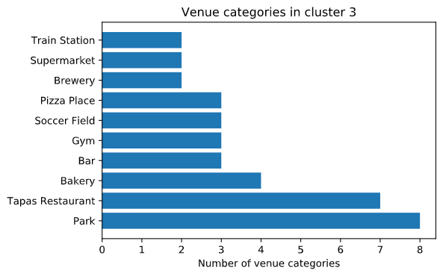
RESULTS
Most suitable residential neighborhoods:
🔵 Cluster 3: Sport lovers residential area
Interesting services for a sport lover family like:
Soccer fields
Gyms
Parks
Supermarkets
Train stations

Slide 10
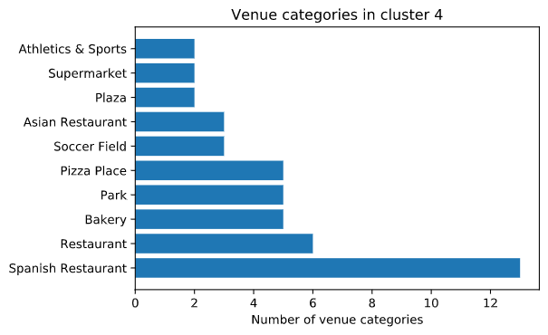
RESULTS
Most suitable residential neighborhoods:
🔵 Cluster 4: Food lovers residential area
Plenty of useful services for a family like:
Restaurants
Spanish restaurants
Parks
Supermarkets
Plaza

Slide 11
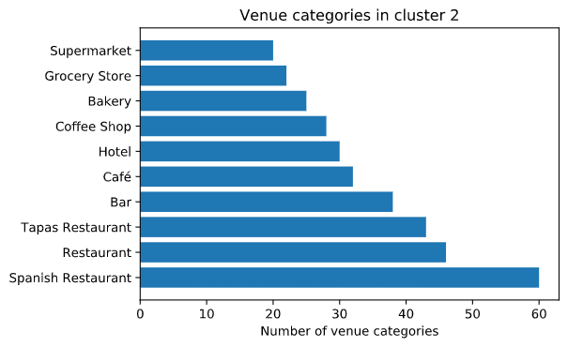
RESULTS
Less suitable residential neighborhoods:
🔵 Cluster 2: Downtown
Plenty of useful services for a tourist like:
High end Restaurants
Hotels
Coffee shops
Bar

Slide 12
Conclusion
Comparing to public schools distribution:
We can see that the previous clusters (🔵, 🔵 and 🔵) are in those neighborhoods with a huge amount of public schools.
That is according to what is expected so its seems to be a pretty realiable Project.
As we have shown before, we can even decide among different type of residential neighborhoods.

