Slide 1
C++ - Lecture 04
Pope Kim

Slide 2
Polymorphism

Slide 3
Before We Learn Polymorphism...
Let’s talk about member function
// Each value is located in Stack or Heap Cat* myCat = new Cat(5, “Lulu”); Cat* yourCat = new Cat(2, “Poppy”);
5 | 4000 |  | 2 | 2048
 | L | u | l | u | \0
P | o | p | p | y | \0
4084
4096
// What about member functions then? myCat->GetName(); yourCat->GetName();
??
Stack
Heap

Slide 4
Memory for Member Functions
Member functions are also located in memory somewhere
EVERYTHING HAS TO. RIGHT?
But, do you need separate memory space for each object?
myCat->GetName(); yourCat->GetName();
Instead, each member function is “allocated” ONCE in memory during compile-time
In low-level, member functions are just like global functions
These work exactly same

Slide 5
The Low-level View
(This shows just a concept)
// main.cpp myCat->GetName(); yourCat->GetName();
int GetAge(Animal* ptr) const { return ptr->mAge; }
class Animal
mov ecx,dword ptr [myCat] // saves myCat address
call Animal::GetName (0A16C7h)
0x0A16C7
char* GetName(Cat* ptr) const { return ptr->mName; }
mov ecx,dword ptr [yourCat] // saves youtCat address
call Animal::GetName (0A16C7h)
class Cat
Code Segment

Slide 6
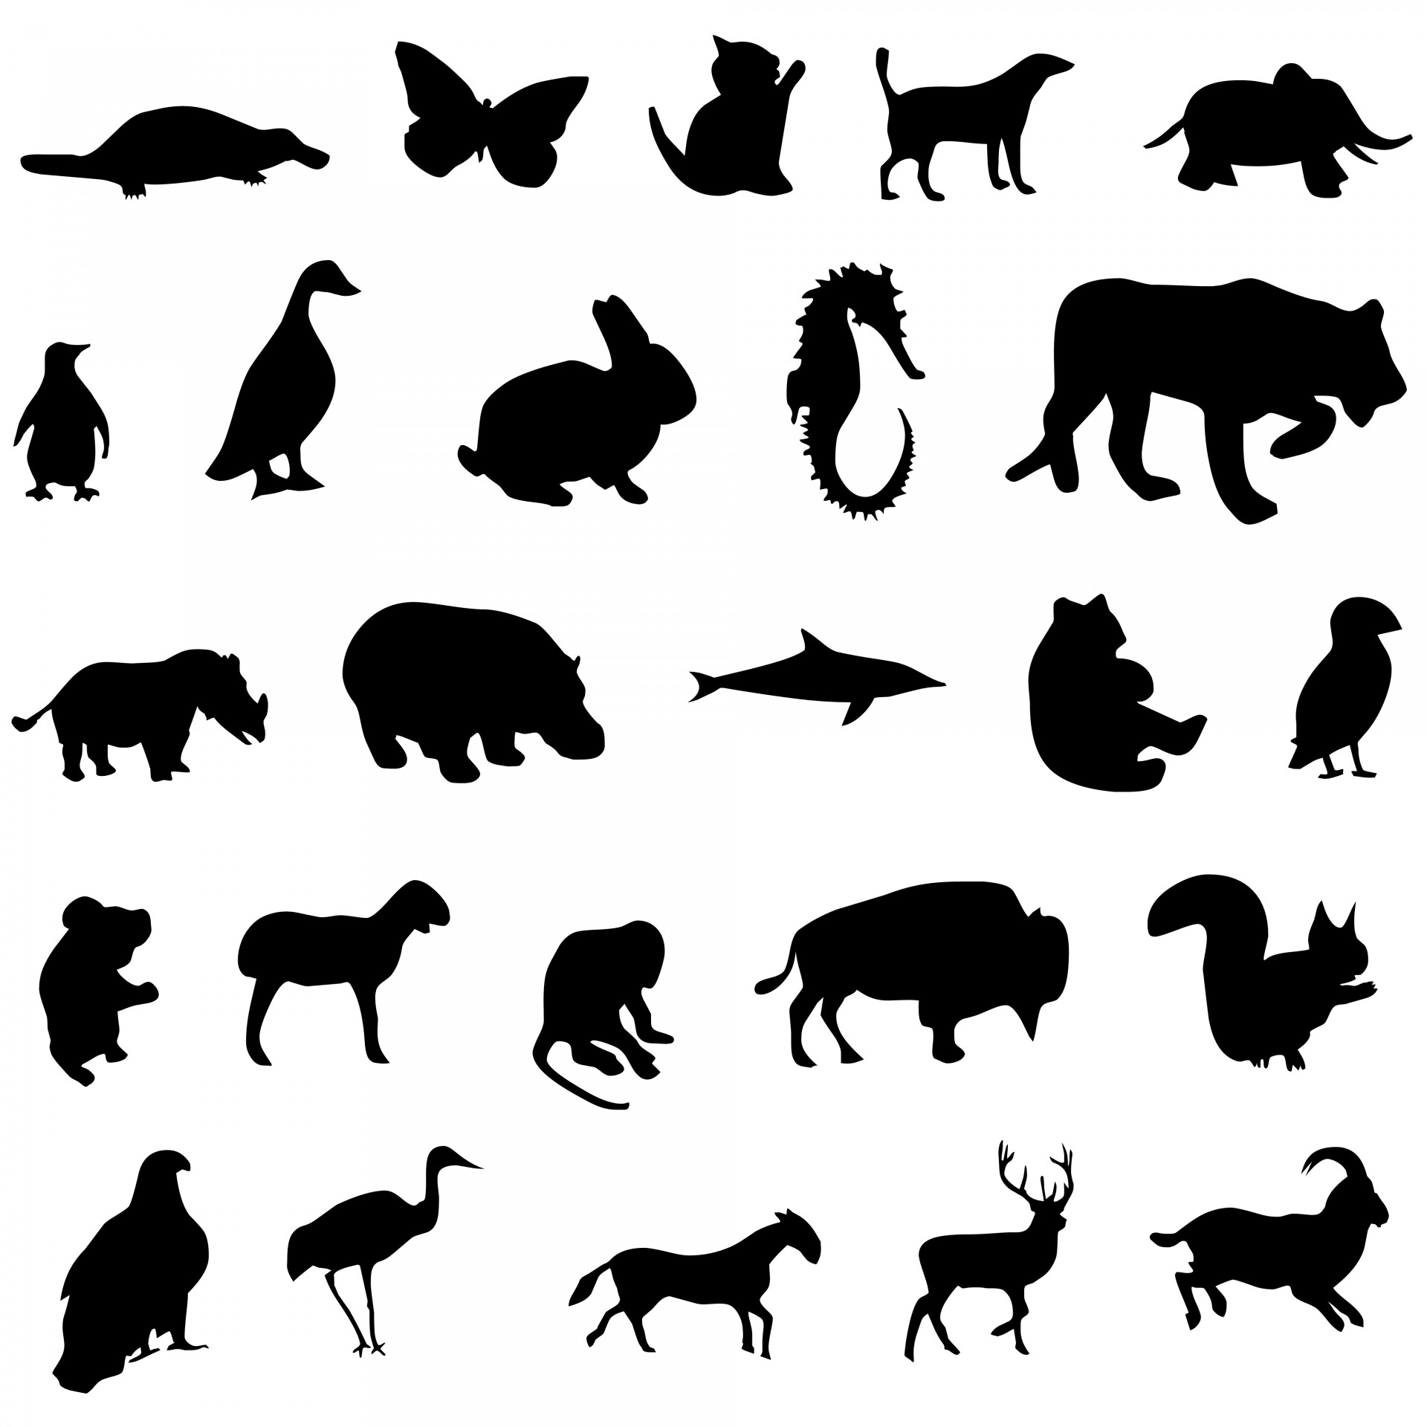
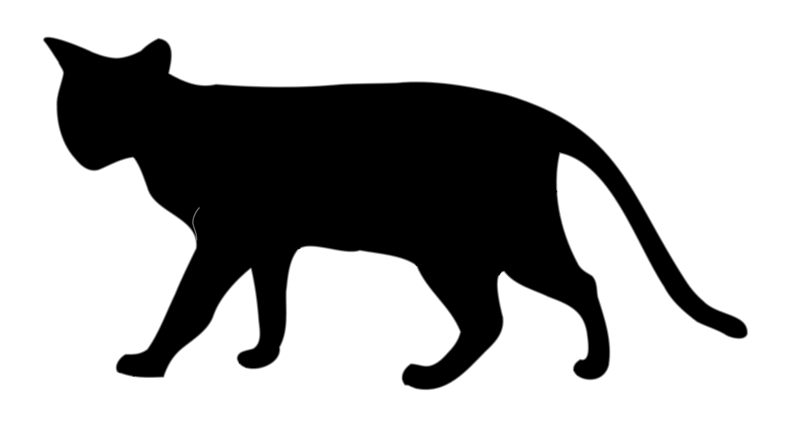
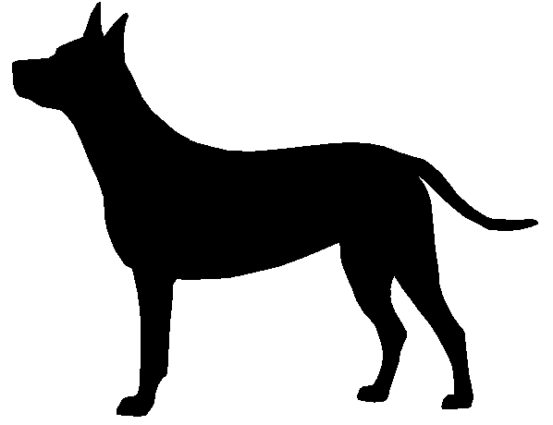
Function Overriding
void Animal::Speak() { std::cout << “Animal speaking” << std::endl; }
Animal
void Cat::Speak() { std::cout << “Meow” << std::endl; }
Woof
Meow
void Dog::Speak() { std::cout << “Woof” << std::endl; }
Cat
Dog

Slide 7
What Are The Results?
// Animal.h class Animal { public: void Speak(); } // Animal.cpp void Animal::Speak() { std::cout << “An animal is speaking” << std::endl; }
// Cat.h class Cat { public: void Speak(); } // Cat.cpp void Cat::Speak() { std::cout << “Meow” << std::endl; }
// Cat.h class Cat { public: void Speak(); } // Cat.cpp void Cat::Speak() { std::cout << “Meow” << std::endl; }
// Meow?
// Meow?

Slide 8
Java & C++ Inheritance
Java
public class Animal { // Print “An animal is speaking” public void Speak() {} } public class Cat extends Animal { // Print “Meow” public void Speak() {} } Cat myCat = new Cat(2, “Lulu”); myCat.Speak(); Animal yourCat = new Cat(5, “Poppy”); youtCat.Speak();
C++
class Animal { public: void Speak(); // Print “An animal is speaking” } class Cat { public: void Speak(); // Print “Meow” }
Cat* myCat = new Cat(); myCat->Speak(); Animal* yourCat= new Cat(); yourCat->Speak();
// Meow
// Meow
// Meow
(Only in Java)
// An animal is speaking

Slide 9
Static Binding - Member Variables
Cat* yourCat = new Cat(5, “Poppy”);
5 | 4000
P | o | p | p | y | \0
4096
yourCat
Stack
Heap

Slide 10
Static Binding - Member Variables
Animal* yourCat = new Cat(5, “Poppy”);
Cat class range
5 | 4000
P | o | p | p | y | \0
4096
yourCat
Stack
Heap

Slide 11
Static Binding - Member Functions
(This shows just a concept)
// main.cpp
Cat* myCat = new Cat(); myCat->Speak(); Animal* yourCat = new Cat(); yourCat->Speak();
0x0AA16BD
void Speak(Animal* ptr) const { ... }
class Animal
mov ecx,dword ptr [myCat] // saves myCat address
call Cat::Speak (0AA16C2h)
0x0AA16C2
void Speak(Cat* ptr) const { ... }
class Cat
mov ecx,dword ptr [yourCat] // saves youtCat address
call Animal::Speak (0AA16BDh)
Code Segment
Notes:
Virtual is going to make the program slow because the extra layer

Slide 12
Virtual Function (Core of Polymorphism)
// Animal.h class Animal { public: virtual void Move(); virtual void Speak(); } // Animal.cpp void Animal::Move() { }
void Animal::Speak() { std::cout << “An animal is speaking” << std::endl; }
// Cat.h class Cat { public: void Speak(); } // Cat.cpp void Cat::Speak() { std::cout << “Meow” << std::endl; }
// Main.cpp Cat* myCat = new Cat(2, “Lulu”); myCat->Speak(); Animal* yourCat= new Cat(5, “Poppy”); yourCat->Speak();
// Meow??
// Meow??

Slide 13
Java & C++ Inheritance
Java
public class Animal { // Print “An animal is speaking” public void Speak() {} } public class Cat extends Animal { // Print “Meow” public void Speak() {} } Cat myCat = new Cat(2, “Lulu”); myCat.Speak(); Animal yourCat = new Cat(5, “Poppy”); youtCat.Speak();
C++
class Animal { public: virtual void Speak(); } class Cat { public: void Speak(); }
Cat* myCat = new Cat(); myCat->Speak(); Animal* yourCat= new Cat(); yourCat->Speak();
// Meow
// Meow
// Meow
// Meow
Notes:
In java, everything is virtual.
In C++, everything is not virtual(Polymriphc)

Slide 14
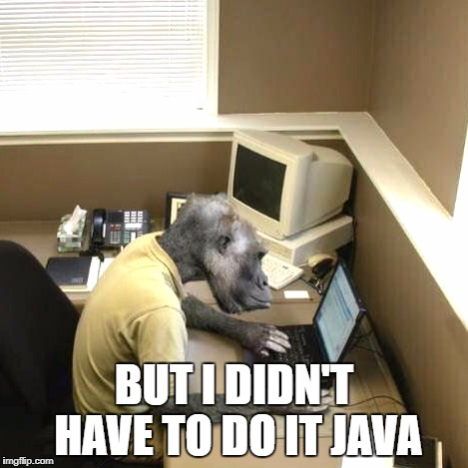

Slide 15
In Java Everything is Virtual by Default
Java programmers can use final keyword
(forgetting it will be always slower than non virtual)
In C++, omitting virtual sometimes results in bad s*#t
(we will see it later)

Slide 16
Virtual Function
Even if parent’s pointer or reference is used
It calls a member function of a child class
Dynamic binding / late binding
Determines actual function location during runtime
Slower than static binding, duh~
For this, a virtual table is created
Has all address of class’ member functions
Q: Is it per class vs per object?
A: per class
When you create an object, the address of virtual table of that class is saved together
Notes:
Why Dynamic? Because you don’t know until runtime
Virtual Table: Link between function and class, per class

Slide 17


Virtual Table
Why is it slower?
Someone made it
Where is Speak()?
Let me see…
Oh, it’s in 0x009EDC
Let’s understand it
It’s a good interview question
It’s a jump, or lookup, table

Slide 18
Dynamic Binding - Virtual Function for Member Functions
(This shows just a concept)
pointer to “Poppy”
5
virtual table address
Address of Animal::Move()
Address of Animal::Speak()
void Move(Animal* ptr) const {}
void Speak(Animal* ptr) const {}
Animal Class
Animal Virtual Class
YourCat (on Heap)
void Move(Cat* ptr) const {}
void Speak(Cat* ptr) const {}
Address of Cat::Move()
Address of Cat::Speak()
pointer to “Lulu”
2
virtual table address
Cat Class
Code Segment
Cat Virtual Class
MyCat (on Heap)
Compile Time
Runtime

Slide 19
Let’s Think about This
// Animal.h Class Animal { public: ~Animal(); private: int mAge; }
// Cat.h Class Cat : public Animal { public: ~Cat(); private: char* mName; } // Cat.cpp Cat::~Cat() { delete[] mName; }
Notes:
M

Slide 20
What Happens?
Cat* myCat = new Cat(2, “Lulu”); delete myCat;

Slide 21
What Happens?
Animal* yourCat = new Cat(5, “Poppy”); delete yourCat;
Notes:
Doesn’t work because computer think you are Animal and call the Destructor for animal which does not kill your cat

Slide 22
Non-virtual Destructor
// Animal.h Class Animal { public: ~Animal(); private: int mAge; } // Cat.h Class Cat : public Animal { public: ~Cat(); private: char* mName; }
Cat* myCat = new Cat(2, “Lulu”); delete myCat; Animal* yourCat = new Cat(5, “Poppy”); delete yourCat;
Calls this implicitly
No virtual function Calls this only
Not called

Slide 23
Remember omitting virtual can do something bad? MEMORY LEAKS

Slide 24
Virtual Destructor
// Animal.h Class Animal { public: virtual ~Animal(); private: int mAge; }
// Cat.h Class Cat : public Animal { public: // virtual not really required here virtual ~Cat(); private: char* mName; } // Cat.cpp Cat::~Cat() { delete mName; }

Slide 25
Virtual Destructor
(This shows just a concept)
...
...
Address of ~Animal()
Cat* myCat = new Cat(2, “Lulu”);
delete myCat;
Animal Virtual Class
40000 |  | 2 |  | 1024
 | L | u | l | u | \0
...
...
Address of ~Cat()
Animal Class
~Animal(Animal* ptr)
~Cat(Cat* ptr)
Heap
Cat Class
Code Segment
Cat Virtual Class
Compile Time
Runtime

Slide 26
Virtual Destructor
(This shows just a concept)
...
...
Address of ~Animal()
Animal* yourCat = new Cat(5, “Poppy”);
delete yourCat;
Animal Virtual Class
40000 |  | 5 |  | 2048
P | o | p | p | y | \0
...
...
Address of ~Cat()
Animal Class
~Animal(Animal* ptr)
~Cat(Cat* ptr)
Heap
Cat Class
Code Segment
Cat Virtual Class
Compile Time
Runtime

Slide 27
Virtual Destructor
VERY IMPORTANT!!
DO IT FOR EVERY CLASS
But, virtual is slow, isn’t it?
What if I don’t inherit from a class with a virtual destructor?
(C++14 or 17 has a solution)

Slide 28
ALWAYS PUT VIRTUAL FOR ANY DESTRUCTORS

Slide 29
Virtual Functions for Animal, Cat and Dog

Slide 30
SO WHAT IS POLYMORPHISM? (in plain English)
Notes:
Same interface, different behaviour

Slide 31
Summary: Polymorphism
Non-virtual function
Virtual function
Virtual table
Are these per class or per object?
Explain it in plain English
Notes:
g

Slide 32
Multiple Inheritance

Slide 33
Multiple Inheritance
Java
// Not Available
C++
// Faculty.h class Faculty { } // Student.h class Student { } // TA.h class TA : public Student, public Faculty { } // Main.cpp TA* myTA = new TA();

Slide 34
Which Parent’s Constructor Is Called first?
The order of parent class in a derived class
The order of initializer list doesn’t matter
// Calls Student() first, Faculty() next class TA : public Student, public Faculty { } // Calls Faculty() first, Student() next class TA : public Faculty, public Student { }
// Calls Student() first, Faculty() next class TA : public Student, public Faculty : Faculty() , Student() { }

Slide 35
Remember This Question?
Can We Use super() Like Java?
No, Because of the multiple inheritance
class TA : public Student, public Faculty { }
: Faculty(“a12345678”) , Student(“Full-time”)
: super(“a12345678”) // What does super point? , super(“Full-time”) // What does super point?
Notes:
Password doesn’t became more secure how many special chars, its about how long

Slide 36
Problem 1 - Which Function Is Called?
// Faculty.h class Faculty { public: void DisplayData(); } // Student.h class Student { public: void DisplayData(); }
// TA.h class TA : public Student, public Faculty { } // Main.cpp TA* myTA = new TA(); myTA->DisplayData(); // ??
Notes:
Same function in the two parent class

Slide 37
How to Solve This?
When ambiguous, you have to specify parent class MANUALLY
myTA->Student::DisplayData();
Notes:
Complier would give an error if you don’t decide which class to call

Slide 38

Problem 2 - The Diamond Problem
Not as pretty as real diamond
Animal
Liger* myLiger = new Liger();
How many Animals does Liger have?
2 Animals
Tiger
Lion
Liger
Notes:
If animal have var called age, then Tiger and Lion have Age as well, if we inheritance both of them, we have two ages.

Slide 39

Virtual Base Class
// Animal.h class Animal { } // Tiger.h class Tiger : virtual public Animal { }
// Lion.h class Lion : virtual public Animal { } // Liger.h class Liger: public Tiger, public Lion { }
Notes:
If you put virtual on both parents, it will resolve the duplicated methods etc. Never use this shit tho, may have some stupid company ask for it but fuck them, Don’t work with them EVER

Slide 40
DON’T USE MULTIPLE INHERITANCE. USE INTERFACE INSTEAD
Like Java lol
They don’t allow multiple inheritance Instead, they use interface, right?
We cover interface later :)
Notes:
C++ doesn’t have an interface, we have to make our own interface.

Slide 41
Multiple-Inheritance (just because we have time)

Slide 42
Abstract Class

Slide 43
Abstract Class
// Animal.h class Animal { public: virtual ~Animal(); virtual void Speak() = 0; private: int mAge; }
// Cat.h class Cat : public Animal { public: ~Cat(); void Speak(); private: char* mName; }
Notes:
In the class, there’s something doesn’t have implementation
Use function = 0 to make sure there’s no implementation
Must to have virtual

Slide 44
Pure Virtual Function
Member function that does not have implementation
Forces you to implement it in derived classes
class Animal { public: virtual void Speak() = 0; private: int mAge; }
class Cat: public Animal { public: Cat(int age, const char* name); private: char* name; }
// ??
// Compile Error
// There is no Speak() definition
Notes:
We have to implement it somewhere in the child class

Slide 45
How to Declare Pure Virtual Functions?
virtual <return-type> <function-name> (<argument-list>) = 0;
virtual void Speak() = 0; virtual float GetArea() = 0;

Slide 46
Abstract Class
A base class with pure virtual functions is an abstract class
You can NOT instantiate objects from an abstract class
You can still use abstract class as pointer or reference type
class Animal { public: virtual void Speak() = 0; private: int mAge; }
Animal myAnimal; // Impossible
Animal myAnimal = new Animal(); // Impossible
Animal* myCat = new Cat(); // OK
Animal& myCatRef = *myCat; // OK

Slide 47
“Interface”
// IFlyable.h class IFlyable { public: virtual void Fly(); } // IWalkable.h class IWalkable { public: virtual void Walk(); }
class Bat : public IFlyable, public IWalkable { public: void Fly(); void Walk(); }
class Cat: public IWalkable { public: void Walk(); }
Notes:
Every time you think of interface, think about something you can do with it. Use ~able

Slide 48
“Interface”
C++ does not support it natively
We can mimic Java’s interface with pure abstract class by having
only pure virtual functions
no member variables
class IFlyable { public: virtual Fly() = 0; }

Slide 49
IFlyable, IWalkable, Bat and Cat Class

Slide 50
Summary
Multiple Inheritances
Abstract Class
Interface

