Slide 1
Lecture 06
Pope Kim

Slide 2
Exception

Slide 3
Java Example 1: FileNotFoundException
import java.io.FileInputStream; import java.io.FileNotFoundException;
public class RadialGlobalMenu extends Group { private ImageView getImageView(final String path) { ImageView imageView = null; try { imageView = ImageViewBuilder.create().image(new Image(new FileInputStream(path))).build(); } catch (final FileNotFoundException e) { e.printStackTrace(); } assert (imageView != null); return imageView; } }
(Source: https://github.com/MrLoNee/RadialFx/blob/1795eca080d23803904658ea5ba535ca71b1622a/src/com/mrlonee/radialfx/globalmenu/RadialGlobalMenu.java)

Slide 4
Java Example 2: NumberFormatException
import java.lang.NumberFormatException;
public class Parser extends DefaultHandler { private void setIterations(char ch[], int start, int length) { int n; try { n = Integer.parseInt(new String(ch, start, length)); if (n < 0) { throw new NumberFormatException(); } } catch (NumberFormatException e) { System.out.println("Error: the number of iterations is not a positive integer! " + "Setting it to 100."); n = 100; } settings.setIterations(n); } }
(Source: https://www.programcreek.com/java-api-examples/index.php?source_dir=openpixi-master/pixi/src/main/java/org/openpixi/pixi/ui/util/Parser.java)

Slide 5
Exceptions are Everywhere in Java
This makes no sense
Because a lot of exceptional cases can be handled with if statements

Slide 6
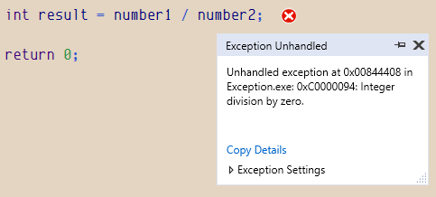
Exceptional Case 1: Division by Zero
int number1 = 0;
int number2 = 0;
cin >> number1 >> number2;
int result = number1 / number2;
What happen if number2 is 0?

Slide 7
Exceptional Case 1: Division by Zero
int number1; Int number2; cin >> number1 >> number2; If (number2 != 0) { int result = number1 / number2;
}

Slide 8
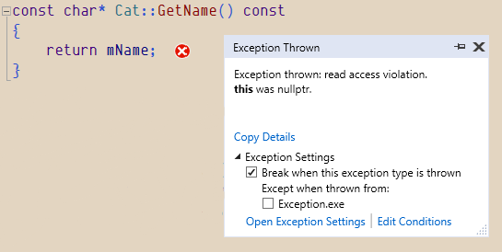
Exceptional Case 2 - Null Object
Cat* myCat = nullptr;
const char* myCatName = myCat->GetName();
cout << myCatName << endl;
What happen if myCat is NULL?

Slide 9
Exceptional Case 2 - Null Object
Cat* myCat = new Cat(5, “Lulu”); if (myCat == NULL) { // Do something.. }
You can do this already
NULL means fail/success status as well
Any reference type has both object and fail/success status
Notes:
If NULL it means it failed

Slide 10
So, Most Exceptions Don’t Make Sense
The only case that theoretically makes sense is constructor

Slide 11
Exceptional Case 3 - Constructor
Inventory::Inventory(int count) { mSlots = new int[count]; }
If mSlots is NULL, what should we do?
Notes:
Only time it makes sense beacuse constructor does not return anything

Slide 12
Exception in Constructors
// Exceptions.h struct SlotNullExcption : public exception { const char * what() const throw () { return "Slot is NULL";
}
};
// Inventory.cpp
Inventory::Inventory(int slotCount) {
mSlots = new int[slotCount];
if (mSlots == NULL) {
throw SlotNullExcption();
}
}

Slide 13
Exception in Constructors
// Main.cpp Inventory* myInventory = NULL; try { myInventory = new Inventory(5); } catch (const SlotNullExcption& e) { cerr << e.what() << endl; } catch (const exception& e) { // Other Errors }

Slide 14
So, Can We Use Exceptions for Constructors?
Sure, but exception is turned off by default in C++
It is SLOW: using hardware interrupt in C++
Remember which industries still use C++?
Also What would you do when an exception is thrown because of out of memory?
Close your program?
How is it different from crash?
Try call constructor again?
But there is not enough memory

Slide 15
C++ vs Other Languages
You MIGHT work at a company who uses C++ exceptions
So know it's there
Other languages have used exceptions extensively SO FAR
But big shift is happening
Why?
History first

Slide 16
C and Error Code
#define SUCEESS 0x0 #define FAILED_OPEN_FILES 0x1 ... int PrintAllRecord() { FILE *fp = NULL; fp = fopen(FILE_NAME, "r"); if (fp == NULL) { return FAILED_OPEN_FILES; } ... return SUCEESS; }
int main() { int result = PrintAllRecord(); if (result != SUCEESS) { fprintf(stderr, "Can't print records.\n"); } return 0; }

Slide 17
C++ and Error Code
Remember cin? How did we handle errors?
int number; cin >> number; if (cin.fail()) // this is a kind of error code { // ….. }

Slide 18
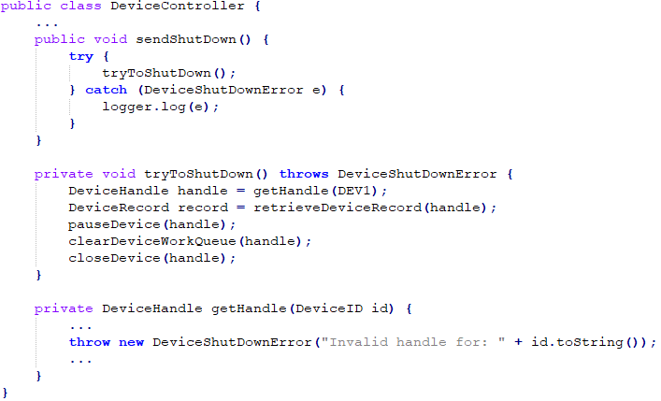

Someone Said...
Error code is not readable, so easy to make mistakes
Exceptions make your code more maintainable
Exceptions make your code safer and robust
(Source: Clean Code by Robert Cecil Martin)

Slide 19
Error Code is Unreadable

Slide 20
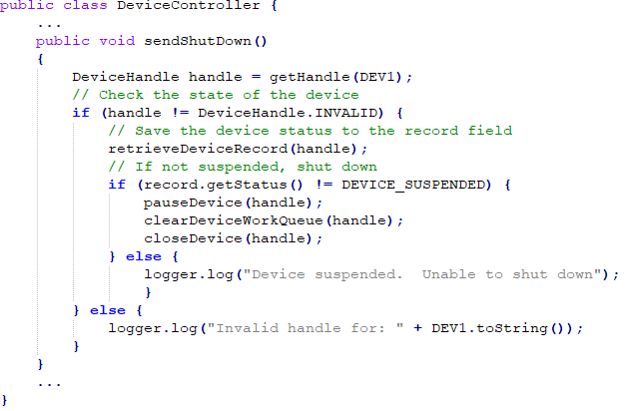
Unreadable Error Codes
(Source: Clean Code by Robert Cecil Martin)

Slide 21
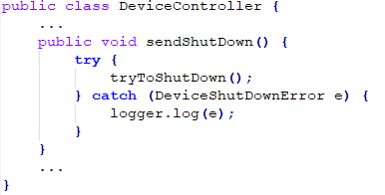
Readable Exceptions
(Source: Clean Code by Robert Cecil Martin)

Slide 22
Error Codes vs Exceptions

Slide 23
Real Exception Codes
private void tryToShutDown() throws DeviceShutDownError
{
DeviceHandle handle;
…
throw new DeviceShutDownError("Invalid handle for: " + DEV1.toString());
…
DeviceRecord record = retrieveDeviceRecord(handle);
pauseDevice(handle);
clearDeviceWorkQueue(handle);
closeDevice(handle);
}

Slide 24
More Readable Error Codes
public void sendShutDown()
{
boolean bSuccess = trySendShutDown();
}

Slide 25
Error Codes vs Exceptions
Error Codes
public void sendShutDown()
{
bool bSuccess = trySendShutDown();
}
Exceptions
private void tryToShutDown() throws DeviceShutDownError
{
DeviceHandle handle;
…
throw new DeviceShutDownError ("Invalid handle for: " + DEV1.toString());
…
DeviceRecord record = retrieveDeviceRecord(handle);
pauseDevice(handle);
clearDeviceWorkQueue(handle);
closeDevice(handle);
}

Slide 26
Real Comparison
Exceptions
public void sendShutDown() {
try {
tryToShutDown();
} catch (DeviceShutDownError e) {
logger.log(e); }
}
Error Codes
public void sendShutDown()
{
bool bSuccess = trySendShutDown();
}

Slide 27
Truth
Error code is as readable as exceptions
Or maybe even better. You decide.

Slide 28
2. Exceptions are More Maintainable

Slide 29
3. Programs are More Robust with Exceptions

Slide 30
Someone Said...
Exceptions make program run even during exceptional cases
So it makes your service run seamlessly

Slide 31





Does Exception Make More Robust Software?
There is no proof or data to back it up.
Most robust programs were written in C-sih with error codes.

Slide 32
Benefit of Doubt
No proof does not automatically mean they are wrong
So I'll tell you what we found out after using exceptions more than 21 years
Most programmers cannot handle exception properly

Slide 33
Exception Safety - Java
Unsafe code
public class CoffeeShop { .... void SellWithPoint(Customer customer, int itemID, int points) throws EmptyItemException { deductPoint(customer, points); if (isEmpty(itemID)) { throw new EmptyItemException(); } } }

Slide 34
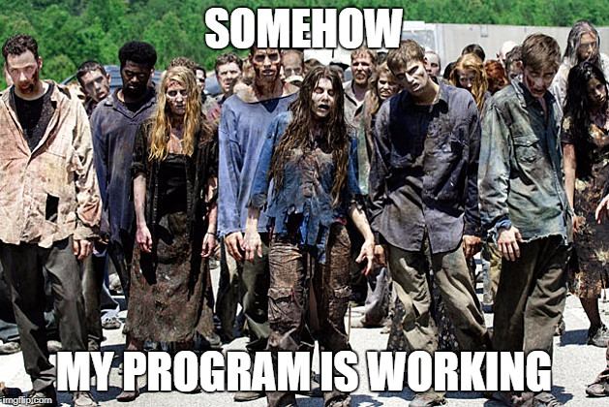
Somehow Your Program is Working...
Exceptions make your program as “Zombie”

Slide 35
Exception Safety - Java
Safe code
public class CoffeeShop { .... void SellWithPoint(Customer customer, int itemID, int points) throws EmptyItemException { if (isEmpty(itemID)) { throw new EmptyItemException(); } deductPoint(c, points); } }

Slide 36
YES, IT’S GOOD IN THEORY
Not easy to write 100% exception-safe program
Human minds are wired to read thingslinearly.
Can you think of 100 exit points from a 100 line function?

Slide 37
Which Function Handles Exceptions?
You don’t know which function throws which exceptions in a lot of languages
Your function header does not define which exception is thrown from a given function
Java is exception to this

Slide 38
Handling Exceptions - C++
void ExceptionExample::Function1()
{
try
{
Function2();
}
catch (const SampleExcption& e)
{
cerr << e.what() << endl;
}
} void ExceptionExample::Function2()
{
Function3();
}
void ExceptionExample::Function3()
{
Function4();
}
void ExceptionExample::Function4()
{
//...
throw SampleExcption();
//...
}

Slide 39
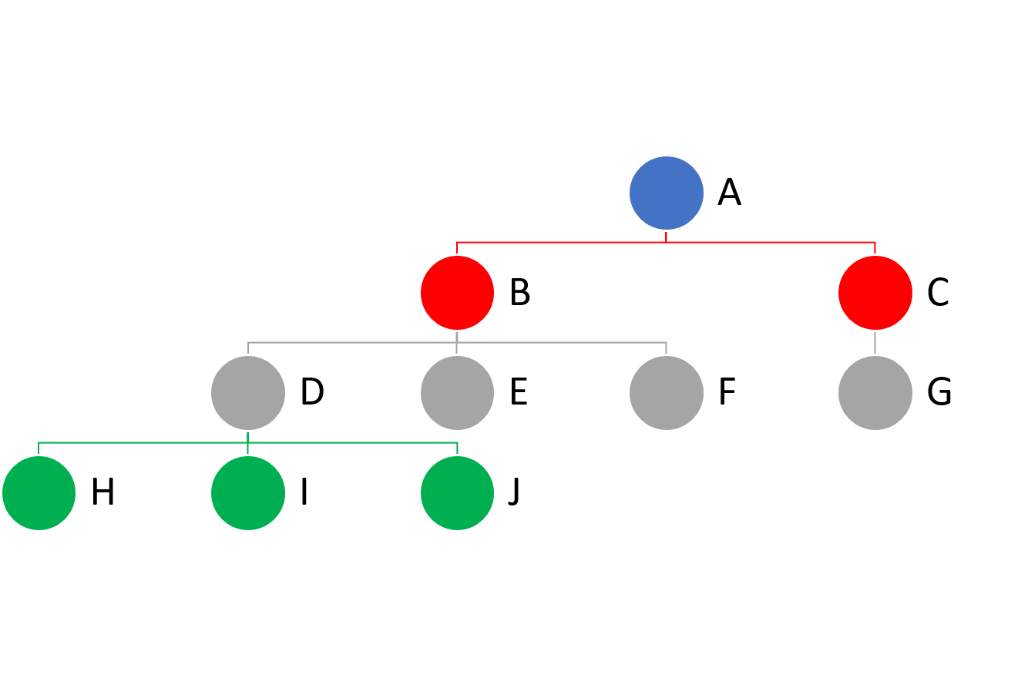
Can You Keep Track of This?
throw exceptions
So to see if any code is throwing an exception, you have to read every function in the tree
Java is better because it specifies a list of exceptions in the function signature

Slide 40
Handling Exceptions - Java
public void Function1()
{
try
{
Function2();
}
catch (ClassNotFoundException e)
{
//...
}
} public void Function2()
{
Function3();
}
public void Function3()
{
Function4();
}
public void Function4()
throw ClassNotFoundException
{
//...
throw new ClassNotFoundException(“”);
//...
}

Slide 41
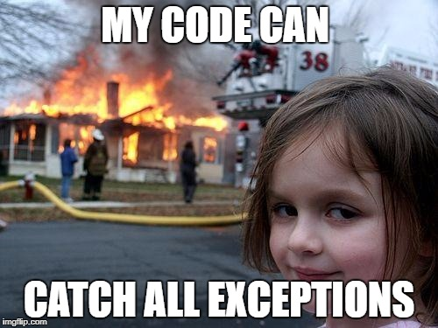
Recent Exception Handling Trend in Java
In Java, many people just use catch(Exception) in catch phrase
try { Cat myCat = new Cat(5, “Lulu”); } catch (Exception e) // Catches all RuntimeException { // Do something }

Slide 42
We Almost Had a Solution (WCF)
WCF (Windows Communication Foundation)
Official: A framework for building service-oriented application
Unofficial: …..
Transaction support at the language level
You can’t use/access an object which an exception occurs
If you try to access it, you can get another exception

Slide 43
The Web Went Back to ErrorCode
Web request returns both StatusCode and Body
If StatusCode says 20x.
Body is there
If StatusCode is an error code (4xx, 5xx),
Body might be empty

Slide 44
Error Handling in the Web Applications
We can apply this in C++ by using
Struct
Class

Slide 45
Example for Public Web Request Style
// Error.h enum EError {
SUCCESS,
ERROR,
}; struct ErrorCode {
EError status;
int code;
}; template <typename T> struct Result {
ErrorCode error;
T value;
};
// Main.cpp Result<const char*> result; result = record.GetStudentIDByName("Pope Kim"); if (result.error.status == ERROR) { cout << "Error Code " << result.error.code << endl; } else { cout << "Student ID is " << result.value << endl; }

Slide 46
Proper Exception Handling

Slide 47
Proper Exception Handling Strategy
Validation/exception only on boundaries
Public web request example
File reading exception example
Once it enters your system, assume they are all correct
use assert to fix issues during dev
Use NULL actively if exceptional cases happen
but by default all functions never return or accept null or null params
Coding standard: naming better when a function returns or takes null

Slide 48
Handling Exceptions at Boundaries
// C# style string ReadFileOrNull(string filename) { If (!File.Exists(filename)) { return null; } try { return File.LoadAllText(filename); } catch (Exception e) { return null; } }

Slide 49
Once it enters your system, assume they are all correct
Use assert to fix issues during dev
int ConvertToHumanAge(const Animal* pet) { Assert(pet); ... }

Slide 50
Coding Standards 1
If a parameter can be null, postfix the parameter name with ‘OrNull’
const char* GetCoolName(const char* startWithOrNull) const;

Slide 51
Coding Standards 2
If a return type can be null, postfix the function name with ‘OrNull’
const char* GetHobbyOrNull() const;

Slide 52
Exception Is Not A Silver Bullet
Same programmers write both logic and exceptions
If they are getting logic wrong, they will be likely getting exceptions wrong
This is why unittests written by same programmers are another fad
Software quality has nothing to do with exceptions
Software quality is rather testing issue

Slide 53
Catch Bugs During Development
Don’t do it on your live server (that's what exceptions do)
Use assert to catch any bug in your code during development.
Asserts show right call stack
If QA is not done properly, crashing your software is better
since it will be discovered and fixed right away
but, don’t kill anyone :D

Slide 54

Isn't Zombie Better than Dead?
Without exceptions
A program will crash
You can get memory dump from the crash easily
Developers can open up dump files later and debug
With exceptions
You CANNOT
Maybe you have printf logs somewhere

Slide 55



Congraturations!!
You still got ⅔ more to go:)
You’ve just finished core c++
This is what C++ programmers learned 15 YEARS AGO
This is for midterm 1

Slide 56
Standard Template Library(STL)
Containers

Slide 57
STL List
Vector
Map
Set
Stack
Queue
List
Deque
...

Slide 58
The Purpose of the STL Container
Based on template
Standard interface for every container
Automatic memory management

Slide 59
Vector

Slide 60
What is Vector?
Dynamic array of any type
data types
class
pointer
Has elements in contiguous memory spaces
Provides automatic memory management based on the number of elements
Provides random access to elements

Slide 61
Example: Creating Vectors
#include <vector>
int main() { std::vector<int> scores; scores.reserve(2);
scores.push_back(30);
scores.push_back(50);
scores.pop_back(); cout << "Current capacity : " << scores.capacity() << endl;
cout << "Current size : " << scores.size() << endl << endl; }
Notes:
Reserve is the min but if system give you 4 reserve means nothing
2 or more
1

Slide 62
Defining Vector Variable 1
std::vector<<type>> <name>;
Creates an empty vector
std::vector<int> scores; std::vector<string> names;
std::vector<Cat> myCats;
std::vector<Cat*> myCats;

Slide 63
Defining Vector Variable 2
std::vector<<type>> <name>(const vector& x);
Creates an vector which has same size and data of vector x
std::vector<int> scores; scores.push_back(1); scores.push_back(2);
std::vector<int> scores1(scores); // Copy of scores

Slide 64
Defining Vector Variable 3
std::vector<<type>> <name>(<size>);
Creates an vector with size (all value of elements is 0)
std::vector<int> scores(10);
std::vector<Cat> myCats(4);
Notes:
Either reserve max 10
Add 10 to the reserve
Change size()
Bad idea because C# it means reserve not insert

Slide 65
Adding an Element at the End
push_back(<data>);
Adds an element at the end of a vector
scores.push_back(30);
names.push_back(“Lulu”);
myCats.push_back(myNewCat);

Slide 66
Removing an Element at the End
pop_back();
Deletes an element at the end of a vector
scores.pop_back();

Slide 67
What about if you want to remove from middle?
not so easy
We will see it later :)

Slide 68
Capacity and Size
capacity()
The number of elements that a vector allocated space
size()
The number of element that a vector actually holds
size : 2
10
20
scores
scores.capacity();
scores.size();
capacity : 3

Slide 69
Increasing the Capacity of a Vector
reserve(<size>);
Increases the capacity of a vector
If growing, reallocates new storage and copies whole elements in a vector into there
scores.reserve(10);
Use this right after creating a vector to prevent unnecessary reallocation

Slide 70
Accessing an Element
operator[] (size_t n);
Returns a reference of the element at the position, n
scores[i] = 3;
std::cout << names[i] << “ “;
std::cout << myCats[i].GetScore() << “ “;

Slide 71
Example: Printing All Elements 1
#include <vector>
int main() { std::vector<int> scores; scores.reserve(2);
scores.push_back(30);
scores.push_back(50);
for (size_t i = 0; i < scores.size(); ++i) { std::cout << scores[i] << “ “; }
... }

Slide 72
But This is Vector Specific
You cannot use operator[] for map
So, iterator a standard way of iterating any STL containers

Slide 73
Example: Printing All Elements 2
#include <vector>
int main() { std::vector<int> scores; scores.reserve(2);
scores.push_back(30);
scores.push_back(50);
for (std::vector<int>::iterator iter = scores.begin(); iter != scores.end(); ++iter) { std::cout << *iter << “ “; } ... }

Slide 74
Iterator
vector<<type>>::iterator <name>
Is used to traverse the elements of a vector
std::vector<int>::iterator iter = scores.begin();

Slide 75
Iterator - begin() / end()
begin()
returns the iterator which points the first element of a vector
end()
returns the iterator which points the past-the-last element of a vector
capacity
10
20
begin()
end()
vector<int>::iterator bIter = scores.begin();
vector<int>::iterator eIter = scores.end();

Slide 76
Adding My Scores And Printing Them

Slide 77
Insert an Element at a Certain Position
std::vector<int> scores; scores.reserve(4);
scores.push_back(10); // 10
scores.push_back(50); // 10, 50
scores.push_back(38); // 10, 50, 38
scores.push_back(100); // 10, 50, 38, 100 std::vector<int>::iterator it = scores.begin();
it = scores.insert (it , 80); // 80, 10, 50, 38, 100

Slide 78
Copy Issue
std::vector<int> scores; scores.reserve(4); // Pushes 10, 50, 38 std::vector<int>::iterator it; it = scores.begin();
it = scores.insert (it , 80);
10
50
38
80
10
50
3
4
38
4
1024

Slide 79
Reallocation + Copy Issue
std::vector<int> scores; scores.reserve(4); // Pushes 10, 50, 38, 100 std::vector<int>::iterator it; it = scores.begin();
it = scores.insert (it , 80);
10
50
38
4
100
80
10
5
4
50
38
100
5
1024
2048
Notes:
Create memory
Copy everything
Delete old memory
SOOOOOOO BAD ALWAYS RESERVE IF YOU CAN

Slide 80
Delete an Element at a Certain Position
std::vector<int> scores; scores.reserve(4);
scores.push_back(10); // 10
scores.push_back(50); // 10, 50
scores.push_back(38); // 10, 50, 38
scores.push_back(100); // 10, 50, 38, 100 std::vector<int>::iterator it; it = scores.begin();
it = scores.erase(it); // 50, 38, 100

Slide 81
Did we copy?
Did we realloc?
Notes:
We copying but
No reallocate when we remove the items

Slide 82
Realloc? Copy?
std::vector<int> scores; // insert scores …. std::vector<int>::iterator it; it = scores.begin();
it = scores.erase(it);
10
50
38
50
38
100
4
100
3
4
4
1024

Slide 83
Example: Swapping Vectors
// Main.cpp
vector<int> scores;
scores.reserve(2);
scores.push_back(85); // 85
scores.push_back(73); // 85, 73
vector<int> anotherScores;
anotherScores.assign(7, 100); // 100, 100, 100, 100, 100, 100, 100
scores.swap(anotherScores); // scores: 100, 100, 100, 100, 100, 100, 100
// anotherScores: 85, 73

Slide 84
Assigning Elements
assign(size_t n, <data>);
Replaces a vector with n copies of value <data>
vector<int> anotherScores;
anotherScores.assign(7, 100); // 100, 100, 100, 100, 100, 100, 100

Slide 85
Exchanging Two Vectors
swap(vector& other);
Exchanges two vectors of the same type
vector<int> scores; // 10, 20, 30, 100
vector<int> anotherScores; // 40, 50, 60
scores.swap(anotherScores); // scores: 40, 50, 60
// anotherScores: 10, 20, 30, 100

Slide 86
Swapping Your And My Scores

Slide 87
Example: Shrinking Vector
std::vector<int> scores;
scores.reserve(3);
scores.push_back(30); // 30
scores.push_back(100); // 30, 100
scores.push_back(70); // 30, 100, 70
scores.resize(2); // 30, 100
for (int i = 0; i < scores.size(); ++i)
{
std::cout << scores[i] << “ “; // “30 100”
}

Slide 88
Changing a Size of a Vector
resize(size_t n);
Resizes a size of a vector
If new size is smaller than a vector's size, extra items are removed
If new size is bigger than a vector’s capacity, reallocation happens
scores.resize(10);

Slide 89
What was the function that change capacity?
reserve(size_t n);
How is it different?

Slide 90
Clear a Vector
clear();
Clears a vector
Size will be zero, and capacity does not change
scores.clear();

Slide 91
Calculating Sum of My Scores

Slide 92
Example: Vector of Objects
// Score.h
class Score
{
public:
...
private:
int mScore;
string mClassName;
};
// Main.cpp
int main()
{
vector<Score> scores;
scores.reserve(4);
scores.push_back(Score(30, "C++"));
scores.push_back(Score(59, "Algorithm"));
scores.push_back(Score(87, "Java"));
scores.push_back(Score(41, "Android")); }

Slide 93
Object Vector

Slide 94
The Problem of Non-pointer Vector 1
vector<Score> scores;
score.reserve(1); scores.push_back(Score(10, "C++"); scores.push_back(Score(41, "Android"));
10
2024
“C++”
1
10
2
“C++”
2
41
1
“And..”
1024
2056

Slide 95
The Problem of Non-pointer Vector 2
vector<Score> scores;
score.reserve(1); score.puss_back(Score(10, "C++"); scores.push_back(Score(41, "Android"));
vector<Score> scores2 = scores;
2
2
10
2024
“C++”
2072
2
10
“C++”
41
“And..”
2
0
0
10
“C++”
2056
41
“And..”

Slide 96
Example - Vector of Pointer
int main()
{
vector<Score*> scores;
scores.resize(2);
scores.push_back(new Score(30, “C++”));
scores.push_back(new Score(87, “Java”));
scores.push_back(41, "Android");
scores.clear();
return 0; }

Slide 97
Reallocating with a Vector of Pointer
vector<Score*> scores;
score.reserve(1); // Insert scores scores.push_back(new Score(41, "Android"));
2024
10
“C++”
1
2
2024
4048
2
1
1024
41
“And..”
2056

Slide 98
Wait...
Aren't We Missing Something?

Slide 99
Example - Deleting a Vector of Pointer
int main()
{
vector<Score*> scores;
scores.push_back(new Score(30, “C++”));
scores.push_back(new Score(87, “Java”)); for (vector<Score*>::iterator iter = scores.begin(); iter != scores.end(); ++iter)
{
delete *iter;
}
scores.clear(); return 0; }
Notes:
You have to use .clear() because we delete all the object but the pointer still in scores Vector

Slide 100
Be Careful to Use delete on Elements
Make sure that those pointers are NOT used anymore before deallocating
Notes:
If you have new, always have to have delete. Once no more no less

Slide 101
Pointer Vector

Slide 102
Advantage of Vector
Random access to elements
It is fast to insert/delete an element at the end
Notes:
Get any vector by index is easy
Don’t need to shift at end

Slide 103
Disadvantage of Vector
If you don’t insert/delete elements at the end, a vector works slow
Reallocation/copy elements are expensive
Notes:
O(n)

