Slide 1
Lecture 08
Pope Kim

Slide 2
Template Programming

Slide 3
Vector Again
// Main.cpp
#include <iostream>
#include <vector>
int main()
{
std::vector<int> scores;
scores.push_back(10); // 10
scores.push_back(50); // 10, 50
return 0;
}

Slide 4
What is Template?
Similar to generic method/class in Java/C#
STL vector is also template
Prevents to write same codes for different data types

Slide 5
Example: Adding Two Integers
// MyMath.h
int Add(int a, int b) { return a + b; }
// Main.cpp
#include "MyMath.h"
#include <iostream>
int main()
{
std::cout << Add(3, 10) << std::endl;
return 0;
}

Slide 6
What if you want to add two floats?

Slide 7
Example: Adding Two Integers
// MyMath.h
int Add(int a, int b) { return a + b; }
float Add(float a, float b) { return a + b; }
// Main.cpp
#include "MyMath.h"
#include <iostream>
int main()
{
std::cout << Add(3, 10) << std::endl; std::cout << Add(3.1f, 10.1f) << std::endl;
return 0;
}

Slide 8

What if you want to add two doubles?
Create one more Add() function for doubles

Slide 9
Example: Adding Two Values
// MyMath.h
template <typename T> // or template <class T> T Add(T a, T b) { return a + b; }
// Main.cpp
#include "MyMath.h"
#include <iostream>
int main()
{
std::cout << Add<int>(3, 10) << std::endl; std::cout << Add<float>(3.14f, 10.14f) << std::endl;
return 0;
}

Slide 10
Function Templates
template <class <type_name>> <function_declaration>;
template <typename <type_name>> <function_declaration>;
template <class T>
T Add(T a, T b) { … }
template <typename T>
T Add(T a, T b) {
... }

Slide 11
Function Templates
You can omit template parameters when you call function templates
Add<int>(3, 10);
Add(3, 10);

Slide 12
typename vs class
What's the difference?
Practically none https://stackoverflow.com/questions/213121/use-class-or-typename-for-template-parameters
Just use typename

Slide 13
How Templates Work?
// Main.cpp
#include “MyMath.h”
int main() {
int resultInt = Add<int>(3, 10); float resultFloat = Add<float>(3.14f, 10.14f); }
Compiler generates codes internally
whenever templates are instantiated
int Add(int a, int b) { return a + b; }
// MyMath.h template <typename T> T Add(T a, T b) { return a + b; }
float Add(float a, float b) { return a + b; }
Notes:
Its not run-time!!! Make the code during compiling time

Slide 14
What Does This Mean?
As more types are used for template, your exe file gets bigger
You can sort of make polymorphic behavior during compile time
Was a new promise land when it was introduced
So we misused it a lot -sighs-
More on this later

Slide 15
Can I make class templates?

Slide 16
Example: MyIntArray
#pragma once
class MyIntArray
{
public:
bool Add(int data);
MyIntArray();
private:
enum { MAX = 3 };
int mSize;
int mArray[MAX];
};
#include "MyIntArray.h"
int main()
{
MyIntArray scores;
scores.Add(10); // returns true
scores.Add(20); // returns true
scores.Add(30); // returns true
scores.Add(40); // returns false
return 0;
}
What if I want to make a float array?

Slide 17
Example 1: MyArray
// MyArray.h
#pragma once
template<typename T>
class MyArray
{
public:
bool Add(T data);
MyArray();
private:
enum { MAX = 3 };
int mSize;
T mArray[MAX];
};
// MyArray.cpp
#include "MyArray.h"
template<typename T>
bool MyArray<T>::Add(T data)
{
if (mSize >= MAX)
{
return false;
}
mArray[mSize++] = data; return true;
}
// MyArray.cpp
template<typename T>
MyArray<T>::MyArray()
: mSize(0)
{
}
// Main.cpp
#include "MyArray.h"
int main()
{
MyArray<int> scores;
scores.Add(10); // returns true
scores.Add(20); // returns true
scores.Add(30); // returns true
scores.Add(40); // returns false
return 0;
}
Notes:
Every single function requires templates

Slide 18
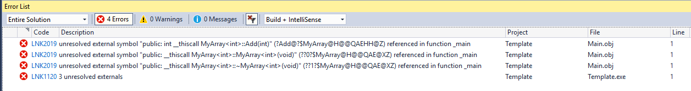

What are These?
1>Main.obj : error LNK2019: unresolved external symbol "public: int __thiscall MyArray<int>::Add(int)"
(?Add@?$MyArray@H@@QAEHH@Z) referenced in function _main
1>Main.obj : error LNK2019: unresolved external symbol "public: __thiscall MyArray<int>::MyArray<int>(void)" (??0?$MyArray@H@@QAE@XZ) referenced in function _main
1>Main.obj : error LNK2019: unresolved external symbol "public: __thiscall MyArray<int>::~MyArray<int>(void)" (??1?$MyArray@H@@QAE@XZ) referenced in function _main

Slide 19
What is the Problem?
When the compiler compiles “Main.cpp”, it can’t see “MyArray.cpp”
It only can see the declaration of MyArray class through “MyArray.h”
Therefore, the compiler can’t generate MyArray<int>

Slide 20
Solution
// MyArray.h
#pragma once
template<typename T>
class MyArray
{
public:
bool Add(T data);
MyArray();
private:
enum { MAX = 3 };
int mSize;
T mArray[MAX];
};
// MyArray.h
template<typename T>
bool MyArray<T>::Add(T data)
{
if (mSize >= MAX)
{
return false;
}
mArray[mSize++] = data; return true;
}
// MyArray.h
template<typename T>
MyArray<T>::MyArray()
: mSize(0)
{
}

Slide 21
Class Templates
You must specify the template parameters when you declare objects
MyArray<int> scores; // Correct
MyArray scores; // Error

Slide 22
Array

Slide 23
Another Neat Trick
// FixedVector.h
template<typename T, size_t N>
class FixedVector
{ public: // public methods private:
T mArray[N];
};
// main.cpp
FixedVector<int, 16> numbers;

Slide 24
FixedVector

Slide 25
Example 2: MyPair
// MyPair.h
#pragma once
template<typename T>
class MyPair
{
public:
const T& GetFirst() const;
const T& GetSecond() const;
MyPair(const T& first, const T& second);
private:
T mFirst;
T mSecond;
};
template<typename T>
const T& MyPair<T>::GetFirst() const
{
return mFirst;
}
template<typename T>
const T& MyPair<T>::GetSecond() const
{
return mSecond;
}
template<typename T>
MyPair<T>::MyPair(const T& first, const T& second)
: mFirst(first)
, mSecond(second)
{
}
// Main.cpp
...
std::vector<MyPair<std::string>> students;
students.emplace_back(MyPair<std::string>(“a1234”, “Lulu”));
students.emplace_back(MyPair<std::string>(“a5678”, “Teemo”));
for (std::vector<MyPair<std::string>>::iterator it = students.begin(); it != students.end(); ++it)
{
std::cout << it->GetFirst() << " : " << it->GetSecond() << std::endl;
}
...

Slide 26
Can I make one more template parameter?
I want MyPair<std::string, int>

Slide 27
Better Example 2: MyPair
// MyPair.h
#pragma once
template<typename T, typename U>
class MyPair
{
public:
const T& GetFirst() const;
const U& GetSecond() const;
MyPair(const T& first, const U& second);
private:
T mFirst;
U mSecond;
};
template<typename T, typename U>
const T& MyPair<T, U>::GetFirst() const
{
return mFirst;
}
template<typename T, typename U>
const U& MyPair<T, U>::GetSecond() const
{
return mSecond;
}
template<typename T, typenameU>
MyPair<T, U>::MyPair(const T& first, const U& second)
: mFirst(first)
, mSecond(second)
{
}
// Main.cpp
...
std::vector<MyPair<std::string, int>> scores;
scores.emplace_back(MyPair<std::string, int>("Lulu", 10));
scores.emplace_back(MyPair<std::string, int>("Teemo", 100));
for (std::vector<MyPair<std::string, int>>::iterator it = scores.begin(); it != scores.end(); ++it)
{
std::cout << it->GetFirst() << " : " << it->GetSecond() << std::endl;
}
...

Slide 28
Two Different Template Parameters
template <class <type_name>, class <type_name>>
template <typename <type_name>, typename <type_name>>
template <typename T, typename U>
void Print(const T& a, const U& b) { std::cout << a << “/ ” << b << std::endl; }
template <typename T, typename U>
class MyClass { private: T mX; U mY; }

Slide 29
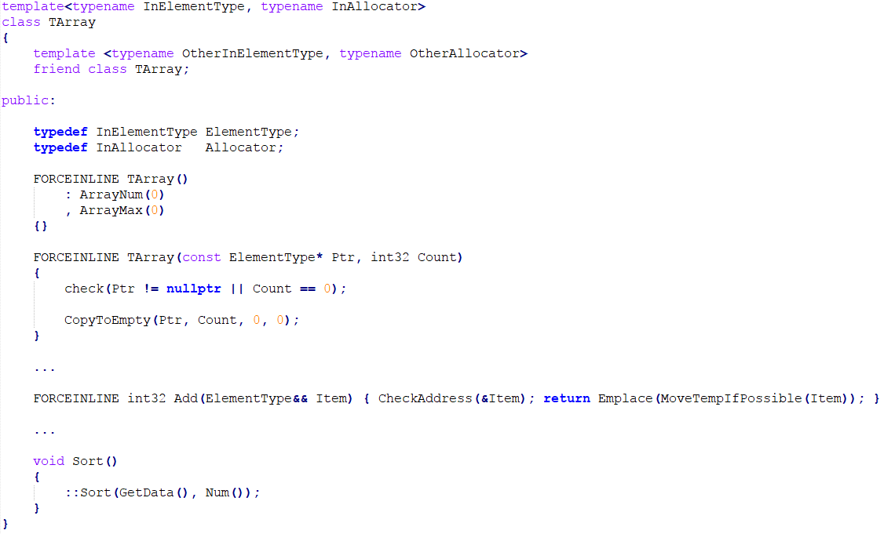
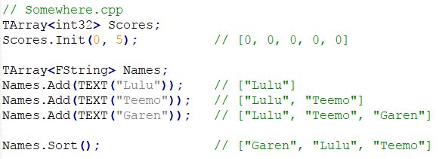
More Example: Unreal Engine 4 - TArray

Slide 30
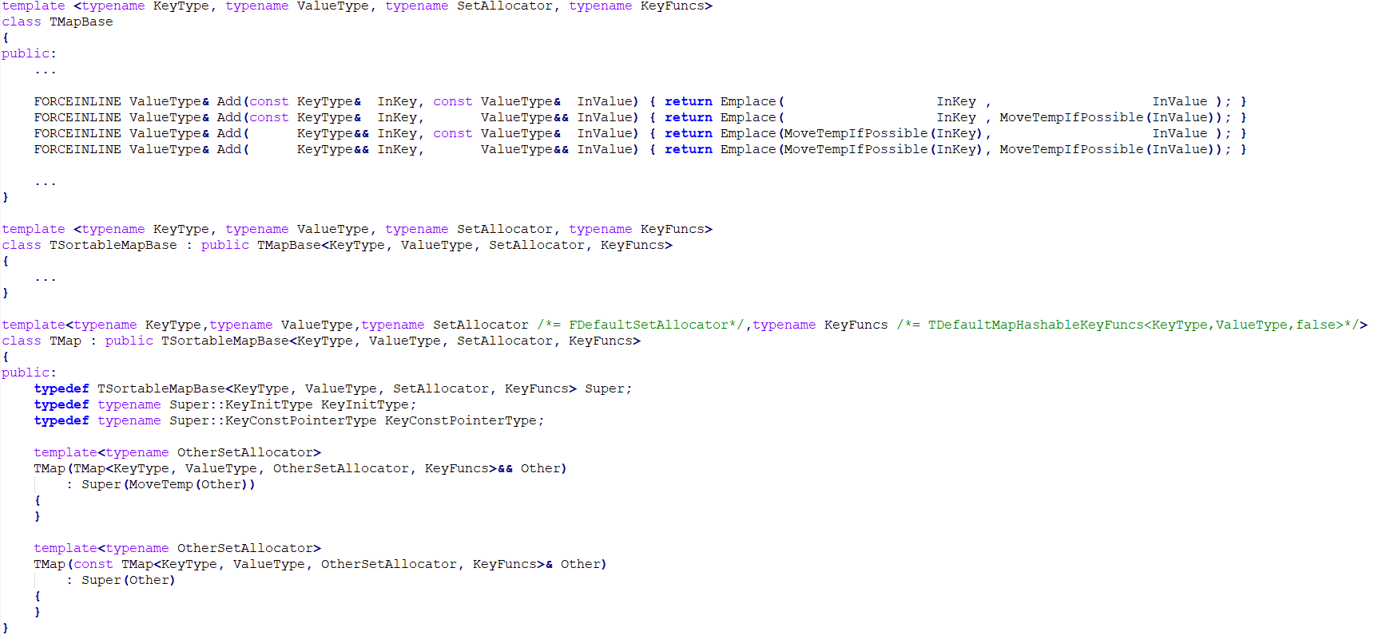
More Example: Unreal Engine 4 - TMap

Slide 31
Math Class
Notes:
<<<Add/multiply/Divide/Min/Max

Slide 32
Template Specialization

Slide 33
Template Specialization
Allows customization of template code for CERTAIN template parameters
std::vector has a good example
Why different for bool?
template <class T, class Allocator> class std::vector<T, Allocator>{} // generic vector for every type template <class Allocator> class std::vector<bool, Allocator> // specialized vector for bool

Slide 34
Template Specialization
Think this way
Generic template is applied to any type
Unless there is a specialized template for given type(s)
Really not used a lot
I personally have not written one
But std::vector<bool> has some value
If your platform is really tight on memory
Can you think of an example?

Slide 35
Example: Add(), Subtract(), Multiply() and Divide()
// MyMath.h
template <typename T>
T Add(T a, T b)
{
return a + b;
}
template <typename T>
T Subtract(T a, T b)
{
return a - b;
}
template <typename T>
T Multiply(T a, T b)
{
return a * b;
}
template <typename T>
T Divide(T a, T b)
{ // assert(b != 0);
return a / b;
}
// Main.cpp
#include <iostream>
#include "MyMath.h"
int main()
{
float addResultFloat = Add(10.0f, 2.3f);
int addResultInt = Add(10, 2);
float subResultFloat = Subtract(10.0f, 2.3f);
int subResultInt = Subtract(10, 2);
float mulResultFloat = Multiply(10.0f, 2.3f);
int mulResultInt = Multiply(10, 2);
float divideResultFloat = Divide(10.0f, 2.3f);
int divideResultInt = Divide(10, 2);
return 0;
}

Slide 36
What about power()?

Slide 37

Example: Power()
// MyMath.h
template<typename V, typename EXP>
Value Power(const V value, EXP exponent)
{ V result = 1; while (exponent-- > 0) {
result *= value;
}
return result;
}
#include <iostream>
#include "MyMath.h"
int main()
{
int powerResultInt = Power(10, 2);
float powerResultFloat = Power(10.f, 2.5f);
return 0;
}

Slide 38

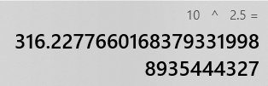
Example: Function Specialization
// MyMath.h
template<typename V, typename EXP>
Value Power(const V value, EXP exponent)
{ V result = 1; while (exponent-- > 0) {
result *= value;
}
return result;
}
template<>
float Power(float value, float exp)
{
return std::powf(value, exp);
}
// Main.cpp
int powerResultInt = Power(10, 2);
float powerResultFloat = Power(10.f, 2.5f);

Slide 39
Template Specialization
Full Template Specialization
The list of template parameter is empty
template<typename VAL, typename EXP> Value Power(const VAL value, EXP exponent){} // generic power() for every type template <> float Power(float value, float exp) // specialized power() for float
Partial Template Specialization
template <class T, class Allocator> class std::vector<T, Allocator>{} // generic vector for every type template <class Allocator> class std::vector<bool, Allocator> // specialized vector for bool

Slide 40
Class Template Specialization
// MyArray.h
#pragma once
// The definition is omitted
template<class T>
class MyArray
{
public:
bool Add(T data);
MyArray();
private:
enum { MAX = 3 };
int mSize;
T mArray[MAX];
};
template<>
class MyArray<bool>
{
public:
bool Add(bool data);
MyArray();
private:
enum { MAX = 3 };
int mSize;
int mArray;
}; MyArray<bool>::MyArray()
: mSize(0)
, mArray(0)
{
}
bool MyArray<bool>::Add(bool data)
{
if (mSize >= MAX) {
return false;
}
if (data) {
mArray |= (1 << mSize++);
}
else {
mArray &= ~(1 << mSize++);
}
return true;
}

Slide 41
Pros and Cons
Compiler generates code for each template instances at compile-time
Compile time is slower
It gets even slower as you add more template parameters std::pair<string, int> std::pair<string, string> std::pair<float, string> ….
But runtime speed is probably faster
Not always true because the size of executable file is bigger
This is somewhat true for C# and Java as well (so you shouldn't use ArrayList)

Slide 42
Pros and Cons
Great way to remove code duplication for different types
But no way to prevent useless template variations
Do you need all these?
Add<int>(...);
Add<short>(...);
Add<unsigned int>(...);
Or these?
Vector<3>(...) // number of components is the template parameter
Vector<4>(...)
Vector<15>(...)

Slide 43
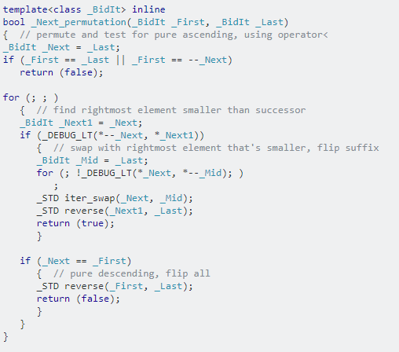
Pros and Cons
Can be used to make compile-time polymorphism
The feature C++ programmers misused too much
No virtual table makes program run faster
But bigger exe size can make it slower
Code is harder to read
(source: https://stackoverflow.com/questions/4180166/why-is-the-code-in-most-stl-implementations-so-convoluted)

Slide 44
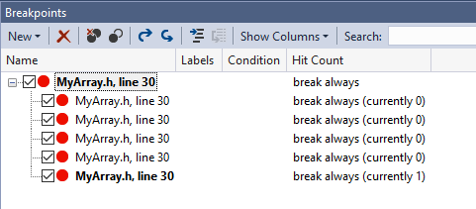
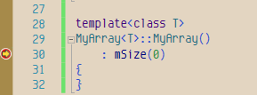
Pros and Cons
Debugging can be funny
Not a big issue anymore

Slide 45
Best Practices on Template Programming
Makes perfect sense for containers
So many types you can store
That's why Java and C# generics are mostly used for containers
For non-containers
If you are dealing with more than 3 or 4 of different types, use template
If you need only a few types make two different class class Math; class FloatMath;
Notes:
Best practice
For Containers
IF you deal with x of type → make time
If you only handle such as, float/int, just make two different class. (matrix <- another example)
IF someone makes 400x400 or 4x2 accidently, there will be a lot of variation of matrix….
70-80 slides.. good luck -_-!!

Slide 46
Template
Template
Template Specialization

Slide 47
STL Algorithm

Slide 48
What is STL Algorithm
Functions that can be used on the ranges of elements
[First, Last)
Can be used on an array or some of STL containers
Accesses containers via iterators
Does not change size(thus memory allocation) of containers

Slide 49
Types of STL Algorithm
Non-modifying sequence operations
find(), for_each(), ...
Mutating sequence operations
copy(), swap(), ...
Sorting and related operations
sort(), merge(), ...
Generalized numeric operations
accumulate(), ...
#include <algorithm>
#include <numeric>

Slide 50
Copying a Vector to Another
#include <algorithm>
#include <iostream>
#include <vector>
int main()
{
std::vector<int> scores;
scores.push_back(10);
scores.push_back(70);
scores.push_back(40);
std::vector<int> copiedScores(scores.size());
std::copy(scores.begin(), scores.end(), copiedScores.begin());
for (std::vector<int>::iterator it = copiedScores.begin(); it != copiedScores.end(); ++it)
{
std::cout << *it << std::endl;
}
return 0;
}

Slide 51
Copy()
template<class _InIt, class _OutIt>
_OutIt copy(_InIt _First, _InIt _Last, _OutIt _Dest)
// int vector
std::copy(scores.begin(), scores.end(), copiedScores.begin());
// string vector
std::copy(names.begin(), names.begin()+2, copiedNames.begin());
Notes:
렉쳐 슬라이드에는 suffle 혹은 copy
optional, if I need more length, show both s and c implementation
코드 슬라이드 how to use algorithm...
코드 슬라이드에는 다른거
존재하는 알고리즘
자신만의 알고리즘 (shuffle, copy)

Slide 52
How to Use Algorithm
Notes:
Copy() /

Slide 53
Copy() Implementation
template<class _InIt, class _OutIt>
_OutIt copy(_InIt _First, _InIt _Last, _OutIt _Dest)
{
for (; _First != _Last; ++_Dest, (void)++_First)
{
*_Dest = *_First;
}
return (_Dest);
}

Slide 54
Find() Algorithm
Notes:
Show Find() implement

Slide 55
List of STL Algorithms
Too many
See here: http://www.cplusplus.com/reference/algorithm/

Slide 56

Congratulations!
You just finished C++03!
Midterm 2 cutoff Point
C++03 was an attempt to make C++ close to Java
But really only containers survived
A lot of features were not well thought out
So, most of them are deprecated by C++11
Maybe that is why it took 8 years to clean it up? lol
This means that there are more to learn until final exam :(

