Slide 1
Lecture 10
Pope Kim

Slide 2

New STL

Slide 3
New STL
std::unordered_map (and unordered_multimap)
std::unordered_set (and unordered_multiset)
std::array
Notes:
HashSet and HashMap

Slide 4
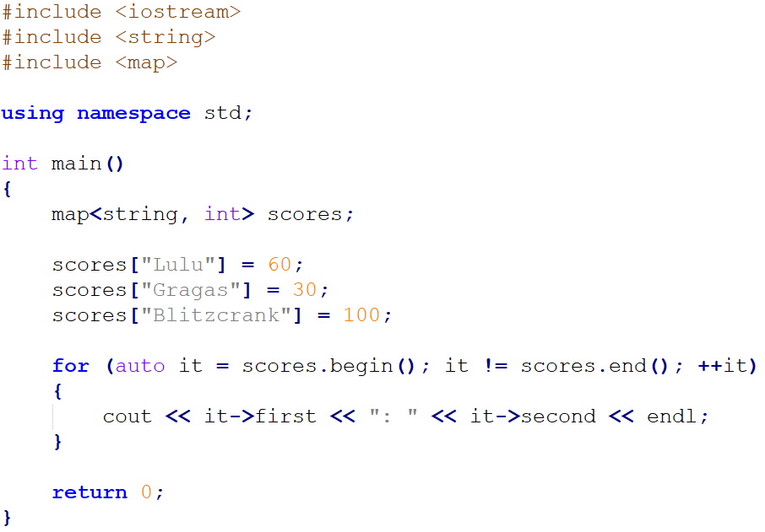

Do You Remember std::map?

Slide 5
What is the Problem?
std::map is a SORTED container
So, if you frequently insert/delete elements, performance will degrade
Can we use this without sorting?
NO, but we have new one, std::unordered_map

Slide 6
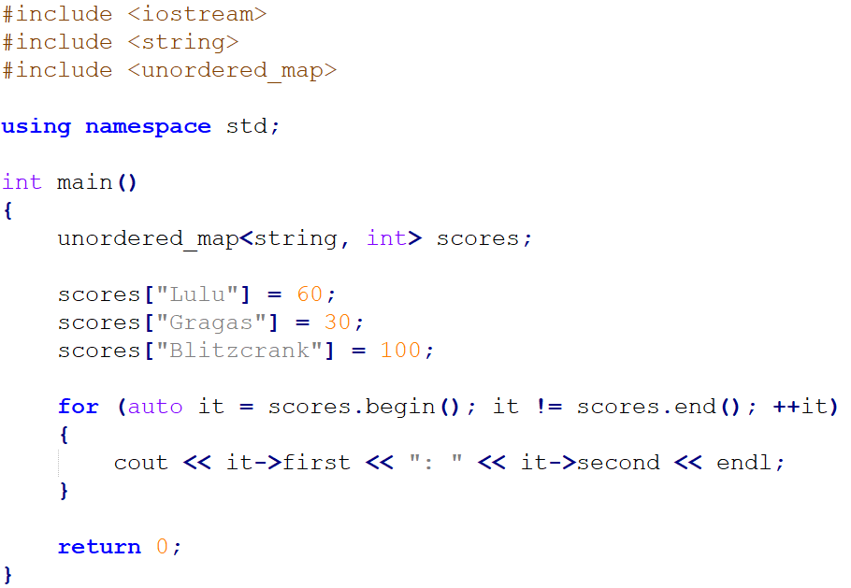
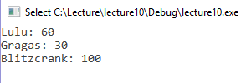
Example: std::unordered_map
Notes:
Use unordered map by default

Slide 7
std::unordered_map
Contains pairs of key and value
Keys are unique
Unsorted container
Elements are organized into buckets based on index generated by a hash function
This is hashmap

Slide 8
Inserting an Element
(This shows just the concept of a hash function)
scores[“Gragas”] = 30;
“Gragas”
Hash Function
3
Key
Index
‘G’ + ‘r’ + ‘a’ + ‘g’ + ‘a’ + ‘s’
71 + 114 + 97 + 103 + 97 + 115 = 597
597 % 6 = 3
Hash
Buckets
30
[0]
[1]
[2]
[3]
[4]
[5]

Slide 9
Accessing an Element
(This shows just the concept of a hash function)
auto found = scores.find(“Gragas”);
“Gragas”
Hash Function
3
Key
Index
‘G’ + ‘r’ + ‘a’ + ‘g’ + ‘a’ + ‘s’
71 + 114 + 97 + 103 + 97 + 115 = 597
597 % 6 = 3
Buckets
30
[0]
[1]
[2]
[3]
[4]
[5]

Slide 10
Hash Collision
Sometime different keys have same hash
In this case, you will see more than one data in a bucket
Amumu
44
Gragas
30
Lulu
60
Buckets
[0]
[1]
[2]
[3]
[4]
[5]
(This shows just a concept of a hash collision)
Notes:
Good number for the buckets size? Prime Number

Slide 11
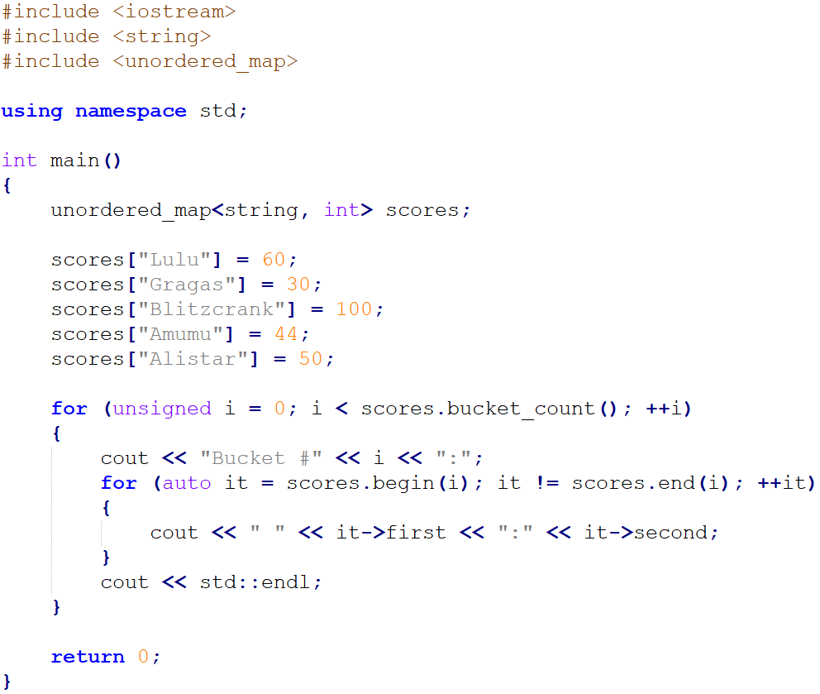
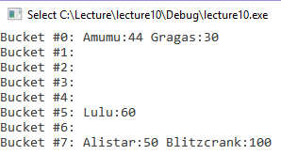
Example: Displaying Buckets

Slide 12
map vs unordered_map
map
Sorted container
Contains key-value pairs
Binary search tree
Search time: O(logn)
Frequent insertions and deletions will make it run slow
unordered_map
Unsorted container
Contains key-value pairs
Hash table
Search time:
O(1), if there is no hash collision
O(n), the worst case
Increased memory usage because of preserved buckets
Notes:
Unordered map is usually faster

Slide 13
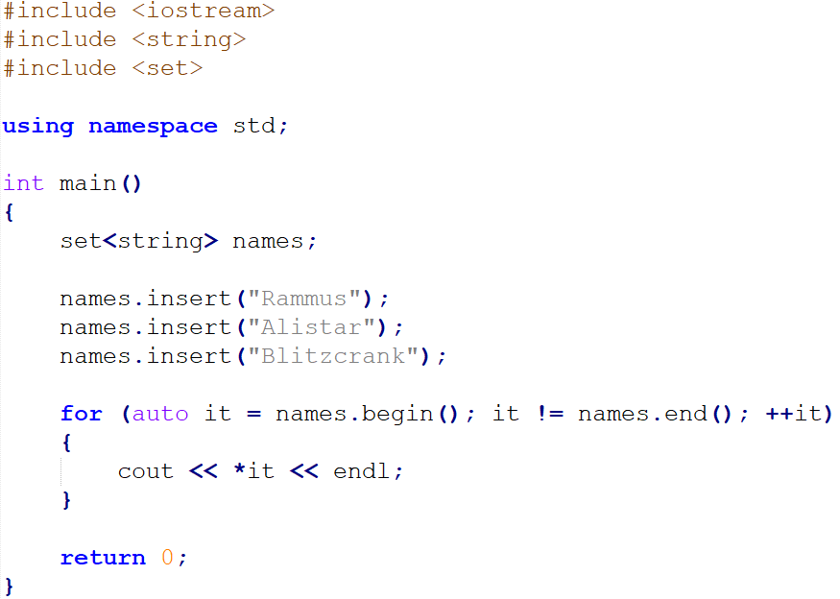

Same thing with std::set

Slide 14
What is the Problem
Has same problems as std::map
Sorted container
So, if you frequently insert/delete elements, std::set will be slow

Slide 15
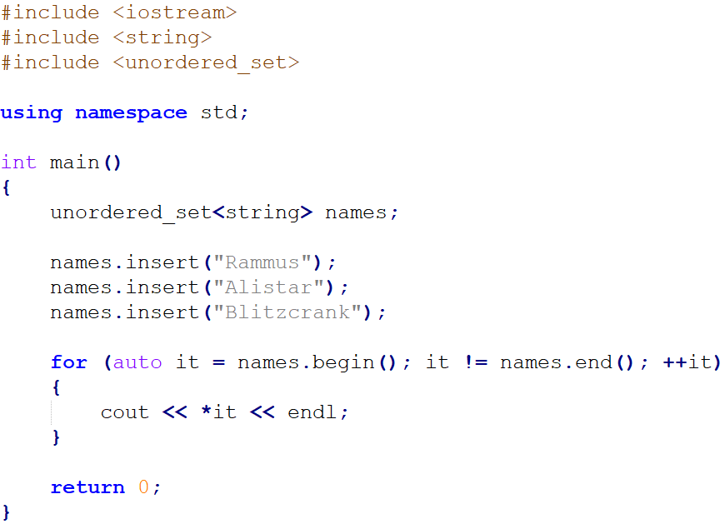

Example: std::unordered_set

Slide 16
set vs unordered_set
Set
Sorted container
Contains keys
Binary search tree
Search time: O(logn)
If insertions and deletions are happened often, it will be slow
Unordered_set
Unsorted container
Contains keys
Hash table
Search time:
O(1), if there is no hash collision
O(n), the worst case
Memory usage is increased because of preserved buckets

Slide 17
std::array
Similar to FixedVector template class we wrote
But, no element count tracking
Just a simple abstraction over C-style array

Slide 18
FixedVector vs std::array
FixedVector<int, 3> numbers; numbers.Add(1);
cout << numbers.GetSize(); // ?? cout << numbers.GetCapacity(); // ??
FixedVector<int, 3> numbers; numbers.Add(1);
cout << numbers.GetSize(); // 1 cout << numbers.GetCapacity(); // 3
std::array<int, 3> numbers; numbers[0] = 1;
cout << numbers.size(); // ?? cout << numbers.capacity(); // ??
std::array<int, 3> numbers; numbers[0] = 1;
cout << numbers.size(); // 3 cout << numbers.capacity(); // 3
Notes:
Just because this is STI so we can use iteratotr

Slide 19
std::array
no element count tracking
So I am not 100% sure why it is needed
Maybe you can use std::algorithm with it
Maybe you can use iterator with it
But there's a better way

Slide 20

Range-based for Loop

Slide 21
for loop
int scores[3] = { 10, 20, 30 };
for (int i = 0; i < 3; ++i)
{
cout << scores[i] << " " << endl;
}
map<string, int> scoreMap;
scoreMap["Gragas"] = 10;
scoreMap["Rammus"] = 50;
scoreMap["Blitzcrank"] = 100;
for (auto it = scoreMap.begin(); it != scoreMap.end(); ++it)
{
cout << it->first << ": " << it->second << endl;
}

Slide 22
Example: Printing All Scores
int scores[3] = { 10, 20, 30 };
for (int score : scores)
{
cout << score << " " << endl;
}
map<string, int> scoreMap;
scoreMap["Gragas"] = 10;
scoreMap["Rammus"] = 50;
scoreMap["Blitzcrank"] = 100;
for (auto& score : scoreMap)
{
cout << score.first << ": " << score.second << endl;
}

Slide 23
Range-based for Loop
Makes for loop simple
More readable than old for loop
Works on both STL containers and C-style array
can use auto keyword with range-based for loop
CANNOT iterate containers/arrays backwards

Slide 24
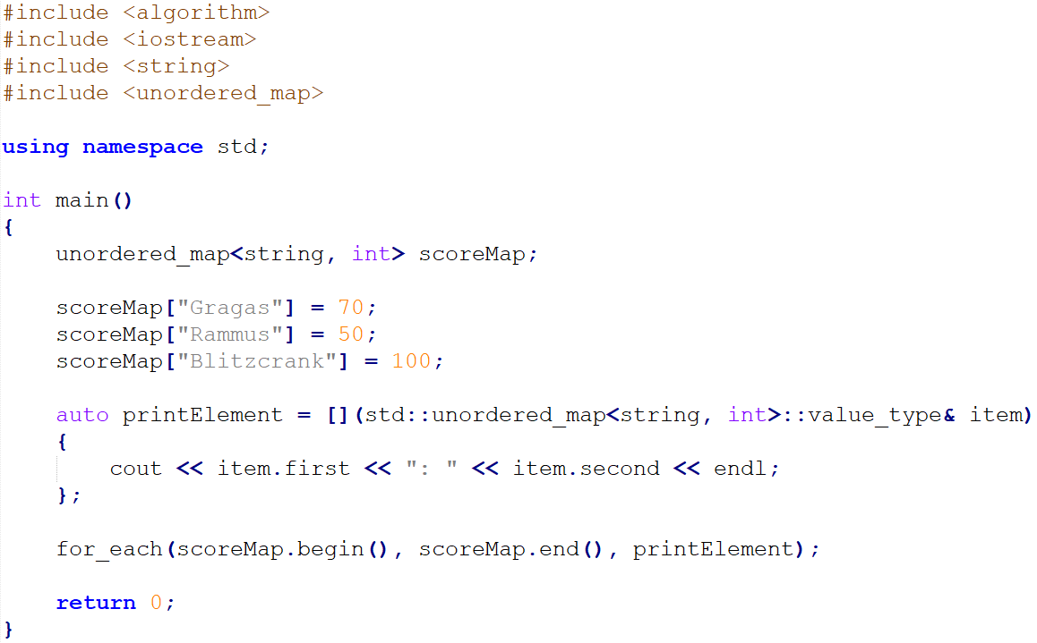

What about std::for_each?
It’s a lambda function.
We will cover this later.

Slide 25
std::for_each
C++03
Algorithm to run a function on each element in a container
Not as readable as range-based for
Kind of weird
Other languages support for each as language syntax, not as a algorithm
So, use range-based for :)

Slide 26
Range-based for Loop
for (<range_declaration> : <range_expression>)
{
// Do something
}
// int scores[10] for (int score : scores)
{
cout << score << " " << endl;
}
// std::map<string, int> scores;
for (auto& score : scores)
{
cout << score.first << “: ” << score.second << endl;
}

Slide 27
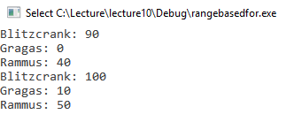
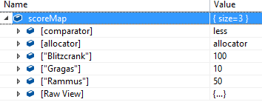
Example 1: By Value and By Reference
map<string, int> scoreMap; // {“Gragas”, 10}, {“Rammus”, 50}, {“Blitzcrank”, 100}
for (auto score : scoreMap)
{
score.second -= 10;
cout << score.first << ": " << score.second << endl;
}
for (auto& score : scoreMap)
{
cout << score.first << ": " << score.second << endl;
}
By value
By reference

Slide 28
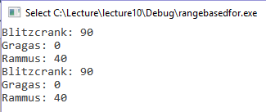
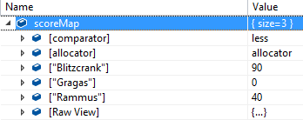
Example 2: By Reference and const
map<string, int> scoreMap; // {“Gragas”, 10}, {“Rammus”, 50}, {“Blitzcrank”, 100}
for (auto& score : scoreMap)
{
score.second -= 10;
cout << score.first << ": " << score.second << endl;
}
for (const auto& score : scoreMap)
{
cout << score.first << ": " << score.second << endl;
}
By reference
By const reference

Slide 29
Summary
New STL containers
std::unordered_map
std::unordered_set
std::array
Ranged For

Slide 30
Smart Pointers

Slide 31
Smart Pointers
unique_ptr
shared_ptr
weak_ptr

Slide 32
Example: Pointer
#include "Vector.h"
int main()
{
Vector* myVector = new Vector(10.f, 30.f);
// Do something
delete myVector;
return 0;
}

Slide 33

What is the Problem?
You have to deallocate memory when you don’t need to use pointers
When you use smart pointers,
you don’t need to call delete manually
And this is faster than garbage collection!
Notes:
Its as fast as NEW and Delete

Slide 34
unique_ptr

Slide 35

Example: Creating an unique pointer (C++11)
#include "Vector.h"
#include <memory>
using namespace std;
int main()
{
unique_ptr<Vector> myVector(new Vector(10.f, 30.f));
myVector->Print();
return 0;
}
There is no pointer icon(*)
But it works like a pointer
There is no “delete”

Slide 36
std::unique_ptr
The sole ownership of a pointer (let's call it naked or internal pointer)
Naked pointer won't be shared with anyone
So NO copy or assignment is allowed
When unique_ptr goes out of scope, the internal pointer will be deleted
unique_ptr<Vector> myVector(new Vector(10.f, 30.f));
unique_ptr<Vector> copiedVector1 = myVector; // Compile Error
unique_ptr<Vector> copiedVector2(myVector); // Compile Error

Slide 37
Unique pointers really make sense
for these 3 cases

Slide 38
Example: Constructor/Destructor in a Class
OLD
class Player { private: Vector* mLocation; } Player::Player(string name)
: mLocation(new Vector())
{
}
Player::~Player()
{
delete mLocation;
}
NEW
class Player { private: unique_ptr<Vector> mLocation;
}
Player::Player(string name)
: mLocation(make_unique<Vector>())
{
}

Slide 39
Example: Local Variables
OLD
#include "Vector.h"
int main()
{
Vector* vector = new Vector(10.f, 30.f);
vector->Print();
delete vector;
//...
}
NEW
#include "Vector.h"
#include <memory>
using namespace std;
int main()
{
unique_ptr<Vector> vector = make_unique<Vector>(10.f, 30.f);
vector->Print();
//...
}

Slide 40
Example: Storing Pointer in a STL Vector
OLD
int main()
{
vector<Player*> playerList;
playerList.push_back(new Player("Lulu"));
playerList.push_back (new Player("Rammus"));
for (int i = 0; i < playerList.size(); ++i)
{
delete playerList[i];
}
playerList.clear(); //... }
NEW
int main()
{
vector<unique_ptr<Player>> playerList;
playerList.push_back
(make_unique<Player>("Lulu"));
playerList.push_back (make_unique<Player>("Rammus"));
playerList.clear();
// …
}

Slide 41

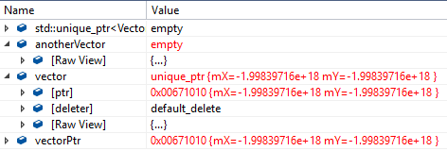
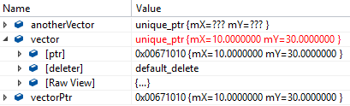
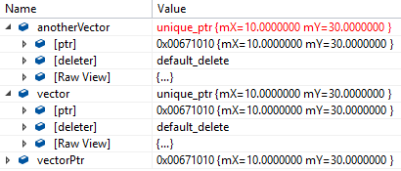
Problem: Sharing a Naked Pointer
Vector* vectorPtr = new Vector(10.f, 30.f);
unique_ptr<Vector> vector(vectorPtr);
unique_ptr<Vector> anotherVector(vectorPtr);
anotherVector = nullptr;

Slide 42
Solution Since C++14
#include "Vector.h"
#include <memory>
using namespace std;
int main()
{
unique_ptr<Vector> myVector = make_unique<Vector>(10.f, 30.f);
myVector->Print();
return 0;
}

Slide 43
What Does make_unique Do?
It calls new keyword with given parameters and type for you
So technically same as passing a naked pointer
But it prevents the sharing of a naked pointer by multiple unique_ptrs

Slide 44

Compile Errors
Vector* vectorPtr = new Vector(10.f, 30.f);
unique_ptr<Vector> vector1 = make_unique(vectorPtr);
unique_ptr<Vector> vector2 = make_unique<Vector>(vectorPtr);
unique_ptr<Vector> vector3 = make_unique<Vector*>(10.f, 30.f);

Slide 45
Creating an Unique Pointer
// non-array
template< class T, class... Args >
unique_ptr<T> make_unique( Args&&... args );
// array
template< class T >
unique_ptr<T> make_unique( std::size_t size );
It’s r-value.
We will cover this later.
// C++11 (if you cannot use C++14)
unique_ptr<Vector> vector(new Vector(10.f, 30.f));
unique_ptr<Vector[]> vectors(new Vector[20]);
// C++14 (please use this)
unique_ptr<Vector> vector = std::make_unique<Vector>(10.f, 30.f);
unique_ptr<Vector[]> vectors = std::make_unique<Vector[]>(20);

Slide 46
Example: reset()
int main()
{
unique_ptr<Vector> vector = make_unique<Vector>(10.f, 30.f);
vector.reset(new Vector(20.f, 40.f));
vector.reset();
// …
}
(This shows just a concept)
10
30
deleter
vector
ptr
20
40
nullptr
Notes:
Seemlier as delete

Slide 47
Use nullptr Instead?
// unique_ptr<Vector> vector
vector.reset();
// unique_ptr<Vector> vector
vector = nullptr;
Both codes are same
nullptr is more readable than reset()
But reset() clearly shows it is not a naked pointer
My personal preference is nullptr :)

Slide 48
Resetting an Unique Pointer
void reset( pointer ptr = pointer() ) noexcept;
Replaces a pointer
When reset unique_ptr, a pointer which it owns are destroyed automatically
myVector.reset(new Vector(20.f, 40.f));
myVector.reset();

Slide 49

Example: get()
// Vector.cpp
void Vector::Add(const Vector* other)
{
mX += other->mX;
mY += other->mY;
}
// Main.cpp int main()
{
unique_ptr<Vector> vector = make_unique<Vector>(10.f, 30.f);
unique_ptr<Vector> anotherVector = make_unique<Vector>(20.f, 40.f);
vector->Add(anotherVector.get());
vector->Print();
// …
}

Slide 50
Getting a pointer
pointer get() const noexcept;
Returns a pointer
// unique_ptr<Vector> vector
Vector* ptr = vector.get();

Slide 51

Example: release()
int main()
{
unique_ptr<Vector> vector = make_unique<Vector>(10.f, 30.f);
Vector* vectorPtr = vector.release();
// …
}
(This shows just a concept)
vectorPtr
10
30
deleter
vector
ptr
nullptr

Slide 52
Releasing an Ownership of a Pointer
pointer release() noexcept;
Releases an ownership of pointer and returns the pointer
If you call get() after calling release(), nullptr will return
// unique_ptr<Vector> vector
Vector* vectorPtr = vector.release();

Slide 53
Can I copy a unique pointer at all?
NO, you only can move an ownership of a pointer
to another unique_ptr

Slide 54
Example: Moving an Ownership of a Pointer
int main()
{
unique_ptr<Vector> vector =
make_unique<Vector>(10.f, 30.f);
unique_ptr<Vector> anotherVector (std::move(myVector));
// ...
}
(This shows just a concept)
deleter
anotherVector
ptr
10
30
deleter
vector
ptr
nullptr

Slide 55
Example: What about a const Unique Pointer?
int main() {
const unique_ptr<Vector> vector = make_unique<Vector>(10.f, 30.f);
unique_ptr<Vector> anotherVector(std::move(vector)); // Compile Error
// ...
}

Slide 56
Transferring an Ownership
unique_ptr does not share its internal pointer with anyone
Meaning no copy of the address
Instead, you can move the ownership to another unique_ptr
Exception: const unique_ptr

Slide 57
std::move()
A way to give up all members in object A to give the ownership to B
No memory allocation and deallocation happens
Think it as simply assign all pointers in A to B and set nullptr in A
"I am MOVING the member variables"
To understand how it works, you need to learn r-value and move constructor.
Will cover it later
Notes:
Its like shallow copy plus delete the old one

Slide 58
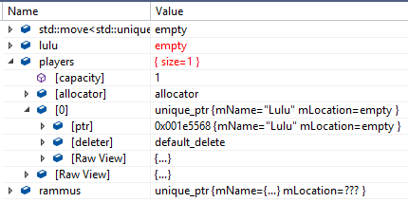
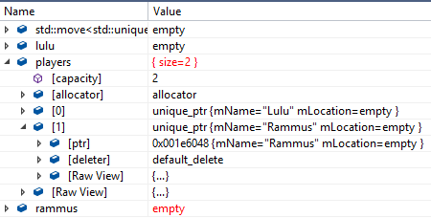
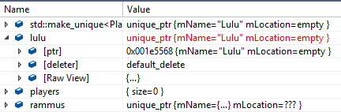
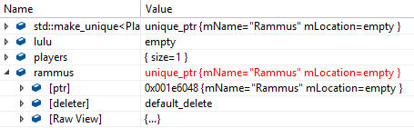
Example: Adding Elements into STL Vector
vector<unique_ptr<Player>> players;
unique_ptr<Player> lulu = make_unique<Player>("Lulu");
players.push_back(std::move(lulu));
unique_ptr<Player> rammus = make_unique<Player>("Rammus");
players.push_back(std::move(rammus));

Slide 59
Revealing unique_ptr's Secret
template<typename T> class unique_ptr<T> final { public: unique_ptr(T* ptr) : mPtr(ptr) {} ~unique_ptr() { delete mPtr; } T* get() { return mPtr; } unique_ptr(const unique_ptr&) = delete; unique_ptr& operator=(const unique_ptr&) = delete; private: T* mPtr = nullptr; }

Slide 60
unique_ptr Best Practice
Everyone uses it now
As fast as manual memory management
Fits nicely into RAII(Resource Acquisition is Initialization)
Resource allocation is tied into object lifetime
New in constructor and delete in destructor
unique_ptr member variable does this for you
Hard to make mistake
Use it everywhere!

