Slide 1
Lecture 11
Pope Kim

Slide 2
shared_ptr

Slide 3
Automatic Memory Management
Before learning shared_ptr, let's talk about automatic memory management
There are two main techniques
Garbage Collection (GC), supported by Java and C#
Reference Counting (RefCounting), supported by Swift and Apple Objective-C

Slide 4
How Does It Work?
(This just shows the concept of GC)
Garbages
Stack
(Root)
Heap
Reachable
Unreachable
(Garbage)
Notes:
GC delete all the memory that doesn’t have a pointer points to(How java and C# works)

Slide 5
Problems with GC
It does NOT clean up unused memory immediately
While GC is trying to determine memory to free, it can pause or hang your applications
Notes:
You can control GC in C#

Slide 6
Reference Counting
Like garbage collection, an object will be deallocated when there is no references to it
A reference count is used to track how many times a specific object is being referenced at any given moment
The count increases when a given object A is referenced by another object B
The count decreases when B stops referencing it (e.g, B goes out of scope)

Slide 7
How Does It Work?
class StringValue { private: int mRefCount; char* mString; }; class MyString { private: StringValue* mStringValue; };
(This just shows the concept of reference count)
anotherCat
mStringValue
1
2
‘L’
‘u’
‘l’
‘u’
\0
cat
MyString cat(“Lulu”);
MyString anotherCat(“Naru”);
anotherCat = cat;
1
‘N’
‘a’
‘r’
‘u’
\0
mStringValue
Reference Count

Slide 8
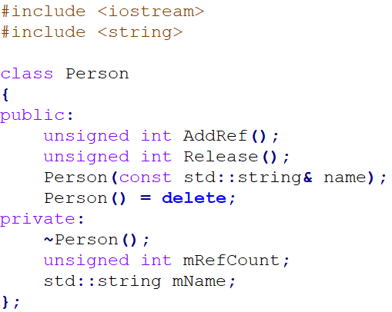
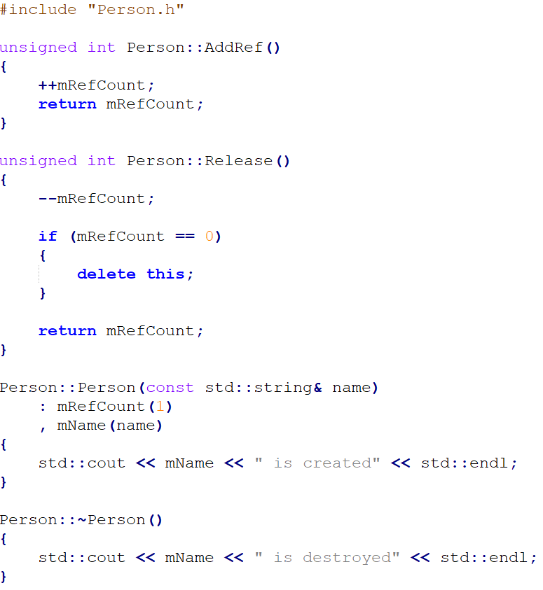
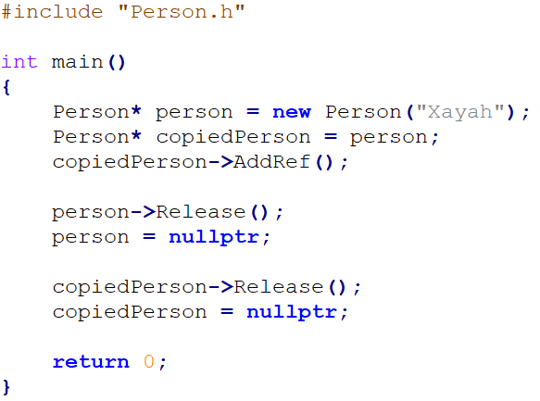
Example: Manual Reference Counting

Slide 9
Garbage Collection
Usually means Tracing Garbage Collection
An attempt to prevent memory leaks
Works in cycles
i.e) If there is not enough free memory
In every cycle, GC is checking “roots”:
Global variables
Stack
Registers
Determines if objects in heap are reachable through roots
If not, they are regarded as garbage, so delete them

Slide 10
Manual Reference Counting
DirectX and Swift support manual reference counting
shared_ptr does it automatically for you

Slide 11
Strong Reference
Strong reference means that when object A has a reference to object B, object B will be never destroyed
Strong reference count is used to store the number of strong references
In general, when you create a new instance, thus a reference to an object, strong reference count increases
The object Gets destroyed when the strong reference count becomes 0

Slide 12
Problems with Reference Counting
Reference count changes too often
To be thread-safe, you need a lock or atomic operations
Definitely slower than mRefCount++
Circular reference
Object A has a reference to object B
Object B has a reference to object A
They never get released!
There is a solution in C++ (will cover it soon)

Slide 13
No Memory Leaks with GC or RefCount?
No traditional memory leak
i.e) you forgot to delete!
People easily make this type of mistakes
Once you detect it, it's easy to fix
Still there is memory leak
e.g) circular reference
People less often make this type of mistakes
Once you detect it, it's still not easy to fix
Also if you are not trained to think this way, you will look stupid when you cannot fix your own memory leak :)
mName(“Xayah”)
mName(“Rakan”)
mRefCount(2)
mRefCount(2)
RelationShip ptr
RelationShip ptr

Slide 14
GC vs RefCounting
GC
Definitely easier to use
Not great for real-time or high-performance programming
Would you like to watch a movie with a 2-sec pause every 3 mins?
Have you seen Android games stuttering more than iPhone ones?
RefCounting
Still easy to use
Good for real-time or high-performance programming
Still slower than pure pointers if you have to worry about multi-threading

Slide 15

Example: Creating shared_ptr
#include "Vector.h"
#include <memory>
using namespace std;
int main()
{
shared_ptr<Vector> vector = make_shared<Vector>(10.f, 30.f);
return 0;
}

Slide 16
std::shared_ptr
Owns two pointers
a pointer which points to data (naked pointer or internal pointer)
a pointer which points to a control block
Unlike unique_ptr, you can share a pointer to another shared_ptr
Based on automatic reference counting
The naked pointer will be destroyed when NO shared_ptr references it
Data ptr
Data
Control block ptr
Strong Ref Count
shared_ptr<T>
Weak Ref Count
Allocator, deleter...etc

Slide 17
Creating shared_ptr
// non-array
template< class T, class... Args >
shared_ptr<T> make_shared( Args&&... args );
Creates a shared_ptr
shared_ptr<Vector> vector = make_shared<Vector>(10.f, 30.f);

Slide 18
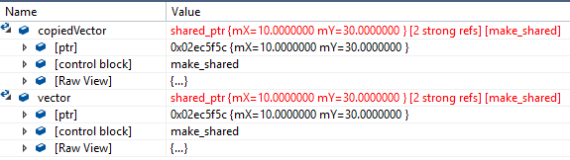
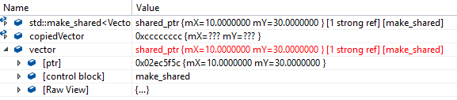
Example: Sharing a Pointer
int main()
{
shared_ptr<Vector> vector = make_shared<Vector>(10.f, 30.f);
shared_ptr<Vector> copiedVector = vector;
// …
}

Slide 19
Sharing the Ownership of a Pointer
shared_ptr& operator= (const shared_ptr& x) noexcept;
template <class U>
shared_ptr& operator= (const shared_ptr<U>& x) noexcept;
Shares the ownership of a pointer
shared_ptr<Vector> copiedVector = vector;

Slide 20
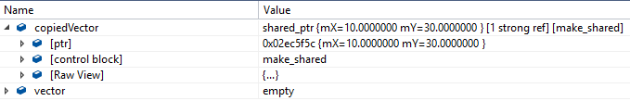
Example : Resetting a Pointer
int main()
{
shared_ptr<Vector> vector = make_shared<Vector>(10.f, 30.f);
shared_ptr<Vector> copiedVector = vector;
vector.reset(); // Same as vector = nullptr;
// ...
}

Slide 21
Resetting a Pointer
void reset() noexcept;
Releases the internal pointer
RefCount is down by one
Same as assigning nullptr
vector.reset();
vector = nullptr;

Slide 22
Example: Getting the RefCount
#include "Vector.h"
#include <memory>
using namespace std;
int main()
{
shared_ptr<Vector> vector = make_shared<Vector>(10.f, 30.f);
cout << "vector: " << vector.use_count() << endl; // vector: 1
shared_ptr<Vector> copiedVector = vector;
cout << "vector: " << vector.use_count() << endl; // vector: 2
cout << "copiedVector: " << copiedVector.use_count() << endl; // copiedVector: 2
}

Slide 23
Getting the RefCount
long use_count() const noexcept;
Returns how many shared_ptrs are referencing to the naked pointer
long number = vector.use_count();

Slide 24
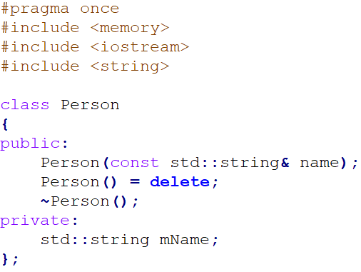
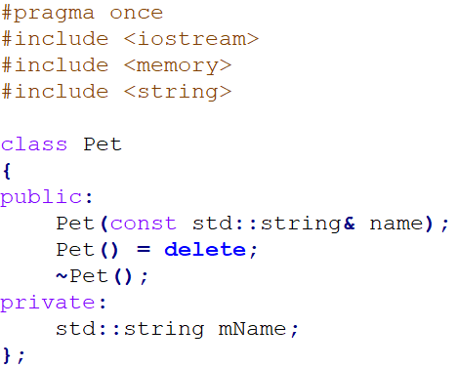
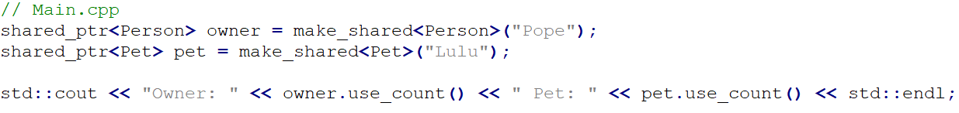
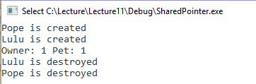
Example: Pet and Person Class

Slide 25
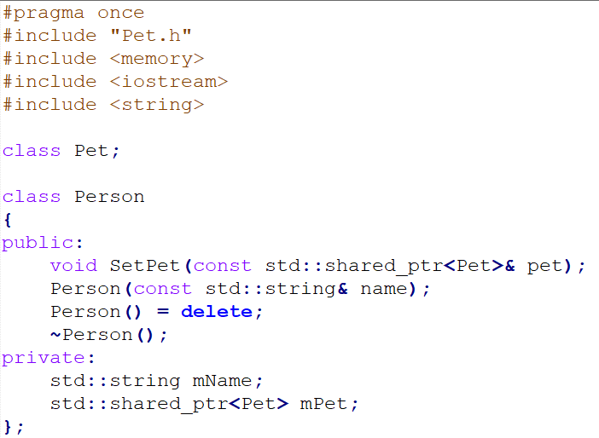
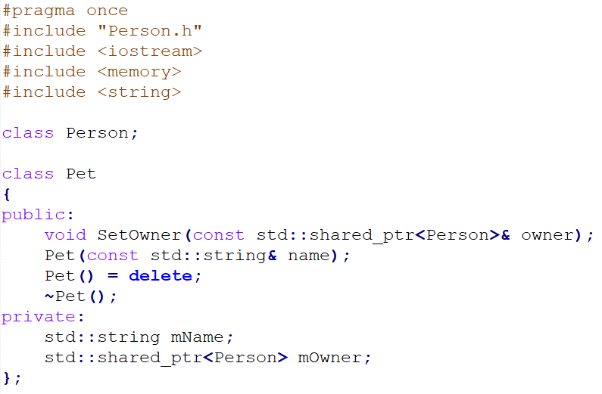
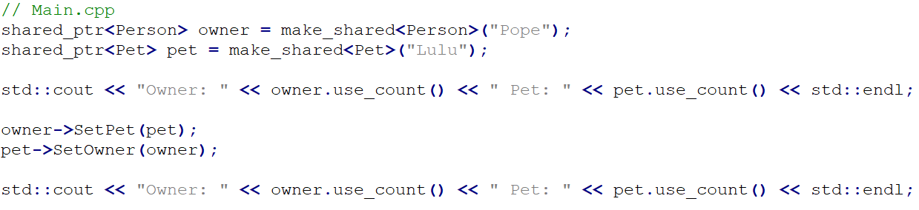
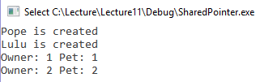
Example: Circular Reference

Slide 26
How to fix this problem?
We have another smart pointer weak_ptr

Slide 27
weak_ptr

Slide 28
Weak Reference
Weak reference does NOT influence the deallocation of the naked pointer
Weak reference count is used to store the number of weak references
And this is a circular definition… sorry lol
An object which is referenced by weak references will be destroyed when its strong reference count becomes 0
This is a solution for the circular reference problem

Slide 29
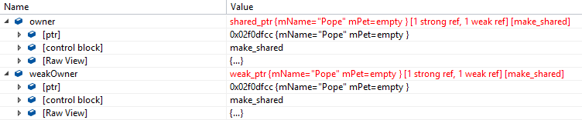
Example: Creating a Weak Pointer
#include <memory> using namespace std;
int main()
{
shared_ptr<Person> owner = make_shared<Person>("Pope");
weak_ptr<Person> weakOwner = owner;
return 0;
}

Slide 30
Creating a Weak Pointer
template <class U>
weak_ptr& operator= (const shared_ptr<U>& x) noexcept;
Creates a weak pointer from a shared pointer
weak_ptr<Person> weakOwner = owner; // owner is a shared pointer

Slide 31


Example: Creating a Shared Pointer from a Weak Pointer
#include <memory> using namespace std;
int main()
{
shared_ptr<Person> owner = make_shared<Person>("Pope");
weak_ptr<Person> weakOwner = owner;
shared_ptr<Person> lockedOwner = weakOwner.lock();
return 0;
}

Slide 32
Creating a Shared Pointer from a Weak Pointer
std::shared_ptr<T> lock() const noexcept;
Create a shared pointer if the naked pointer is existed
shared_ptr<Person> lockedOwner = weakOwner.lock();
Notes:
<<< i thought if lock fails lockedOwner == nullptr no? I think that's how most people were checking weak_ptr.. Auto ptr = weak.lock() If (ptr != nullptr) { // do something } If that' sthe case please add another slide explaining it right after this slide

Slide 33
Example1: Checking if a Shared Pointer Exists
#include <memory> using namespace std;
int main()
{
shared_ptr<Person> owner = make_shared<Person>("Pope");
weak_ptr<Person> weakOwner = owner;
auto ptr = weakOwner.lock();
if (ptr == nullptr) {
// Do something
}
return 0;
}

Slide 34
Example2: Checking If a Shared Pointer Exists
#include <memory> using namespace std;
int main()
{
shared_ptr<Person> owner = make_shared<Person>("Pope");
weak_ptr<Person> weakOwner = owner;
if (weakOwner.expired()) // Returns false {
// … }
return 0;
}
#include <memory> using namespace std;
int main()
{
shared_ptr<Person> owner = make_shared<Person>("Pope");
weak_ptr<Person> weakOwner = owner; owner = nullptr;
if (weakOwner.expired()) // Returns true {
// … }
return 0;
}
But is this safe?

Slide 35
Checking If a Shared Pointer Exists
bool expired() const noexcept;
Returns true, if a shared pointer doesn’t exist
Returns false, if there is no shared pointer
bool bIsExpired = weakOwner.expired();

Slide 36
Let’s Solve Circular Reference

Slide 37
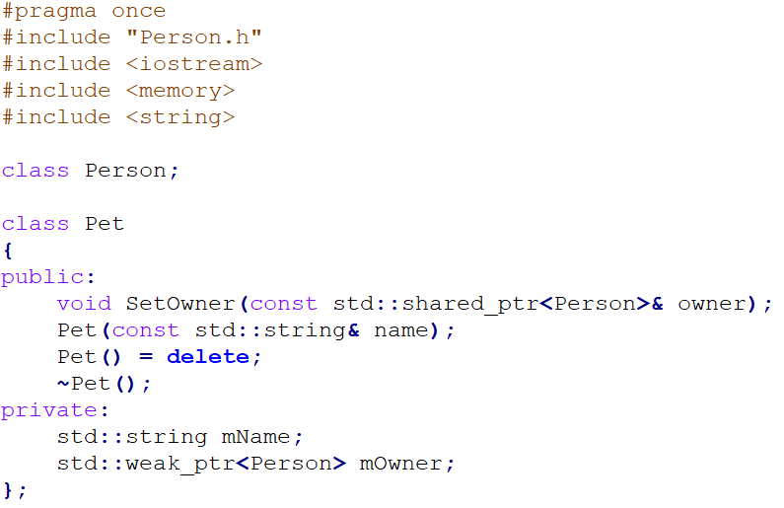
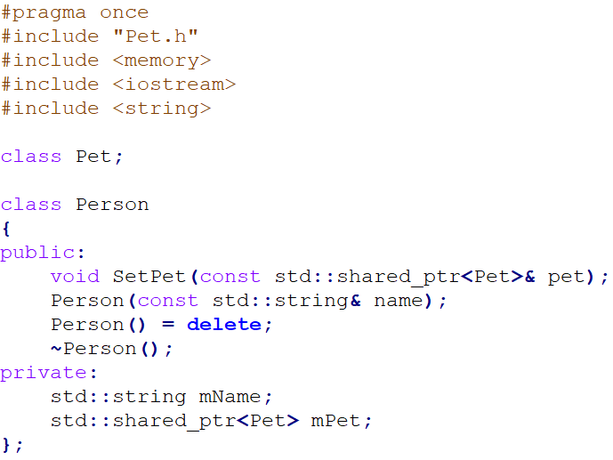
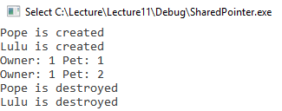
Solution: Circular Reference

Slide 38
Review: shared_ptr, weak_ptr
shared_ptr
Strong reference
Increasing strong reference count
You can use this directly
Because the naked pointer is guaranteed to be there
weak_ptr
Weak reference
Increasing weak reference count
Cannot use directly
Have to lock and check if the shared_ptr is still there

Slide 39

SORRY!
I couldn't finish all slides yet!
Will add more below by Friday!

Slide 40
move constructor
move assignment operator

Slide 41
Value Category
lvalue
rvalue

Slide 42
What is an lvalue?
Object that persists beyond a single expression
has an address
variables which have a name
const variables
array variables
Bit-fields
Unions
class members
function calls which return an lvalue reference(&)
string literal
basically anything you have seen so far

Slide 43
Example1 - lvalue
int main() {
int number = 10; // number is an lvalue
const int NAME_MAX = 20; // NAME_MAX is an lvalue
int* numberPtr = number; // numberPtr is an lvalue
std::map<string, float> scoreMap;
scoreMap[“Lulu”] = 60.f; // scoreMap[“Lulu”] is an lvalue ([] operator)
// …
return 0;
}

Slide 44
Example2 - lvalue
struct Person {
std::string Name;
int Age; };
int main()
{
Person person;
person.Name = “Lulu”; // person.Name is an lvalue
const char* name = “Gragas”; // name and “Gragas” are lvalues
return 0;
}

Slide 45
What is a rvalue?
an object which is not lvalue… lol
a temporary value that does not persist beyond the expression that uses it
an object which does NOT have an address
literal (except string literal)
function calls which return non-reference
++i, i++, --i, and i--
built-in arithmetic, logical, and comparison expression
enum
lambda

Slide 46
Example1 - rvalue
int main() {
int number = 10; // 10 is a rvalue
10 = number; // Error because 10 is a rvalue
(number + 1) = 20; // Error because (number + 1) is a rvalue
int anotherNumber = 20;
int result = number + anotherNumber; // (number + anotherNumber) is a rvalue
&number = 20; // Error because &number is a rvalue
return 0;
}

Slide 47
Example2 - rvalue
int main() {
int number1 = 10;
int number2 = 20;
if (number1 < number2) // (number1 < number2) is rvalue
{
// Do something }
return 0;
}

Slide 48
Problems with Old C++ (Before C++11)
vector<float> ConvertToPercentage (const vector<float>& scores) { vector<float> percentages;
for (vector<float>::const_iterator it = scores.begin(); it != scores.end(); ++it) {
// Do something } return percentages; }
int main() {
vector <float> scores;
// ...
scores = ConvertToPercentage(scores);
// ... }
What is the problem?
There are two copies!

Slide 49
Let’s Revisit Copy Constructor
int main() {
vector<int> scores;
// ...
vector<int> copiedScores = scores;
// ... }
(This just shows the concept)
10
20
30
COPY
copiedScores
3
10
20
30
scores
3

Slide 50
Copy Constructor with rvalue
(This just shows the concept)
vector<float> ConvertToPercentage (const vector<float>& scores) { vector<float> percentages;
// ... return percentages; }
percentages
3
10
33
20
66
30
100
return
value
3
33
66
100
int main() {
vector<int> scores;
// ...
scores = ConvertToPercentage(scores);
// ... }
COPY
COPY
33
66
100
scores
3

Slide 51
How to prevent these copies?
We can solve this with
rvalue reference and move semantics

Slide 52
rvalue Reference (&&)
new operator since C++11
functionally similar to operator &
operator & is for referencing lvalue
operator && is for referencing rvalue

Slide 53
Example: rvalue Reference
float CalculateAverage() {
float average;
//… return average; }
int main() { int number = 10; int&& rNumber = number; // Error, number is an lvalue
int&& rNumber1 = 10; // OK, 10 is a rvalue
float&& rAverage = CalculateAverage(); // OK, CalculateAverage() is a rvalue
//... }

Slide 54
std::move()
returns an rvalue reference
converts a lvalue into an rvalue

Slide 55
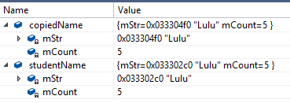
Example: MyString
#pragma once
#include <string>
class MyString
{
public:
MyString(const MyString& other);
MyString(const char* str);
~MyString();
private:
char* mStr;
int mCount;
};
int main() {
MyString studentName(“Lulu”);
MyString copiedName(studentName);
return 0; }

Slide 56

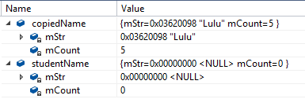
Example: Move Constructor
#pragma once
#include <string>
class MyString
{
public:
MyString(const MyString&& other);
MyString(const MyString& other);
MyString(const char* str);
~MyString();
private:
char* mStr;
int mCount;
};
MyString::MyString(MyString&& other)
: mStr(other.mStr)
, mCount(other.mCount)
{
other.mStr = nullptr;
other.mCount = 0;
}
int main() {
MyString studentName(“Lulu”);
MyString copiedName(std::move(studentName));
return 0; }

Slide 57
Move Constructor
Take ownership of member variables from another object
Unlike copy constructor, it avoids memory reallocation
It is faster than a copy constructor
Kind of shallow copy
<class_name>::<class_name>(<class_name> &&)
MyString::MyString(MyString&& other) {
//... }

Slide 58
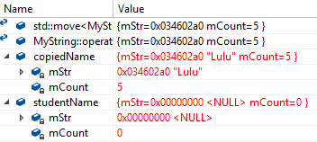
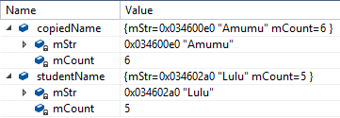
Example: Move Assignment Operator
#pragma once
#include <string>
class MyString
{
public:
MyString& operator= (const MyString&& other);
// ...
private:
char* mStr;
int mCount;
};
MyString& MyString::operator= (MyString&& other)
{
delete[] mStr;
mStr = other.mStr;
mCount = other.mCount;
other.mStr = nullptr;
other.mCount = 0;
return *this;
}
int main() {
MyString studentName(“Lulu”);
MyString copiedName(“Amumu”);
copiedName = std::move(studentName);
return 0; }

Slide 59
Move Assignment Operator
Same concept as move constructor
Takes ownership of member variables from another object
Again, it avoids memory reallocation
Shallow copy
<class_name>& <class_name>::operator=(<class_name>&& )
MyString& MyString::operator= (MyString&& other)
{
//... }

Slide 60
Move Semantics for STL Containers
Since C++11, STL containers have both move constructors and move assignments
So, you do not need to implement them

Slide 61
Move Assignment Since C++11
(This just shows the concept)
int main() {
vector<int> scores;
// ...
scores = ConvertToPercentage(scores);
// ... }
10
20
30
return
value
3
33
66
100
scores
3

Slide 62
rvalue optimization
Another C++ programming jargon that got us excited
Yes, we again misused it
move constructor and assignment operator
still valid
functions returning a object itself instead of a pointer
Returning rvalue from a function is actually slow a lot of times
It breaks compiler optimization named Named Return Value Optimization
Best practice of today
just return objects by default
change functions to return rvalue only if it's proven to be faster
if you return a std::vector containing many objects, rvalue return might be faster

