Slide 1
Android Menus & Preferences
Medhat Elmasry

Slide 2
Objectives
Applied
Given the specifications for a menu that contains one or more items, define the menu and its items and handle the events that occur when users select those items.
Given the specifications for the preferences for an app, use a fragment to allow the user to set those preferences.

Slide 3
Objectives
Knowledge
Name and describe the most common type of menu.
Distinguish between an action item and the action overflow item.
Describe how Android decides whether to display an item as an action item or a menu item.
Explain how to use an intent to start an activity.
In general, explain how the Preferences API works and list one of its benefits.

Slide 4
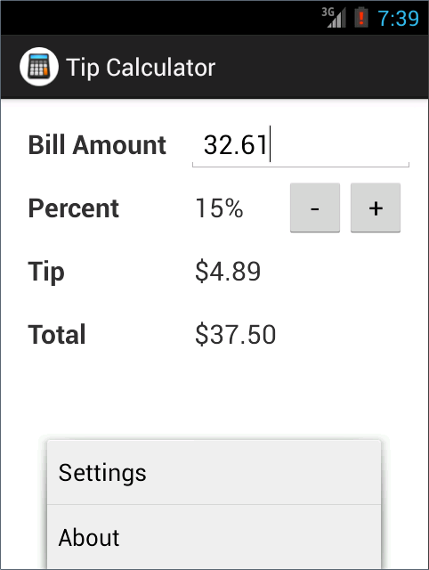
An activity with an options menu that has two items

Slide 5
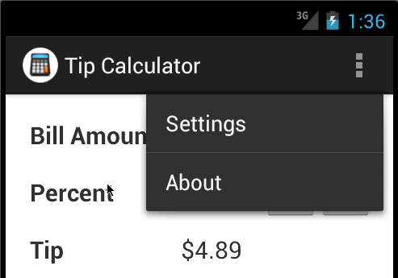
The same options menu displayed from an action overflow icon

Slide 6
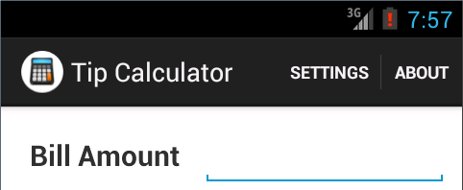
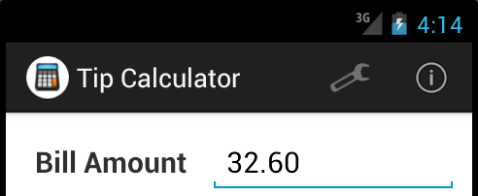
Two action items displayed as text
Two action items displayed as icons

Slide 7
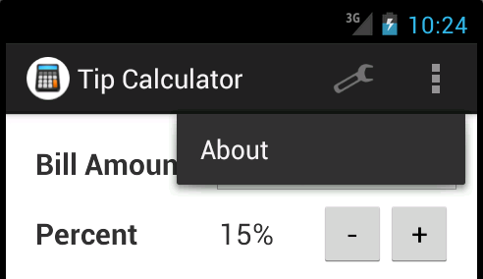
One action icon and an overflow action icon

Slide 8
Three types of menus
An options menu typically drops down from the action overflow icon as shown earlier. However, it can also be displayed across the bottom of the screen as shown earlier.
A floating context menu appears as a floating list of menu items when a user performs a long click on the widget. Alternately, contextual action mode can display action items that apply to the selected item or items.
A popup menu usually appears as a list below a widget or action item.

Slide 9
The file that contains the XML for the menu
res\menu\activity_tip_calculator.xml
The XML for the menu
<menu xmlns:android="http://schemas.android.com/apk/res/android">
<item android:id="@+id/menu_settings"
android:title="@string/menu_settings"
android:icon="@drawable/ic_settings"
android:showAsAction="ifRoom" />
<item android:id="@+id/menu_about"
android:title="@string/menu_about"
android:icon="@drawable/ic_about"
android:showAsAction="never" />
</menu>

Slide 10
Some attributes of a menu item
title
icon
showAsAction
orderInCategory
Typical values for the showAsAction attribute
always
never
ifRoom

Slide 11
The location of the icon files for the items
res\drawable-xhdpi\ic_settings.png
res\drawable-xhdpi\ic_about.png
A directory that has standard icons for API 23
\sdk\platforms\android-23\data\res\drawable-xhdpi

Slide 12
The code that displays the menu
@Override
public boolean onCreateOptionsMenu(Menu menu) {
getMenuInflater().inflate(R.menu.activity_tip_calculator, menu);
return true;
}

Slide 13
The code that handles the menu item events
@Override
public boolean onOptionsItemSelected(MenuItem item) {
switch (item.getItemId()) {
case R.id.menu_settings:
Toast.makeText(this, "Settings",
Toast.LENGTH_SHORT).show();
return true;
case R.id.menu_about:
Toast.makeText(this, "About",
Toast.LENGTH_SHORT).show();
return true;
default:
return super.onOptionsItemSelected(item);
}
}

Slide 14
Code that starts a new activity
Two statements
Intent settings = new Intent(getApplicationContext(), SettingsActivity.class);
startActivity(settings);
One statement
startActivity(new Intent(getApplicationContext(), SettingsActivity.class));

Slide 15
Code that uses menu items to start new activities
@Override
public boolean onOptionsItemSelected(MenuItem item) {
switch (item.getItemId()) {
case R.id.menu_settings:
startActivity(new Intent(getApplicationContext(), SettingsActivity.class));
return true;
case R.id.menu_about:
startActivity(new Intent(getApplicationContext(), AboutActivity.class));
return true;
default:
return super.onOptionsItemSelected(item);
}
}

