Slide 1
Working with Fragments
Medhat Elmasry

Slide 2
Objectives
Applied
Create a fragment and display it in an activity.
Create a preference fragment and display it in an activity.
Use two or more fragments in a single-pane layout for devices that have small screens.
Use two or more fragments in a multi-pane layout for devices that have large screens.
Detect the screen size and display an appropriate single-pane or multi-pane layout.
Control when the soft keyboard is displayed and the action button that’s displayed.
Use Java code to replace one fragment with another.

Slide 3
Objectives
Knowledge
Describe how you can use fragments in a single-pane or a multi-pane layout.
Compare the lifecycle methods of a fragment to the lifecycle methods of an activity.
Describe when the onCreateView and onDestroyView methods of a fragment are called.
Describe how an alias for a layout can help you create multi-pane layouts.
Describe how the smallest-width qualifier allows you to detect the screen size.

Slide 4
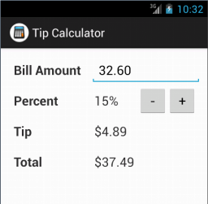
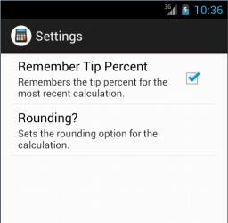
Two activities displaying two fragments

Slide 5
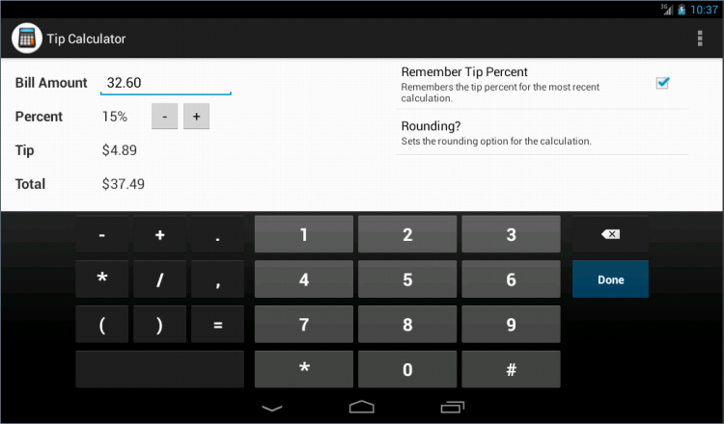
One activity displaying two fragments in landscape orientation

Slide 6
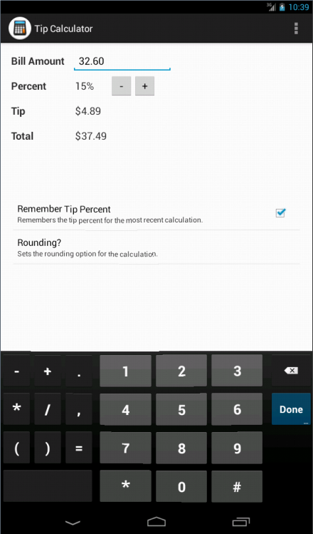
One activity displaying two fragments in portrait orientation

Slide 7
Fragment terminology
You can use a fragment to define part of the user interface for an activity.
A fragment can be thought of as a pane.
On a small screen, an activity typically only displays a single fragment. This is known as a single-pane layout.
On a large screen, an activity can display multiple fragments. This is known as a multi-pane layout.
A fragment can be reused in multiple activities.

Slide 8
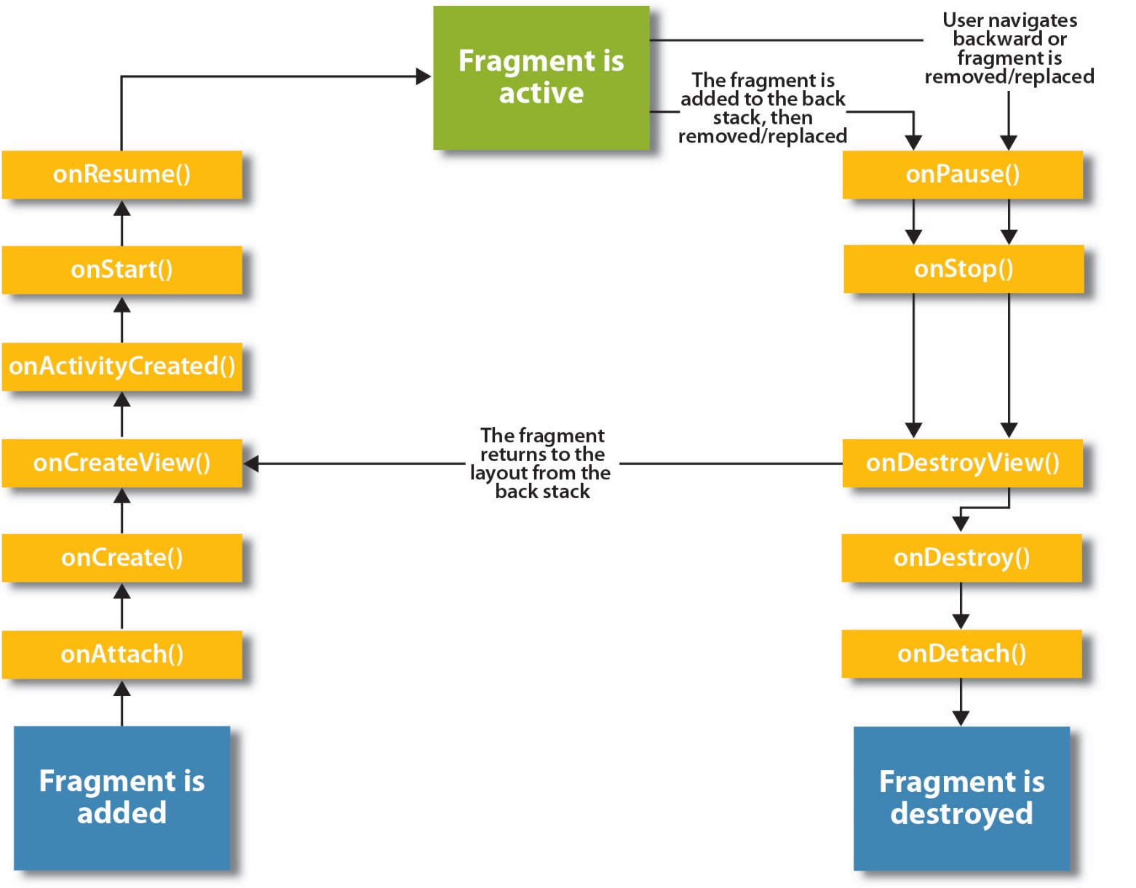
The lifecycle methods of a fragment

Slide 9
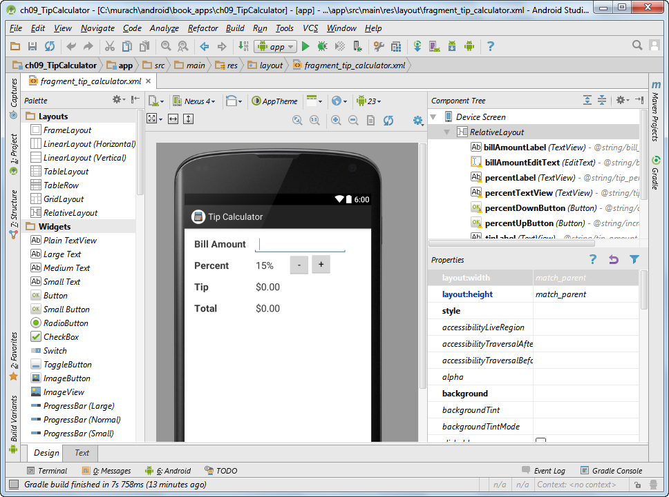
The layout for a fragment

Slide 10
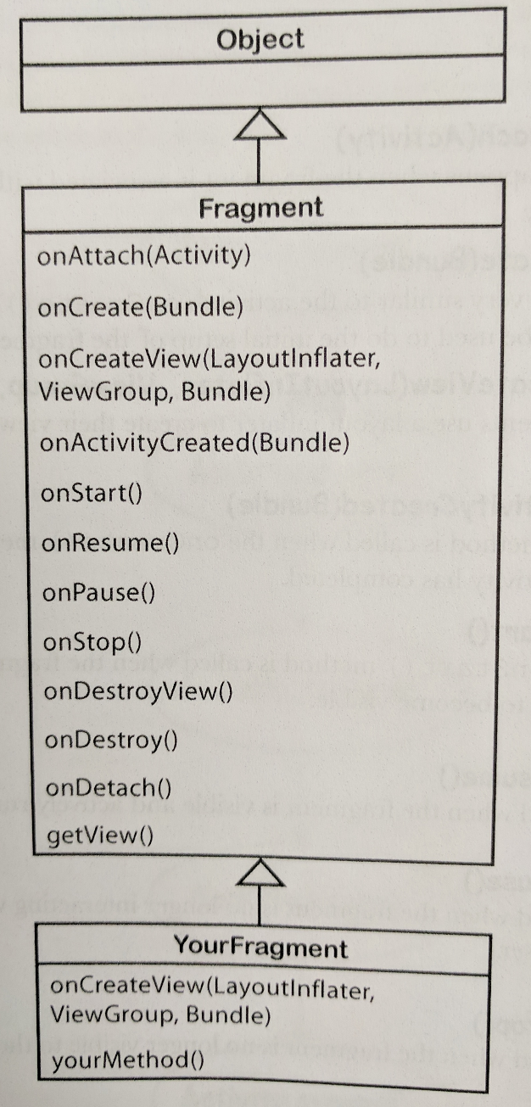
The Fragment class
Unlike the Activity class, a fragment does not implement the context class and therefore does not have direct access to global information about the application’s environment.
Instead, fragments must access this information using the context of other objects such as its parent activity.

Slide 11
Method of the Fragment class
setHasOptionsMenu(bool)

Slide 12
Method of the Activity and Fragment classes
getFragmentManager()
Method of the FragmentManager class
findFragmentById(id)

Slide 13
Method of the FragmentManager class
beginTransaction()
Methods of the FragmentTransaction class
replace(id, fragment)
commit()

Slide 14
The activity_main.xml file
<LinearLayout
xmlns:android="http://schemas.android.com/apk/res/android"
android:orientation="horizontal"
android:layout_width="match_parent"
android:layout_height="match_parent">
<fragment
android:name=
"com.murach.tipcalculator.TipCalculatorFragment"
android:id="@+id/main_fragment"
android:layout_weight="1"
android:layout_width="0dp"
android:layout_height="match_parent" />
</LinearLayout>

Slide 15
Smallest-width qualifiers examples
Qualifier | Typical screen size | Typical device
sw480dp | 640dp x 480dp | 5" tablet
sw600dp | 1024dp x 600dp | 7" tablet
sw720dp | 960dp x 720dp | 10" tablet
res\values-sw600dp-land\layout.xml
<?xml version="1.0" encoding="utf-8"?>
<resources>
<item name="activity_main" type="layout">
@layout/activity_main_twopane_land
</item>
</resources>
res\values-sw600dp-port\layout.xml
<?xml version="1.0" encoding="utf-8"?>
<resources>
<item name="activity_main" type="layout">
@layout/activity_main_twopane_port
</item>
</resources>

