Slide 1
Handling Android Events
Medhat Elmasry

Slide 2
How events work
An event handler is a special type of method that’s executed when an event occurs.
Typically, an event occurs when a user interacts with widgets.
A listener is an object that listens for an event. To create a listener, import the interface for the listener and implement that interface.
After you create a listener, connect, or wire, the listener to an event that’s available from a widget.

Slide 3
What are listeners
A listener is an object that listens for events that can occur on a widget
High-level occur on a specific type of widget
Low-level events occur on all types of widgets
The OnClickListener can be wired to any widget

Slide 4
Listeners for high-level events
Class | Nested Interface | Method(s)
EditText | OnEditorActionListener | onEditorAction
CompoundButton | OnCheckedChangedListener | onCheckedChanged
RadioGroup | OnCheckedChangedListener | onCheckedChanged
AdapterView | OnItemSelectedListener | onItemSelected, onNothingSelected
SeekBar | OnSeekBarChangeListener | onProgressChanged, onStartTrackingTouch, onStopTrackingTouch

Slide 5
Listeners for low-level events
Class | Nested Interface | Method
View | OnClickListener, OnLongClickListener, OnKeyListener, OnFocusChangeListener, OnTouchListener | onClick, onLongClick, onKey, onFocusChange, onTouch

Slide 6
Step 1: Import the interface for the listener
import android.view.View.OnClickListener;
(Step 1 is the same for all 4 techniques that follow)

Slide 7
Step 2a: Implement the interface for the listener
public class TipCalculatorActivity extends Activity
implements OnClickListener {
Step 2b: Implement the interface for the listener
@Override
public void onClick(View v) {
switch (v.getId()) {
case R.id.percentDownButton:
tipPercent = tipPercent - .01f;
calculateAndDisplay();
break;
case R.id.percentUpButton:
tipPercent = tipPercent + .01f;
calculateAndDisplay();
break;
}
}
See: CurrentClassActivity

Slide 8
Step 3: Set the listeners
percentUpButton.setOnClickListener(this);
percentDownButton.setOnClickListener(this);

Slide 9
Use a separate named class as the listener
Step 2: Code a separate class that implements the listener
class ButtonListener implements OnClickListener {
@Override
public void onClick(View v) {
switch (v.getId()) {
case R.id.percentDownButton:
tipPercent = tipPercent - .01f;
calculateAndDisplay();
break;
case R.id.percentUpButton:
tipPercent = tipPercent + .01f;
calculateAndDisplay();
break;
}
}
}
See: ButtonListener & SeparateClassActivity

Slide 10
Step 3: Create an instance of the listener
ButtonListener buttonListener = new ButtonListener();
Step 4: Set the listeners
percentUpButton.setOnClickListener(buttonListener);
percentDownButton.setOnClickListener(buttonListener);

Slide 11
Use an anonymous class as the listener
Step 2: Create an instance variable for the listener
private OnClickListener buttonListener = new OnClickListener() {
@Override
public void onClick(View v) {
switch (v.getId()) {
case R.id.percentDownButton:
tipPercent = tipPercent - .01f;
calculateAndDisplay();
break;
case R.id.percentUpButton:
tipPercent = tipPercent + .01f;
calculateAndDisplay();
break;
}
}
};
See: AnonymousClassActivity

Slide 12

A check box
A method of the View class
getId()
An event handler for a check box
See: CheckboxActivity
@Override
public void onCheckedChanged(CompoundButton widget,
boolean isChecked) {
switch (widget.getId()) {
case R.id.rememberPercentCheckBox:
if (isChecked)
rememberTipPercent = true;
else
rememberTipPercent = false;
break;
}
}

Slide 13
Another event handler for a check box
@Override
public void onCheckedChanged(CompoundButton widget, boolean isChecked) {
rememberTipPercent = isChecked;
}

Slide 14
Three radio buttons in a group
An event handler for a radio group
@Override
public void onCheckedChanged(RadioGroup group, int checkedId) {
switch (checkedId) {
case R.id.noRoundingRadioButton:
rounding = ROUND_NONE;
break;
case R.id.roundTipRadioButton:
rounding = ROUND_TIP;
break;
case R.id.roundTotalRadioButton:
rounding = ROUND_TOTAL;
break;
}
calculateAndDisplay();
}
See: RadioButtonActivity

Slide 15
Another event handler for a radio group
@Override
public void onCheckedChanged(RadioGroup group, int checkedId) {
calculateAndDisplay();
}

Slide 16
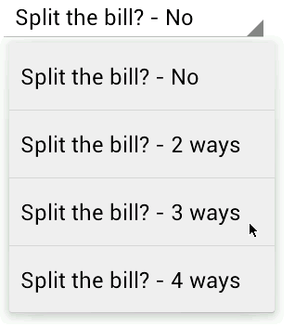
A spinner
An event handler for a spinner
@Override
public void onItemSelected(AdapterView<?> parent, View v, int position, long id) {
split = position + 1;
calculateAndDisplay();
}
@Override
public void onNothingSelected(AdapterView<?> parent) {
// You typically don't need to include any code here
}
See: SpinnerActivity

Slide 17

A seek bar and a label
An event handler for a seek bar
@Override
public void onProgressChanged(SeekBar seekBar, int progress, boolean fromUser) {
percentTextView.setText(progress + "%");
}
@Override
public void onStartTrackingTouch(SeekBar seekBar) {
// TODO Auto-generated method stub
}
@Override
public void onStopTrackingTouch(SeekBar seekBar) {
int progress = seekBar.getProgress();
tipPercent = (float) progress / 100;
calculateAndDisplay();
}
See: SeekBarActivity

Slide 18
An event handler for the Key event
@Override
public boolean onKey(View view,
int keyCode, KeyEvent event) {
switch (keyCode) {
case KeyEvent.KEYCODE_ENTER:
case KeyEvent.KEYCODE_DPAD_CENTER:
calculateAndDisplay();
// hide the soft keyboard
InputMethodManager imm = (InputMethodManager) getSystemService(Context.INPUT_METHOD_SERVICE);
imm.hideSoftInputFromWindow(billAmountEditText.getWindowToken(), 0);
// consume the event
return true;
case KeyEvent.KEYCODE_DPAD_RIGHT:
case KeyEvent.KEYCODE_DPAD_LEFT:
if (view.getId() == R.id.percentSeekBar) {
calculateAndDisplay();
}
break;
}
// don't consume the event
return false;
}
See: KeyActivity

Slide 19
Some constants from the KeyEvent class
KEYCODE_ENTER
KEYCODE_DPAD_CENTER
KEYCODE_DPAD_LEFT
KEYCODE_DPAD_RIGHT
KEYCODE_SPACE

Slide 20
An event handler for a Touch event
@Override
public boolean onTouch(View v, MotionEvent event) {
float downX, downY, upX, upY;
int action = event.getAction();
if (action == MotionEvent.ACTION_DOWN) {
Log.d("MotionEvent", "ACTION_DOWN");
downX = event.getX();
downY = event.getY();
Log.d("MotionEvent", "downX = " + downX);
Log.d("MotionEvent", "downY = " + downY);
return true;
} else if (action == MotionEvent.ACTION_UP){
Log.d("MotionEvent", "ACTION_UP");
upX = event.getX();
upY = event.getY();
Log.d("MotionEvent", "upX = " + upX);
Log.d("MotionEvent", "upY = " + upY);
return true;
} else {
return false;
}
}

Slide 21
Some constants of the MotionEvent class
ACTION_DOWN
ACTION_MOVE
ACTION_UP
Some methods of the MotionEvent class
getAction()
getX()
getY()
getHistorySize()
getHistoricalX(int i)
getHistoricalY(int i)

Slide 22
How to handle the EditorAction event
The EditorAction event typically occurs when user uses a soft keyboard to enter text into an editable text view.
To determine which widget triggered the event, you can use the first argument of the onEditorAction method.
To determine which action key triggered the event, you can use the second argument of the onEditorAction method.
To determine whether the action was trigged by pressing the Enter key, you can use the third argument of the onEditorAction method.
To hide the soft keyboard, you can return a false value from the onEditorAction method.
To keep the soft keyboard displayed, you can return a true value from the onEditorAction method.

Slide 23
A few constants from the EditorInfo class
IME_ACTION_DONE
IME_ACTION_GO
IME_ACTION_NEXT
IME_ACTION_SEARCH
IME_ACTION_UNSPECIFIED
What is an IME?
An input method editor (IME) is a user control such as a soft keyboard that enables users to input data, often text.
See: EditorActivity

Slide 24
Two methods for working with widgets
getText()
setText(string)
Examples
How to get text
String billAmountString = billAmountEditText.getText().toString();
How to set text
tipTextView.setText("Test 1");

Slide 25
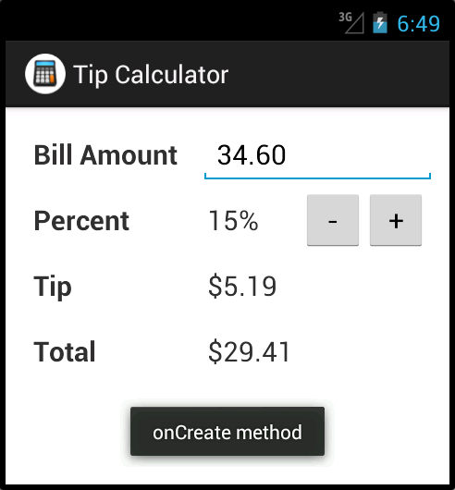
Toast
A toast displayed in an emulator

Slide 26
Two methods of the Toast class
makeText(context,message, length)
show()
Two constants of the Toast class
LENGTH_SHORT
LENGTH_LONG

Slide 27
How to display a toast
Import the Toast class
import android.widget.Toast;
Use two statements
Toast t = Toast.makeText(this, "This is a message", Toast.LENGTH_SHORT);
t.show();
Use a single statement (method chaining)
Toast.makeText(this, " This is a message", Toast.LENGTH_SHORT).show();

