Slide 1
Activities (basis of User Interaction)
Medhat Elmasry

Slide 2
Terms
An Application consists of a window that contains the user interface
An application can have zero or more Activities
Usually an application has at least one Activity
Fragments are mini-activities that can be grouped together to form an Activity
Intents are how activities communicate

Slide 3
Basics
An Activity is a screen
Layouts define what each screen looks like
A layout is usually defined in XML
What an activity does is (generally) defined in Java code

Slide 4
Quick summary
A simple app has one activity and one layout
The activity specifies how the app should interact with the user
The layout controls the app appearance

Slide 5
Basic Activity
public class MainActivity extends Activity {
@Override
protected void onCreate(Bundle savedInstanceState) {
super.onCreate(savedInstanceState);
setContentView(R.layout.activity_main);
}
}

Slide 6
Styles & Themes
By default, activities occupy the entire screen
Dialogs do not
android:theme=“@android:style/Theme.Dialog”

Slide 7
Hide Activity Title
@Override
protected void onCreate(Bundle savedInstanceState) {
super.onCreate(savedInstanceState);
// hide title bar
requestWindowFeature(Window.FEATURE_NO_TITLE);
setContentView(R.layout.activity_main);
}

Slide 8
@Override
https://docs.oracle.com/javase/tutorial/java/IandI/override.html
When overriding a method, you might want to use the @Override annotation that instructs the compiler that you intend to override a method in the superclass.
If, for some reason, the compiler detects that the method does not exist in the superclass, then it will generate a compiler error.

Slide 9
Beer app
A simple app that will show how interactions work
I will put the code on D2L

Slide 10
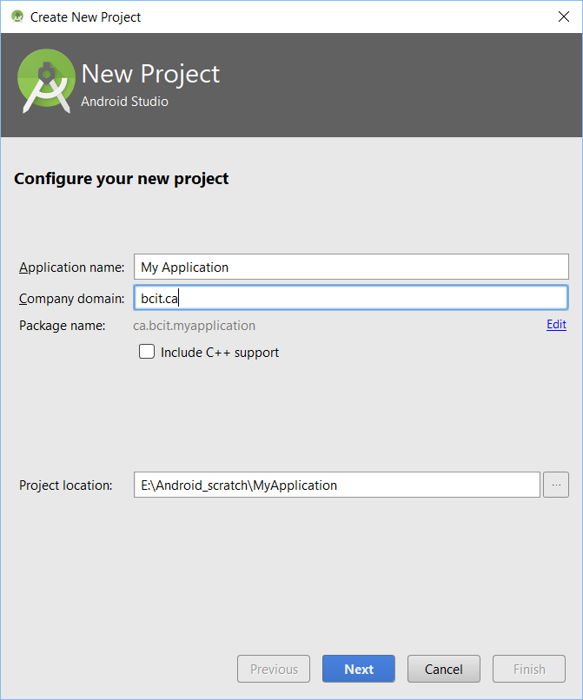
Android Studio: New Project

Slide 11
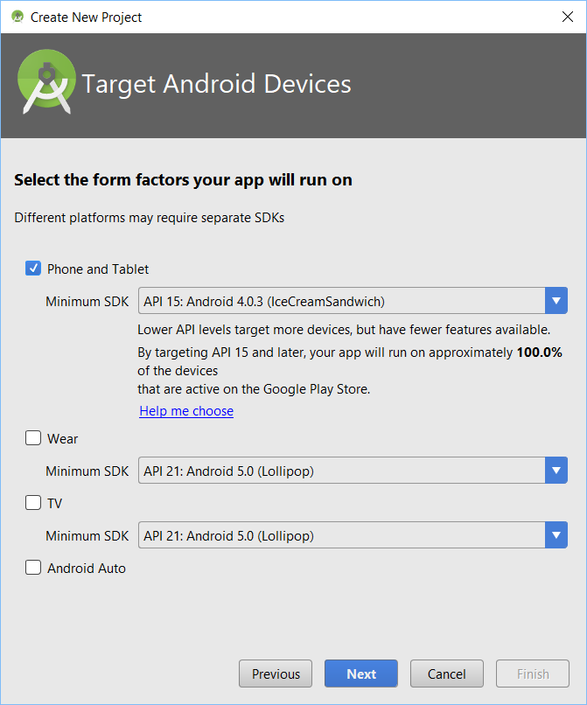
Android Studio: Devices

Slide 12
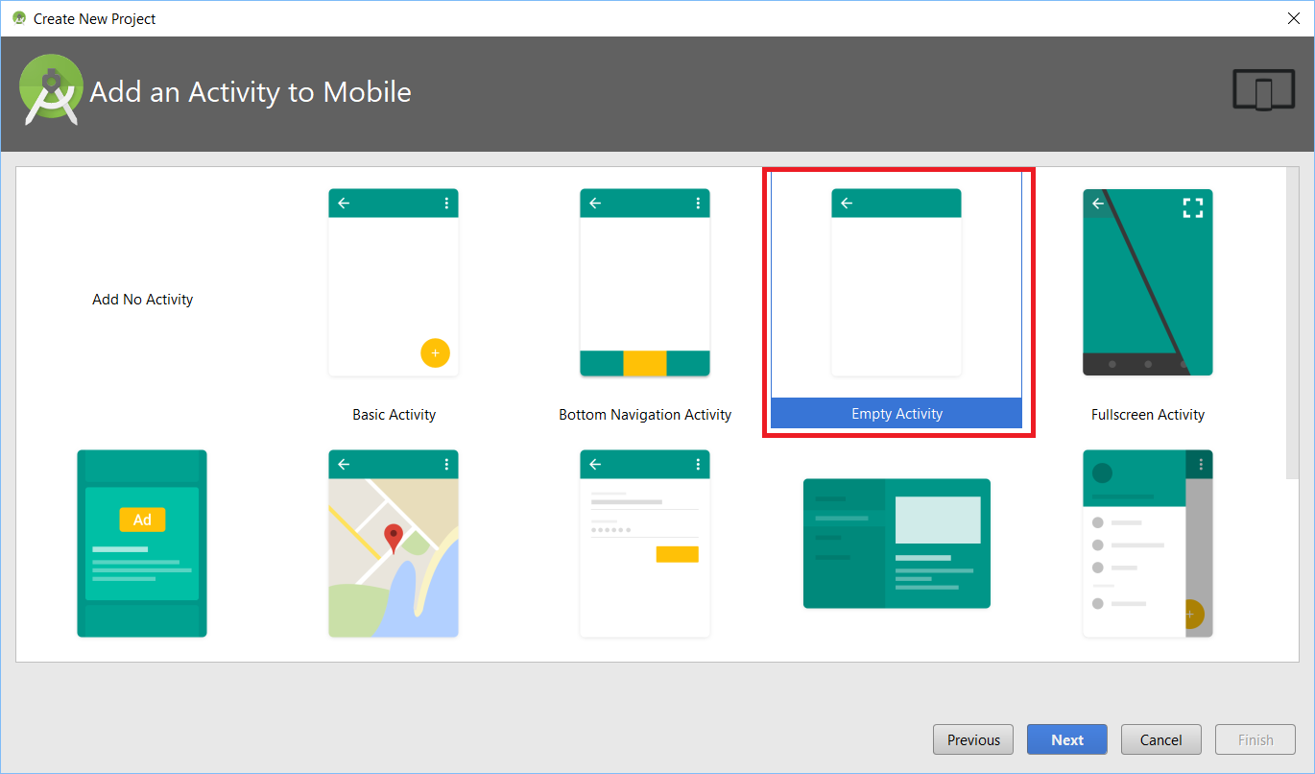
Android Studio: Activity

Slide 13
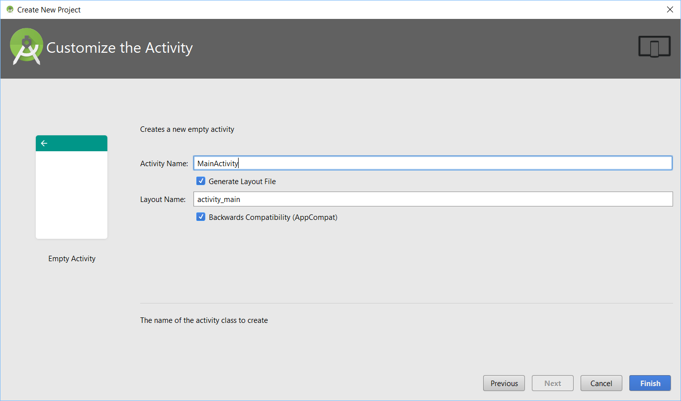
Android Studio: Customize Activity

Slide 14
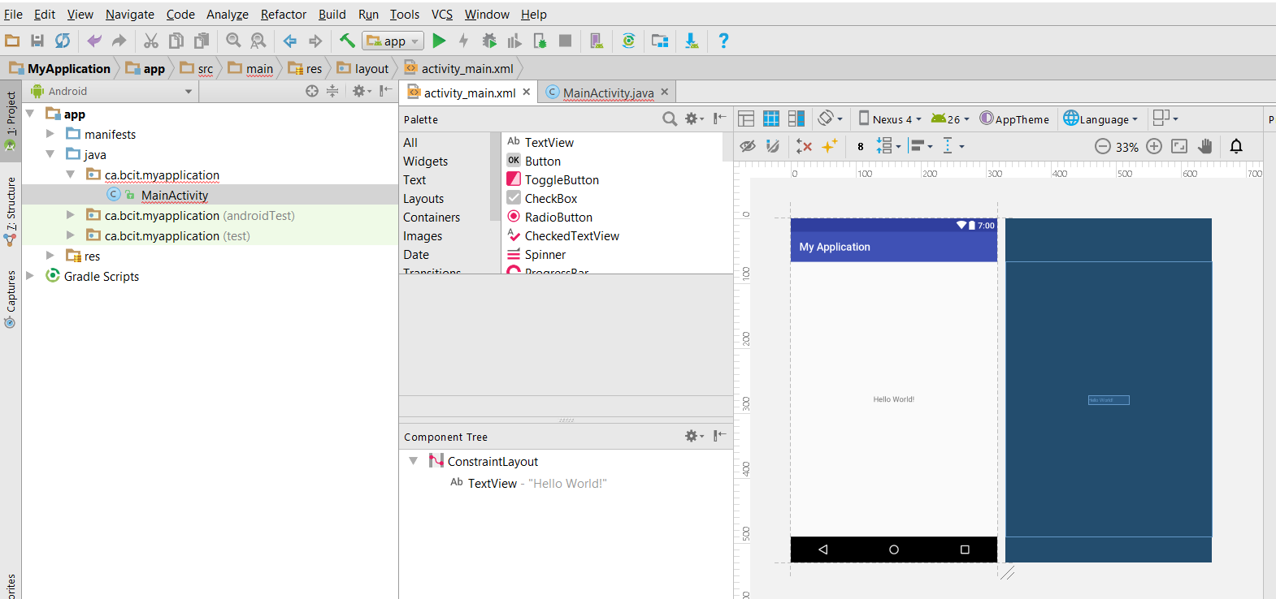
Android Studio: Design surface

Slide 15
Controls
Button or TextView are both subclasses of View
A View occupies a rectangular area on the screen and is responsible for drawing and event handling

Slide 16
Examples of controls
<Spinner
android:id="@+id/spnrMode"
android:layout_width="368dp"
android:layout_height="wrap_content"
android:layout_marginRight="8dp"
app:layout_constraintRight_toRightOf="parent"
android:layout_marginTop="104dp"
app:layout_constraintTop_toBottomOf="@+id/editTextRadius"
android:layout_marginLeft="0dp"
app:layout_constraintLeft_toLeftOf="@+id/textView"
app:layout_constraintHorizontal_bias="1.0" />
<TextView
android:id="@+id/tvResult"
android:layout_width="wrap_content"
android:layout_height="wrap_content"
android:layout_marginLeft="155dp"
android:layout_marginTop="56dp"
android:text=""
app:layout_constraintLeft_toLeftOf="@+id/spnrMode"
app:layout_constraintTop_toBottomOf="@+id/spnrMode" />
<ImageView
android:layout_width="wrap_content"
android:layout_height="wrap_content"
android:contentDescription="@string/photo"
android:src="@drawable/medhat_300x300"
app:layout_constraintLeft_toLeftOf="parent"
app:layout_constraintTop_toBottomOf="@+id/tvResult"/>

Slide 17
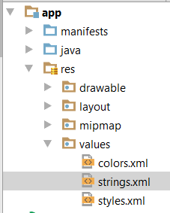
String resources
<resources>
<string name="app_name">ClickEventsApp</string>
<string name="btn1">Button 1</string>
<string name="btn2">Button 2</string>
<string name="btn3">Button 3</string>
<string name="chkMarried">Married</string>
<string name="male">Male</string>
<string name="female">Female</string>
<string-array name="seasons">
<item>Winter</item>
<item>Spring</item>
<item>Summer</item>
<item>Autumn</item>
</string-array>
</resources>
<Spinner
android:id="@+id/spnrSeasons"
android:layout_width="wrap_content"
android:layout_height="wrap_content"
android:entries="@array/seasons"
android:layout_gravity="center"
app:layout_constraintHorizontal_bias="1.0" />

Slide 18
Buttons and click event handler
<TextView
android:layout_width="wrap_content"
android:layout_height="wrap_content"
android:text="Hello World!"
android:id="@+id/helloWorld"/>
<Button
android:id="@+id/clickMe"
android:layout_width="wrap_content"
android:layout_height="wrap_content"
android:text="Click me"
android:onClick="onClickMe" />
public void onClickMe(final View view) {
TextView tv = (TextView) findViewById(R.id.helloWorld);
tv.setText("Button was clicked");
}

Slide 19
Question
How many activities can an Android app have?

Slide 20
Events
<Button
android:layout_width="wrap_content"
android:layout_height="wrap_content"
android:id="@+id/btn1"
android:layout_gravity="center"
android:text="@string/btn1"/>
Button btnSave = (Button) findViewById(R.id.btnSave);
btnSave.setOnClickListener(new View.OnClickListener() {
@Override
public void onClick(View view) {
tvOutput.setText("Button 1 was clicked.");
}
});

