Slide 1
COMP3717
Medhat Elmasry

Slide 2
About me
Name: | Medhat Elmasry
Room: | SW2-121
Email: | medhat_elmasry@bcit.ca
Office Phone: | 604-412-7540
Office Hours: | posted on D2L

Slide 3
What is this course about?
Android app development on mobile and tablet platforms
You will create a number of small Android apps as assignments. This will be done in pairs of students
You will build, package and publish an Android app as a group assignment

Slide 4
Expectations of you
You will be on time (lecture & lab)
You will actively participate (lecture, lab, assignment, project)
You will manage your time effectively
You will ask questions
You will help others whenever you can

Slide 5
Expectations of me
I will be on time (lecture & lab)
I will be available to answer questions
I will offer guidance & help

Slide 6
Resources
Optional Books:
Murach’s Android Programing (2nd Edition)
Head First Android Development (2nd Edition)
Stack Overflow
Good Android Training
http://developer.android.com/training
Android Discuss
https://groups.google.com/d/forum/android-discuss
D2L
Search the internet

Slide 7
Weekly Schedule
Lectures Thursdays & Fridays
2 hours lab

Slide 8
Evaluation
Lab Work | 20%
Assignments | 20%
Group Project | 20%
Mid-term exam | 20%
Final Exam | 20%

Slide 9
Labs (20%)
Labs will be small programming challenges. I will try to relate them to the homework.
If you practice out of class for an hour after each lecture, it will go a long way to helping you in lab.
Labs are 0 or 1. It either works or it does not.

Slide 10
Assignments (20%)
Homework assignments
Due Sunday but checked in lab

Slide 11
Group project (20%)
You will have a 3 person team project
Must be in your set
Teams of 2 allowed only if unable to have teams of 3
You will use Scrum to manage the project (more on this later in this set of slides)
You will provide a working copy of your project
Peer evaluation at the end

Slide 12
Exams (40%)
Midterm and final are both 20% each
You must pass both, on average, to pass course

Slide 13
Scrum
This does not apply until the project starts
Milestones each week with demo on a device
You will put your current build on D2L by 10:00 PM the night before your lab
Slack and Asana are good tools to use
GitHub
Team will hand in a printed status report at start of lab
Not as complicated as it sounds :-)

Slide 14
Tools
Android Studio
https://developer.android.com/sdk/installing/
Make sure your entire project team is using the same version of Android Studio. This is important as it helps avoid issues.
Install a version now and stick with it for the rest of the term.

Slide 15
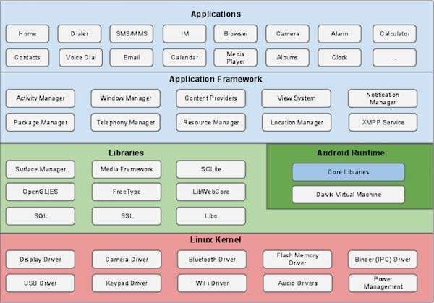
What is Android?

Slide 16
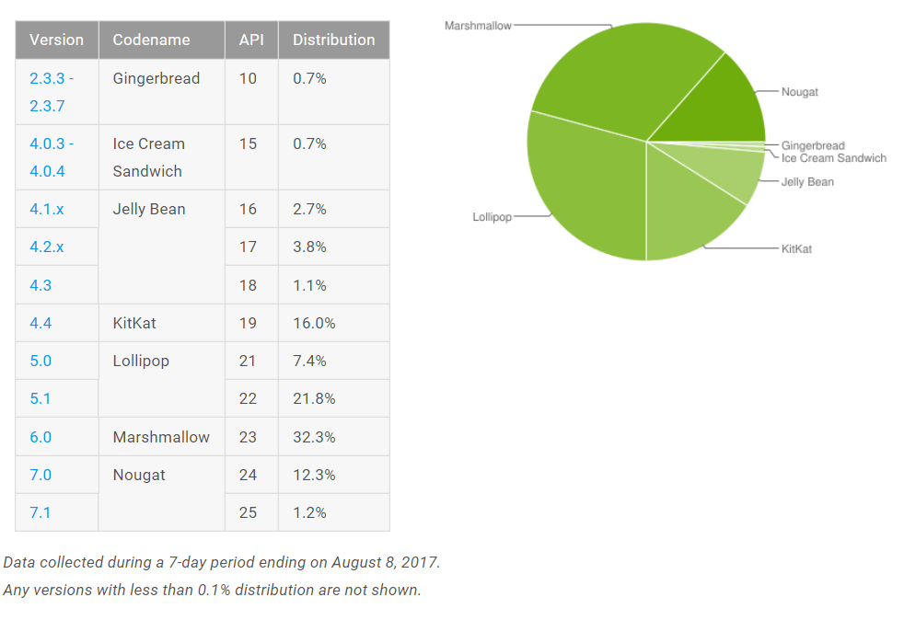
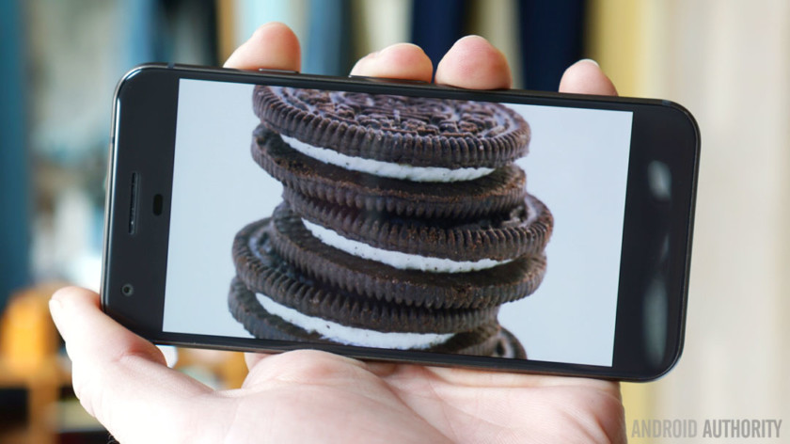
Popular versions of Android
https://developer.android.com/about/dashboards
8.0 Oreo is out
You must write your apps for API level 19 and above.

Slide 17
Devices
Smartphones (and not so smart phones)
Tablets
E-readers
Netbooks
MP4 players
Internet TV
Wearables

Slide 18
Run Android app on your physical device
Enable USB debugging on your device
Settings >> About Phone
Tap the build number 7 times
When you return to the previous screen you will see “Developer Options”
Within “Developer options”, enable USB debugging
Install USB driver on your PC
Plug your device into your PC with a USB cable
Run your app in Android Studio as normal, but target physical device

Slide 19
Homework
Install Android Studio
Get Hello World running
Play around, learn some stuff, have fun.

