Slide 1
Files & adapters
Medhat Elmasry

Slide 2
Objectives
Applied
Given a task that takes more than a few seconds to execute, create a new thread to begin executing that task right away.
Given the URL for a file that’s available from the Internet, write the code that downloads the file from the Internet and saves it to the file system of the Android device.
Given data that’s stored in an array, use an adapter to display the data in a ListView widget and to handle the events that occur on this data.

Slide 3
Objectives
Knowledge
Explain why you should use a separate thread for any task that might slow or stop the responsiveness of the UI thread for an Android app.
In general terms, describe how an asynchronous task works.

Slide 4
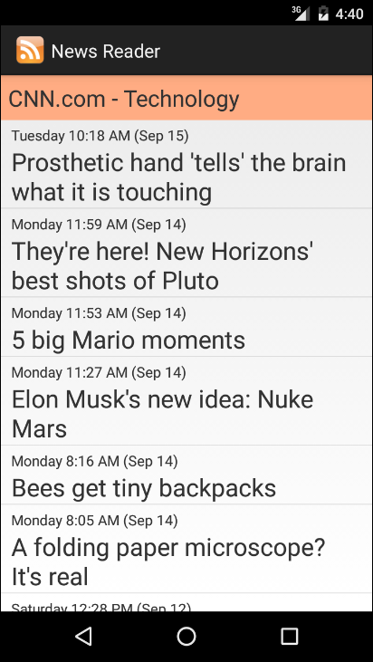
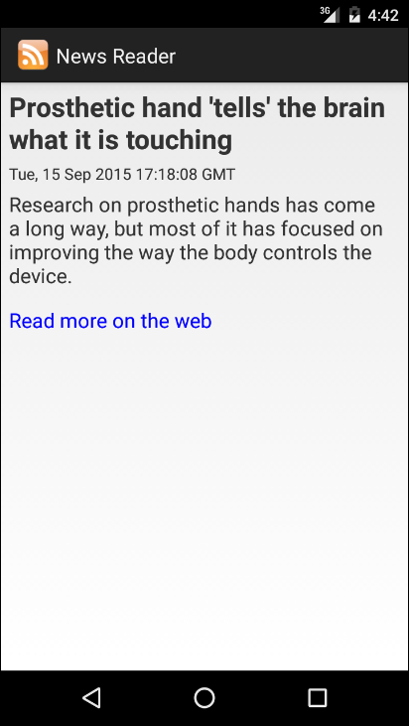
The Items activity
The Item activity

Slide 5
The URL for the RSS feed
http://rss.cnn.com/rss/cnn_tech.rss

Slide 6
Simplified XML for the RSS feed
<rss xmlns:media="http://search.yahoo.com/mrss/"
xmlns:feedburner=
"http://rssnamespace.org/feedburner/ext/1.0"
version="2.0">
<channel>
<title>CNN.com - Technology</title>
<pubDate>Tue, 15 Sep 2015 17:18:54 GMT</pubDate>
<item>
<title>Prosthetic hand 'tells' the brain what it is
touching</title>
<link>http://rss.cnn.com/c/35492/f/676960/s/story01.htm
</link>
<description>Research on prosthetic hands has come a long
way, but most of it has focused on improving the way
the body controls the device.</description>
<pubDate>Tue, 15 Sep 2015 17:18:08 GMT</pubDate>
</item> ......
</channel>
</rss>

Slide 7
How threads improve UI responsiveness

Slide 8
AsyncTask
AsyncTask enables you to implement MultiThreading without getting your hands dirty with threads.
Performs asynchronous tasks (I.E. operations in the background)
You create an AsyncTask by extending the AsyncTask class and implementing the doInBackground() method. The code in this method runs the background thread
The AsyncTask class also has the onPreExecute() method that runs before doInBackground() and onPostExecute() method that runs afterward.
There is an onProgressUpdate() method if you need to display progress

Slide 9
AsyncTask
Add AsyncTask class as an inner class to the activity that needs to use it.
private class MyAsyncTask extends AsyncTask<Params, Progress, Result> {
protected void onPreExecute() {
// code to run before executing the task
}
protected Result doInBackground(Params... params) {
// code that you want to run in a background thread
}
protected void onProgressUpdate(Progress... values) {
// code that you want to run to publish the progress of your task
}
protected void onPostExecute(Result result) {
// code to run when the task is complete
}
}
This method is optional
This method is also optional

Slide 10
AsyncTask parameters
AsynsTask is defined by three generic parameters:
Params: type of object used to pass any task parameters to the doInBackground() method
Progress: type of object used to indicate task progress
Results: type of task result

Slide 11
AsyncTask
private class MyAsyncTask extends AsyncTask<Params, Progress, Result> {
protected void onPreExecute() {
// code to run before executing the task
}
protected Result doInBackground(Params... params) {
// code that you want to run in a background thread
}
protected void onProgressUpdate(Progress... values) {
// code that you want to run to publish the progress of your task
}
protected void onPostExecute(Result result) {
// code to run when the task is complete
}
}

Slide 12
An activity with a nested AsyncTask class
public class ItemsActivity extends Activity {
private static String URL_STRING = "http://rss.cnn.com/rss/cnn_tech.rss";
@Override
protected void onCreate(Bundle savedInstanceState) {
super.onCreate(savedInstanceState);
setContentView(R.layout.activity_items);
new DownloadFeed().execute(URL_STRING);
}
class DownloadFeed extends AsyncTask<String, Void, String> {
@Override
protected String doInBackground(String... params) {
// get the parameter
String urlString = params[0];
// download the feed and write it to a file
// return a message
return "Feed downloaded";
}
@Override
protected void onPostExecute(String result) {
Context context = ItemsActivity.this;
Toast.makeText(context, result, Toast.LENGTH_LONG).show();
}
}
}

Slide 13
The generic types for the AsyncTask class
AsyncTask<Params, Progress, Result>
Possible class declarations
class DownloadFeed extends AsyncTask<String, Integer, String> {}
class DownloadFeed extends AsyncTask<URL, Void, String> {}
class DownloadFeed extends AsyncTask<Void, Void, Void> {}
class ReadFeed extends AsyncTask<String, Integer, RSSFeed> {}
The AsyncTask class
Method | Is executed…
onPreExecute() | On the UI thread.
doInBackground(Params...) | On the background thread.
onProgressUpdate(Progress...) | On the UI thread.
onPostExecute(Result) | On the UI thread.

Slide 14
The classes for downloading from the Internet
java.net.URL
android.content.Context

Slide 15
How to download a file from the Internet
final String FILENAME = "news_feed.xml";
try {
// get the input stream
URL url = new URL("http://rss.cnn.com/rss/cnn_tech.rss");
InputStream in = url.openStream();
// get the output stream
FileOutputStream out = openFileOutput(FILENAME, Context.MODE_PRIVATE);
// read input and write output
byte[] buffer = new byte[1024];
int bytesRead = in.read(buffer);
while (bytesRead != -1) {
out.write(buffer, 0, bytesRead);
bytesRead = in.read(buffer);
}
out.close();
in.close();
} catch (IOException e) {
Log.e("News reader", e.toString());
}

Slide 16
A method of the URL class
openStream()
INTERNET permission in AndroidManifest.xml
<uses-permission android:name="android.permission.INTERNET" />
A method of the Context class
openFileOutput(filename, mode)

Slide 17
The classes used to work with SAX
javax.xml.parsers.SAXParser
javax.xml.parsers.SAXParserFactory
org.xml.sax.InputSource
org.xml.sax.XMLReader

Slide 18
How to parse an XML file
final String FILENAME = "news_feed.xml";
RSSFeed feed;
try {
// get the XML reader
SAXParserFactory factory = SAXParserFactory.newInstance();
SAXParser parser = factory.newSAXParser();
XMLReader xmlreader = parser.getXMLReader();
// set content handler
RSSFeedHandler theRssHandler = new RSSFeedHandler();
xmlreader.setContentHandler(theRssHandler);
// get the input stream
FileInputStream in = openFileInput(FILENAME);
// parse the data
InputSource is = new InputSource(in);
xmlreader.parse(is);
// get the content handler and return it
feed = theRssHandler.getFeed();
} catch (Exception e) {
Log.e("News reader", e.toString());
}

Slide 19
A method of the Context class
openFileInput(filename)

Slide 20
Constructor for SimpleAdapter class
Parameter | Description
context | The context of the View associated with this SimpleAdapter object.
data | A List object that contains Map objects that contain the data for the items in the list.
resource | The ID of a layout for each item in the list.
from | An array of column names that are in the Map objects.
to | An array of IDs for the widgets that should display the data.

Slide 21
How to handle events for an adapter
Step 1: Import the interface for the listener
import android.widget.AdapterView.OnItemClickListener;
Step 2a: Implement the interface for the listener
public class ItemsActivity extends Activity
implements OnItemClickListener {
Step 2b: Implement the interface for the listener
@Override
public void onItemClick(AdapterView<?> parent, View v, int position, long id) {
// get item at position
RSSItem item = feed.getItem(position);
}
Step 3: Set the listeners
itemsListView.setOnItemClickListener(this);

Slide 22
Code in the ItemsActivity class
// create the intent
Intent intent = new Intent(this, ItemActivity.class);
// put data in the intent
intent.putExtra("title", item.getTitle());
intent.putExtra("position", position);
// start the intent
this.startActivity(intent);
Code in the ItemActivity class
// get the intent
Intent intent = getIntent();
// get data from the intent
String pubDate = intent.getStringExtra("pubDate");
int position = intent.getIntExtra("position", 0);

