Slide 1
Layouts & Widgets
Medhat Elmasry

Slide 2
Padding
Layout
Space between a view’s sides and its parent.
<LinearLayout ...
android:paddingBottom="8db"
android:paddingLeft="16db"
android:paddingRight="24db"
android:paddingTop="32db">
</LinearLayout>
<LinearLayout ...
android:padding="16db">
</LinearLayout>
padding

Slide 3
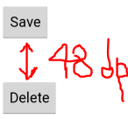
Margins
Use margins to add distance between views
<Button
android:layout_width="wrap_content"
android:layout_height="wrap_content"
android:onClick="onBackClick"
android:layout_marginTop="48dp"
android:text="Delete" />

Slide 4
Margin Attributes
Attribute | What it does
android:marginTop | Adds extra space to the top of the view.
android:marginBottom | Adds extra space to the bottom of the view.
android:marginLeft | Adds extra space to the left of the view.
android:marginRight | Adds extra space to the right of the view.

Slide 5
Dimension resource file
Can specify dimensions in a dimension resource file
app/src/main/res/values/dimens.xml
<Button
android:id="@+id/send"
android:layout_width="wrap_content"
android:layout_height="wrap_content"
android:layout_alignParentLeft="true"
android:layout_alignParentTop="true"
android:layout_marginTop="21dp"
android:layout_marginLeft="36dp"
android:onClick="onSendMessage"
android:text="@string/send"
android:paddingLeft="@dimen/horizontal_padding"
android:paddingTop="@dimen/vertical_padding"/>
<?xml version="1.0" encoding="utf-8"?>
<resources>
<dimen name="horizontal_padding">16dp</dimen>
<dimen name="vertical_padding">16dp</dimen>
</resources>

Slide 6
Layouts covered
Layout | Lays out widgets…
RelativeLayout | Relative to one another.
LinearLayout | In a vertical or horizontal line.
GridLayout | Divides the screen into a grid of rows and columns.
TableLayout | In a table.
FrameLayout | In a stack where one widget is on top of the other.
ConstraintLayout | Add constraints to define the view's position by dragging an anchor line to other elements in the layout

Slide 7
RelativeLayout attributes
Attribute | What it does
android:layout_alignParentBottom | Aligns the bottom edge of the view to the bottom edge of the parent.
android:layout_alignParentLeft | Aligns the left edge of the view to the left edge of the parent.
android:layout_alignParentRight | Aligns the right edge of the view to the right edge of the parent.
android:layout_alignParentTop | Aligns the top edge of the view to the top edge of the parent.
android:layout_centerInParent | Centers the view horizontally and vertically in the parent.
android:layout_centerHorizontal | Centers the view horizontally in the parent.
android:layout_centerVertical | Centers the view vertically in the parent.

Slide 8
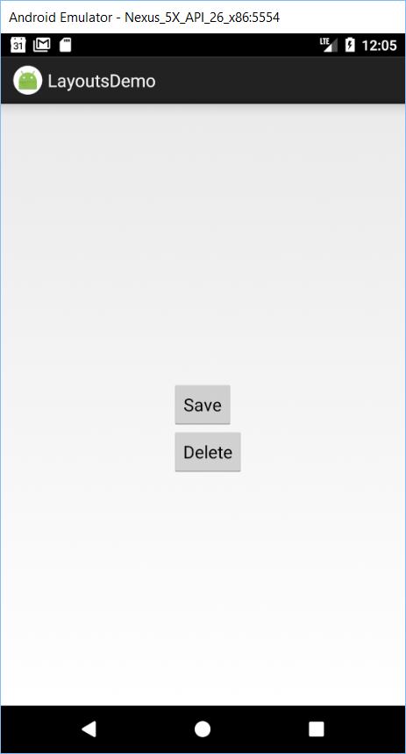
Positioning views relative to other views
<RelativeLayout ....>
<Button
android:id="@+id/btnSave"
android:layout_width="wrap_content"
android:layout_height="wrap_content"
android:layout_centerInParent="true"
android:text="@string/save" />
<Button
android:id="@+id/btnDelete"
android:layout_width="wrap_content"
android:layout_height="wrap_content"
android:layout_alignLeft="@id/btnSave"
android:layout_below="@id/btnSave"
android:text="@string/delete" />
</RelativeLayout>

Slide 9
Attributes for positioning views relative to other views
Attribute | What it does
android:layout_above | Puts the view above the view you are anchoring it to.
android:layout_below | Puts the view below the view you are anchoring it to.
android:layout_alignTop | Aligns the top edge of the view to the top edge of the view you are anchoring to.
android:layout_alignBottom | Aligns the bottom edge of the view to the bottom edge of the view you are anchoring to.
android:layout_alignLeft | Aligns the left edge of the view to the left edge of the view you are anchoring to.
android:layout_alignRight | Aligns the right edge of the view to the right edge of the view you are anchoring to.
android:layout_toLeftOf | Puts the right edge of the view to the left of the view you are anchoring it to.
android:layout_toRightOf | Puts the left edge of the view to the right of the view you are anchoring it to.

Slide 10
A list of widgets
TextView
EditText
Button
CheckBox
RadioButton
Spinner
ProgressBar
SeekBar
RatingBar
ImageView
ImageButton
DatePicker
TimePicker
CalendarView
ScrollView
WebView

Slide 11
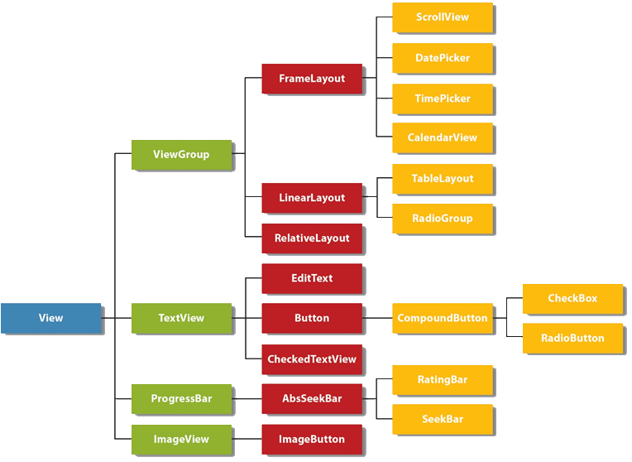
The View Hierarchy

Slide 12
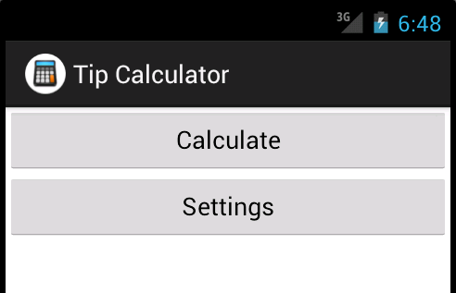
Linear layout with vertical orientation & 2 buttons

Slide 13
The XML for the linear layout
<?xml version="1.0" encoding="utf-8"?>
<LinearLayout xmlns:android=
"http://schemas.android.com/apk/res/android"
android:layout_width="match_parent"
android:layout_height="match_parent"
android:orientation="vertical" >
<Button
android:id="@+id/calculateTipButton"
android:layout_width="match_parent"
android:layout_height="wrap_content"
android:text="@string/calculate_tip" />
<Button
android:id="@+id/settingsButton"
android:layout_width="match_parent"
android:layout_height="wrap_content"
android:text="@string/settings" />
</LinearLayout>

Slide 14
Common attributes with linear layouts
orientation
weight
gravity

Slide 15

Horizontal layout where buttons have no weight
The orientation attribute for the layout
android:orientation="horizontal"

Slide 16
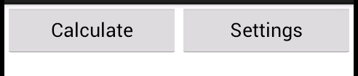
Horizontal layout where buttons have equal weight
The weight attribute for both buttons
android:weight="1"

Slide 17
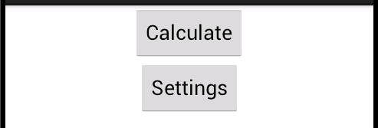
Vertical layout where buttons are centered horizontally
The gravity attribute for both buttons
android:gravity="center"

Slide 18
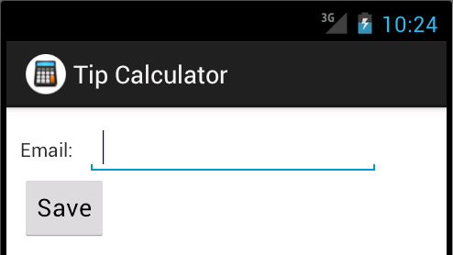
Nested linear layouts
<?xml version="1.0" encoding="utf-8"?>
<LinearLayout xmlns:android=
"http://schemas.android.com/apk/res/android"
android:layout_width="match_parent"
android:layout_height="match_parent"
android:orientation="vertical"
android:padding="10dp" >
<!-- the first row -->
<LinearLayout
android:layout_width="match_parent"
android:layout_height="wrap_content"
android:orientation="horizontal" >
<!-- widgets go here -->
</LinearLayout>
<!-- the second row -->
<LinearLayout
android:layout_width="match_parent"
android:layout_height="wrap_content"
android:orientation="horizontal" >
<!-- widgets go here -->
</LinearLayout>
</LinearLayout>

Slide 19
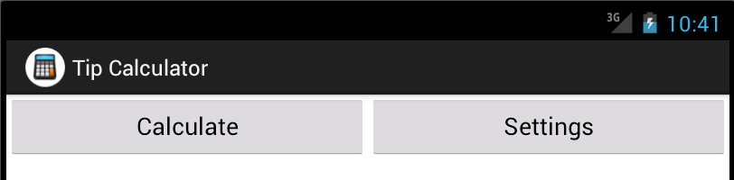
Linear layout with landscape orientation & 2 buttons
The location of the XML files
Portrait
res/layout/settings_activity.xml
Landscape
res/layout-land/settings_activity.xml

Slide 20
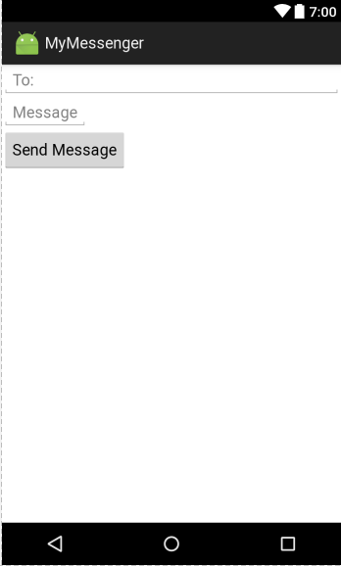
LinearLayout example
<EditText
android:id="@+id/editText2"
android:layout_width="match_parent"
android:layout_height="wrap_content"
android:hint="@string/to" />
<EditText
android:layout_width=" match_parent "
android:layout_height="wrap_content"
android:hint="@string/message" />
<Button
android:id="@+id/button"
android:layout_width="wrap_content"
android:layout_height="wrap_content"
android:text="@string/send" />
We need to streeeeeeeetch message and push button to the bottom

Slide 21
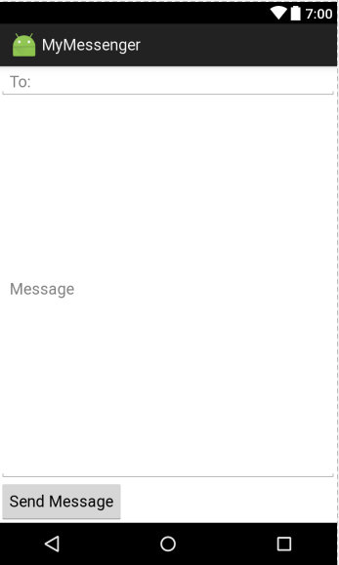
layout_weight (example 1)
<EditText
android:id="@+id/editText2"
android:layout_width="match_parent"
android:layout_height="wrap_content"
android:hint="@string/to" />
<EditText
android:layout_width="match_parent"
android:layout_height="0dp"
android:layout_weight="1"
android:hint="@string/message" />
<Button
android:id="@+id/button"
android:layout_width="wrap_content"
android:layout_height="wrap_content"
android:text="@string/send" />
This view is the only one with any weight so it will expand to fill space that’s not needed by any other views.

Slide 22
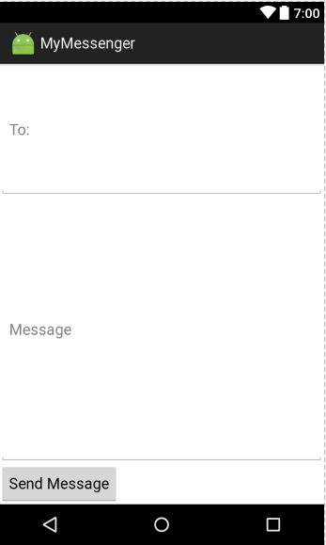
layout_weight (example 2)
<EditText
android:id="@+id/editText2"
android:layout_width="match_parent"
android:layout_height="0dp"
android:layout_weight="1"
android:hint="@string/to" />
<EditText
android:layout_width="match_parent"
android:layout_height="0dp"
android:layout_weight="2"
android:hint="@string/message" />
<Button
android:id="@+id/button"
android:layout_width="wrap_content"
android:layout_height="wrap_content"
android:text="@string/send" />
Weight of 1 so it takes 1/3 of extra space.
Weight of 2 so it takes 2/3 of extra space.

Slide 23
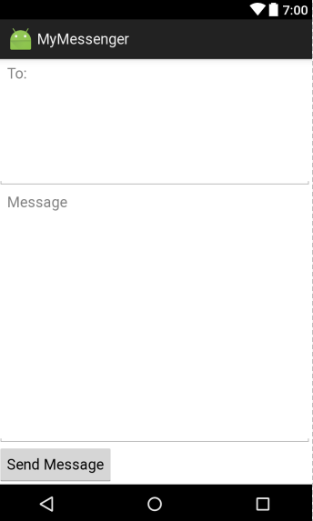
gravity
The android:gravity attribute specifies how to position the contents of a view inside the view.
<EditText
android:id="@+id/editText2"
android:layout_width="match_parent"
android:layout_height="0dp"
android:layout_weight="1"
android:hint="@string/to"
android:gravity="top"/>
<EditText
android:layout_width="match_parent"
android:layout_height="0dp"
android:layout_weight="2"
android:hint="@string/message"
android:gravity="top" />

Slide 24
Values used with android:gravity attribute
Value | What it does
top, bottom, left, right | Puts view contents at top, bottom, left, or right of view
start, end | Puts view contents at start or end of view
center_vertical, center_horizontal | Centers view contents vertically or horizontally
center | Centers view contents vertically & horizontally
fill_vertical, fill_horizontal | Makes view contents fill view vertically or horizontally
fill | Makes view contents fill view vertically & horizontally
You can apply multiple gravities to a view by separating each value with “|”

Slide 25
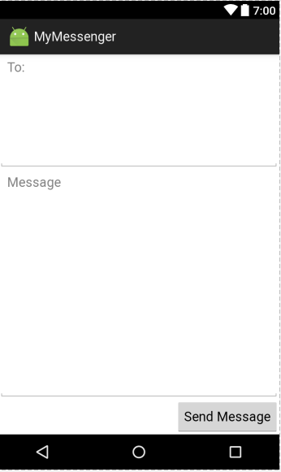
layout:gravity
The android:gravity attribute specifies where you want a view in a linear layout to appear in its enclosing space
<Button
android:id="@+id/button"
android:layout_width="wrap_content"
android:layout_height="wrap_content"
android:layout_gravity="end"
android:text="@string/send"/>

Slide 26
Values used with android:gravity attribute
Value | What it does
top, bottom, left, right | Puts view at top, bottom, left or right of its available space.
start, end | Puts view at start or end of its available space.
center_vertical, center_horizontal | Centers view vertically or horizontally in its available space.
center | Center view vertically and horizontally in its available space
fill_vertical, fill_horizontal | Grows view so that it fills its available space vertically or horizontally.
fill | Grows view so that it fills its available space vertically and horizontally.

Slide 27
GridLayout
A grid layout splits the screen up into a grid of rows and columns, and allocates views to cells.

Slide 28
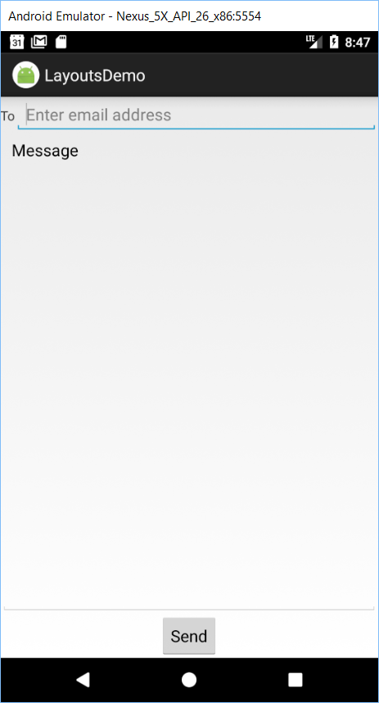
GridLayout example
<GridLayout . . . . .
android:columnCount="2" >
<TextView
android:layout_width="wrap_content" android:layout_height="wrap_content"
android:layout_row="0" android:layout_column="0"
android:text="@string/to" />
<EditText
android:layout_width="wrap_content" android:layout_height="wrap_content"
android:layout_gravity="fill_horizontal"
android:layout_row="0" android:layout_column="1"
android:hint="@string/to_hint" />
<EditText
android:layout_width="wrap_content" android:layout_height="wrap_content"
android:layout_gravity="fill"
android:gravity="top"
android:layout_row="1" android:layout_column="0"
android:layout_columnSpan="2" android:text="@string/message" />
<Button
android:layout_width="wrap_content" android:layout_height="wrap_content"
android:layout_row="2" android:layout_column="0"
android:layout_gravity="center_horizontal"
android:layout_columnSpan="2"
android:text="@string/send" />
</GridLayout>

Slide 29
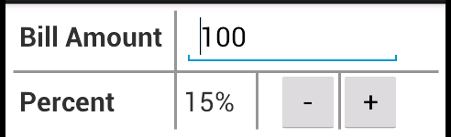
TableLayout
TableLayout positions its children into rows and columns.
Border lines are not displayed
A table layout with two rows and four columns
Common attributes
layout_span

Slide 30
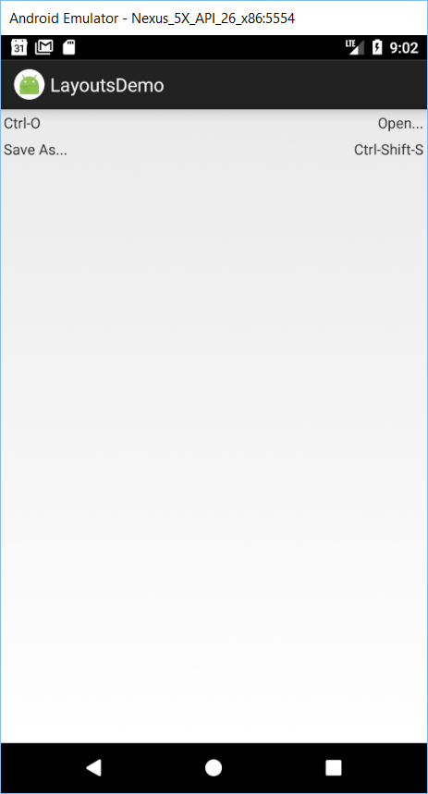
TableLayout example
<TableLayout ....
android:stretchColumns="1">
<TableRow>
<TextView
android:text="@string/open_shortcut"
android:padding="3dip"/>
<TextView
android:text="@string/open"
android:gravity="right"
android:padding="3dip"/>
</TableRow>
<TableRow>
<TextView
android:text="@string/save_as"
android:padding="3dip"/>
<TextView
android:text="@string/save_as_shortcut"
android:gravity="right"
android:padding="3dip"/>
</TableRow>
</TableLayout>

Slide 31
EditText view
<EditText
android:id="@+id/emailEditText"
android:layout_width="wrap_content"
android:layout_height="wrap_content"
android:ems="10"
android:inputType="textEmailAddress">
<requestFocus />
</EditText>
Two attributes of an EditText widget
inputType
lines

Slide 32
Common values for inputType attribute
text
textPersonName
textEmailAddress
textPassword
textMultiline
number
numberDecimal
phone
date
time

Slide 33

A check box
A common XML attribute for check boxes
checked
The XML code
<CheckBox
android:id="@+id/rememberPercentCheckBox"
android:layout_width="wrap_content"
android:layout_height="wrap_content"
android:checked="true"
android:text="@string/remember_percent

Slide 34
Two common Java methods for check boxes
setChecked(boolean)
isChecked()
Two Java examples
Check or uncheck the box
rememberPercentCheckBox.setChecked(true);
Execute code if the box is checked
if (rememberPercentCheckBox.isChecked()) {
// code to execute when the box is checked
}
else {
// code to execute when the box is NOT checked
}

Slide 35
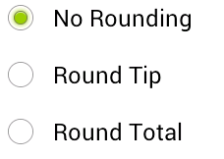
Three radio buttons in a radio group with
vertical orientation
horizontal orientation

Slide 36
The XML code for three radio buttons
<RadioGroup
android:id="@+id/roundingRadioGroup"
android:layout_width="wrap_content"
android:layout_height="wrap_content"
android:orientation="vertical" >
<RadioButton
android:id="@+id/noRoundingRadioButton"
android:layout_width="wrap_content"
android:layout_height="wrap_content"
android:checked="true"
android:text="@string/round_no" />
<RadioButton
android:id="@+id/roundTipRadioButton"
android:layout_width="wrap_content"
android:layout_height="wrap_content"
android:text="@string/round_tip" />
<RadioButton
android:id="@+id/roundTotalRadioButton"
android:layout_width="wrap_content"
android:layout_height="wrap_content"
android:text="@string/round_total" />
</RadioGroup>

Slide 37
Two Java examples for radio buttons
Check or uncheck the radio button
RoundTipRadioButton.setChecked(true);
Execute code if a radio button is checked
if (roundTipRadioButton.isChecked()) {
// code to execute when the button is checked
}

Slide 38
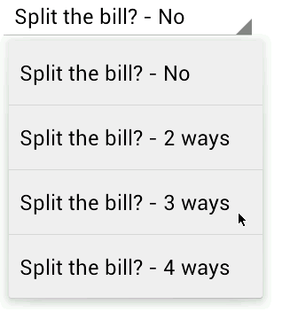
spinner
The XML code
<Spinner
android:id="@+id/splitSpinner"
android:layout_width="wrap_content"
android:layout_height="wrap_content" />
The array in the strings.xml file
<string-array name="split_array">
<item>Split the bill? - No</item>
<item>Split the bill? - 2 ways</item>
<item>Split the bill? - 3 ways</item>
<item>Split the bill? - 4 ways</item>
</string-array>

Slide 39
Common methods of the ArrayAdapter class
createFromResource(context, arrayID, layoutID)
setDropDownViewResource(resourceID)
Common methods for spinners
setAdapter(arrayAdapter)
setSelection(index)
getSelectedItemPosition()
getSelectedItem()
Two Android resources for spinner layouts
android.R.layout.simple_spinner_item
android.R.layout.simple_spinner_dropdown_item

Slide 40
Java examples for spinners
Code that sets up the spinner
// get a reference to the spinner
splitSpinner = (Spinner) findViewById(R.id.splitSpinner);
// create array adapter for specified array and layout
ArrayAdapter<CharSequence> adapter =
ArrayAdapter.createFromResource(this, R.array.split_array, android.R.layout.simple_spinner_item);
// set the layout for the drop-down list
adapter.setDropDownViewResource(android.R.layout.simple_spinner_dropdown_item);
// set the adapter for the spinner
splitSpinner.setAdapter(adapter);

Slide 41
Java examples for spinners (continued)
Code that selects an item
splitSpinner.setSelection(0) // select the first item
Code that gets the position of the selected item
int position = splitSpinner.getSelectedItemPosition();
Code that gets the selected text from the selected item
String selectedText = (String) splitSpinner.getSelectedItem();

Slide 42

A seek bar and a text view
Two common XML attributes for seek bars
max
progress
The XML code for a seek bar and a text view
<SeekBar
android:id="@+id/percentSeekBar"
android:layout_width="200dp"
android:layout_height="wrap_content"
android:max="30"
android:progress="15" />
<TextView
android:id="@+id/percentTextView"
android:layout_width="0dp"
android:layout_height="wrap_content"
android:text="@string/percent" />

Slide 43
Two common Java methods for seek bars
setProgress(int)
getProgress()
Java examples
How to set progress
percentSeekBar.setProgress(20);
How to get progress
int percent = percentSeekBar.getProgress();

Slide 44
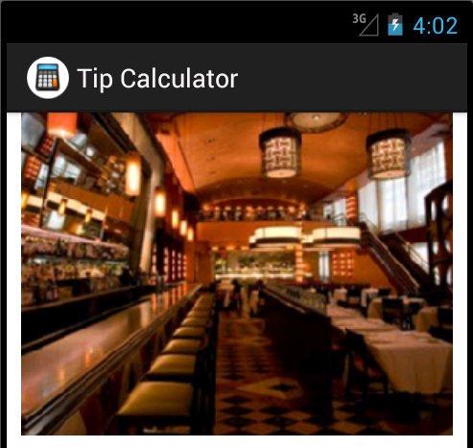
Images
Types of images supported by Android
PNG (recommended)
JPG (acceptable)
GIF (discouraged)

Slide 45
drawable folder
The location of the image file
res/drawable-mdpi/restaurant.jpg
Four qualifiers for the drawable folder
Qualifier | Description
xhdpi | Extra high-density screen (approximately 320dpi).
hdpi | High-density screen (approximately 240dpi).
mdpi | Medium-density screen (approximately 160dpi).
ldpi | Low-density screen (approximately 120dpi).
Android Asset Studio Online: https://androidassetstudio.net/

Slide 46
Two attributes of an ImageView widget
contentDescription
src
The XML code
<ImageView
android:layout_width="match_parent"
android:layout_height="wrap_content"
android:contentDescription="@string/photo"
android:src="@drawable/restaurant" />

Slide 47
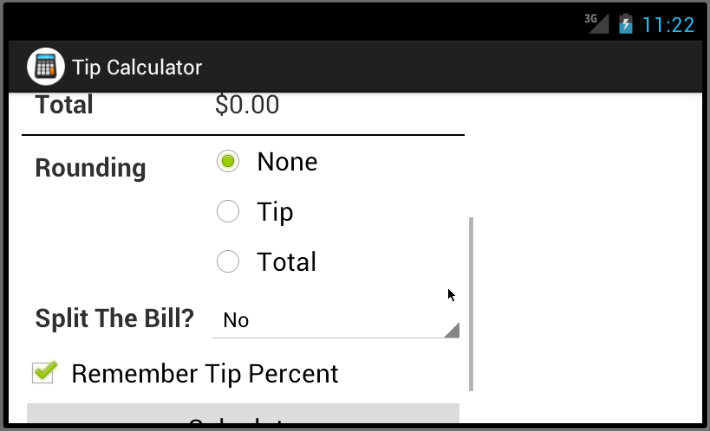
A scrollable layout

Slide 48
The XML for vertical scroll bars
<ScrollView xmlns:android="http://schemas.android.com/apk/res/android"
android:layout_width="wrap_content"
android:layout_height="wrap_content">
<TableLayout
android:layout_width="match_parent"
android:layout_height="wrap_content"
android:padding="10dp" >
<!-- All table rows and widgets go here -->
</TableLayout>
</ScrollView>
Types of scroll bars
Widget name | Scroll bar type
ScrollView | Vertical
HorizontalScrollView | Horizontal

Slide 49

A web view
The Android manifest
An element that must be added just before the application element
An attribute that you often want to add to the activity element
<uses-permission android:name="android.permission.INTERNET" />
"orientation" to prevent restarts when screen orientation changes and "keyboardHidden" to prevent restarts when keyboard availability changes and "screenSize" to prevent restarts when screen size changes.
<activity
android:name="com.murach.books.MainActivity"
android:label="@string/title_activity_main"
android:configChanges="keyboardHidden|
orientation|screenSize">

Slide 50

The layout of the activity
<FrameLayout
xmlns:android="http://schemas.android.com/apk/res/android"
xmlns:tools="http://schemas.android.com/tools"
android:layout_width="match_parent"
android:layout_height="match_parent"
tools:context="com.murach.books.MainActivity">
<WebView
android:layout_width="match_parent"
android:layout_height="match_parent"
android:id="@+id/webView" />
<ProgressBar
android:layout_width="wrap_content"
android:layout_height="wrap_content"
android:id="@+id/progressBar"
android:layout_gravity="center" />
</FrameLayout>

Slide 51
Code from the onCreate method of the activity
Get references to the web view and progress bar
WebView webView = (WebView) findViewById(R.id.webView);
final ProgressBar progressBar = (ProgressBar) findViewById(R.id.progressBar);
Enable JavaScript for the web view
webView.getSettings().setJavaScriptEnabled(true);
Load URLs in the web view, not in browser app
webView.setWebViewClient(new WebViewClient() {
@Override
public boolean shouldOverrideUrlLoading(WebView view,
String url) {
return false;
}
});

Slide 52
Code from the onCreate method (continued)
Display the progress bar until the page is 100% loaded
webView.setWebChromeClient(new WebChromeClient() {
public void onProgressChanged(WebView view, int progress) {
if (progress == 100) {
progressBar.setVisibility(View.GONE);
}
else {
progressBar.setVisibility(View.VISIBLE);
}
}
});
Load the content from the specified URL into the web view
webView.loadUrl("http://www.bcit.ca/");

