Slide 1
Activity Lifecycle (The circle of life)
Medhat Elmasry

Slide 2
Life Cycle
The steps that an application goes through from starting to finishing
Slightly different than normal Java life cycle due to :
the difference in the way Android application are defined
the limited resources of the Android hardware platform

Slide 3
Life Cycle
Each application runs in its own process.
Each activity of an app is run in the apps process
Processes are started and stopped as needed to run an apps components.
Processes may be killed to reclaim needed resources.
Killed apps may be restored to their last state when requested by the user

Slide 4
Separation
Each app runs in a sandbox, all be itself
You can use an Intent to start a different Activity. That Activity can be in another app.
When an Activity is started, onCreate() is called

Slide 5
Management
Most management of the life cycle is done automatically by the system via the activity stack.
The activity class has the following method callbacks to help you manage the app:
onCreate()
onStart()
onResume()
onPause()
onStop()
onRestart()
onDestroy()

Slide 6
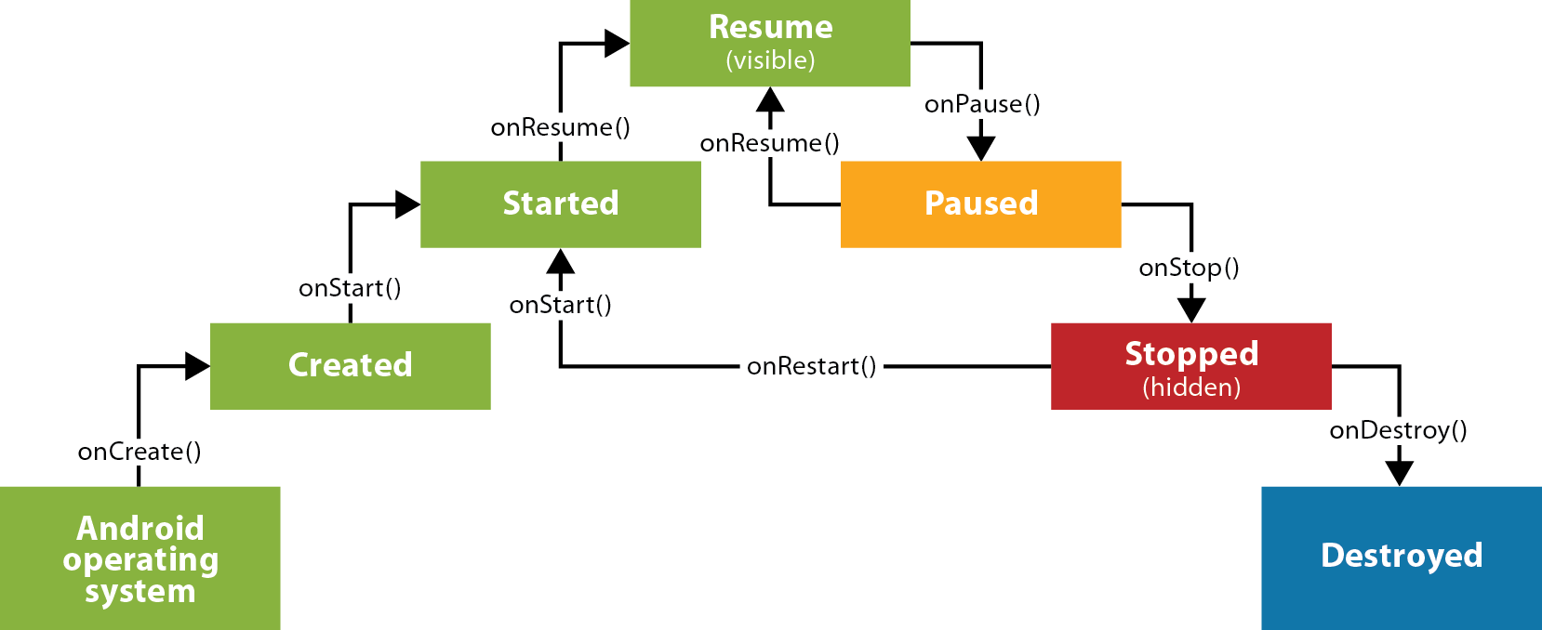
The lifecycle of an activity

Slide 7
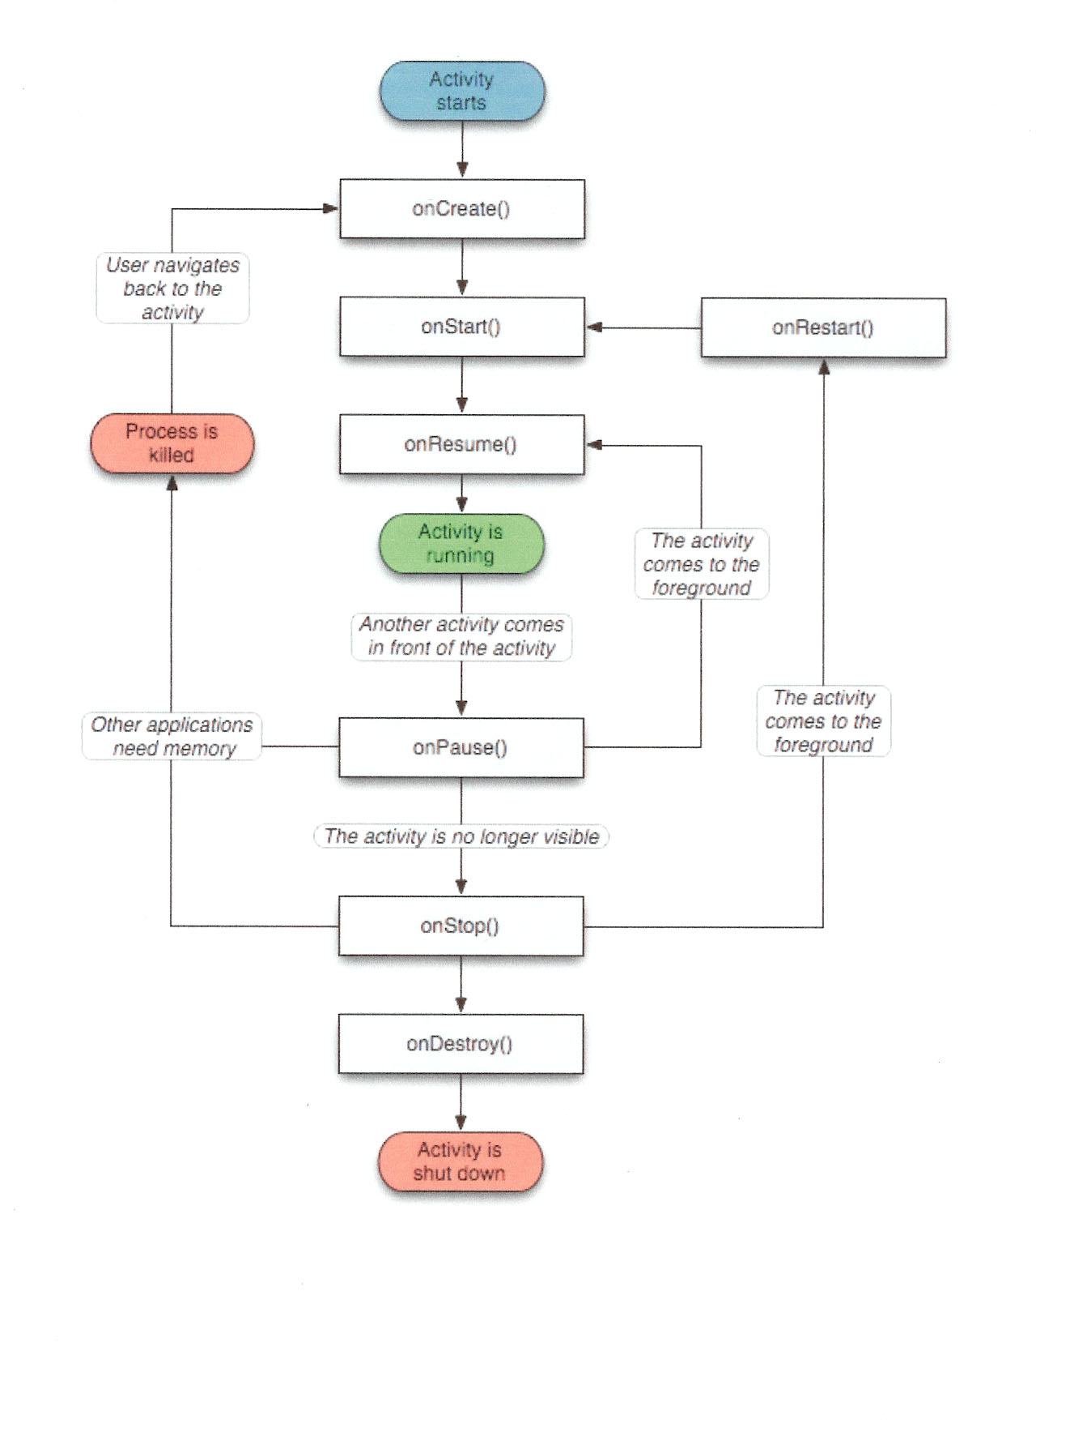

Slide 8
using the callbacks
To use a callback just overload it in your activity java file.
The lifecycle is explained very well here: http://developer.android.com/training/basics/activity-lifecycle/index.html
The use of the callbacks is explained in the api documentation for the activity class: http://developer.android.com/reference/android/app/Activity.html

Slide 9
Basic Lifecycle
Activity launched
onCreate
Activity running
onDestroy
Activity destroyed

Slide 10
Three common states
State | Description
Resumed | This state is also known as the active state or the running state. A running activity is visible and has the focus.
Paused | A paused activity has lost the focus and may be partially hidden by other activities, or the device has gone to sleep.
Stopped | The activity has lost the focus and is completely hidden by another activity.

Slide 11
Lifecycle methods
Method | When it’s called | Next method
onCreate() | when activity is first created | onStart()
onRestart() | after activity has been made invisible and before it gets made visible again. | onStart()
onStart() | when an activity becomes visible to the user. | onResume or onStop()
onResume() | when activity is in the foreground | onPause()
onPause() | when activity is no longer in the foreground | onResume() or onStop()
onStop() | when an activity has stopped being visible to the user. Possible causes are: Activity is hidden by another activity that has appeared on top of it Activity is about to be destroyed. In this case, onSaveInstanceState() gets called before onStop() | onRestart() or onDestroy()
onDestroy() |  | None

Slide 12
How to use onPause to save values
@Override
public void onPause() {
// save the instance variables
Editor editor = savedValues.edit();
editor.putString("billAmountString", billAmountString);
editor.putFloat("tipPercent", tipPercent);
editor.commit();
super.onPause();
}

Slide 13
How to use onResume to restore values
@Override
public void onResume() {
super.onResume();
// get the instance variables
billAmountString = savedValues.getString(
"billAmountString", "");
tipPercent = savedValues.getFloat("tipPercent", 0.15f);
}

Slide 14
An activity element that only allows portrait orientation
<activity
android:name=".TipCalculatorActivity"
android:label="@string/app_name"
android:screenOrientation="portrait">

