Slide 1
COMP3717 Review
Medhat Elmasry

Slide 2
Mid term Exam
Covers weeks 1 to 6 (no SQLite)
Exam questions come from lectures, assignments and lab exercises
Fri, Oct. 27, 2017 from 3:00 PM to 4:00 PM in the SW5-1840
Exam Duration: 1 hour
75 multiple choice questions worth one mark apiece

Slide 3
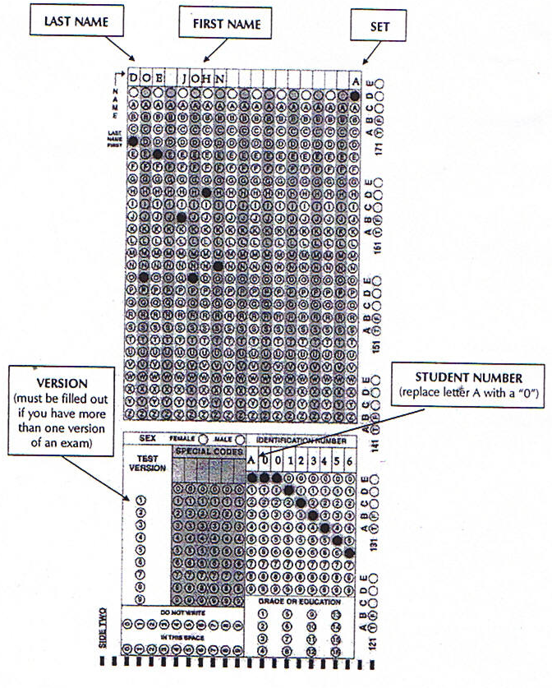
Scan sheets
Bring a pencil with you
Scan sheets must be filled out by pencil
Make sure you correctly fill in the following:
Last-name <space> first-name
Set at the end of the name field
Exam Version number
Student number – replace A with 0 (zero)
NOTE: Each mistake in filling out scan sheet will result in a deduction of 1 mark.

Slide 4
Topics Covered
Week 01
Android activities
Week 02
Intents
Constraint Layout
Spinner
Week 03
Activity lifecycle
Layouts & Widgets
Week 04
ListView
Themes
Events Week 05
Fragments
JSON objects
Week 06
App bar
Menu
Toolbar

