Slide 1
How to work with SQLite databases
Medhat Elmasry

Slide 2
Objectives
Applied
Create a database class that works with a SQLite database.
Write code that creates or upgrades the database.
Write code that opens or closes a connection to the database.
Write code that retrieves one or more rows from a table in the database and works with that data.
Write code that inserts, updates, or deletes rows from a table in the database.
Test the database class to make sure it’s working correctly.

Slide 3
Objectives (continued)
Knowledge
Describe the characteristics of a SQLite database.
Explain what is meant by an embedded database.
Name and describe the three data types supported by SQLite.
Describe how you can use Android Studio’s Android Device Monitor to copy a file from a device to your computer.
Describe how you can use a third-party tool like the DB Browser for SQLite to work with a database files.

Slide 4
SQLite is…
A RDBMS
Standards-compliant
Embedded
Zero-configuration
Lightweight
Secure
Popular
Open-source
Optimized for a single user
Stable
Fast

Slide 5
Where is the database stored
/data/data/{package}/databases/{database name}
Example
/data/data/ca.bcit.Inventory/databases/Inventory.db

Slide 6
Three important classes
SQLiteOpenHelper
SQLiteDatabase
Cursor

Slide 7
Data types supported by SQLite
SQLite data types | Java
TEXT | String
INTEGER | long
REAL | double
NUMERIC | Booleans, dates and date-times
BLOB | Binary Large Object

Slide 8
Insert data
ContentValues values = new ContentValues();
values.put("CONTINENT", country.getContinent());
values.put("COUNTRY", country.getName());
values.put("DESCRIPTION", country.getDescription());
values.put("IMAGE_RESOURCE_ID", country.getImageResourceId());
db.insert("COUNTRY", null, values);

Slide 9
Make changes to the database
private static final int DB_VERSION = 2;
private void updateDb(SQLiteDatabase db, int oldver, int newver) {
try {
if (oldver < 1) {
db.execSQL(getCreateCountryTableSql());
for (Country c : northAmericaCountries) {
insertCountry(db, c);
}
}
if (oldver < 2)
db.execSQL("ALTER TABLE COUNTRY ADD COLUMN POPULATION NUMERIC;");
} catch (SQLException sqle) {
String msg = "DB unavailable" + "\n\n" + sqle.toString();
Toast t = Toast.makeText(context, msg, Toast.LENGTH_LONG);
t.show();
}
}
@Override
public void onCreate(SQLiteDatabase sqLiteDatabase) {
updateDb(sqLiteDatabase, 0, DB_VERSION);
}
@Override
public void onUpgrade(SQLiteDatabase sqLiteDatabase, int i, int i1) {
updateDb(sqLiteDatabase, i, i1);
}

Slide 10
Make changes to the database
If the version number in the SQLite helper code is higher than that of the database, it calls the SQLite helper onUpgrade() method.
If the version number in the SQLite helper code is lower than that of the database, it calls the onDowngrade() method.

Slide 11
Why upgrade the database
Change DB records: add, update or delete records
Change DB structure: add columns to existing table, change column names in a table, rename tables, or remove tables

Slide 12
Update records with update() method
The update() method lets you update records in the database, and returns the number of affected records
ContentValues values = new ContentValues();
values.put("DESCRIPTION", "Shovel");
db.update("PRODUCT",values, "SKU = ?", new String[] {"ABC123"});

Slide 13
Deleting records with the delete() method
You delete records using the SQLiteDatabase delete() method.
db.delete("PRODUCT", "SKU = ?", new String[] {"ABC123"});

Slide 14
Schema changes
db.execSQL("ALTER TABLE PRODUCT ADD COLUMN UNIT_PRICE NUMERIC;");
db.execSQL("ALTER TABLE PRODUCT RENAME TO PRODUCT_LIST;");
db.execSQL("DROP TABLE PRODUCT_LIST;");

Slide 15
The SQL statement that creates the List table
CREATE TABLE list (
_id INTEGER PRIMARY KEY AUTOINCREMENT,
list_name TEXT NOT NULL UNIQUE
)
The SQL statement that creates the Task table
CREATE TABLE task (
_id INTEGER PRIMARY KEY AUTOINCREMENT,
list_id INTEGER NOT NULL,
task_name TEXT NOT NULL,
notes TEXT,
date_completed TEXT,
hidden TEXT
)
The SQL statement that drops the List table
DROP TABLE IF EXISTS list
The SQL statement that drops the Task table
DROP TABLE IF EXISTS task

Slide 16
Common column attributes
PRIMARY KEY
AUTO_INCREMENT
NOT NULL
UNIQUE

Slide 17
Methods of the SQLiteDatabase class
execSQL(sqlString)
update(table, values, where, whereArgs)
delete(table, where, whereArgs)
Two methods of the SQLiteOpenHelper class
getReadableDatabase()
getWriteableDatabase()
A method of the SQLiteDatabase class
close()
A method of the SQLiteDatabase class
query(table, columns, where, whereArgs, groupBy, having, orderBy)
STOPPED HERE

Slide 18
Methods of the Cursor class
moveToNext()
moveToPrevious()
moveToFirst()
moveToLast()
getInt(columnIndex)
getDouble(columnIndex)
getString(columnIndex)
close()

Slide 19
SimpleCursorAdapter
An easy adapter to map columns from a cursor to TextViews or ImageViews defined in an XML file
You can specify which columns you want, which views you want to display the columns, and the XML file that defines the appearance of these views
SimpleCursorAdapter (Context context,
int layout,
Cursor c,
String[] from,
int[] to)

Slide 20
Many rows being bound to ListView
String continent = getIntent().getExtras().get("continent").toString();
SQLiteOpenHelper helper = new MyPlanetDbHelper(this);
SQLiteDatabase db = helper.getReadableDatabase();
Cursir cursor = db.query("COUNTRY",
new String[] {"_id", "COUNTRY"},
"CONTINENT = ?",
new String[] {continent},
null, null, null);
SimpleCursorAdapter adapter = new SimpleCursorAdapter(this,
android.R.layout.simple_list_item_1,
cursor,
new String[] {"COUNTRY"},
new int[] {android.R.id.text1});
ListView listCountries = getListView();
listCountries.setAdapter(adapter);

Slide 21
Where only one row is returned
Country country = null;
SQLiteOpenHelper helper = new MyPlanetDbHelper(this);
SQLiteDatabase db = helper.getReadableDatabase();
Cursor cursor = db.query("COUNTRY",
new String[] {"CONTINENT", "COUNTRY", "DESCRIPTION", "IMAGE_RESOURCE_ID"},
"COUNTRY = ?",
new String[] {cntry},
null, null, null);
// move to the first record
if (cursor.moveToFirst()) {
// get the country details from the cursor
country = new Country(
cursor.getString(0),
cursor.getString(1),
cursor.getString(2),
cursor.getInt(3) );
}

Slide 22
Executing raw sql
SQLiteOpenHelper helper = new MyPlanetDbHelper(this);
String[] continents = null;db = helper.getReadableDatabase();
Cursor cursor= db.rawQuery("select DISTINCT CONTINENT from COUNTRY", null);
int count = cursor.getCount();
continents = new String[count];
if (cursor.moveToFirst()) {
int ndx=0;
do {
continents[ndx++] = cursor.getString(0);
} while (cursor.moveToNext());
}

Slide 23
Using SQL functions in queries
AVG() | The average value
COUNT() | The number of rows
SUM() | The sum
MAX() | The largest value
MIN() | The smallest value
Cursor cursor = db.query("COUNTRY",
new String[] {"COUNT(_id) AS count"},
null, null, null, null, null};
Cursor cursor = db.query("COUNTRY",
new String[] {"AVG(POPULATION) AS population"},
null, null, null, null, null};

Slide 24
SQL GROUP BY and HAVING clauses
Example, suppose you want to find out the number of countries in each continent
Cursor cursor = db.quest("COUNTRY",
new String[] {"COUNTRY", "COUNT(_id) AS count},
null, null,
"CONTINENT",
null, null};
Return the country column and number of countries
Group by continent

Slide 25
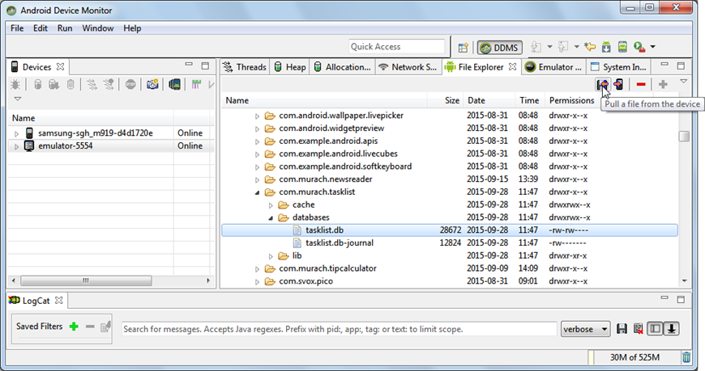
The SQLite database file

Slide 26
Setting permissions to see DB file on device
In a terminal window on your computer, go to the \platform-tools folder
Type:
adb shell
su
chmod -R 777 /data
Type the following to exit to the operating system:
exit
exit
Restart the adb as root by typing the following command:
adb root

Slide 27
How to view the file for a database
Start Android Studio.
Open the standalone Android Device Monitor tool by selecting the Tools >>Android >>Android Device Monitor item.
In the Devices view, select the device.
In the main window, click on the File Explorer tab.
Navigate to the databases directory for the app.
/data/data/ca.bcit.myplanet/databases/MyPlanet.db

Slide 28
How to copy a database file
To copy a file from the device to your computer, select the file and click on the “Pull a file” button.
To copy a file from your computer to a device, select the directory on the device and click the “Push a file” button.

Slide 29
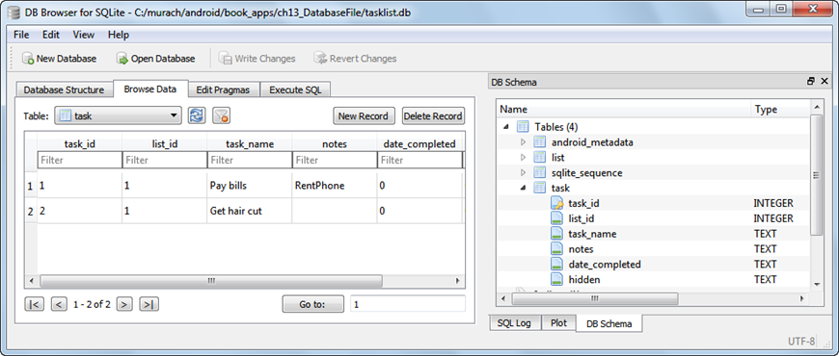
SQLite Browser
The URL for downloading this software
http://sqlitebrowser.org/

Slide 30
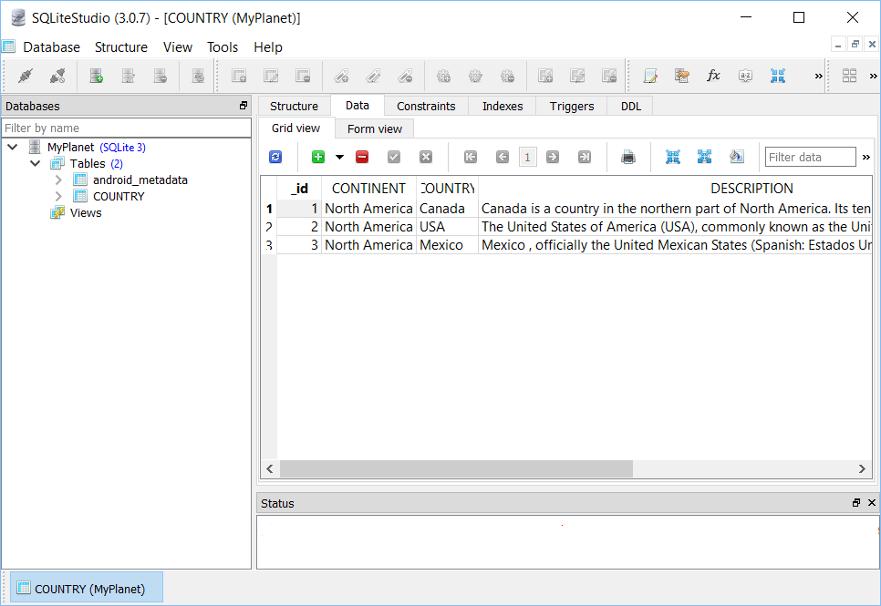
SQLite Studio
The URL for downloading this software
https://sqlitestudio.pl/

