Slide 1
Android Themes & Styles
Medhat Elmasry

Slide 2
Objectives
Applied
Define a style and apply it to a widget.
Create a style sheet.
Modify an existing theme for different API levels.
Apply a built-in or custom theme to the entire app or to a specific activity.
Define colors and apply them to widgets, styles, or themes.
Knowledge
Distinguish between a style and a theme.
Distinguish between a title bar and an action bar.
Name and describe at least two built-in themes.

Slide 3
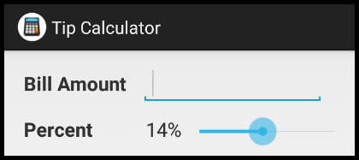
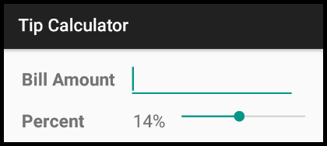

The Holo theme (light with dark action bar)
The Material theme (light with dark action bar)
The AppCompat theme (light with dark action bar)

Slide 4
Style vs. theme
A style is a collection of properties that specify formatting for a widget.
A theme is a style that’s applied to an entire activity or app. Android includes several built-in themes. When a theme is applied, every widget applies each style of the theme that it supports.

Slide 5
Title bar vs. action bar
Prior to Android 4.0, an activity can include a title bar that displays the title of the activity.
With Android 4.0 and later, an activity can include an action bar that displays the activity’s title and, optionally, buttons that allow the user to perform actions.

Slide 6
The application element of the AndroidManifest.xml file
<application
android:icon="@drawable/ic_launcher"
android:label="@string/app_name"
android:theme="@style/AppTheme"
android:allowBackup="true">

Slide 7
Two styles.xml files
In the res\values directory (prior to API 21)
<resources>
<style name="AppTheme" parent="android:Theme.Holo.Light.DarkActionBar" />
</resources>
In the res\values-v21 directory (API 21 and later)
<resources>
<style name="AppTheme" parent="android:Theme.Material.Light.DarkActionBar" />
</resources>

Slide 8
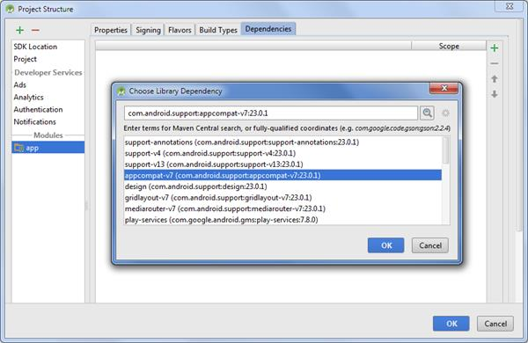
Adding a dependency

Slide 9
How to add a dependency for the v7 appcompat library
In Android Studio, right-click on the app node of your project and select the Open Module Settings item.
Click the Dependencies tab, click the Add (+) button, and use the resulting dialog to add the v7 appcompat library. This should add a dependency to the end of the Gradle build script like this: dependencies {compile 'com.android.support:appcompat-v7:23.0.1'}
Open the class for the activity. Then, replace the import statement for the Activity class with an import statement for the AppCompatActivity class like this: import android.support.v7.app.AppCompatActivity;

Slide 10
How to add a dependency for the v7 appcompat library (continued)
In the class for the activity, modify the class declaration so it extends the AppCompatActivity class, not the Activity class, like this: public class TipCalculatorActivity extends AppCompatActivity
Open res/values/styles.xml file. Then, modify style named AppTheme so it inherits an AppCompat theme like this:
<style name="AppTheme"
parent="Theme.AppCompat.Light.DarkActionBar">
<!-- Customize your theme here. -->
</style>

Slide 11
A style that overrides one property
<style name="TextView">
<item name="android:textSize">20sp</item>
</style>
A style that inherits a user-defined style
<style name="EditText" parent="@style/TextView" />
A style that inherits a user-defined style and overrides two properties
<style name="Label" parent="@style/TextView">
<item name="android:textStyle">bold</item>
<item name="android:padding">10dp</item>
</style>
Another way to code the previous style
<style name="TextView.Label">
<item name="android:textStyle">bold</item>
<item name="android:padding">10dp</item>
</style>

Slide 12
How to inherit multiple user-defined styles
<style name="TextView.Label.Indent">
<item name="android:layout_marginLeft">10dp</item>
</style>

Slide 13
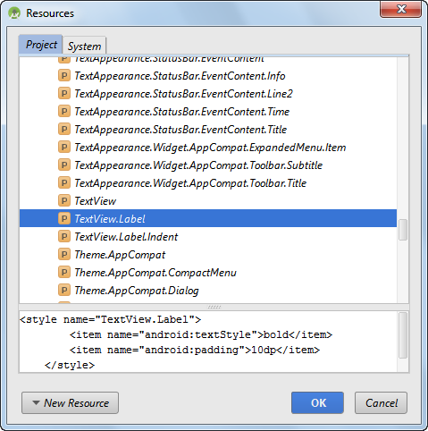
The Resources dialog for a style

Slide 14
A TextView widget with the TextView.Label style
<TextView
android:id="@+id/percentLabel"
android:layout_width="wrap_content"
android:layout_height="wrap_content"
android:layout_alignLeft="@+id/billAmountLabel"
android:layout_below="@+id/billAmountLabel"
android:text="@string/tip_percent_label"
style="@style/TextView.Label" />
A TextView widget with the TextView style
<TextView
android:id="@+id/percentTextView"
android:layout_width="wrap_content"
android:layout_height="wrap_content"
android:layout_alignBaseline="@+id/percentLabel"
android:layout_alignLeft="@+id/billAmountEditText"
android:padding="5dp"
android:text="@string/tip_percent"
style="@style/TextView" />

Slide 15
A styles.xml file in the res\values directory with four user-defined styles
<resources>
<!-- The theme -->
<style name="AppTheme" parent="Theme.AppCompat.Light.DarkActionBar" />
<!-- Four custom styles -->
<style name="TextView">
<item name="android:textSize">20sp</item>
</style>
<style name="EditText" parent="@style/TextView" />
<style name="Button" parent="@style/TextView">
<item name="android:textStyle">bold</item>
</style>
<style name="TextView.Label">
<item name="android:textStyle">bold</item>
<item name="android:padding">10dp</item>
</style>
</resources>

Slide 16
A styles.xml file that customizes the Holo theme
<resources>
<style name="AppTheme" parent="android:Theme.Holo.Light.DarkActionBar">
<!-- Set new styles for three widgets in the theme -->
<item name="android:textViewStyle">@style/TextView</item>
<item name="android:editTextStyle">@style/EditText</item>
<item name="android:buttonStyle">@style/Button</item>
</style>
<!-- These styles are applied automatically -->
<style name="TextView" parent="@android:style/Widget.TextView">
<item name="android:textSize">20sp</item>
</style>
<style name="EditText" parent="@android:style/Widget.EditText">
<item name="android:textSize">20sp</item>
</style>
<style name="Button" parent="@android:style/Widget.Button">
<item name="android:textSize">20sp</item>
<item name="android:textStyle">bold</item>
</style>
<!-- This style needs to be applied manually -->
<style name="TextView.Label">
<item name="android:textStyle">bold</item>
<item name="android:padding">10dp</item>
</style>
</resources>

Slide 17
API documentation for standard attributes in a theme
https://developer.android.com/reference/android/R.styleable.html#Theme
API documentation for standard attributes in a theme
\android\sdk\platforms\android-23\data\res\values\styles.xml

Slide 18
A styles.xml file that customizes the AppCompat theme
<resources>
<style name="AppTheme" parent="Theme.AppCompat.Light.DarkActionBar">
<!-- Set new styles for three widgets in the theme -->
<item name="android:textViewStyle">@style/TextView</item>
<item name="editTextStyle">@style/EditText</item>
<item name="buttonStyle">@style/Button</item>
</style>
<!-- These styles are applied automatically -->
<style name="TextView" parent="@android:style/Widget.TextView">
<item name="android:textSize">20sp</item>
</style>
<style name="EditText" parent="Widget.AppCompat.EditText">
<item name="android:textSize">20sp</item>
</style>
<style name="Button" parent="Widget.AppCompat.Button">
<item name="android:textSize">20sp</item>
<item name="android:textStyle">bold</item>
</style>
<!-- This style needs to be applied manually -->
<style name="TextView.Label">
<item name="android:textStyle">bold</item>
<item name="android:padding">10dp</item>
</style>
</resources>

Slide 19
The API documentation for the attributes from the AppCompat theme
https://developer.android.com/reference/android/support/v7/appcompat/R.attr.html
The styles.xml file for the v7 appcompat support library
\android\sdk\extras\android\support\v7\appcompat\res\values\styles.xml

Slide 20
The styles.xml file in the res\values directory
<resources>
<style name="AppTheme" parent="AppBaseTheme">
<!-- Theme customizations NOT specific to an API -->
<item name="android:textViewStyle">@style/TextView</item>
<item name="android:editTextStyle">@style/EditText</item>
<item name="android:buttonStyle">@style/Button</item>
</style>
<style name="AppBaseTheme" parent="android:Theme.Holo.Light.DarkActionBar">
<!-- API 15-20 theme customizations go here -->
</style>
<!-- These styles are applied automatically -->
<style name="TextView" parent="@android:style/Widget.TextView">
<item name="android:textSize">20sp</item>
</style>
<style name="EditText" parent="@android:style/Widget.EditText">
<item name="android:textSize">20sp</item>
</style>
<style name="Button" parent="@android:style/Widget.Button">
<item name="android:textSize">20sp</item>
<item name="android:textStyle">bold</item>
</style>
<!-- This style needs to be applied manually -->
<style name="TextView.Label">
<item name="android:textStyle">bold</item>
<item name="android:padding">10dp</item>
</style>
</resources>

Slide 21
The styles.xml file in the res\values-v21 directory
<resources>
<style name="AppBaseTheme" parent="android:Theme.Material.Light.DarkActionBar">
<!-- API 21+ theme customizations go here. -->
</style>
<!-- Custom styles go here -->
</resources>

Slide 22
Some built-in styles for controlling text appearance
TextAppearance
TextAppearance.Inverse
TextAppearance.Small
TextAppearance.Small.Inverse
TextAppearance.Medium
TextAppearance.Large

Slide 23
styles.xml file that modifies TextAppearance styles
<resources>
<style name="AppTheme" parent="Theme.AppCompat.Light.DarkActionBar">
<!-- Set two new text appearance styles -->
<item name="android:textAppearanceSmall" parent="@style/TextAppearanceSmall"</item>
<item name="android:textAppearanceSmallInverse" parent="@style/TextAppearanceSmallInverse"</item>
</style>
<!-- These styles are applied automatically -->
<style name="TextAppearanceSmall" parent="@android:style/TextAppearance.Small">
<item name="android:textSize">20sp</item>
</style>
<style name="TextAppearanceSmallInverse" parent="@android:style/TextAppearance.Small.Inverse">
<item name="android:textSize">20sp</item>
</style>
</resources>

Slide 24
An EditText widget that uses a TextAppearance style
<EditText
android:id="@+id/billAmountEditText"
android:layout_width="wrap_content"
android:layout_height="wrap_content"
android:inputType="numberDecimal"
android:text="@string/bill_amount"
android:textAppearance="@style/TextAppearanceSmall">
</EditText>

Slide 25
Some old themes
Theme.Light
Theme.Black
Theme.Light.NoTitleBar
Theme.Black.NoTitleBar
Theme.Dialog

Slide 26
Some Holo themes
Theme.Holo
Theme.Holo.Dialog
Theme.Holo.NoActionBar
Theme.Holo.Light
Theme.Holo.Light.Dialog
Theme.Holo.Light.NoActionBar
Theme.Holo.Light.DarkActionBar

Slide 27
Some Material themes
Theme.Material
Theme.Material.Dialog
Theme.Material.NoActionBar
Theme.Material.Light
Theme.Material.Light.Dialog
Theme.Material.Light.NoActionBar
Theme.Material.Light.DarkActionBar

Slide 28
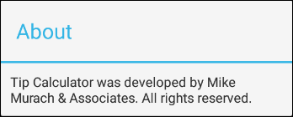
Theme.Holo.Light.Dialog

Slide 29
AndroidManifest.xml file used to…
Apply a user-defined theme to the entire application
<application
android:icon="@drawable/ic_launcher"
android:label="@string/app_name"
android:theme="@style/AppTheme"
android:allowBackup="true">
Apply a built-in theme to a single activity
<activity
android:name="com.murach.dialogtest.DialogActivity"
android:theme="@android:style/Theme.Holo.Light.Dialog"
android:label="@string/about_title" >
Apply a built-in theme to a single activity
<activity
android:name="com.murach.dialogtest.DialogActivity"
android:theme="@style/DialogTheme"
android:label="@string/about_title" >

Slide 30
Two styles.xml files for a user-defined theme
In the res\values directory (prior to API 21)
<style name="DialogTheme"
parent="android:Theme.Holo.Light.Dialog"/>
In the res\values-v21 directory (API 21 and later)
<style name="DialogTheme"
parent="android:Theme.Material.Light.Dialog"/>

Slide 31
How to apply themes at different levels
You can use the AndroidManifest.xml file to apply a theme to the entire application or to a specific activity.
To apply a theme to the entire application, use the theme attribute of the application element to specify the theme as shown in figure 7-2.
To apply a theme to a specific activity, use the theme attribute of the activity element to specify the theme.
You can use the theme attribute to specify a built-in theme or a custom theme.
When you specify a theme for the application and activity levels, the theme at the activity level overrides the theme at the application level.

Slide 32
A colors.xml file in the res/values directory
<?xml version="1.0" encoding="utf-8"?>
<resources>
<color name="primary">#141315</color>
<color name="secondary">#736C6B</color>
<color name="tertiary">#DDE0CE</color>
<color name="background">#A6D39D</color>
<color name="dark">#000000</color>
<color name="light">#FFFFFF</color>
</resources>

Slide 33
How to apply colors to a widget
Using a hexadecimal value
android:textColor="#141315"
Using a name from the colors.xml file
android:textColor="@color/primary"
Using a hexadecimal value
android:textColor="@android:color/darker_gray"

Slide 34
How to apply colors to a style
<style name="TextView" parent="@android:style/Widget.TextView">
<item name="android:textColor">@color/primary</item>
</style>
How to apply colors to a theme
<style name="AppTheme" parent="AppBaseTheme">
<!-- Set new colors for the theme -->
<item name="android:windowBackground">@color/background</item>
<item name="android:textColorPrimary">@color/primary</item>
<item name="android:textColorSecondary">@color/secondary</item>
</style>
The colors.xml file for Android 6.0 (API 23)
\android-sdks\platforms\android23\data\res\values\colors.xml

