Slide 1
Intro to Technical Financial Evaluation with R
Ted Kwartler
https://github.com/kwartler/ODSC_TechnicalTrading

Slide 2







About me
https://www.linkedin.com/in/edwardkwartler/
Education
Work
Side Hustles
2

Slide 3
Agenda
Start | End | Item
 |  | Securities Summary
 |  | Securities Technical Trading Indicator- SMA
 |  | Securities Technical Trading Indicator- MACD
 |  | Securities Technical Trading Indicator- RSI
 |  | Financial Risk Modeling
 |  | Non-Traditional Markets
3

Slide 4
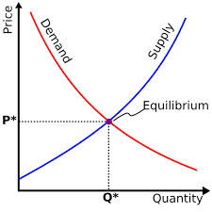
What is a Market?
Traditional Markets
Stock Markets
Bond Markets
Housing/Mortgages
Commodities – gold/silver etc
Crop Futures – corn/soybean
Consumer Credit
…
A market is one of the many varieties of systems, institutions, procedures, social relations and infrastructures whereby parties engage in exchange. Traditional markets are often regulated, have defined trading norms/rules, and have been in existence for some time.
4

Slide 5

Securities Trading can be distilled into 4 categories
Belief Based Investing
The intrinsic value of a company is appealing regardless of market & financial factors. As a result, intrinsic value changes trigger buy/sell action.
I like Wonder bread, so I bought stock in Flower Foods (FLO) since they make it.
https://www.steadygo.digital/blog/terrible-stock-photos/
5
Notes:
I like Netflix movies so I bought Netflix.
I don’t agree with tobacco sales so I avoid those stocks.
Warren Buffet “Buy companies you understand”

Slide 6

Securities Trading can be distilled into 4 categories
Financial Fundamentals Investing
Traditional financial performance indicators trigger an action regardless of sector, or company product.
Monsanto (MON) makes genetically modified food, I don’t care if they are safe. I bought the stock because the EPS is good.
6
Notes:
Reviewing an annual report and pouring over cash flow, revenue growth, expenditures like R/D all count as fundamental investing

Slide 7

Securities Trading can be distilled into 4 categories
Technical Trading
Trade based on “indications”. Uses non-financial mathematical indicators to quantify risk/reward, or trigger buy/sell
“Algorithmic Trading” – using algorithms to identify an equity action
Momentum – Recognize prices moving up/down at thresholds to trigger action
“Charting” – Visual chart patterns trigger actions (crossovers, head & shoulders)
The MACD crossover pattern for Smith & Wesson (AOBC) is positive so now is a good time to buy.
7
Notes:
Reviewing an annual report and pouring over cash flow, revenue growth, expenditures like R/D all count as fundamental investing

Slide 8
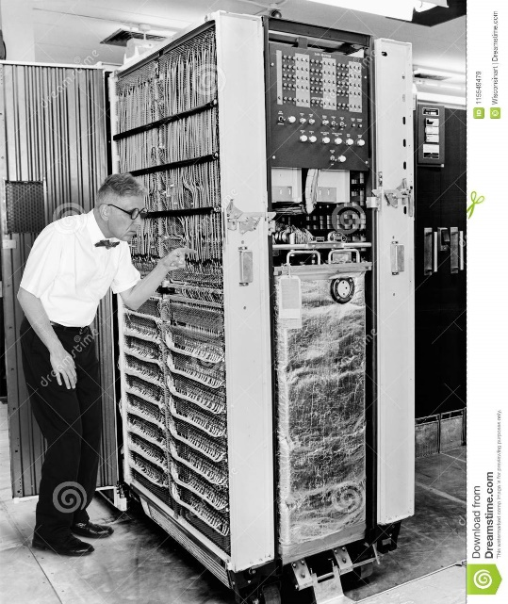

Securities Trading can be distilled into 4 categories
High Frequency Trading
Extremely technical trading executed without a human that can trigger thousands of actions measured in nano-seconds. “scalping” small profits thousands of times per minute.
1001100100…
*Although HFT uses algorithms:
>There is no human in the loop
>Primary profits derive from market making
8
Notes:
$460M

Slide 9
What type?
The Stochastic Momentum Indicator (SMI), a formula for measuring momentum, crossed over to positive territory. I think I will buy Google (Alphabet).
Belief Based – some intrinsic value of the company is appealing and triggers a buy/selling action.
Fundamental Trading - traditional financial indicator triggers an action regardless of sector, or company product.
Technical Trading – trade based on “indications” or “algo trading”
High Frequency Trading – “scalping” small profits repeatedly
9

Slide 10
What type?
Our PhD physicist wrote an algorithm that trades apple stock 10,000 per minute.
Belief Based – some intrinsic value of the company is appealing and triggers a buy/selling action.
Fundamental Trading - traditional financial indicator triggers an action regardless of sector, or company product.
Techhnical Trading – trade based on “indications” or “algo trading”
High Frequency Trading – “scalping” small profits repeatedly
10

Slide 11
What type?
I won’t buy firearm companies.
Belief Based – some intrinsic value of the company is appealing and triggers a buy/selling action.
Fundamental Trading - traditional financial indicator triggers an action regardless of sector, or company product.
Techhnical Trading – trade based on “indications” or “algo trading”
High Frequency Trading – “scalping” small profits repeatedly
11

Slide 12
What type?
At ODSC we modeled the probability of risk using a decision tree and it looks like a buying a retail loan is a good investment.
Belief Based – some intrinsic value of the company is appealing and triggers a buy/selling action.
Fundamental Trading - traditional financial indicator triggers an action regardless of sector, or company product.
Technical Trading – trade based on “indications” or “algo trading”
High Frequency Trading – “scalping” small profits repeatedly
12

Slide 13
What type?
Google’s quarterly ad revenue is improving, so I am going to buy some shares.
Belief Based – some intrinsic value of the company is appealing and triggers a buy/selling action.
Fundamental Trading - traditional financial indicator triggers an action regardless of sector, or company product.
Technical Trading – trade based on “indications” or “algo trading”
High Frequency Trading – “scalping” small profits repeatedly
13

Slide 14
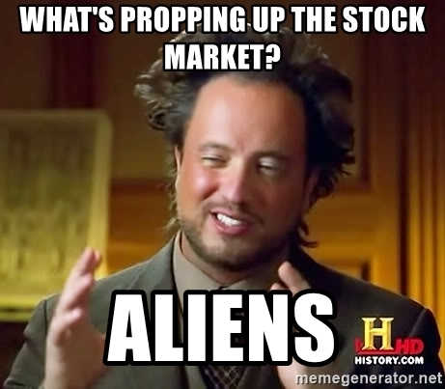
Financial Risk Modeling
14

Slide 15
Let’s zoom into Technical Trading Rules (TTR)
Our learning goal is to use and understand some of the common technical indicators which affect you as a saver, pension holder, stock trader etc.
Our learning goal is NOT to make you a trader, or convince you that you are now qualified to be a technical trader.
15

Slide 16
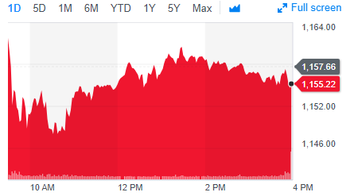
Stock Prices represent a time series
PRICE or Volume
TIME
From a forecasting perspective stock prices are often considered a “random walk” meaning traditional econometric forecasting techniques do not apply.
16

Slide 17
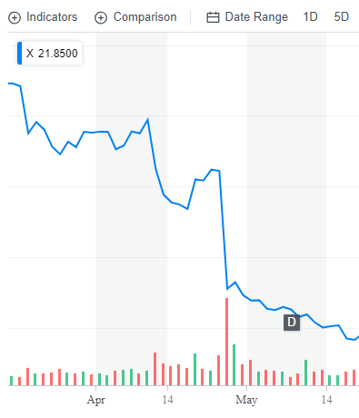
Why can’t you forecast the time series?
Daily Chart
U.S. Steel
4/25/17 Close : $31
4/26/17 Close: $22
4/26/17 Volume spike
17

Slide 18
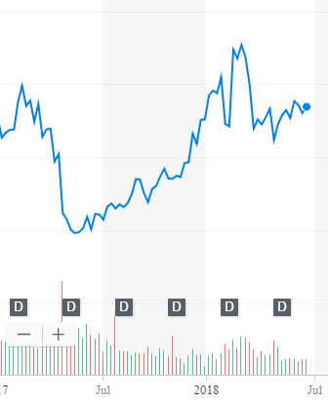
What other forces can impact US Steel?
Weekly Chart
U.S. Steel
4/25/17 Close : $31
4/26/17 Close: $22
4/26/17 Volume spike
5/15/17: ~$20
2/26/18: ~$45
Missed Qrtly Earnings
18

Slide 19
What other forces can impact US Steel?
Weekly Chart
U.S. Steel
4/25/17 Close : $31
4/26/17 Close: $22
4/26/17 Volume spike
5/15/17: ~$20
2/26/18: ~$45
4/16/18: ~$36
6/16/18: ~36
Missed Qrtly Earnings
Steel tariffs
19

Slide 20
What other forces can impact US Steel?
Weekly Chart
U.S. Steel
4/25/17 Close : $31
4/26/17 Close: $22
4/26/17 Volume spike
5/15/17: ~$20
2/26/18: ~$45
4/16/18: ~$36
6/16/18: ~36
Missed Qrtly Earnings
Steel tariffs
Auto tariffs
20

Slide 21
So forecasting (pattern recognition) methods won’t work.
Weekly Chart
U.S. Steel
Some stock movements are self-inflicted (quarterly miss), others political (tariffs) while others are based on out of sector (automotive) performance.
External factors remove pattern recognition that econometric forecasts seek.
21

Slide 22
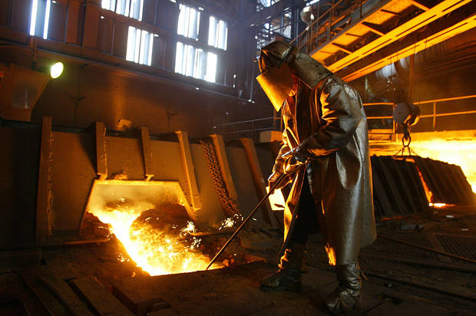
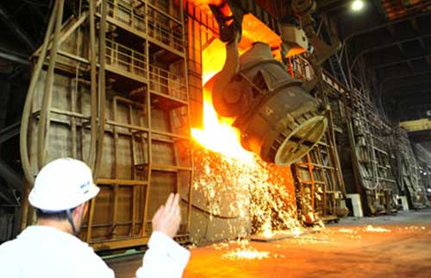

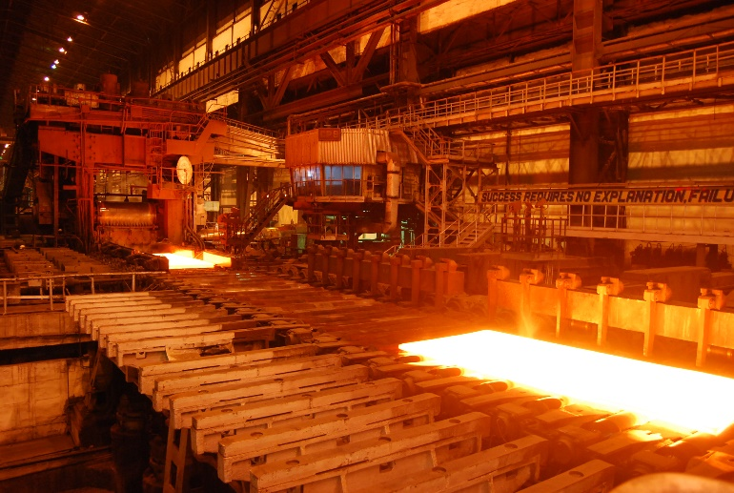
Meanwhile, US Steel was... producing steel.
Coincidentally, a belief investor would not have bought or sold but fundamental, technical and HFT would have been in and out at different times.
22

Slide 23
Let’s Practice! Open 1_TTR_A.R
Learning Objective:
Get real stock data
Subset an xts object
Plot the data in a dynamic plot
23

Slide 24
Instead of forecasting, can we identify indicators to move in or out of positions?
library(TTR)
SMA() #simple moving average
MACD() #moving avg convergence/divergence
RSI() #Relative Strength Index
For expediency we will cover 3 indicators but there are many more and you could even develop your own.

Slide 25
Agenda
Start | End | Item
 |  | Securities Summary
 |  | Securities Technical Trading Indicator- SMA
 |  | Securities Technical Trading Indicator- MACD
 |  | Securities Technical Trading Indicator- RSI
 |  | Financial Risk Modeling
 |  | Non-Traditional Markets

Slide 26
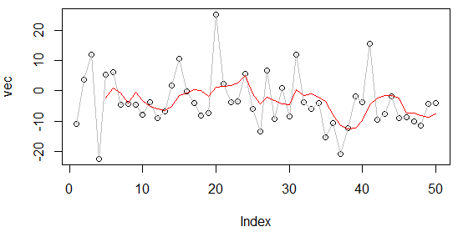
What is a moving average?
set.seed(1234)
vec <-rnorm(50,1,10)
plot(vec)
lines(vec, col='grey')
lines(SMA(vec, n=5), col='red')
vec[1:15]
[1,] -11.070657
[2,] 3.774292
[3,] 11.844412
[4,] -22.456977
[5,] 5.291247
[6,] 6.060559
[7,] -4.747400
[8,] -4.466319
[9,] -4.644520
[10,] -7.900378
[11,] -3.771927
[12,] -8.983864
[13,] -6.762539
[14,] 1.644588
[15,] 10.594941
A smoothing technique reducing noise in a data series. Takes the average over “n” number of periods.
26

Slide 27
What is a moving average?
vec[1:15]
[1,] -11.070657
[2,] 3.774292
[3,] 11.844412
[4,] -22.456977
[5,] 5.291247
[6,] 6.060559
[7,] -4.747400
[8,] -4.466319
[9,] -4.644520
[10,] -7.900378
[11,] -3.771927
[12,] -8.983864
[13,] -6.762539
[14,] 1.644588
[15,] 10.594941
A smoothing technique reducing noise in a data series. Takes the average over “n” number of periods.
27

Slide 28

What is a moving average?
vec[1:15]
[1,] -11.070657
[2,] 3.774292
[3,] 11.844412
[4,] -22.456977
[5,] 5.291247
[6,] 6.060559
[7,] -4.747400
[8,] -4.466319
[9,] -4.644520
[10,] -7.900378
[11,] -3.771927
[12,] -8.983864
[13,] -6.762539
[14,] 1.644588
[15,] 10.594941
A smoothing technique reducing noise in a data series. Takes the average over “n” number of periods.
28

Slide 29

What is a moving average?
vec[1:15]
TTR::SMA(vec[1:15], n=5)
[1,] -11.070657
[2,] 3.774292
[3,] 11.844412
[4,] -22.456977
[5,] 5.291247
[6,] 6.060559
[7,] -4.747400
[8,] -4.466319
[9,] -4.644520
[10,] -7.900378
[11,] -3.771927
[12,] -8.983864
[13,] -6.762539
[14,] 1.644588
[15,] 10.594941
[1,] NA
[2,] NA
[3,] NA
[4,] NA
[5,] -2.5235367
[6,] 0.9027066
[7,] -0.8016318
[8,] -4.0637779
[9,] -0.5012865
[10,] -3.1396115
[11,] -5.1061087
[12,] -5.9534017
[13,] -6.4126457
[14,] -5.1548241
[15,] -1.4557603
A smoothing technique reducing noise in a data series. Takes the average over “n” number of periods.
29

Slide 30
What is a moving average?
A smoothing technique reducing noise in a data series. Takes the average over “n” number of periods.
vec[1:15]
TTR::SMA(vec[1:15], n=5)
[1,] -11.070657
[2,] 3.774292
[3,] 11.844412
[4,] -22.456977
[5,] 5.291247
[6,] 6.060559
[7,] -4.747400
[8,] -4.466319
[9,] -4.644520
[10,] -7.900378
[11,] -3.771927
[12,] -8.983864
[13,] -6.762539
[14,] 1.644588
[15,] 10.594941
[1,] NA
[2,] NA
[3,] NA
[4,] NA
[5,] -2.5235367
[6,] 0.9027066
[7,] -0.8016318
[8,] -4.0637779
[9,] -0.5012865
[10,] -3.1396115
[11,] -5.1061087
[12,] -5.9534017
[13,] -6.4126457
[14,] -5.1548241
[15,] -1.4557603
30

Slide 31

So how does SMA become an Indicator?
Red Card! We need to lag the trading rule to ensure the signal is realistic. Calculations are not real time, but at close so you need to adjust the results to emulate a real scenario.
31

Slide 32
Open 1_TTR_B.R
Learning Objective:
Get real stock data
Subset an xts object
Create three simple moving averages and plot to see the smoothing effect
32

Slide 33
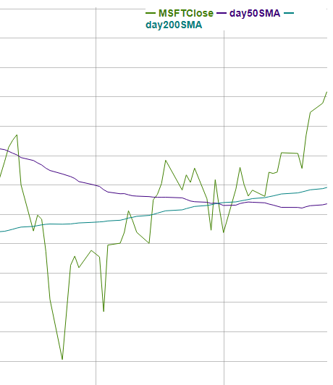
How does SMA become an indicator? MSFT 50 & 200 day SMA
This is a “death cross” meaning the 50 day moving average (purple) goes below the 200 day…time to SELL!

Slide 34
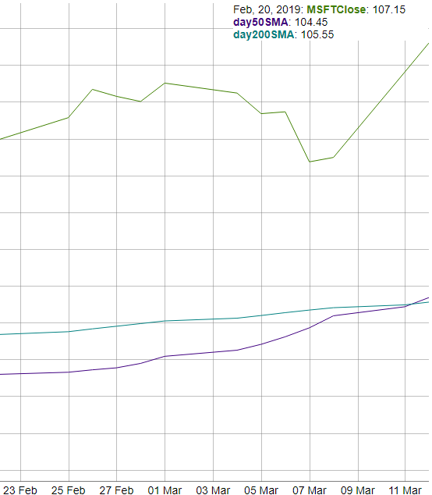
MSFT 50 & 200 day SMA
MSFT recently had a “golden cross” meaning the 50 day went over the 200day…time to BUY!

Slide 35
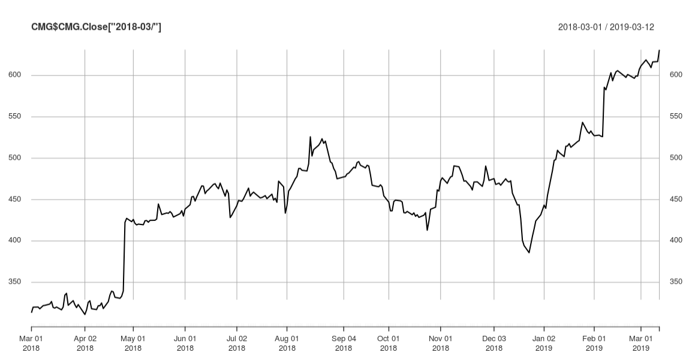
Now let’s apply death/golden cross to CMG
An investor can “backtest” the strategy to find an acceptable “n” in case 50/200 doesn’t work. Once the best “n” is found, an investor can look for “crosses” to indicate buy/sell.

Slide 36

1_TTR_C_50Day_200Day_SMA
Learning Objective:
Get real stock data
Subset an xts object
Calculate SMA
Create a trading indicator (rule)
Lag the Rule
Back-test the lagged rule to see cumulative returns
Switch a single character in the rule & back-test again to see the impact like Knight Capital
36

Slide 37
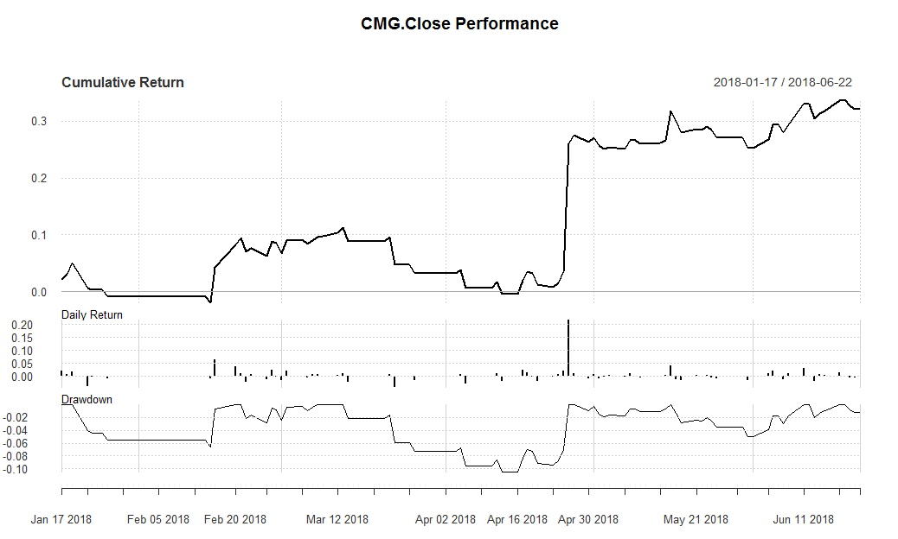
SMA as an Indicator for CMG
Update
Start here
Total Cumulative Return using the rule.
Day to Day Return
Important if rule is sub one day periodicity.
Peak to trough % change, used to understand volatility.
Due to the price spike, ~20% of the total cumulative ~30% came in a single session. One could still argue the rule reduced risk because there were days without any capital exposure and the rule provided returns beyond the 1 day surge.
37

Slide 38
Agenda
Start | End | Item
 |  | Securities Summary
 |  | Securities Technical Trading Indicator- SMA
 |  | Securities Technical Trading Indicator- MACD
 |  | Securities Technical Trading Indicator- RSI
 |  | Financial Risk Modeling
 |  | Non-Traditional Markets

Slide 39
Moving Average Convergence Divergence
By measuring the moving average of two moving averages with different time frames, an investor hopes to capture when momentum is building or receding.
Instead of “n”:
nFast(12) – the smaller window to measure (12 periods)
nSlow(26)- the longer window to measure (26 periods)
nSig(9)- the number of periods used to measure the avg difference “signal”
Calculate the 12 (nFast) day & 26 (nSlow) day moving averages.
Calculate the difference between average from #1
Calculate the 9 day Moving Avg (nSig) of #2
When MACD > Signal, the price is accelerating, positive momentum/money is coming to the equity which represents a buying opportunity. Converse is true.
39

Slide 40
One small addition difference.
MACD uses exponential moving averages (EMA).
SMA
EMA
Each value in the “n” window has an equal weight.
Each value in the “n” window has an different weight. The weights decrease the farther back in time e.g. recent data is more relevant.
For example:
vec <-c(1,2,3,4,5)
mean(vec)
#sum(vec)/5 i.e. 15/5
3
Advantage:
Faster to recognize a buy/sell signal.
Disadvantage:
More false signals, more sensitivity
40

Slide 41
Open 1_TTR_D.R
Learning Objective:
Get real stock data
Subset an xts object
Calculate MACD
Plot a dynamic graph of the closing & MACD indicator
Visually inspect the results of buy/sell actions
Calculate cumulative return for the indicator
41

Slide 42
Agenda
Start | End | Item
 |  | Securities Summary
 |  | Securities Technical Trading Indicator- SMA
 |  | Securities Technical Trading Indicator- MACD
 |  | Securities Technical Trading Indicator- RSI
 |  | Financial Risk Modeling
 |  | Non-Traditional Markets

Slide 43
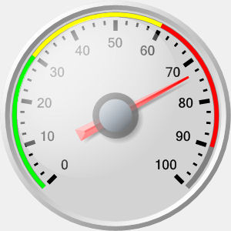
Relative Strength Index (RSI)
Momentum Oscillator
Index between 0-100
Compares average gains and losses in 14 day periods (“n”)
Usually interpreted as an overbought/oversold (over 70 / below 30)
* Usually uses EMA but we will do SMA.
43

Slide 44
Creates a control chart.
70
RSI
30
TIME
When the RSI dips below a threshold (30) the stock is considered “oversold” meaning the market has overreacted to something and RSI may indicate a buying opportunity. RSI greater than 70 indicates the market is over buying the stock so it may be good to exit your position.
44

Slide 45
Calculating the RSI
RSI = 100 - (100 / 1+RS)
Where RS:
RS = Avg Gain / Avg Loss
Avg Gain = For “up” days, total number of points up / number of “up” days
Avg Loss = For “down” days, total number of points down/ number of “down” days
45

Slide 46
Open 1_TTR_F.R
Learning Objective:
Get real stock data
Calculate RSI
Plot a dynamic graph of the closing & RSI indicator
Visually inspect the results of buy/sell actions
Calculate cumulative return for RSI and MACD together
46

Slide 47
Agenda
Start | End | Item
 |  | Securities Summary
 |  | Securities Technical Trading Indicator- SMA
 |  | Securities Technical Trading Indicator- MACD
 |  | Securities Technical Trading Indicator- RSI
 |  | Financial Risk Modeling
 |  | Non-Traditional Markets

Slide 48

Consumer Credit - Lending Club
US consumers apply for various loans and instead of banks providing funds, everyday consumers fund the loan by purchasing “notes” and receive the interest.
Peer to Peer funding for
Personal Loans
Auto Loans
Small Business Loans
Medical Loans
Everyday investors can accept the loan risk – making it a new banking distribution model
Consumer credit is a traditional market. There are defined inputs (credit score), consumer protections (usury laws), and established distribution (credit applications).
48

Slide 49
What’s the Risk?
Risk
Mitigation
Over exposure in a single loan
Diversify – Do not fund more than $25 on a single loan
Early payment reduces interest received
Monitor & re-invest monthly
Illiquid – notes are 36-60 months
Buy notes with 36m horizons
Default – debtors that stop paying
Model the probability of default
49

Slide 50
What’s the Reward?
Reward
Result
Interest is imposed by LC
Investors have no input to the amount
Usually lower rates for the applicant
Lower capital cost for debtor
LC takes 1% of interest
Reduces reward incentive for investor
Remaining interest is paid monthly to note holders.
Investors act as banks & receive consistent returns
50

Slide 51

Example
Erin decides to buy a car. Instead of a traditional loan she applies at LC.
Erin applies for a $10k car loan
LC assesses her creditworthiness & posts a $10k loan @ 6% interest on the investor site.
Trish & hundreds of other LC investors fund the loan in $25 increments called “notes”
Each month Erin pays her loan, LC takes 1% and the investors make 5% on their outstanding notes.
51

Slide 52
Data
11 yrs of historical performance – Over 1M notes publicly available
Some platform changes in that time
Datasets are updated monthly
Sampled to 20k – either in fully paid of charged off state
Loan Origination
36 or 60 Monthly Payments
Fully Paid
1 = Success Class
Transitional States of Nature:
Grace Period, 30-60,60-90 days
0 = Failure Class
Charged Off
https://www.lendingclub.com/info/download-data.action
52

Slide 53
What is cross – validation?
This is a typical partitioning schema to avoid overfitting.
Training Data
All Data
Test Data
53
Notes:
No Cross Validation
No Feature Engineering

Slide 54
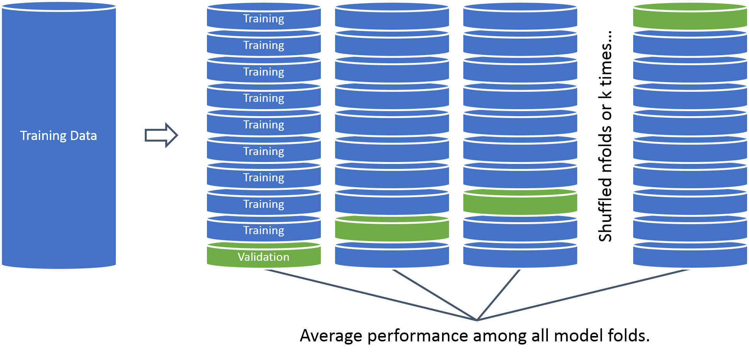
What is cross – validation?
In this example we will perform cross validation because the data set is 20k records.
54

Slide 55
Open 2_CreditModeling_A.R
Learning Objective:
Load in real lending club data
Treat the variables for modeling
Build a cross validated logistic regression with caret
Save model object & variable treatment plan
55

Slide 56
Cutoff Threshold
Is 0.50 the optimal cutoff?
Should we be equal weighted?
Do we care equally about picking paying notes and charged off loans?
56

Slide 57
Open 2_CreditModeling_B.R
Learning Objective:
Score new notes
Make a plot similar to CAPM
Identify top loans to fund
57

Slide 58
Agenda
Start | End | Item
 |  | Securities Summary
 |  | Securities Technical Trading Indicator- SMA
 |  | Securities Technical Trading Indicator- MACD
 |  | Securities Technical Trading Indicator- RSI
 |  | Financial Risk Modeling
 |  | Non-Traditional Markets

Slide 59
Non-Traditional Markets
Traditional
Non-Traditional
Stock Markets
Bond Markets
Housing/Mortgages
Commodities – Gold, Silver etc.
Crop Futures
Consumer Credit
Crypto-currencies
Beanie Babies
Derivatives (originally)
Web Domains
…
In contrast to traditional markets, emerging or non traditional markets lack transparency, regulations and can often be manipulated more easily.
59

Slide 60


A non-traditional Market - Example
Owned by Hasbro, MTG is a 25 year old collectible trading card game. It is estimated that there are 8-12million players worldwide. Thus is it popular and has demonstrated longevity unlike other non-traditional markets.
60

Slide 61
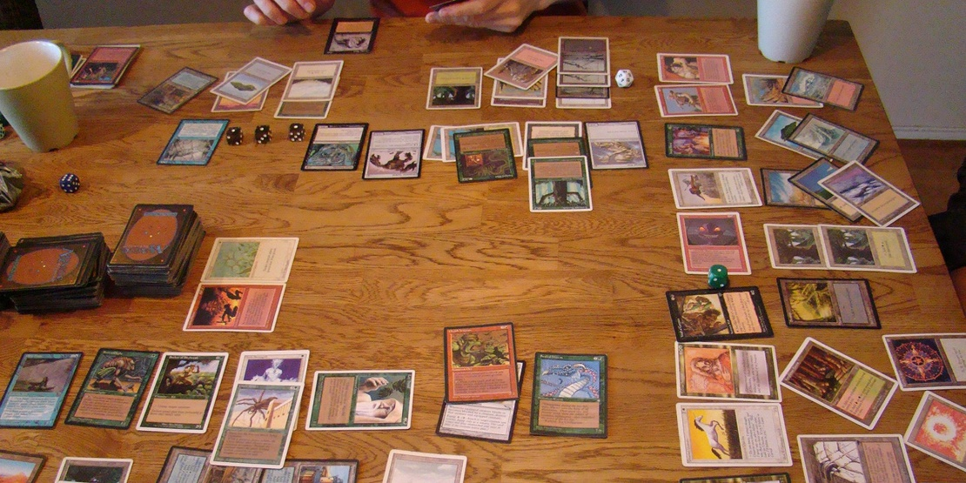
Magic The Gathering
Players create 60 card decks with cards of different abilities for a duel. Cards are fantasy based with creatures, sorceries, and mythical artifacts.
61

Slide 62
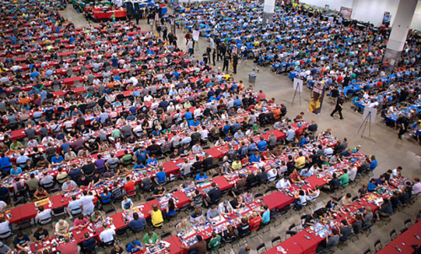

Magic The Gathering
Limited Print Runs
Specific Card Rarities
62

Slide 63
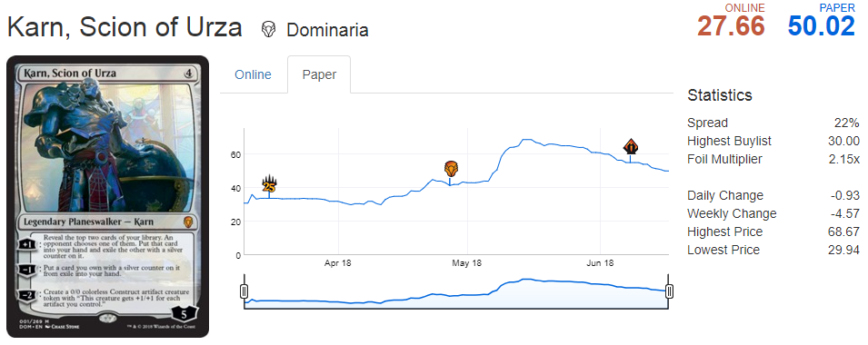
And that’s why it’s a market…
Karn, Scion of Urza is a popular card selling for ~$50 but has been as much as $65. Websites such as mtggoldfish.com and mtgstocks.com track prices on various market sites.
63

Slide 64
So how do you get cards?
Say you are a player that needs to get Karn, Scion of Urza to complete a deck.
For $50
You could buy Karn from an online marketplace.
For $3
You can open a booster pack from the appropriate expansion set and hope you get it.
For $90
You can buy a booster box of 36 packs from the set and increase your odds of getting it while also getting many other potential valuable cards.
For $540
You can buy 6 of the booster boxes in a case.
Cards go out of print limiting the supply.
64

Slide 65
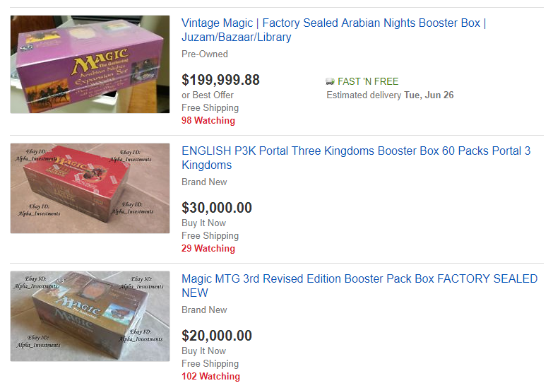
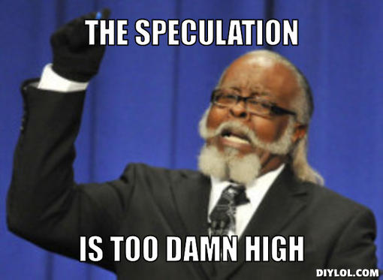
People Speculate as Supply Diminishes
65

Slide 66
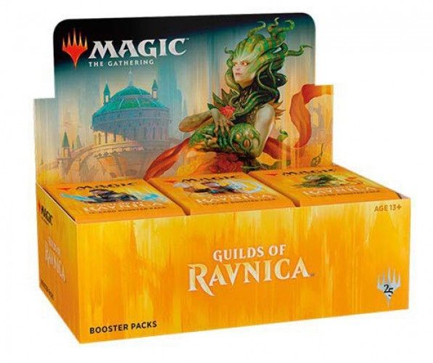
Regardless of the Reserved List
Newly printed cards are sold in 15 card packs.
Usually a pack contains
11 Commons
3 Uncommons
1 Rare
1 in 8 packs will replace the rare with a mythic
1 in 6 packs will have a random premium foil card replacing a common.
66

Slide 67
Modeling Risk/Reward outside of the Reserved List
When you open a pack:
Risk:
Each expansion set has varying prices. Some cards are worthless while other cards can be expensive..
Reward:
Some packs will contain expensive cards which you can immediately sell for more than the cost of the pack.
Since we know the cards in a set, their prices, and the probabilities of getting specific cards, we can simulate pack openings.
*Keep in mind there are friction costs, shipping a physical good takes time and money.
67

Slide 68

Open 3_SimulateBoosters.R
68

