Slide 1
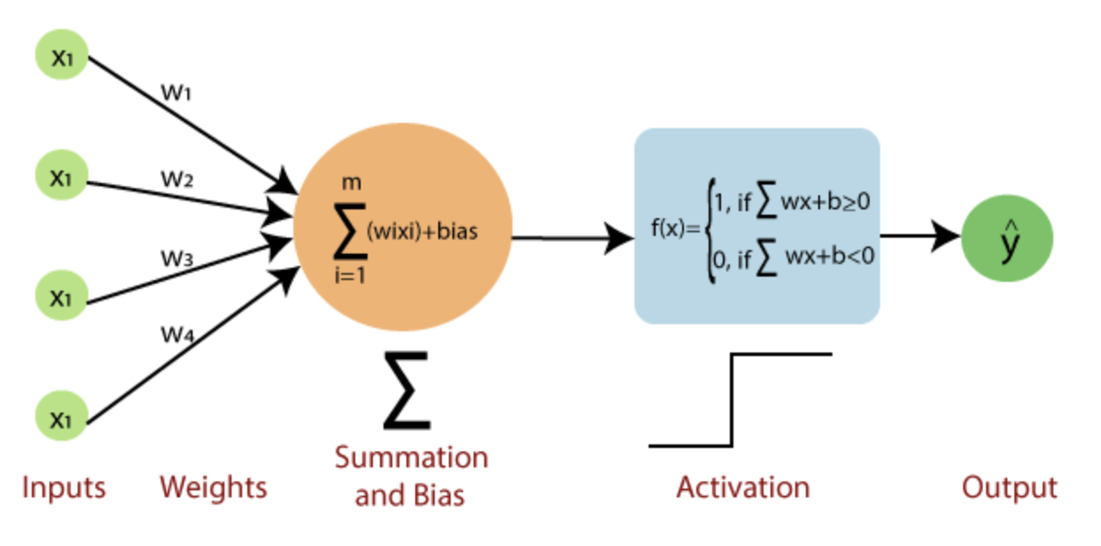
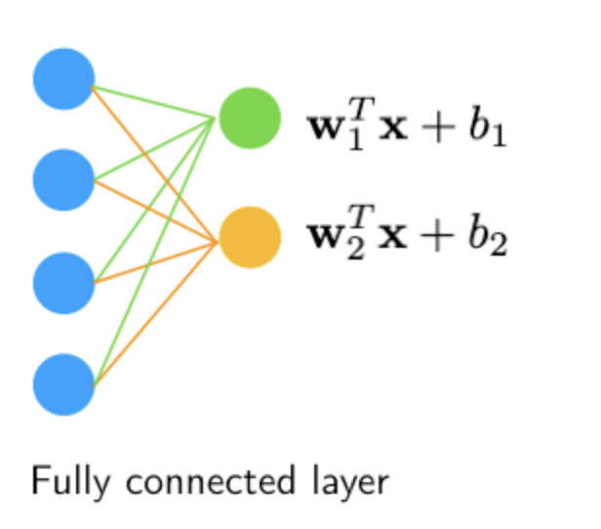
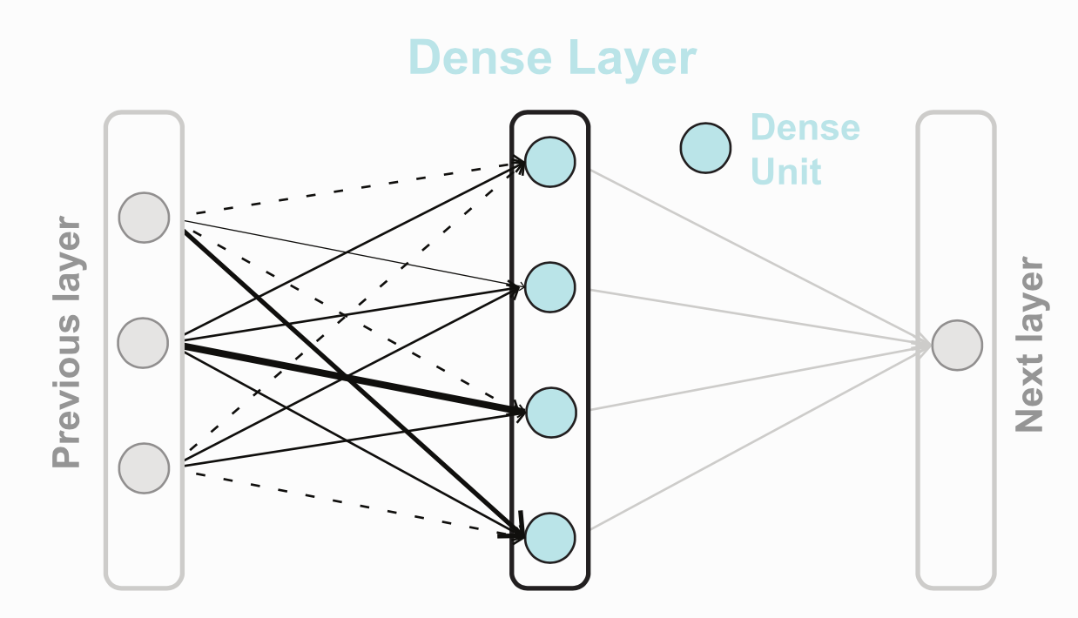
Notes:
https://www.javatpoint.com/single-layer-perceptron-in-tensorflow
https://sebastianraschka.com/faq/docs/fc-to-conv.html

Slide 2












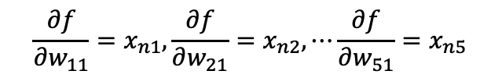


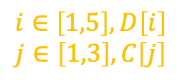






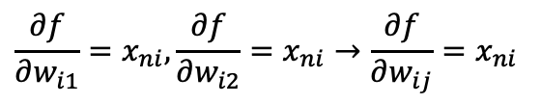






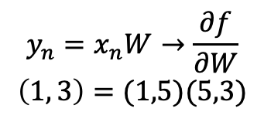


















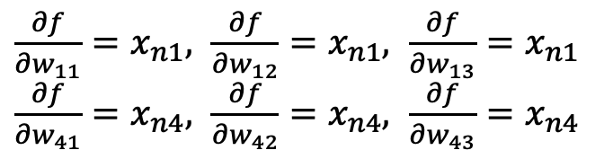


$$f\left(X;W\right)=XW$$
X: A numpy array of shape (N, D), N=100, D=5,X[n] means n_th sample
W: A numpy array of shape (D, C) weights, C=3
Y: A numpy array of shape (N, C) output score;
- y: A numpy array of shape (N,) labels; y[i] = c
$$y_{n}=x_{n}W→\frac{∂f}{∂W}$$
$$\left(1, 3\right)=(1,5)(5,3)$$
$$w_{ij}$$
$$i∈\left[1,5\right], D\left[i\right]$$
$$j∈\left[1,3\right], C\left[j\right]$$
$$w_{ij}$$
$$x_{n1}$$
$$x_{n1}$$
$$w_{ij}$$
$$x_{n1}$$
$$w_{11}$$
$$w_{11}$$
$$w_{21}$$
$$w_{12}$$
$$x_{n2}$$
$$y_{n1}$$
$$x_{n2}$$
$$y_{n1}$$
$$x_{n2}$$
$$w_{22}$$
$$y_{n1}$$
$$w_{12}$$
$$w_{31}$$
$$w_{13}$$
$$x_{n3}$$
$$y_{n2}$$
$$x_{n3}$$
$$w_{32}$$
$$x_{n3}$$
$$y_{n2}$$
$$y_{n2}$$
$$w_{41}$$
$$w_{41}$$
$$w_{42}$$
$$w_{42}$$
$$x_{n4}$$
$$y_{n3}$$
$$x_{n4}$$
$$y_{n3}$$
$$x_{n4}$$
$$y_{n3}$$
$$w_{51}$$
$$w_{43}$$
$$w_{52}$$
$$x_{n5}$$
$$x_{n5}$$
$$x_{n5}$$
$\frac{∂f}{∂w_{11}}=x_{n1}, \frac{∂f}{∂w_{12}}=x_{n1},$ $\frac{∂f}{∂w_{13}}=x_{n1}$
$\frac{∂f}{∂w_{41}}=x_{n4}, \frac{∂f}{∂w_{42}}=x_{n4},$ $\frac{∂f}{∂w_{43}}=x_{n4}$
$$\frac{∂f}{∂w_{11}}=x_{n1}, \frac{∂f}{∂w_{21}}=x_{n2},⋯\frac{∂f}{∂w_{51}}=x_{n5}$$
$\frac{∂f}{∂w_{12}}=x_{n1}, \frac{∂f}{∂w_{22}}=x_{n2},$... $\frac{∂f}{∂w_{52}}=x_{n5}$
$$\frac{∂f}{∂w_{i1}}=x_{ni}, \frac{∂f}{∂w_{i2}}=x_{ni}→\frac{∂f}{∂w_{ij}}=x_{ni}$$
$\frac{∂f}{∂w_{1j}}=x_{n1}, \frac{∂f}{∂w_{4j}}=x_{n4}→$ $\frac{∂f}{∂w_{ij}}=x_{ni}→dW\left[:j\right]=X[n]$
$dW\left[1:j\right]=X\left[n,1\right]$, $dW\left[2:j\right]=X\left[n,2\right]$,$dW\left[3:j\right]=X\left[n,3\right]→ dW\left[:j\right]=X[n]$

