Slide 1
Online Course Registration System
CST499 Capstone Project
Jeremy Caston
https://github.com/CastonJ/Capstone_Project
Instructor: Joseph Rangitsch
Notes:
Hello everyone. My name is Jeremy, and this presentation covers my Online Course Registration System developed as part of the CST499 Capstone course. Throughout this project, I designed, developed, tested, and implemented a web-based application that allows students to register for accounts, enroll in courses, manage their schedules, and view their academic information through a secure web interface.

Slide 2
Project Overview
Web-based course registration system
PHP and MySQL
XAMPP development environment
Student account management
Course enrollment and waitlists
Notes:
The goal of this project was to develop a functional course registration system similar to what colleges and universities use. The application was built using PHP, MySQL, HTML, CSS, and JavaScript. Students can create accounts, log in securely, enroll in courses, view their schedules, join waitlists when classes are full, and remove courses from their schedules. The project was developed and tested locally using XAMPP.

Slide 3
Software Requirements Specification (SRS)
Student Registration
User Authentication
Course Enrollment
Waitlist Management
Schedule Management
Database Integration
Notes:
During the requirements phase, I developed a Software Requirements Specification document that defined the system's functional requirements. The system needed to support student registration, secure login functionality, course enrollment, waitlist management, and database integration. These requirements guided the design and implementation of the application throughout the project.

Slide 4

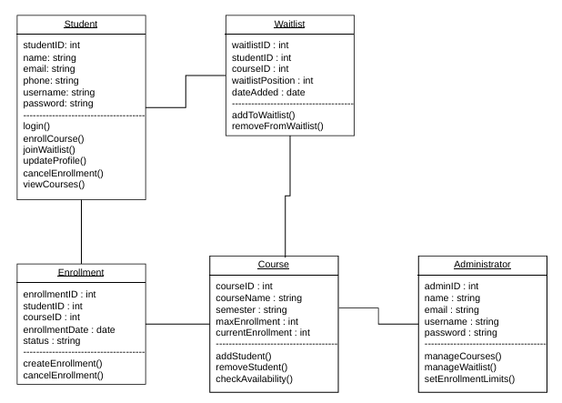
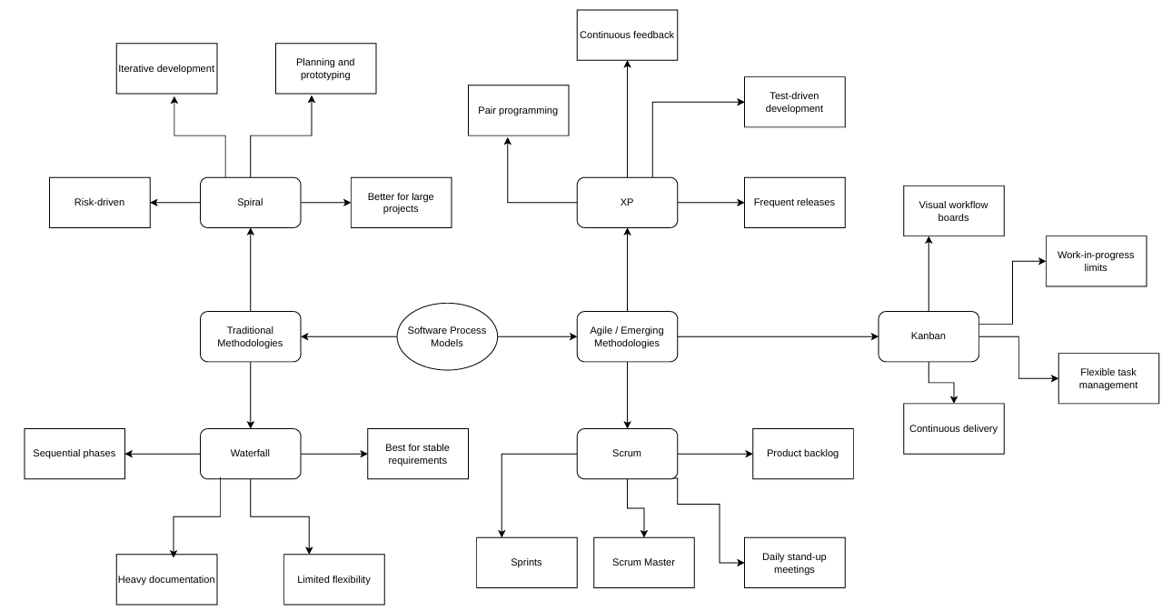
UML Design Models
Notes:
UML diagrams were used to visualize the system before development began. The use case diagram identified the interactions between students and the system, including registration, login, enrollment, and schedule management. The class diagram illustrated the relationships between students, courses, enrollments, and waitlist records. These diagrams helped ensure the database and application design met the project requirements.

Slide 5
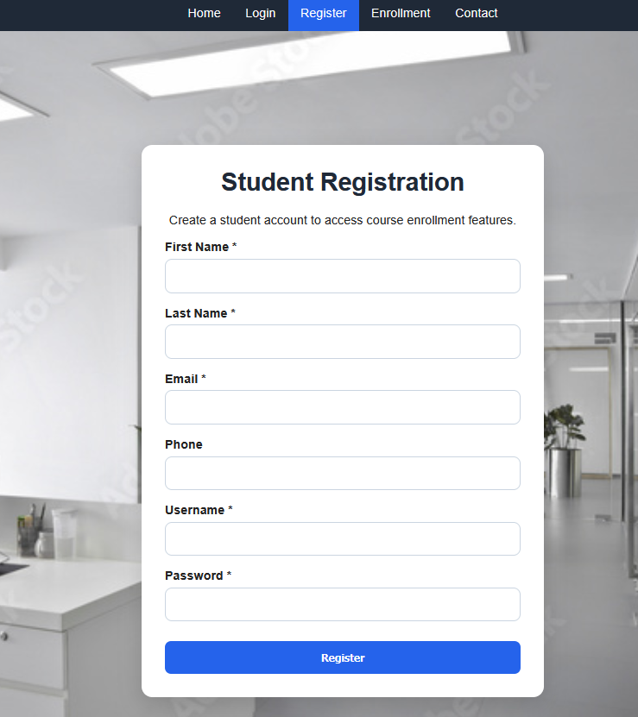
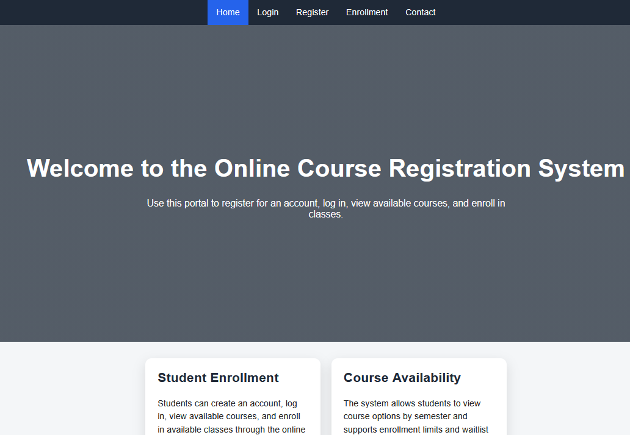
Landing Page and Registration
Notes:
The landing page serves as the entry point to the application and provides navigation to all major functions. New users can create an account through the registration page. The registration form collects student information and securely stores account credentials in the database using password hashing. Validation checks ensure all required information is entered before an account is created.

Slide 6
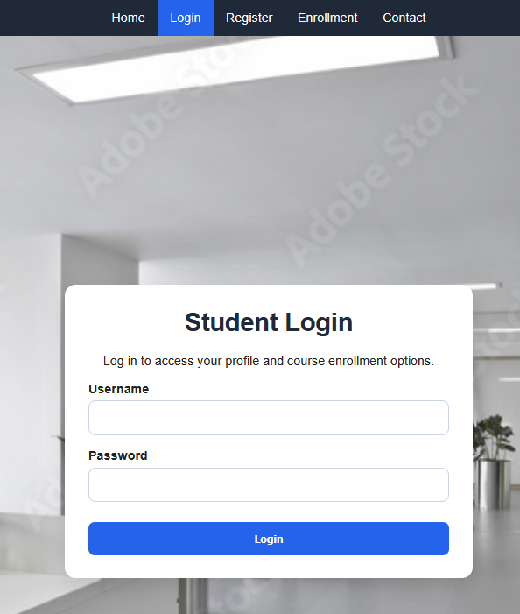
Login and Session Management
Notes:
The login page authenticates users against information stored in the database. Once authenticated, PHP session management is used to maintain the user's login state. Protected pages such as enrollment and profile pages require authentication before access is granted. This helps prevent unauthorized access to student information.

Slide 7
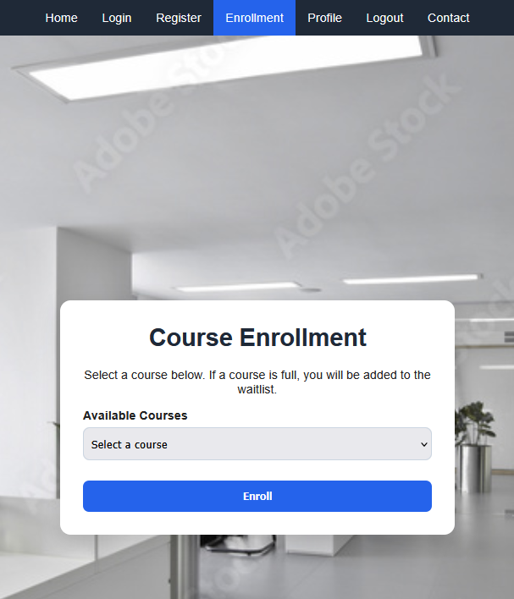
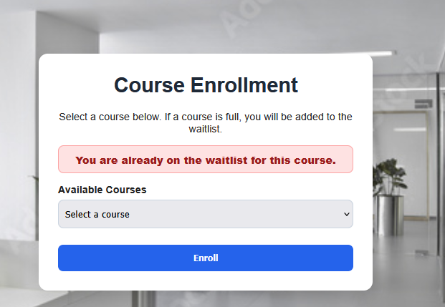
Enrollment and Waitlist Features

Slide 8
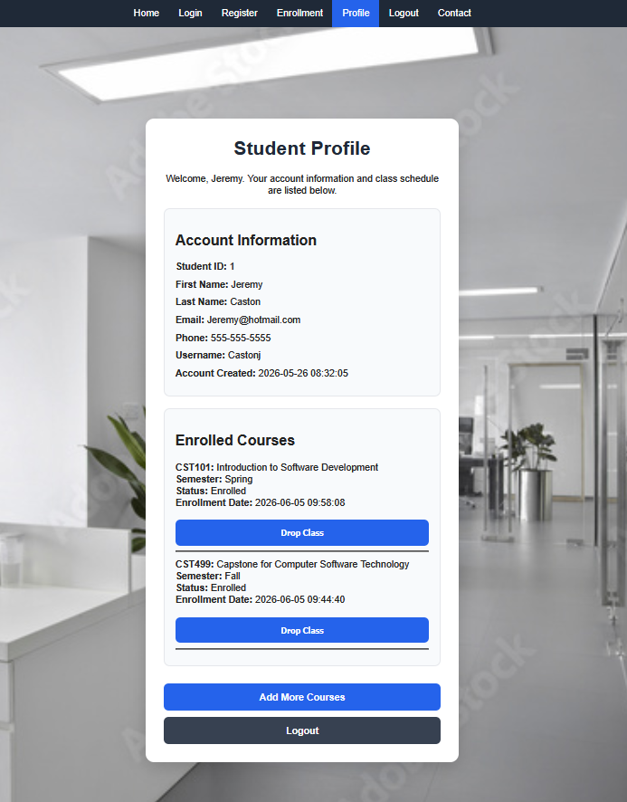
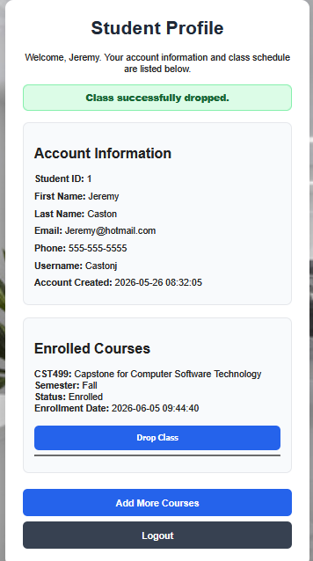
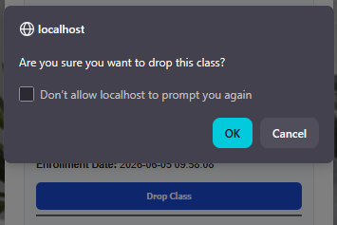
Student Profile and Course Management
Notes:
The profile page displays student information along with all currently enrolled courses. Students can view course details, enrollment dates, and enrollment status. A drop course feature was added to allow students to remove courses from their schedules. When a course is dropped, the enrollment record is removed and course counts are automatically updated in the database.

Slide 9
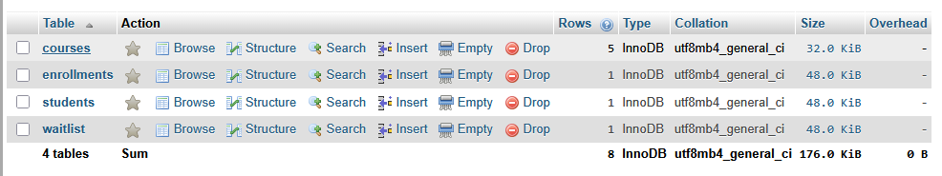
Database Design and Backend Development
Notes:
The application uses a MySQL database to store and manage system data. The Students table stores user account information. The Courses table contains available course offerings. The Enrollments table tracks registered classes, while the Waitlist table manages students waiting for openings in full courses. PHP database connections and prepared statements were used to securely communicate with the database and help prevent SQL injection vulnerabilities.

Slide 10
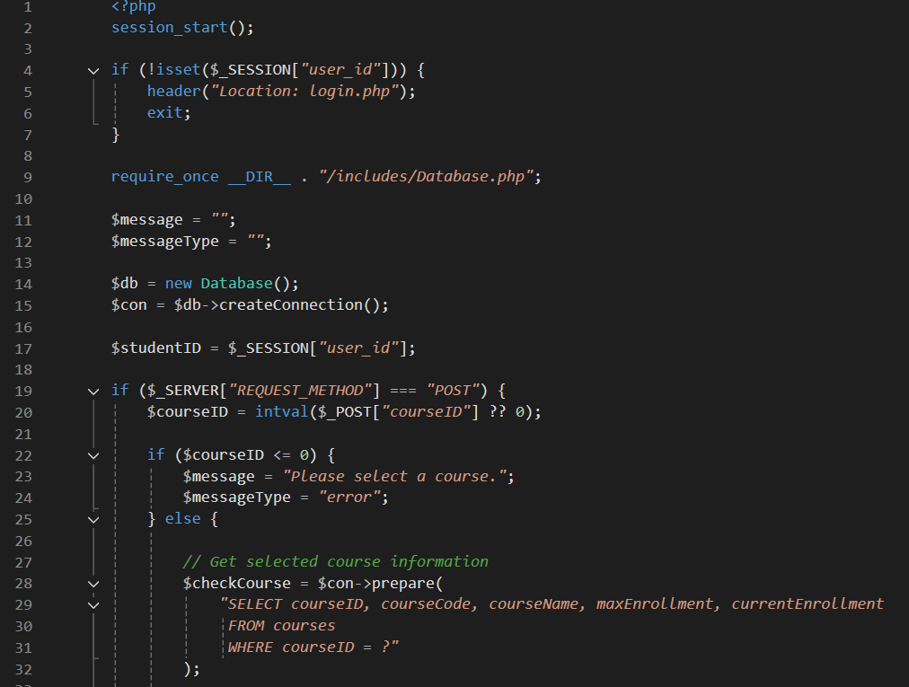
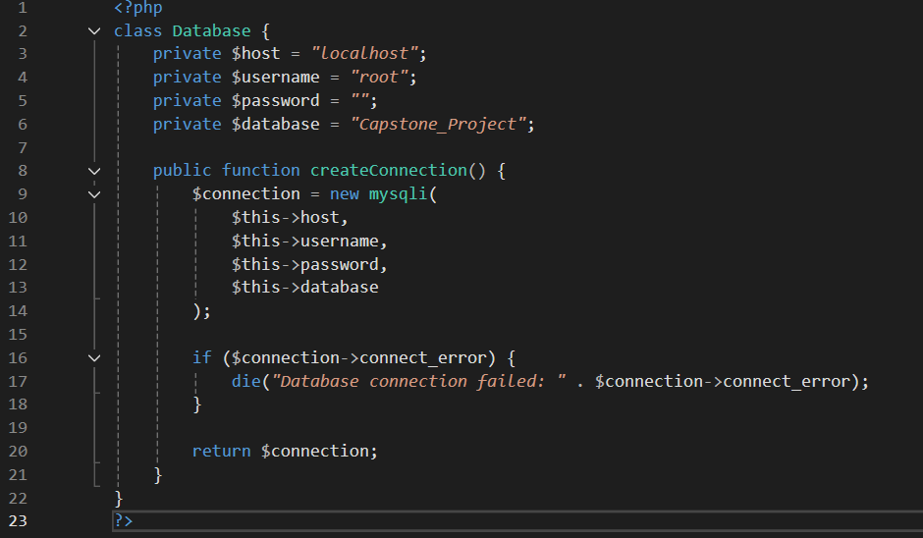
PHP Code and Testing
Notes:
PHP was used to implement all server-side functionality, including registration, login validation, enrollment processing, waitlist management, and course removal. Testing included functional testing, integration testing, and regression testing. Multiple test cases were performed to verify successful registration, enrollment, waitlist placement, and course removal. The completed application met all major project requirements.

Slide 11
Lessons Learned and Conclusion
Lessons Learned:
Database Design
PHP Development
GitHub Version Control
Testing and Debugging
Software Project Management
Notes:
This project provided valuable experience in software development, database design, testing, and project management. I gained hands-on experience using PHP, MySQL, GitHub, and XAMPP while applying concepts learned throughout the program. One of the most important lessons was the value of planning, testing, and version control throughout the development process. Overall, the project successfully met the requirements and resulted in a fully functional Online Course Registration System.

Slide 12
References
Guru99. (n.d.). Test plan template: Sample document with web application example. https://www.guru99.com/test-plan-for-project.html
GitHub. (n.d.). GitHub. https://github.com
Spillner, A., Linz, T., & Schaefer, H. (2014). Software testing foundations: A study guide for the certified tester exam (4th ed.). Rocky Nook.
Tsui, F., Karam, O., & Bernal, B. (2018). Essentials of software engineering (4th ed.). Jones & Bartlett Learning.
The PHP Group. (n.d.). PHP: Hypertext Preprocessor. https://www.php.net
Oracle. (n.d.). MySQL documentation. https://dev.mysql.com/doc/
Apache Friends. (n.d.). XAMPP. https://www.apachefriends.org
Notes:
Thank you for your time. This concludes my presentation of the Online Course Registration System project.

