Slide 1
DESKTOP PUBLISHING (DTP)
INTRODUCTION
Desktop publishing is an application software used in production of publication work within the computer framework of art and design.
Publishing involves production of publications like newspapers, cards, pamphlets, pictures and calendars of professional quality.

Slide 2
DESKTOP PUBLISHING (DTP)
DESKTOP PUBLISHING
Desktop publishing is the process of producing publications by designing, inserting, editing, formatting and printing of text and graphical objects using desktop publishing software.
DTP software gives the user more tools and control of the page layout, text manipulation, and graphics than a word processor.

Slide 3
DESKTOP PUBLISHING (DTP)
EXAMPLES OF DTP SOFWARES
Adobe page maker,
Microsoft publisher
QuarkXPress
Adobe InDesign
Ventura
Serif PagePlus
Apple Page 2

Slide 4
Purpose of Desktop Publishing Software
Graphic Design: allows a publisher to create and edit very complex text and graphical objects like pictures .
Page layout Design: allows user to design a page layout by setting consistent picture and object locations and creating layers
Printing: once the publication artwork has been completed, printing can be done using offset or digital printer

Slide 5
Advantages of DTPs over word processors
DTP have some superior features that make them do more than word processors, yielding the following advantages;
Every page is contained in a layered frame and can be edited and formatted independently
Content can be contained in a single frame or threaded between several frames.
Frames do not need to flow in logical order. E.g., content on page 1 may be continued on page 8.
DTPs provide wide range of templates like brochures, booklets, posters, business cards etc.
Multiple stories from different authors can be handled with ease.
Master pages are used to set common layout
which maybe repeated on several pages. E.g. logos and page numbers.

Slide 6
Designing a publication
Different publications can be designed and formatted in DTP software, they include;
Cards: wedding card, graduation cards, congratulation cards
Certificates: this type of publications are very sensitive because they must be designed to discourage duplications or counterfeits
Newspapers, magazines, pamphlets and newsletters
Books: bulky publications with many pages
Calendars: contains heavy catchy graphics for advertisement purposes other than showing dates.

Slide 7
Getting started with Ms Publisher 2013
LAUNCHING PUBLISHER 2013
Click the start button to display the start menu.
On the start menu, scroll to Ms office 2013, then click Publisher 2013. this displays various templates and a list of recently opened or saved publications.
To open recent publication, click its name on the recent list.
To open a publication not in the recent list, click the Open Other Publications Option. Or simply click on a blank publication or any other template.

Slide 8
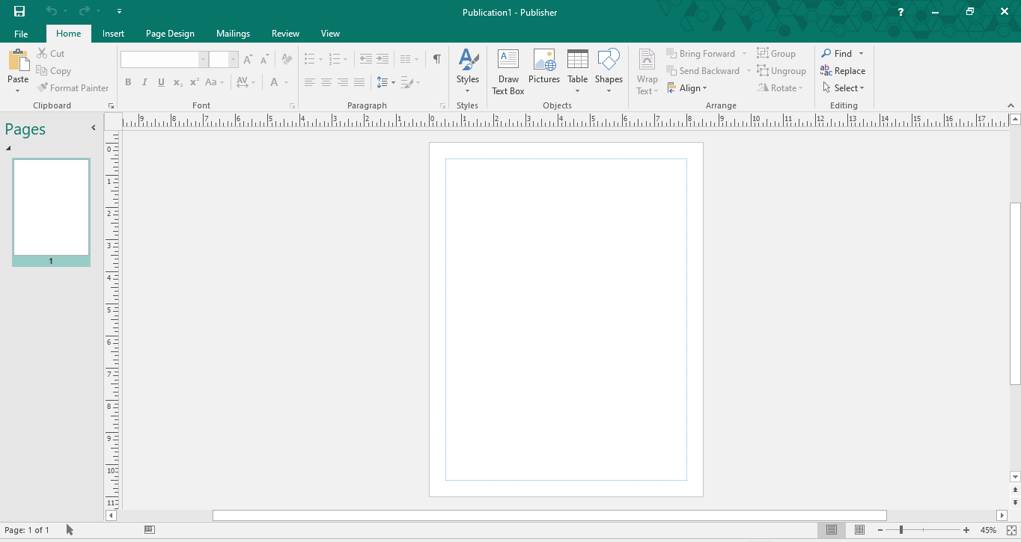
Ms Publisher 2013 screen Layout
Ms Publisher 2013 Application window
Quick access toolbar
Command button in groups
Ribbon
Horizontal ruler bar
Pasteboard
Printable area
Pages pane

Slide 9
Ms Publisher 2013 screen Layout
FEATURES OF MS PUBLISHER 2013
The following features are found in the Publisher 2013 window, the are used to create and manipulate a publication.
The pasteboard
The ribbon
Rulers
Printable area
Status bar
Quick Access toolbar

Slide 10
Ms Publisher 2013 screen Layout
FEATURES OF MS PUBLISHER 2013
4. The printable area:
This area looks like a page.
Surrounded by text box
Any text or object in this area will be printed by the printer
5. Quick Access toolbar:
A set of buttons on the left of the title bar that is customised to have a set mostly used commands, e.g., save, undo, redo etc.. The user might specify any other
6. Status bar: Displays status information to the user.

Slide 11
Ms Publisher 2013 screen Layout
FEATURES OF MS PUBLISHER 2013
1. The pasteboard:
A large working area where you place texts and graphical objects before moving and placing them on the printable area enclosed with margins.
2. The ribbon and command groups:
The application window has a horizontal tabbed ribbon each with a list of grouped commands.
3. Rulers:
The vertical and the horizontal rulers help the user to place the contents accurately , also performs measurements.

Slide 12
Setting up a publication
Involves making necessary changes to setup options of a publication like page size, margins, orientation etc.
On the PAGE DESIGN tab, in the Page Setup group, select the following options.
Click margins command then select relevant margin settings e.g. wide, Narrow, moderate etc. you can also custom margins.
Click orientation then select portrait or landscape orientation
Click the size button to set the page size e.g A4, A5, letter, etc

Slide 13
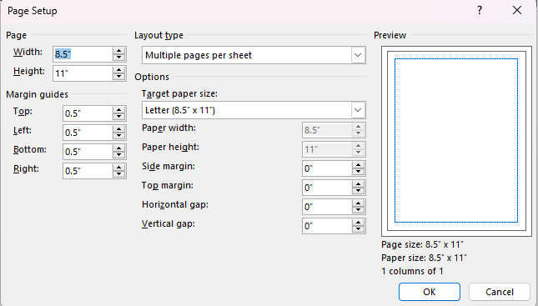
Setting up a publication
Using page setup dialog box
Click page setup dialog box launcher located at the bottom right of the page setup group to open the setup dialog box as shown.

Slide 14
Setting up a publication
Using page setup dialog box Cont’
ii. Enter the width, height, margin guides and layout type then click OK to save the changes
iii. In the layout type box, choose layout such as One page per sheet, Booklet, Email, Envelope, Folded Card, Multiple pages per sheet or web page.
iv. Click OK to close the dialog box.

Slide 15
Setting up a publication
Setting up a publication using Master Pages

Slide 16
Saving the layout
To save a publication, proceed as follows,
Click FILE tab then select Save As command.
In the Saves As screen, select the location and then enter in the Save As dialog box as displayed

Slide 17
Displaying and Hiding rulers
If the rulers are not displayed, click the VIEW tab, then check the Rulers Checkbox in the show group.
Unchecking the checkbox hides rulers

Slide 18
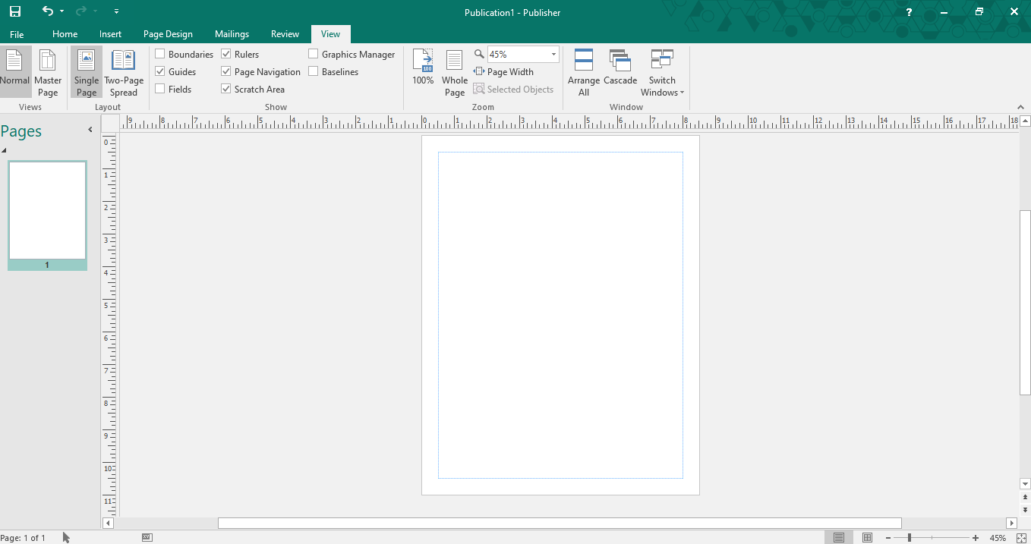
Displaying and Hiding rulers
.

Slide 19
Selecting ruler measurement units
Involves setting different measurements e.g. millimeters, centimeters, inches etc.
Click the FILE tab then choose the Options command
In the Publisher Options, Click Advanced tab to display Advanced Options dialog box, select the preferred units measurement in the show measurements in units of : under display section.

Slide 20
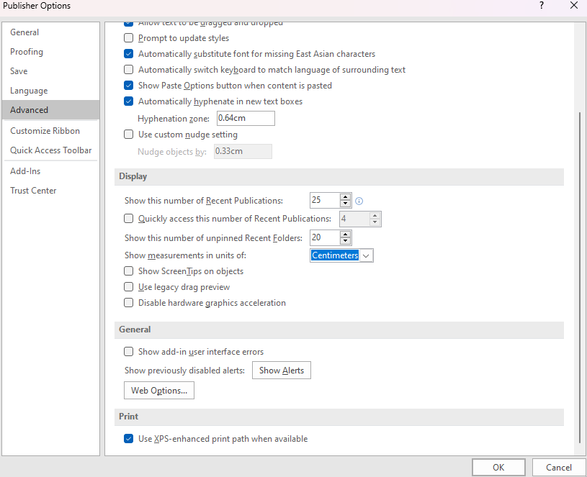
Selecting ruler measurement units
Setting ruler measurements units
.

Slide 21
MANIPULATING TEXT GRAPHICAL OBJECTS
Manipulating text
In publisher, a document can be created by typing text into the text box or text frames that can be manipulated as objects.

Slide 22
MANIPULATING TEXT GRAPHICAL OBJECTS
Typing text using text box
On the INSERT tab in the text group, click, Text Box, Drag a rectangular area to define a text block or frame. It is the text frame that defines the space you want the text to occupy.
Type the text in the text box and it will take the rectangular area that you specified.

Slide 23
MANIPULATING TEXT GRAPHICAL OBJECTS
Using text frame
Text can also be typed into a shape that becomes a text frame since the text is contained inside it.
On the insert tab, click shapes then select a shape. Draw the shape on the canvas.
Click the shape to select it.
On the format ribbon under Drawing tool, Click edit text button located in the insert shapes group.

Slide 24
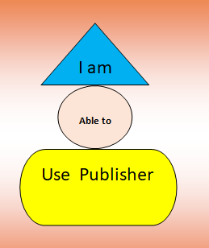
MANIPULATING TEXT GRAPHICAL OBJECTS
Using text frame
This figure shows various text
Frames
<To be used as a practical activity>

Slide 25
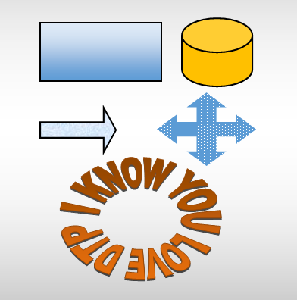
MANIPULATING TEXT GRAPHICAL OBJECTS
Manipulating Graphical Objects
The figure shows Graphic objects in Publisher.
They can also be formatted with fill color , patterns , borders styles etc..

Slide 26
MANIPULATING TEXT GRAPHICAL OBJECTS
Manipulating Graphical Objects
To draw graphical objects;
Click INSERT, then Shapes then select preferred shape, Draw the shape on the canvas
Click a shape to select it
Drag the shape on the publication canvas to draw
To fill the shape with color, select it and the click FORMAT tab under the DRAWING TOOLS
Use the shape fill, shape outline and Shape Effects In the shape styles to format the shape
To insert artistic words(Word Art) in the publication
On the INSERT tab, click WordArt and then select a Word Art.
Enter text in the edit Word Art text box then click OK

Slide 27
MANIPULATING TEXT GRAPHICAL OBJECTS
Manipulating Graphical Objects
To draw graphical objects;
Click INSERT, then Shapes then select preferred shape, Draw the shape on the canvas
Click a shape to select it
Drag the shape on the publication canvas to draw
To fill the shape with color, select it and the click FORMAT tab under the DRAWING TOOLS
Use the shape fill, shape outline and Shape Effects In the shape styles to format the shape
To insert artistic words(Word Art) in the publication
On the INSERT tab, click WordArt and then select a Word Art.
Enter text in the edit Word Art text box then click OK

Slide 28
FORMATING A PUBLICATION
Formatting the publication is the process of applying special attributes to text, graphical objects to make them attractive and appealing to the reader.
Formatting may therefore include Font sizing, Bolding, changing text color, adjusting picture brightness and formatting columns on page

Slide 29
FORMATING A PUBLICATION
TEXT FORMATTING
FORMATTING TEXT
Commands available on the HOME and PAGE DESIGN ribbons are used.
To format text;
Highlight the text you want to format
On the HOME ribbon in the font group, use the bold, Italic, Underline, Subscript, Superscript, color etc. to format font.

Slide 30
FORMATING A PUBLICATION
TEXT FORMATTING
CHANGING CASE
PROCEDURE
To change Case;
Select the text you want to change case
Click the Change Case buttoin in the font group
Select Normal, Small Caps or All caps
The Change case command (Aa) is found within the font group. Case can be changed to Normal, Small Caps and All Caps

Slide 31
FORMATING A PUBLICATION
TEXT FORMATTING
FORMATING TEXT TO SUPERSCIPT AND SUBSCRIPT
PROCEDURE
Select the text you want to style as subscript or superscript.
In the font group, click Superscript (X²) or subscript (X₂) button
Superscript refers to text placed slightly higher than the rest on the same line e.g. power of 3 in 10³
While subscript s text slightly below the same line like 2 in H₂O

Slide 32
FORMATING A PUBLICATION
TEXT FORMATTING
DROP CAP
PROCEDURE
D
Select thee character you want to drop
On the format ribbon under the text box tool, click Drop Cap command button
Select the drop cap style the list from the list
rop cap as shown by the first let D in the paragraph is to make the first character in a first line of a paragraph bigger. The letter drops down to occupy the space in the next lines

Slide 33
FORMATING A PUBLICATION
PARAGRAPH FORMATTING
SETTING INDENTS AND TABS
PROCEDURE
Indents move text inward from right while or left while tab stops position text at specific positions.
To set Indents
Click the paragraph you want to indent
Click Either the Decrease Indent Position Or Increase Indent Position In the Paragraph Group.

Slide 34
FORMATING A PUBLICATION
PARAGRAPH FORMATTING
ADDING BLANK SPACE ABOVE OR BELOW PARAGRAPHS
PROCEDURE
To increase decrease space before or after paragraph;
You can control the vertical space between paragraphs by specifying the amount of space before or after selected paragraphs
Select the paragraph you wish to preset space before, or after.
In the paragraph dialog box, click the indents and spacing tab.
In the line spacing section , set the spacing

Slide 35
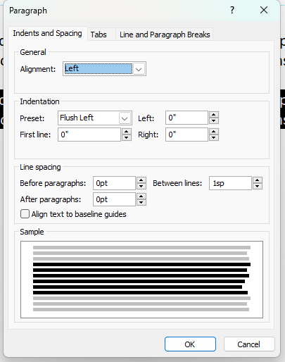
FORMATING A PUBLICATION
PARAGRAPH FORMATTING
Setting Space between paragraphs
In the Before paragraphs box, set the space to be inserted before a paragraph.
In the After paragraphs dialog box, set the space to be inserted after paragraph.

Slide 36
FORMATING A PUBLICATION
PARAGRAPH FORMATTING
Tracking and kerning
Tracking refers to the visual closeness or denseness of characters in a word or line of text.
Tracking varies within a document depending on the target reader
Kerning Is the art of fixing particular pairs of letter that are too close or too far from each other in a word or sentence.

Slide 37
FORMATING A PUBLICATION
PARAGRAPH FORMATTING
LINE SPACING
PROCEDURE
Adjusts the space between lines in paragraphs
To adjust space between lines in paragraphs;
Select one or more paragraphs.
On the HOME ribbon click the line spacing command in the paragraphs group.
Click a line spacing e.g. 1.0, 1.5,2.0,2.5 or 3.0 etc.
Click line spacing options incase you need more spacing options and set customs
Click OK button.

Slide 38
FORMATING A PUBLICATION
FORMATTING GRAPHICAL OBJECTS
APPLYING ROUNDED CORNERS AND CHANGING SHAPES
PROCEDURE
To apply rounded corners to rectangles and squares;
Graphical objects can be edited and formatted using picture and drawing tools.
Select the rectangle or square whose corners you ant to change
On the DRAWING TOOLS, click the change shape command in the insert shapes group.
Select the option of rounded corners
To change a shape completely, select a different shape.

Slide 39
FORMATING A PUBLICATION
FORMATTING GRAPHICAL OBJECTS
Creating complex shapes
PROCEDURE
Drawing complex shapes like Pentagon might require a bit of creativity, unlike drawing shapes like stars, triangles that are just picked
To insert a star shaped;
On the shapes drop down list select a shape.
Draw the shape on the canvas
Click the Edit shape to deepen edges. A yellow handle appears within the shape
Drag the yellow handle inwards or outwards to adjust the size of the star edges.

Slide 40
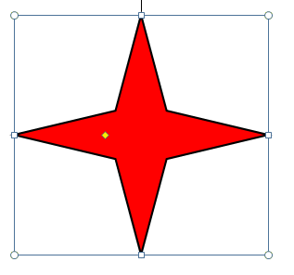
FORMATING A PUBLICATION
FORMATTING GRAPHICAL OBJECTS
Before Drawing
After drawing
Yellow handle

Slide 41
FORMATING A PUBLICATION
FORMATTING GRAPHICAL OBJECTS
Copying and moving Objects
Importing Graphical Objects
To copy or move an object;
Select one or more objects
On the HOME ribbon, click the Cut or Copy In the Clipboard group
Position the insertion pointer where you want to place the object.
From Edit menu, select paste
To import a graphic, proceed as follows;
Click the picture button on the insert ribbon.
Browse the picture you wish to insert.
Select the file you want to insert then click the insert button.
The picture will be inserted in publisher. You can resize and format the picture as you wish.

Slide 42
FORMATING A PUBLICATION
FORMATTING GRAPHICAL OBJECTS
Grouping and Ungrouping objects
To group Objects
Objects can be grouped to so as to format, resize or move them as a single entity
Using the pointer tool, hold down the shift keys as you click the objects to be grouped to select multiple objects.
Click the group button in the arrange group of format ribbon. Note that the object behave like one.
To ungroup objects
Select the Group
Click the Ungroup button next to Group button

Slide 43
FORMATING A PUBLICATION
FORMATTING GRAPHICAL OBJECTS
Rotating Objects
To Rotate an Object
The process of rotating an object falls under the group of operations called Arrange because it transforms an object by changing its angular replacement.
Click the object to activate picture , or drawing tools ribbon.
Click Rotate button in the Arrange group.
Select rotation option from the list.

Slide 44
FORMATING A PUBLICATION
FORMATTING GRAPHICAL OBJECTS
Cropping an object
To crop a graphic using the cropping tool
Cropping involves hiding parts of a graphic that you don’t want to be printed
Click the object to activate the picture tools ribbon
Click the crop button located in the crop group of the format ribbon
Position the cropping tool and the n drag towards the center of the object. The cropped part becomes invisible

Slide 45
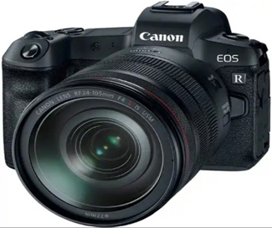
FORMATING A PUBLICATION
BEFORE AND AFTER CROPPING
Before Cropping
After Cropping

Slide 46
PRINTING A PUBLICATION
PRINTING A PUBLICATION
To print a publication in publisher;
On the File tab, click PRINT. The print screen pops up.
In the print screen preview your work as played on the left.
To define print options;
In the copies of print job box, set the number of copies to be printed.
Click the down arrow under the printer to select the printer.
Under settings, set the page range to print, paper size, orientation and composite RGB or grayscale.
4. Click the PRINT button to print your work
Unlike printing in other applications programs learnt earlier, printing in DTP is a bit technical

Slide 47
DESKTOP PUBLISHING
TOPICAL REVIEW QUESTIONS

Slide 48
DESKTOP PUBLISHER
THE END

