Slide 1
Comparing Stop-the-World Garbage Collection Strategies on a Stack-Based Bytecode Interpreter
Vitor Andrade Fernandez - 2798043
First supervisor: Atze van der Ploeg
Second supervisor: Klaus Freiherr von Gleissenthal
Notes:
[ notes ]

Slide 2
THE PLAN
Presentation Content
ACT 1 · SETUP
1
The problem
2
The idea
3
The implementation
4
What we ask
ACT 2 · THE RESULT
5
Throughput
6
Collection is not the culprit
7
The budget sweep
8
The no-GC control
ACT 3 · MORE THAN JUST THROUGHPUT
9
Latency & space
10
Choosing a collector
11
Limitations
12
Conclusion
Notes:
[ notes ]

Slide 3
ACT 1 · THE PROBLEM
Textbook GC's are boring
Textbook claims are qualitative: “copying wastes half the heap”, “mark-sweep fragments”
No numbers for a real machine: which wins, by how much, why?
The catch
Existing comparisons vary collector + runtime + allocator + benchmarks at once
The algorithm is entangled with everything around it
Result: trade-offs stay hidden, never measured
Notes:
Spend time here. Make them FEEL the confound before offering the fix: every published comparison varies too much at once, so the textbook trade-offs are never actually measured on one machine.

Slide 4
ACT 1 · THE IDEA
One interface, five GC's, same workload
baseline
IJVM host
raw allocation
root enumeration
heap walk
mark / forward bits
relocate
mark-sweep
one
interface
mark-compact
cheney
generational
Notes:
The one-sentence contribution. Five collectors plug into one interface; everything else is frozen, including the optimisation level. Be honest: the interface holds five, but generational only runs at the largest heap, so the EVALUATION is three collectors plus the baseline. That sets up the 'three' you compare from here on.

Slide 5
ACT 1 · THE IMPLEMENTATION
Designing the VM and the Heap
1
Stack-based IJVM
object layout
extended with array heap instructions (NEWARRAY / ANEWARRAY, loads, stores)
length
(4B)
tags
(4B)
element 0
element 1
…
2
8-byte header, walkable heap
← 8-byte header →
int32 elements →
length + tag bits; objects contiguous and 4-aligned, so the heap can be walked linearly
why it matters
walkable heap → sweep & compaction
roots by address → relocate in place
precise tags → no conservative scanning
3
Precise model & roots
tag bits separate references from integers; roots are tagged stack slots, yielded by address
Notes:
Keep this tight - the VM is the stage, not the story. Three facts, ~45s: stack-based IJVM with array instructions; 8-byte header + walkable heap; precise model and roots-by-address. Each fact justifies something later. Describe the CONTRACT the GC relies on, not the VM internals (private repo).

Slide 6
ACT 1 · THE IMPLEMENTATION
The collectors
collector
allocation
reclamation
baseline
bump pointer
never collects. It is the performance floor
mark-sweep
size-segregated free lists
mark, then sweep into free lists
mark-compact
bump pointer
mark, forward, update refs, relocate
cheney
bump (one semispace)
copy live to the other semispace
generational
bump (nursery)
copy nursery survivors to old gen; mark-compact when full
Notes:
Don't walk pseudocode. The audience needs exactly one contrast: mark-sweep searches free lists; the moving collectors bump-allocate into a dense heap. That single difference is the whole RQ1 story.

Slide 7
ACT 1 · THE COLLECTORS
Mark-Sweep
mark-sweep
HOW IT WORKS
HEAP VIEW
Mark
after marking from the roots
Start from the roots and follow every pointer, marking each object you can reach as live.
A
×
B
×
×
C
Sweep
Walk the whole heap; anything left unmarked is garbage and goes onto a free list.
after sweeping — live cells stay put
A
free
B
free
free
C
Reuse in place
Nothing moves — addresses never change, so no pointers need updating.
freed gaps → free list (note: A, B, C never moved)
TRADE-OFF
Simple and non-moving, but reclaimed space is scattered, so the heap fragments.
Live objects keep their addresses; the gaps between them are reclaimed onto a free list. No copying — but free space stays scattered.

Slide 8
ACT 1 · THE COLLECTORS
Mark-Compact
mark-compact
HOW IT WORKS
HEAP VIEW
Mark
before — live objects scattered
As in mark-sweep, trace from the roots to find every live object.
A
×
B
×
×
C
Slide together
Move all the live objects to one end of the heap, packed tightly.
after — survivors slid to one end
A
B
C
one contiguous free region
Fix pointers
Update every reference to point at each object's new address.
TRADE-OFF
Leaves one contiguous free region (no fragmentation), but takes several passes over the heap.
Marked objects are slid together to one end, leaving a single free region. Allocation becomes a cheap bump pointer again — at the cost of extra passes to relocate and fix pointers.

Slide 9
ACT 1 · THE COLLECTORS
Copying — Cheney semi-space
cheney
HOW IT WORKS
HEAP VIEW
Two halves
from-space (active)
to-space (empty)
Split the heap in two. The program only ever allocates into one half.
copy live
Copy the living
A
×
B
A
B
When it fills, copy just the live objects into the empty half, packed.
Flip
…then flip: to-space becomes the new active half ⇄
Swap the roles of the two halves and carry on. Dead objects are simply left behind.
TRADE-OFF
Allocation and compaction are almost free, but only half the heap is ever usable.
The heap is two equal halves. Live objects are copied into the empty half and the roles flip; the dead are abandoned wholesale. Cheap and compacting — but you pay with half the heap.

Slide 10
ACT 1 · THE COLLECTORS
Generational
generational
HOW IT WORKS
HEAP VIEW
Most objects die young
old / tenured (rarely collected)
young / nursery
So split the heap into a small young nursery and a large old region.
promote
Collect the nursery often
S
S
×
s
×
Cheap, frequent collections; the few survivors are promoted to the old region.
Write barrier
A tiny check on each pointer store remembers old→young pointers so they aren't missed.
write barrier records this old→young pointer
TRADE-OFF
Little work per collection and little copying — but needs a write barrier, and the rare full collection is expensive.
Objects are born in the small nursery, collected often and cheaply; the few survivors are promoted to the old region, collected only rarely. A write barrier tracks old→young pointers.

Slide 11
ACT 1 · WHAT WE ASK
The four research questions
RQ1
Throughput
How do the collectors compare on mutator throughput and GC overhead as heap pressure varies?
RQ2
Latency
How do pause-time distributions (mean and maximum) differ across collectors and workloads?
RQ3
Space
How tight a heap can each collector survive and what is Cheney's semispace penalty in practice?
RQ4
Generational
Does the generational collector match the others' throughput and footprint — and what do its write barrier and worst-case pause cost?
Notes:
State the questions only - no answers. The detective arc in Act 2 reveals RQ1; RQ2/RQ3 in Act 3. Note mutate maps to no RQ so nobody asks why four workloads for three questions. ~30 seconds; this is scaffolding, not a result.

Slide 12
ACT 1 · THE WORKLOADS
Four workloads, each stressing one thing
Synthetic, seed-controlled allocation patterns — 50,000 iterations each. They are the 1–4 on every results chart.
1
churn
2
density
A 64-slot keeper array; each step allocates one array that dies at once unless (~5%) it is kept. Heavy short-lived garbage over a tiny live set.
The same allocations as churn, but the arrays are reference-dense (they point at the keeper) — same volume, far costlier to trace.
live set ~5.1 KiB · stresses throughput
live set ~7.1 KiB · stresses tracing cost
3
longlived
4
mutate
A 256-node linked list kept alive for the whole run, while short-lived garbage churns around it. A large, permanent live set.
Mostly pointer rewrites over 256 ring-linked nodes; it allocates only ~¼ of the time. This is what exercises the write barrier.
live set ~41 KiB · stresses compaction / retention
live set ~17 KiB · stresses mutation / write barrier

Slide 13
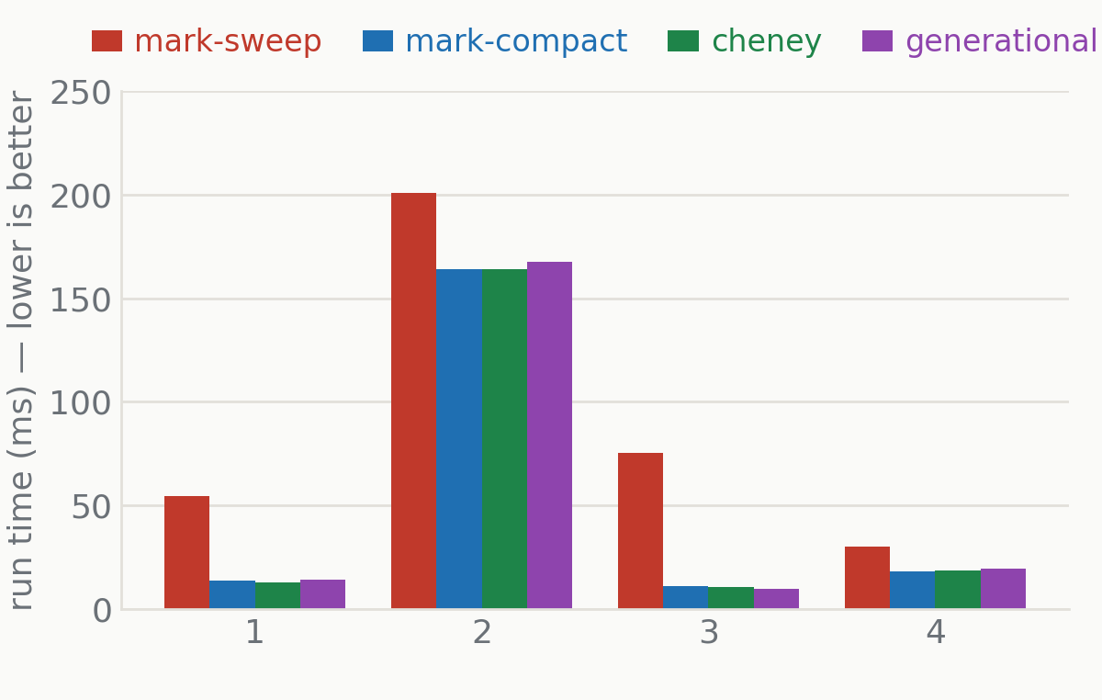
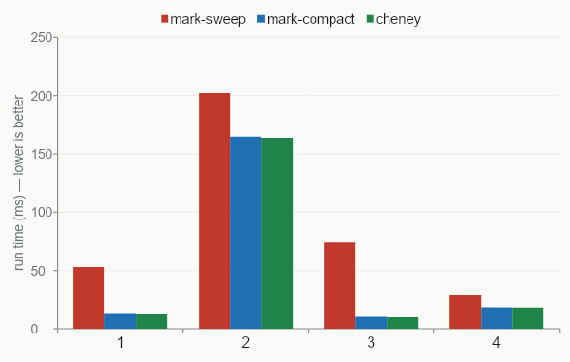
ACT 2 · THROUGHPUT
Moving collectors are faster. By a lot.
4.0–7.6×
on churn & longlived (allocation-bound)
density: only 1.2×
there, mutator work dominates, not allocation
Notes:
The headline. Bars are run time, lower is better; mark-sweep (red) towers on churn and longlived. The two moving collectors tie each other. density barely moves because it's mutator-bound - a clue we use later. Then ask: WHY is mark-sweep slow?

Slide 14
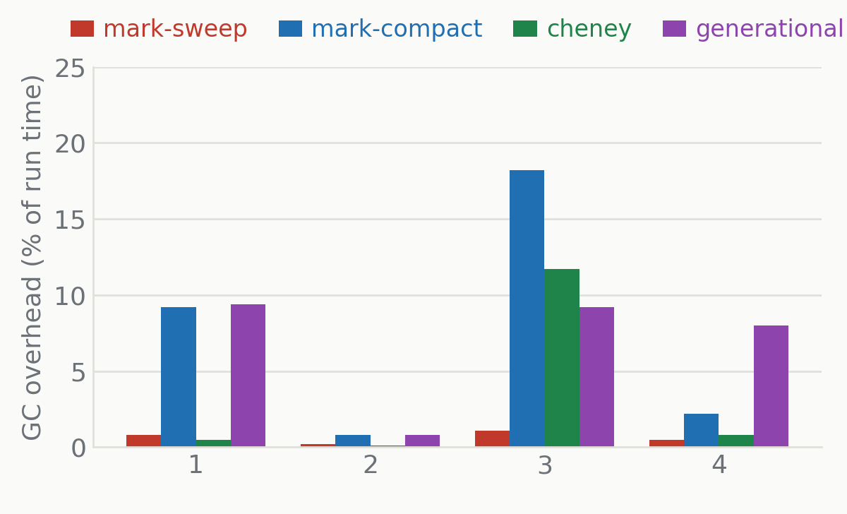
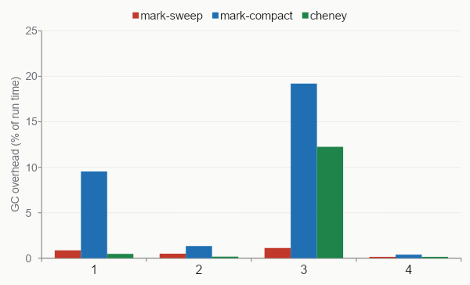
ACT 2 · COLLECTION IS NOT THE CULPRIT
Free-lists are the real bottleneck
< 1.1%
mark-sweep time in collect()
true even where it is the slowest collector
the slowness is not the sweep
Notes:
The reversal. Obvious suspect - 'mark-sweep collects all the time' - is wrong: its overhead is the SMALLEST of the three. Note the irony: mark-compact pays up to ~19% relative overhead and still wins on throughput because its absolute run time is tiny. If not collection, where is the cost? Next slide.

Slide 15
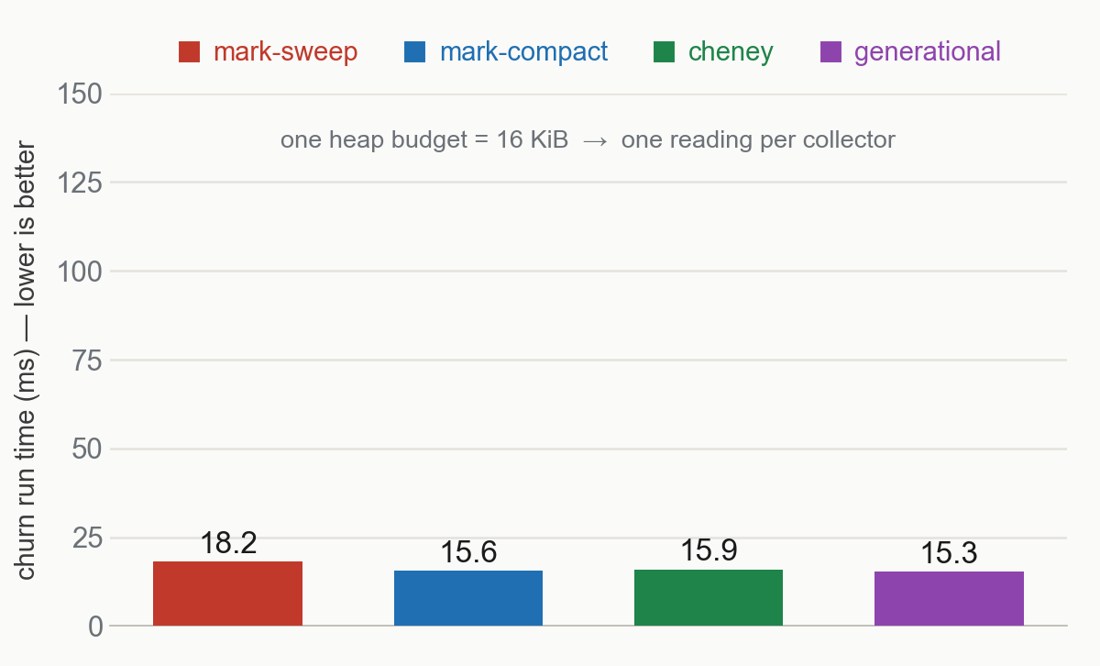
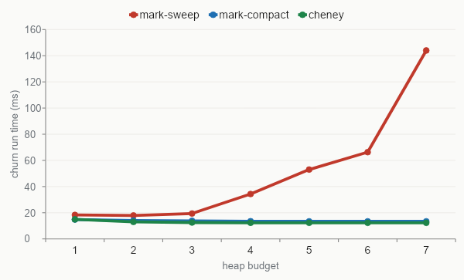
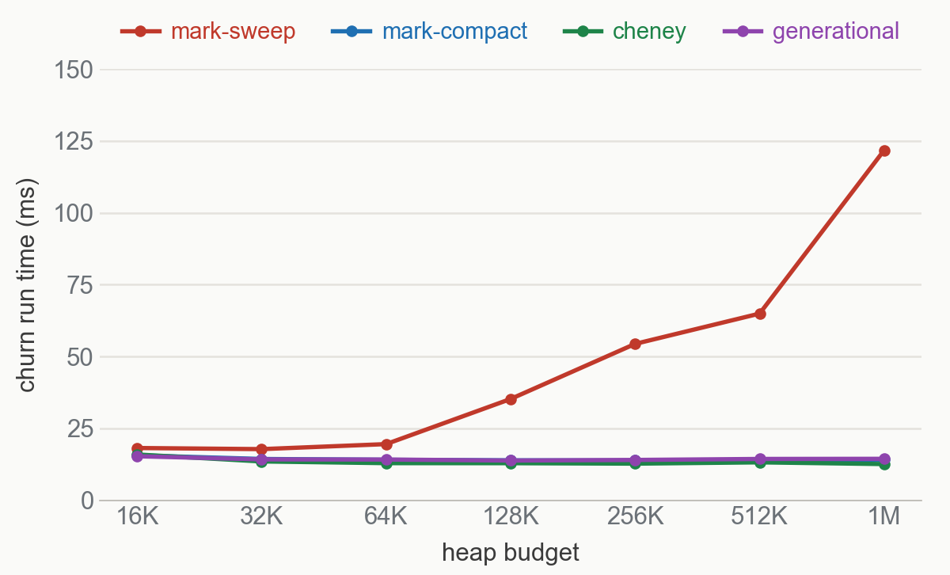
ACT 2 · THE BUDGET SWEEP
Vary the heap budget, hold everything else
the method
budget = only variable
read run time vs heap size
single-budget bars -> a curve
Notes:
Set up the sweep as a method: budget is the independent variable, run time the reading. This is different in kind from the single-budget bars before. Don't reveal the punchline yet - that's slide 10. (Cheney's line simply starts where it can run; don't explain the absence here, that's the space slide.)

Slide 16
ACT 2 · THE BUDGET SWEEP
Only mark-sweep slows down as the heap grows
The real problem
mark-sweep climbs 18→122 ms
moving + generational stay flat
yet its overhead falls below 1%
cost is in the allocation path
worsens as free space scatters
Notes:
Your best slide. One red line climbing, two flat lines at the bottom - and overhead is FALLING over the same range. The flatness of the moving collectors is half the proof: it's not heap size per se, it's what mark-sweep DOES with it. Title note: the climb is the moderate-to-large regime; it's fast again at the tightest budgets and at the anchor.

Slide 17
ACT 2 · THE NO-GC CONTROL
Allocation is the real penalty
 | churn | density | longlived | mutate
baseline | 13.4 | 166.4 | 9.4 | 18.4
mark-sweep | 13.5 | 168.2 | 9.9 | 18.5
mark-compact | 13.2 | 168.4 | 9.6 | 18.4
cheney | 13.3 | 165.3 | 9.8 | 18.1
generational | 15.2 | 167.8 | 35.5 | 20.4
What if the heap is massive?
8 MiB anchor: no collection fires
free list never touched
mark-sweep ties the bump collectors
deficit = free-list allocation, not collection
run time at the 8 MiB anchor (ms). No collection fires for the non-generational collectors, which all tie; generational still collects (nursery < heap), so it sits higher — sharply on longlived.
Notes:
Closes RQ1. Switch off the suspected cause (huge heap, no collection, free list never touched) and the penalty vanishes - mark-sweep ties baseline and the moving collectors. Elimination: overhead measured directly (<1.1%); remainder tied to allocation by the sweep + anchor controls. Be honest: this is attribution by elimination, NOT direct profiling - we don't separate search cost from fragmentation.

Slide 18
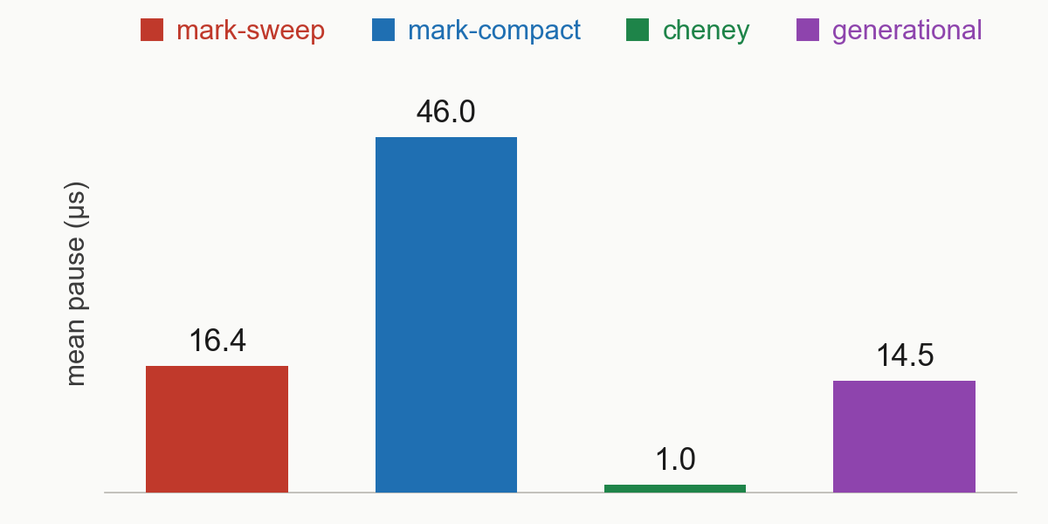
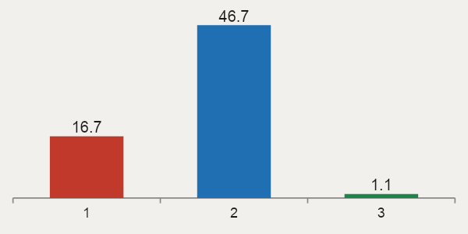
ACT 3 · LATENCY & SPACE
There is no free lunch
Latency - mean pause (µs)
Space - smallest heap survived
 | churn | density | longlived | mutate
mark-sweep | 16K | 16K | 64K | 32K
mark-compact | 16K | 16K | 64K | 32K
cheney | 16K | 32K | 128K | 64K
generational | 16K | 16K | 64K | 32K
mark-sweep, mark-compact & generational share the tightest heap
Cheney pays the biggest penalty (semispace halving)
Cheney is the smallest: scales with live-set
mark-compact is the largest: does several heap passes
measured with churn at 262 KiB
Notes:
Compress RQ2 and RQ3 - supporting context, not headline. The ranking INVERTS: Cheney best on latency, worst on space; mark-compact worst on latency. No universal winner - that's the point of 'no free lunch'.

Slide 19
ACT 3 · CHOOSING A COLLECTOR
Decide the most important variable
Tight memory + throughput
mark-compact smallest footprint, and far faster than mark-sweep at it
Latency, heap to spare
cheney shortest pauses, needs 2x more heap
Simplicity / non-moving
mark-sweep simple, but concedes throughput as the heap grows
Throughput + low pauses
generational matches mark-compact on space & speed at the lowest typical pause; worst case is heavier
Notes:
One line per scarcity regime. Land it verbally: the best collector depends entirely on which resource you're short of. density aside - there the collector barely matters at all.

Slide 20
ACT 3 · LIMITATIONS
What is the limitation?
Optimisation held at -O0
deliberate isolation: collector is the only variable
-O2 helps collectors unequally (bump allocation will be helped less than free-list)
the order will not change with different optimizations
1
Single machine, synthetic workloads
2
run on a single M2 Pro machine
workloads isolate allocation behaviour over realism
Stop-the-world
3
no concurrency claims
Notes:
Be confident, not apologetic. Lead with -O0 because an examiner WILL ask: it's a deliberate isolation choice, same logic as fixing seeds and workloads. -O2 changes magnitudes, not the ordering (bump allocation has nothing to strip; the free-list walk does). Then single-machine/synthetic and stop-the-world, briefly.

Slide 21
CONCLUSION
No collector wins on every axis
RQ1
moving & generational collectors win throughput up to 7.6×; the gap is a free-list allocation cost, proven by elimination
RQ2
Cheney's pauses smallest, mark-compact's largest
RQ3
non-moving & generational collectors share the tightest heap; Cheney pays up to a doubling
RQ4
matches the moving collectors' throughput and the non-moving footprint at the lowest typical pause; its worst-case pause is heavy-tailed
Notes:
Return to the ONE idea: the cost is allocation, not collection, proven by elimination in a fully controlled setting. One line per RQ. End on future work (generational - the hook already exists), then take questions.

Slide 22
BACKUP · FOR QUESTIONS
All averaged metrics
Per collector × workload at the 262 KiB budget · mean over n = 8 seeds.
Workload | Collector | Colls | Run (ms) | GC (ms) | GC (%) | Mean (µs) | Max (µs) | p99 (µs) | Moved (KiB) | Alloc (MiB) | Peak live (KiB)
churn | mark-sweep | 28 | 54.4 | 0.45 | 0.8 | 16.4 | 21.4 | 21.4 | 0 | 6.87 | 5.2
 | mark-compact | 28 | 13.8 | 1.27 | 9.2 | 46.0 | 55.1 | 55.1 | 47 | 6.87 | 5.1
 | cheney | 57 | 12.7 | 0.06 | 0.5 | 1.0 | 2.4 | 2.4 | 284 | 6.87 | 5.1
 | generational | 93 | 14.0 | 1.33 | 9.4 | 14.5 | 47.6 | 42.0 | 161 | 6.87 | 128.2
density | mark-sweep | 28 | 200.9 | 0.48 | 0.2 | 17.3 | 23.1 | 23.1 | 0 | 6.87 | 7.1
 | mark-compact | 28 | 163.9 | 1.35 | 0.8 | 48.7 | 61.2 | 61.2 | 48 | 6.87 | 7.1
 | cheney | 58 | 164.2 | 0.17 | 0.1 | 2.9 | 7.4 | 7.4 | 407 | 6.87 | 7.1
 | generational | 94 | 167.6 | 1.39 | 0.8 | 15.2 | 54.9 | 51.2 | 162 | 6.87 | 127.6
longlived | mark-sweep | 32 | 75.5 | 0.80 | 1.1 | 24.9 | 32.8 | 32.8 | 0 | 6.90 | 41.2
 | mark-compact | 32 | 10.9 | 1.98 | 18.2 | 61.5 | 72.6 | 72.6 | 4 | 6.90 | 41.2
 | cheney | 81 | 10.4 | 1.21 | 11.7 | 15.0 | 23.4 | 23.4 | 3319 | 6.90 | 41.2
 | generational | 110 | 9.9 | 0.91 | 9.2 | 8.3 | 739.9 | 3.1 | 56 | 6.90 | 56.5
mutate | mark-sweep | 6 | 30.0 | 0.16 | 0.5 | 25.7 | 27.8 | 27.8 | 0 | 1.62 | 16.6
 | mark-compact | 6 | 18.1 | 0.39 | 2.2 | 64.4 | 71.5 | 71.5 | 46 | 1.62 | 16.6
 | cheney | 14 | 18.4 | 0.15 | 0.8 | 10.6 | 14.8 | 14.8 | 237 | 1.62 | 16.6
 | generational | 21 | 19.6 | 1.58 | 8.0 | 73.8 | 486.1 | 486.1 | 169 | 1.62 | 129.3
Baseline omitted — it OOMs at 262 KiB (completes only at the 8 MiB anchor). Moved = cumulative bytes copied. Generational Peak live reflects the old-generation high-water mark — promoted objects not yet reclaimed by a major, not the true live set.

Slide 23
BACKUP · FOR QUESTIONS
The 8 MiB no-GC anchor
Run time (ms) when the heap is so large that almost nothing collects — it isolates pure mutator cost. Mean over n = 8 seeds.
Collector | churn | density | longlived | mutate
baseline | 13.4 | 166.4 | 9.4 | 18.4
mark-sweep | 13.5 | 168.2 | 9.9 | 18.5
mark-compact | 13.2 | 168.4 | 9.6 | 18.4
cheney | 13.3 | 165.3 | 9.8 | 18.1
generational | 15.2 | 167.8 | 35.5 | 20.4
WHAT IT SHOWS
•
baseline = pure-mutator floor; it never collects.
•
mark-sweep ties the bump collectors here → its deficit is allocation, not collection.
•
generational is the exception: nursery < heap, so it still collects (~3×). longlived's 35.5 ms is its one-off first-collection cost.
At this budget only Cheney (1×) and generational (~3×) fire any collection at all; baseline, mark-sweep and mark-compact fire none.

Slide 24
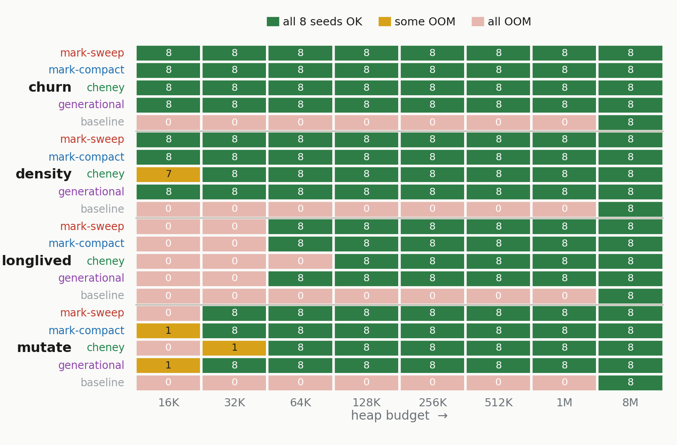
BACKUP · FOR QUESTIONS
Space frontier — across all budgets
Do all 8 seeds complete at each budget? The frontier is where a row turns green. Cell numbers = seeds completed (of 8).
READING IT
mark-sweep, mark-compact & generational share the tightest frontier — they use the whole heap.
cheney needs 1–2 budget steps more: only half its heap is usable (semispace).
baseline never frees, so it survives only at the 8 MiB anchor.

