Slide 1
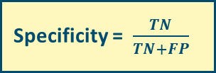

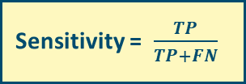



Sensitivity und specificity: before testing (pre-test-probability)
Test positive
Tpos (+)
true positive cases (TP)
sick /
infected
Sensitivity = $\frac{TP}{TP+FN}$
Test negative
Tneg (-)
false negative cases (FN)
persons
Test positive
Tpos (+)
false positive cases (FP)
healthy /
not infected
Specificity = $\frac{TN}{TN+FP}$
Test negative
Tneg (-)
true negative cases (TN)
Positive und negative predictive value: after testing (post-test-probability)
positive predictive value = $\frac{TP}{TP+FP}$
negative predictive value = $\frac{TN}{TN+FN}$
1-positive predictive value = $\frac{FP}{TP+FP}$
1-negative predictive value = $\frac{FN}{TN+FN}$
Notes:
Qualitätskriterien eines diagnostischen Tests

