Slide 1
CS 6320 Project 5
Jordy A. Larrea Rodriguez
U1236145

Slide 2
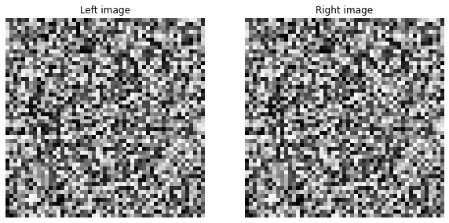
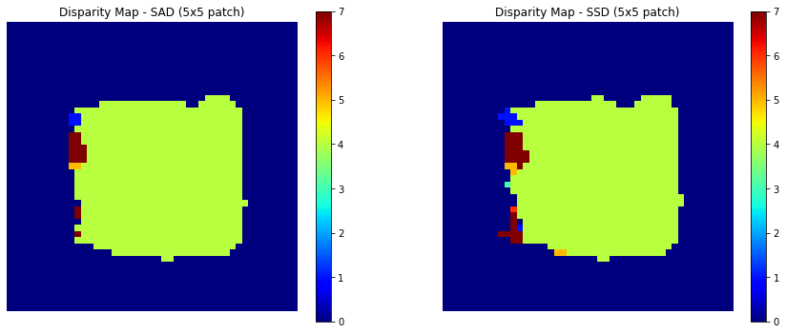
What is the relation between disparity map and depth? [Text/Equations/Drawing whatever you feel is relevant]
Response: The disparity, D, map informs how much a point (x,y) in the left image has shifted horizontally in the right image. By the relation depth = f*B/d (f is the focal length of the camera, and B is the combined distance between the two images), the depth is larger for smaller disparities and the opposite is true for shorter depths (inverse relationship).
Random dot stereogram image [51x51x3] + Can you judge depth by looking them?
From viewing the original dot stereogram image the depth is impossible (very difficult) to discern from site alone.

Slide 3
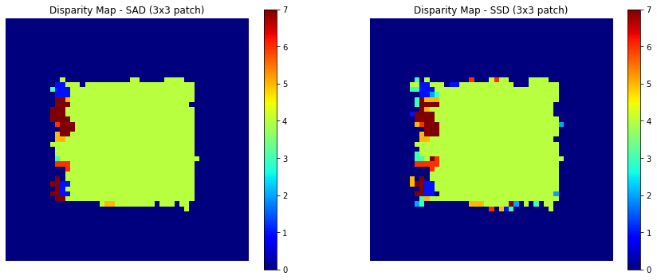
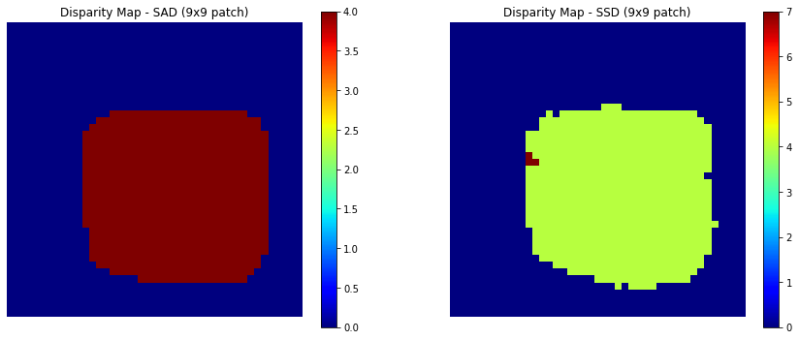
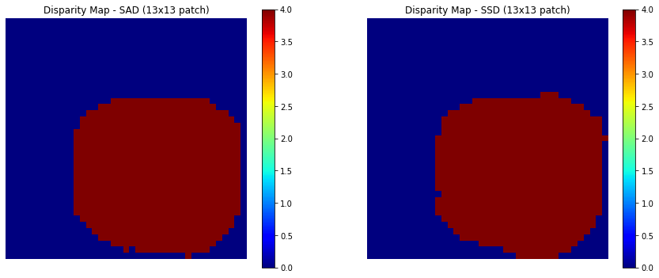
Random dot stereogram disparity maps
What is the effect of increasing the block size? Explain the reasoning behind it?
Increasing block size leads to faster computation but results are generally less accurate; however, increasing patch size increases accuracy at the expense of detail.

Slide 4
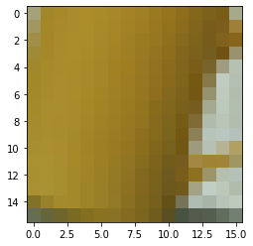
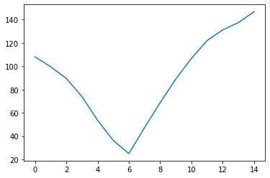
Random dot stereogram: Why is the result poor on the left edge and not on the other edges?
Response: Pixels on left edge may lack corresponding pixels in the right image; therefore, leading to incomplete information for disparity calculation.
Convex error profile: Can you generalize the type of regions which will generate convex profiles?
Yes, look for points consisting of unique features leading to global minimas in the error profile.

Slide 5
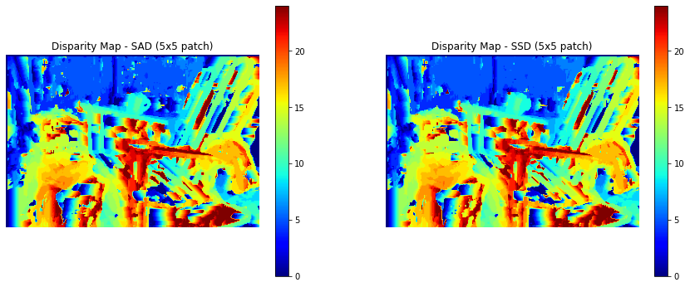
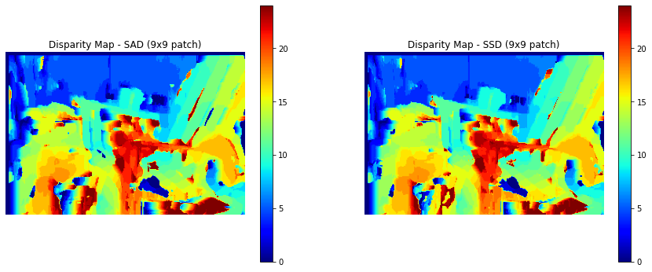
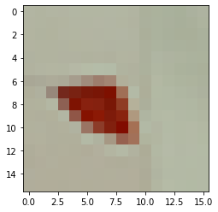
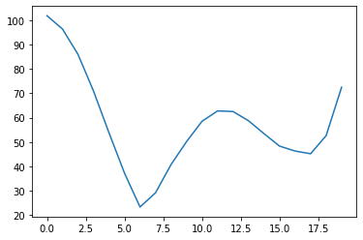
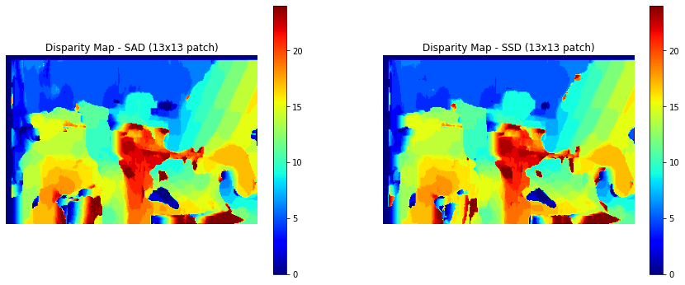
Nonconvex error profile: Can you generalize the type of regions which will generate non-convex profiles?
Yes, areas that use the same texture or repeat certain features such as patterns generally result in non-convex profiles.
Disparity map for Set 1 (for 3 patch sizes)

Slide 6
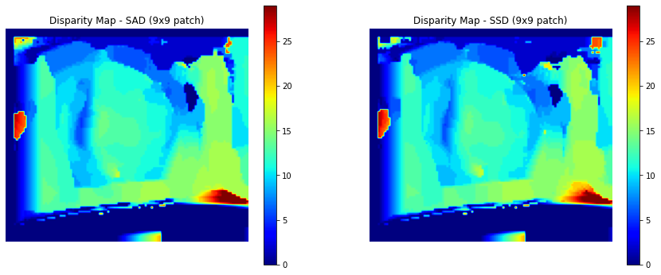
Set 1: Can you think of an explanation as to why the backrest of the chair appears blocky?
Response: The chairs likely appear blocky as a result of the similar texture, color, and shape of the wooden boards making up the chair.
Set 4 disparity maps (only one patch size)

Slide 7
Set 3, 4: peculiar behaviour of the disparity maps near right bowling pin: what do you see in input there and can you explain disparity map there?
Response: The bottom disparities go near zero since the bottom in the set 4 bowling image is set to a single color, white in this case. Thus, the error profiles in the aforementioned region are similar throughout.
Set 3, 4: What was the change between set 3 and set 4? What effect did it have on the disparity? Can you generalize the reasons where disparity calculations wont
Response: Explained in the previous response.

Slide 8
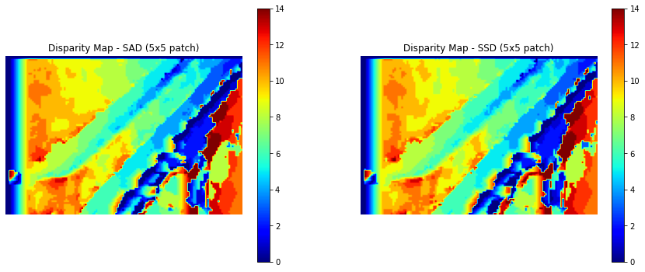
Set 6: Effect on block size on the stairs in disparity maps
The disparity values are innacurate as a result of similar features through the image (lots of local minima in error profiles). Detail reduction w/ increasing patch size causes the disparity on the guard rail to become increasingly inaccurate.
Set 6: Gradual shift in disparity values on the wall
The gradual depth shift in the wall disparity values are fairly accurate, aside from the left edge.

Slide 9
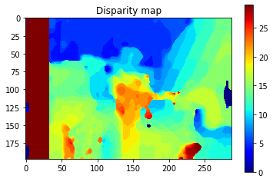
Smoothing
Compare these results on the chair image qualitatively to the output of the chair image without smoothing.
Response: Overall the depth detection on the chair image with the smoothed image is more accurate relative to its non-smoothed counterpart. The left edge reflects poorer results; however, this is probably because of some hiccup in my implementation.
2. What regions of the image does smoothing seem to perform better on and why do you think that is?
Response: Smoothing works better on the latter 80% of the image vs the original.

Slide 10
Smoothing(contd.)
3. What regions of the image does smoothing seem to perform worse on and why do you think that is?
Smoothing works worse on the left edge: a common trend w/ disparity map approximation via the block matching method.
4. Would smoothing still work for images with both a horizontal and vertical shift?
I would be under the assumption that it should work well enough with vertically shifted images.

Slide 11
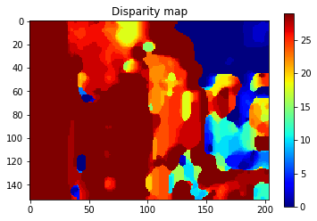
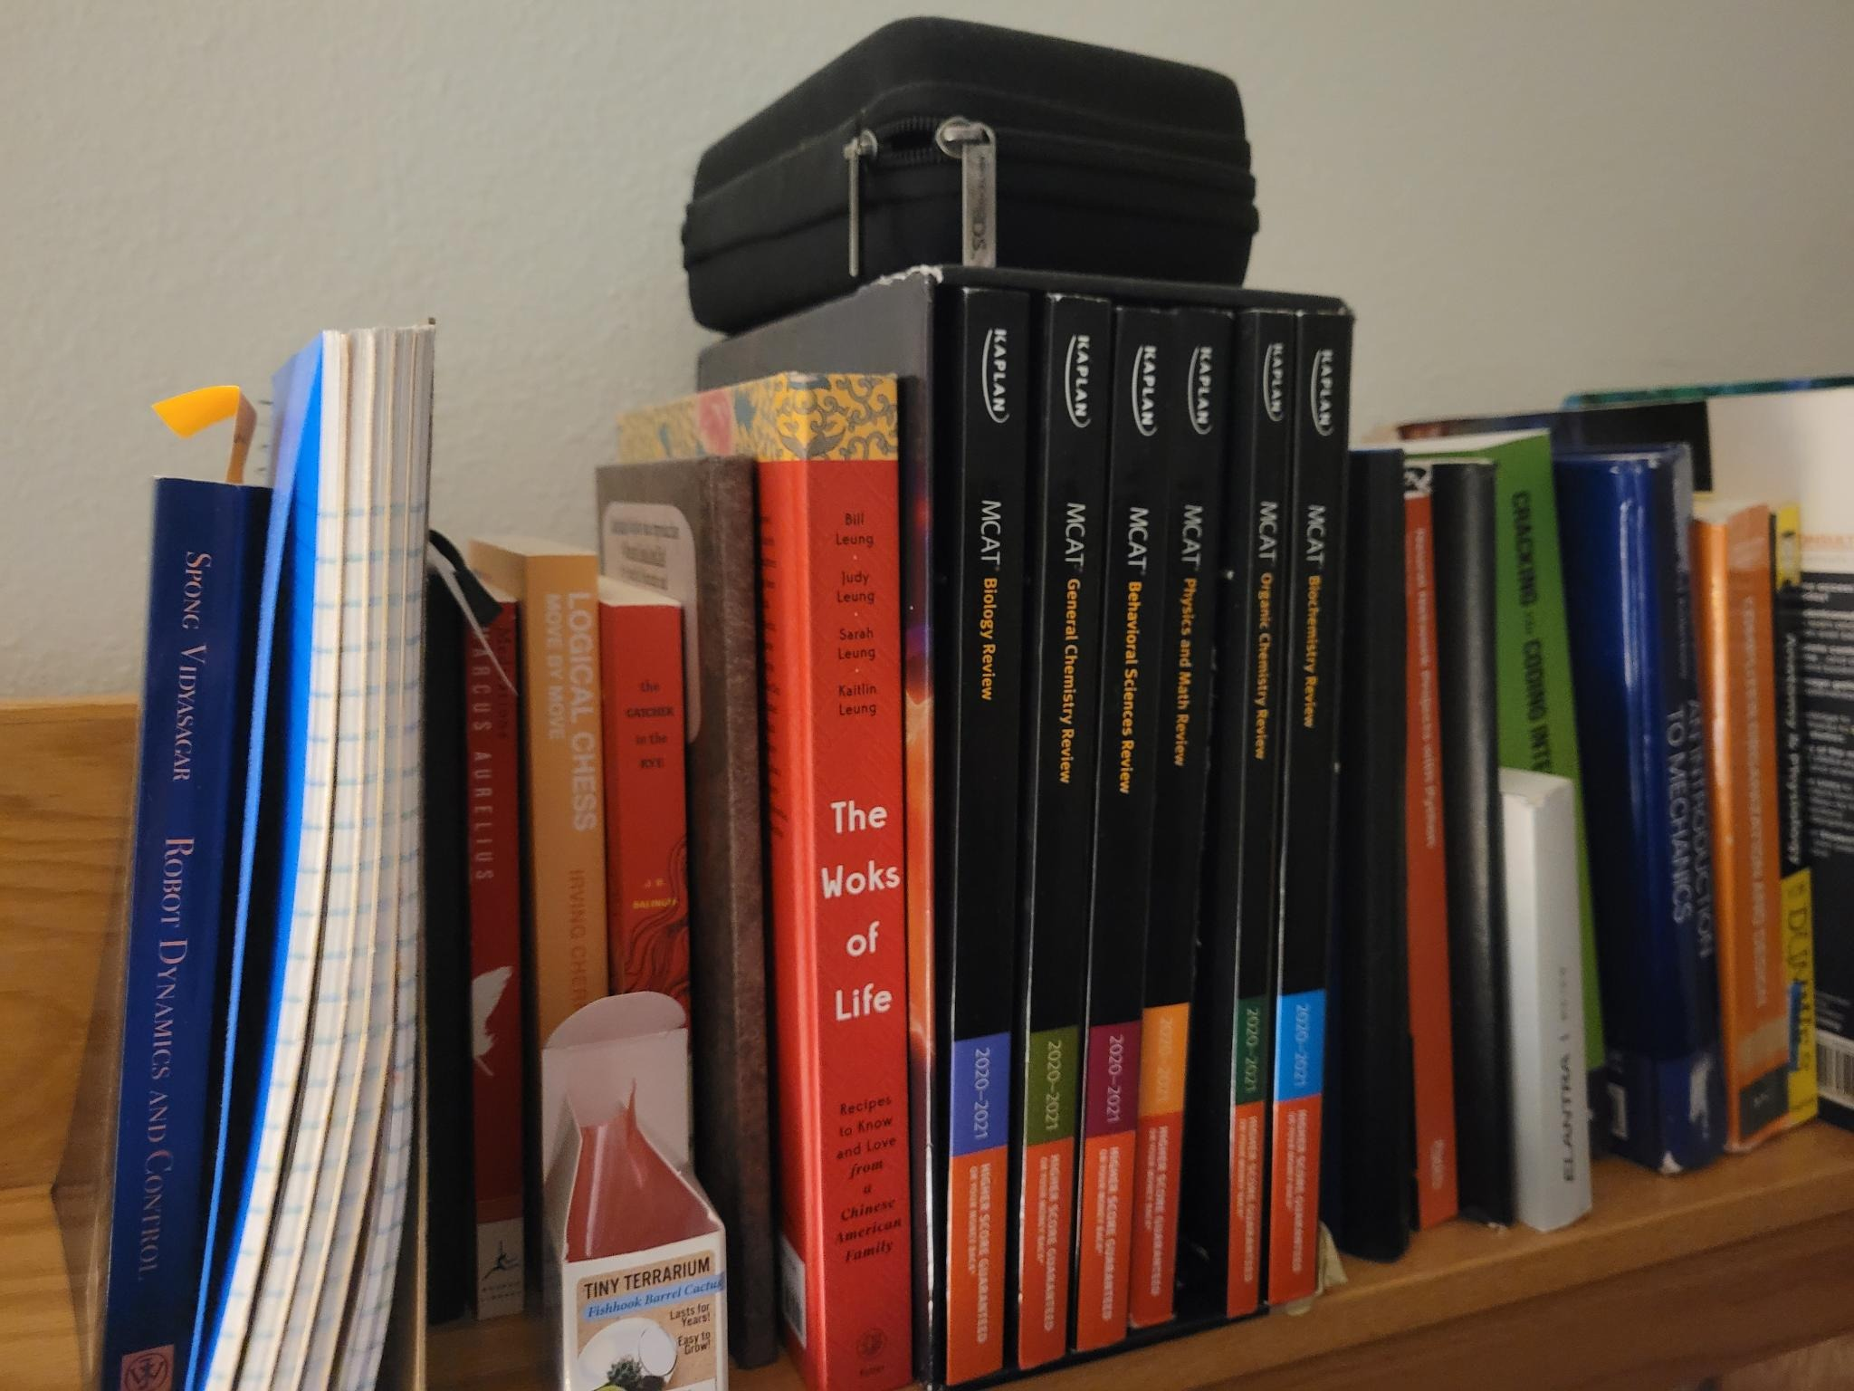
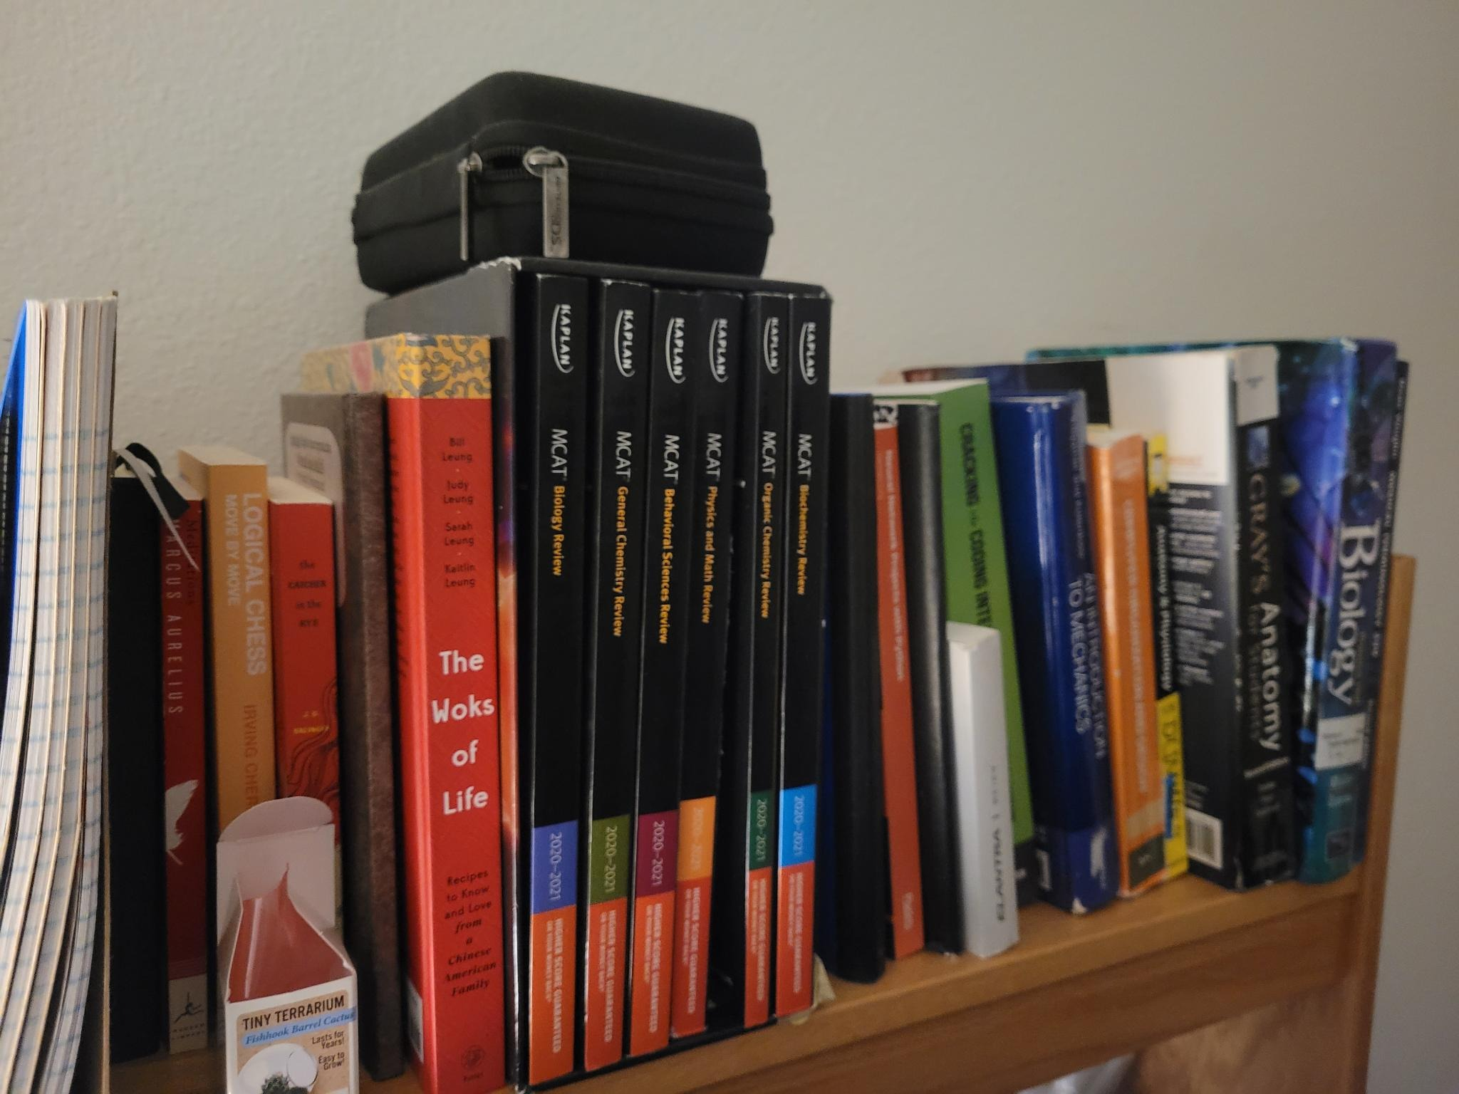
Extra Credit
Response: I did the EC at the end of the notebook (smoothing w/ personal images). My results are fairly decent, aside from the left side of the smoothed disparity map.
Left Image Right Image

