Slide 1
CS 6320 Project 6
Jordy A. Larrea Rodriguez
Jordy.Larrea@utah.edu
u1236145

Slide 2
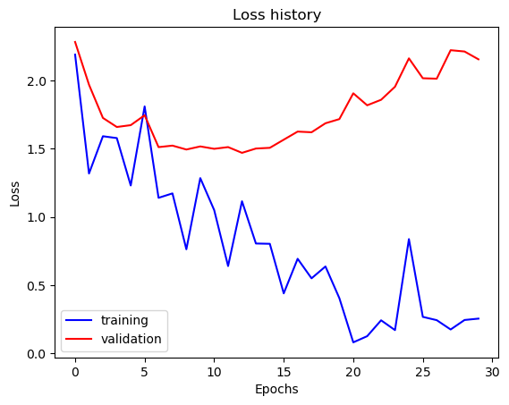
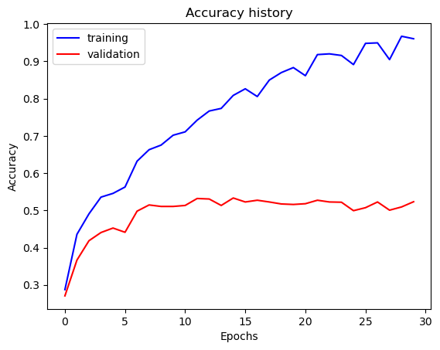
Part 1: Your Training History Plots
With lr =1e-3 and weight_decay = 6e-3
Final training accuracy value: 0.9610
Final validation accuracy value: 0.5233

Slide 3
Part 1: Experiment: play around with some of the parameters in nn.Conv2d and nn.Linear, and report the effects for: 1. kernel size; 2. stride size; 3. dim of nn.Linear. Provide observations for training time and performance, and why do you see that?
Kernel size: Decreasing the kernel size resulted in improved validation or test accuracy performance (tested for kernel size in [4, 6], w/ k=5 as baseline). On the other hand, k=6 resulted in slightly improved training accuracy w/ reduced performance in validation accuracy and runtime. My results are likely due to extraction of more local features with the smaller kernel vs a larger kernel which extracts global features more frequently; furthermore, a larger kernel results in more computations leading to a longer runtime.
Stride size: The baseline stride size was 1. Incrementing the stride size increased the speed of computation (for stride in [1, 4]). I noticed decreased accuracy during testing.
Dim of nn.Linear: I only altered in_features = n where n was [Linear(in=500, out=n), Linear(in=n, out=15)] and n was in [100, 120, 150, 180, 200]. Overall I noticed the best performance for n=120.

Slide 4
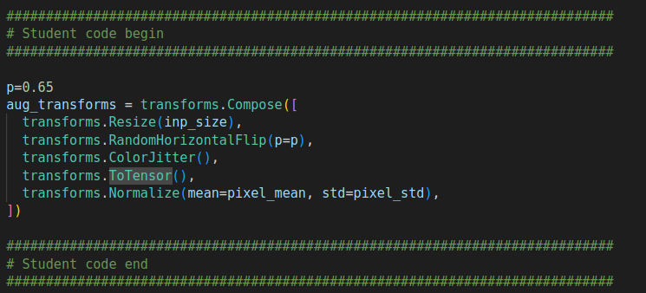
Part 2: Screenshot of your get_data_augmentation_transforms() [code and image example]

Slide 5
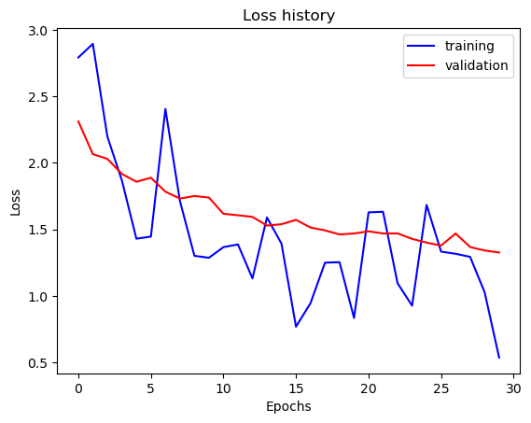
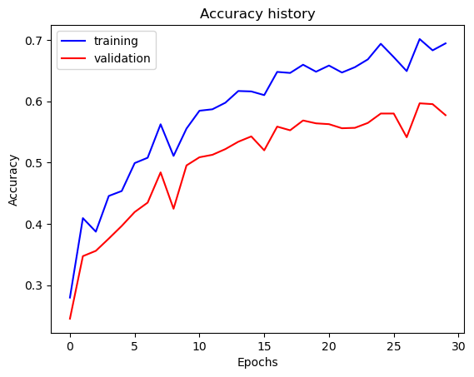
Part 2: Your Training History Plots
Final training accuracy value: 0.6950
Final validation accuracy value: 0.5773

Slide 6
Part 2: Reflection: compare the loss and accuracy for training and testing set, how does the result compare with Part 1? How to interpret this result?
The loss and accuracy for both the training and validation sets were overall fairly similar given the visualizations. This contradicted the part 1 results where performance between the two sets was quite different. The improvement is a result of reduced over-fitting by the addition of dropout layers and augmentation transforms that introduced nonlinear noise to the data. Reducing network bias towards global features in the training set (reduced over-fitting).

Slide 7
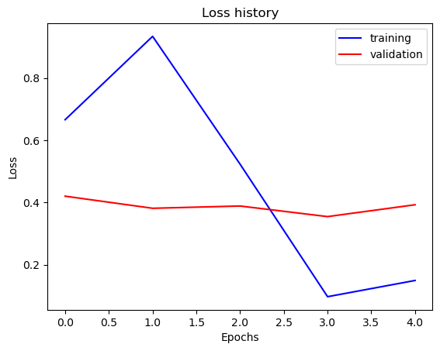
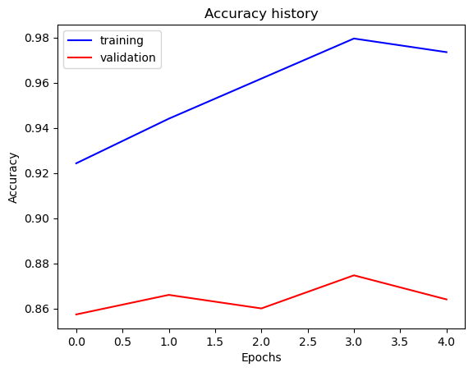
Part 3: Your Training History Plots
Final training accuracy value: 0.9740
Final validation accuracy value: 0.8640

Slide 8
Part 3: Reflection: what does fine-tuning a network mean?
Taking a pretrained (eg, AlexNet) external model and adjusting layer parameters in respect to current system constraints (15 classes for proj6) and requirements.

Slide 9
Part 3: Reflection: why do we want to “freeze” the conv layers and some of the linear layers in pretrained AlexNet? Why CAN we do this?
AlexNet was trained on a large dataset for a independent classes, and the parameters are generally tuned well enough for our purposes. Thus we do not to further optimize the pretrained model.

Slide 10
Conclusion: briefly discuss what you have learned from this project.
Fine-tuning a NN by fusing with an existing reputable network was quite the learning experience, and improved my understanding of what ML engineering for more complicated NN architectures looks like from a big picture perspective.

Slide 11
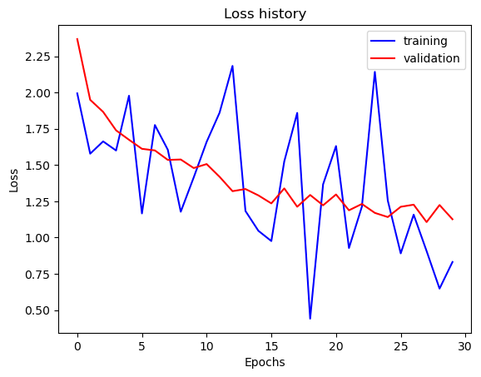
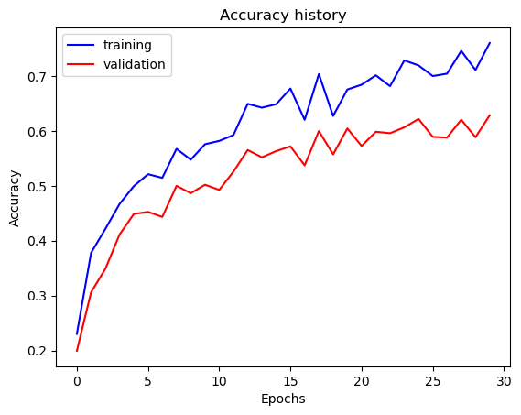
Extra Credit
EC-pt2: Added batch normalization layers at the output of the convolution layers. My accuracy increased to ~63% for the pt2 simple NN w/ dropout layer(s).
Train Accuracy = 0.7604690117252931; Validation Accuracy = 0.6286666666666667

