Slide 1
QC Social Media
report 3
Stanislav Sobolevsky, Cheng Qian, Philipp Kats
Cusp 2016

Slide 2
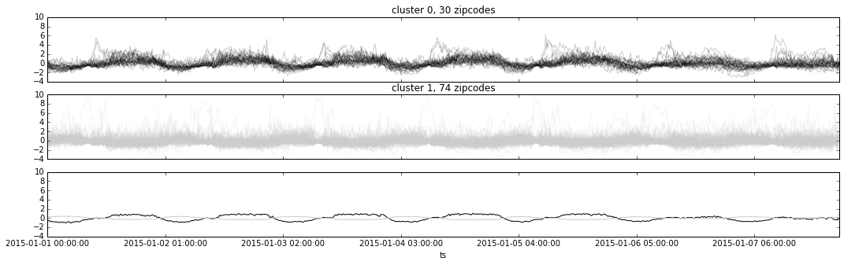
Clustering, k=2
treshhold: >=250 tweets total

Slide 3
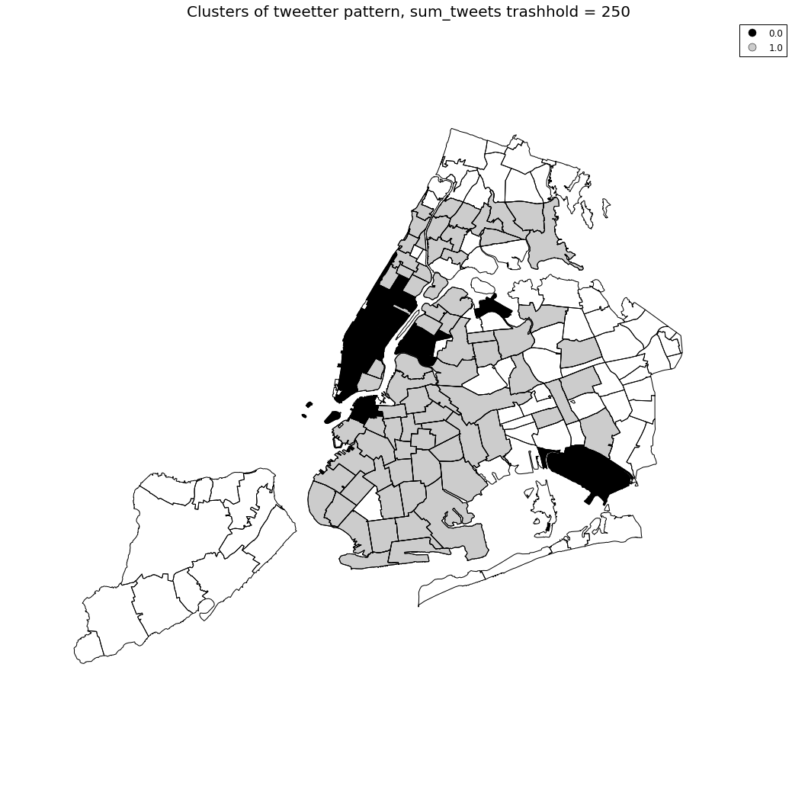
Clustering, k=2
treshhold: >=250 tweets total

Slide 4
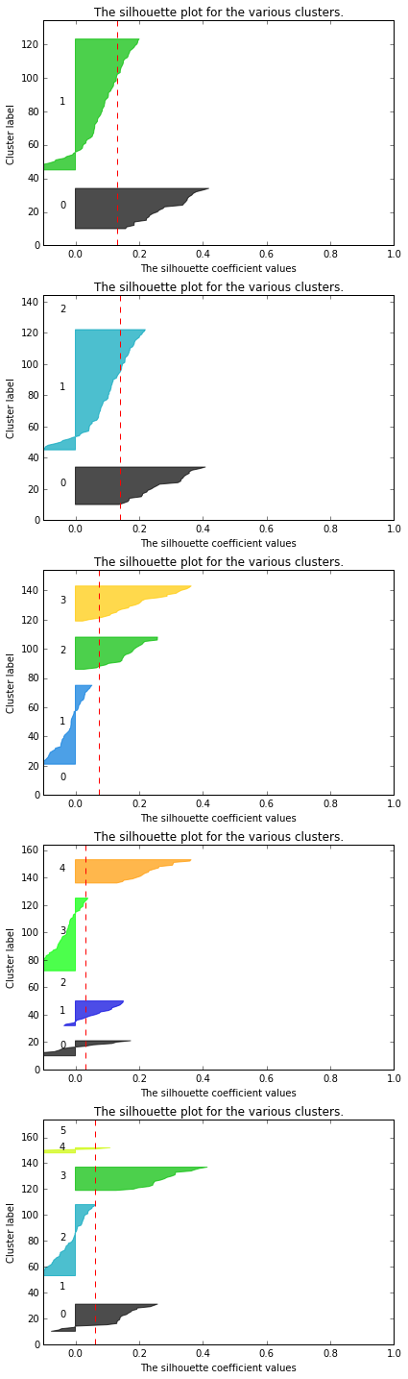
Silhouette
K-mean silhoettes, for 2,3,4,5,6 clusters
treshold: >=250 tweets total

Slide 5
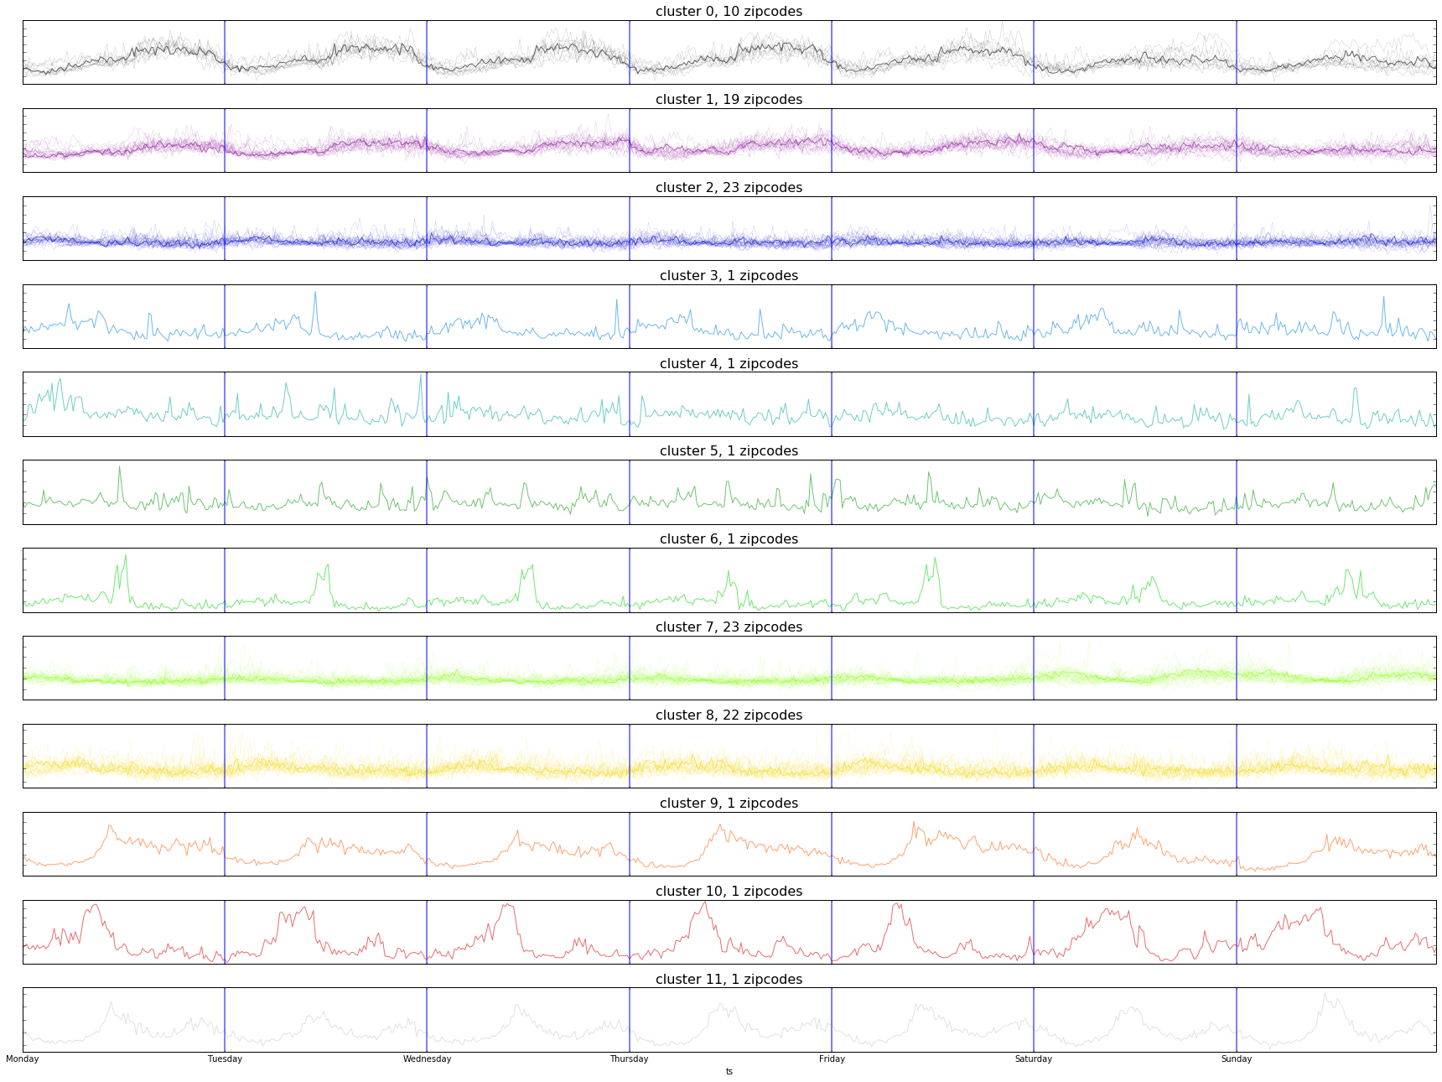
Affinity Propagation
does not enforce equal-size clusters and it can choose automatically the number of clusters from the data.
treshold: >=250 tweets total

Slide 6
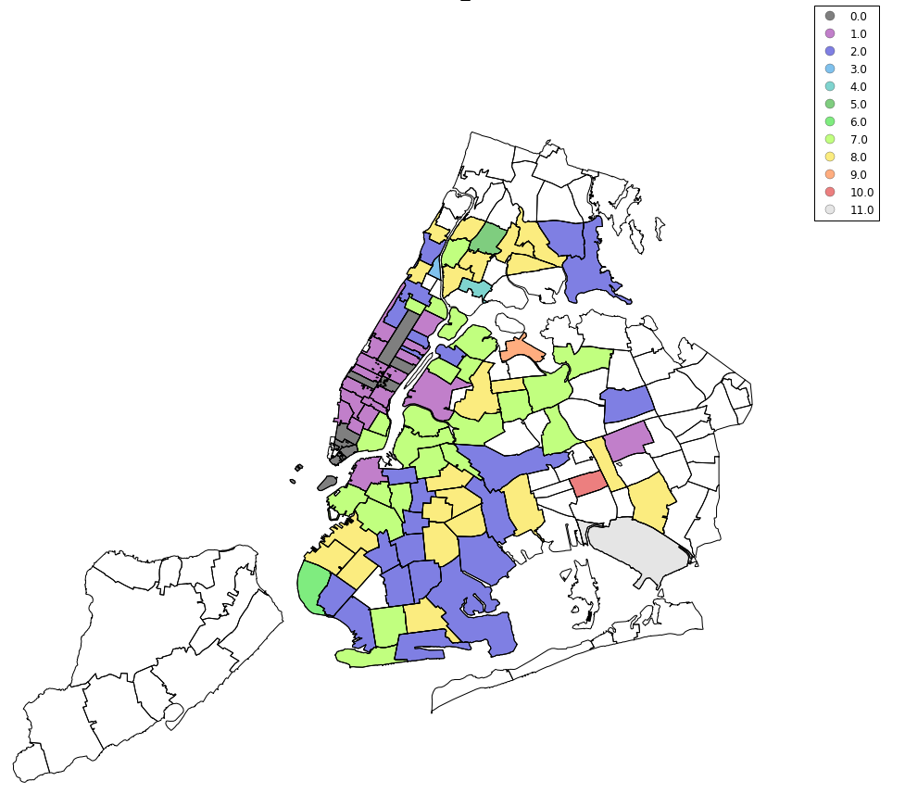
Affinity Propagation
does not enforce equal-size clusters and it can choose automatically the number of clusters from the data.
treshold: >=250 tweets total

Slide 7
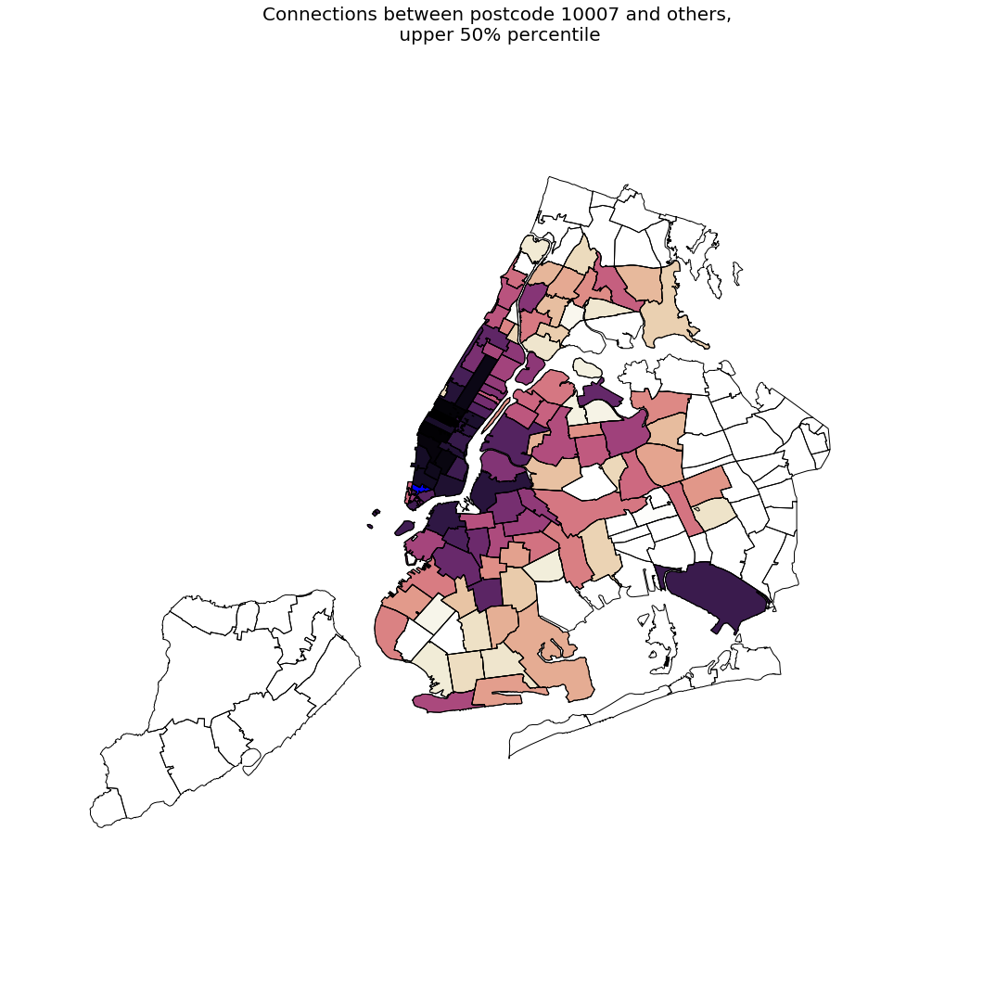
zip 10007
(Staten Island)
upper 10% of
zipcodes
Po

Slide 8
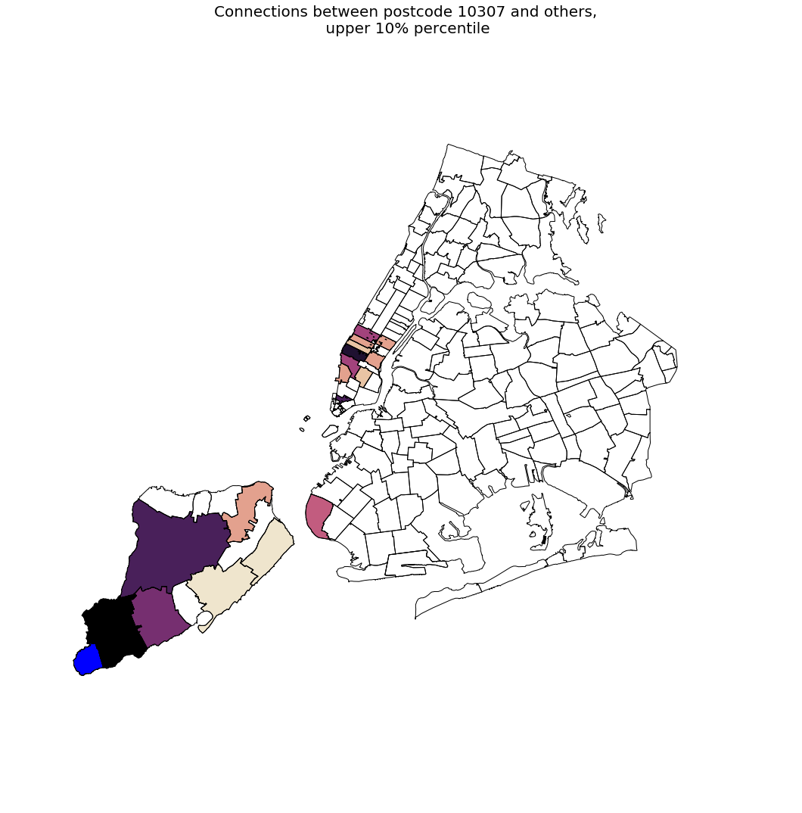
zip 10307
(Staten Island)
upper 10% of
zipcodes
Po

Slide 9
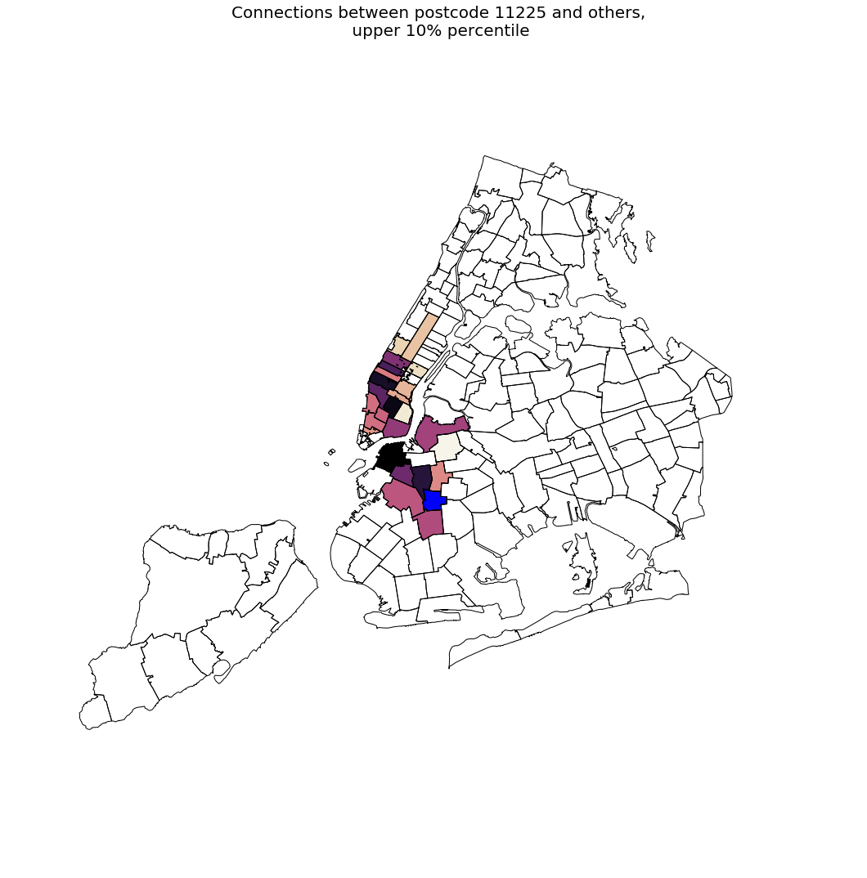
zip 11225
(Brooklyn)
upper 10% of
zipcodes

Slide 10
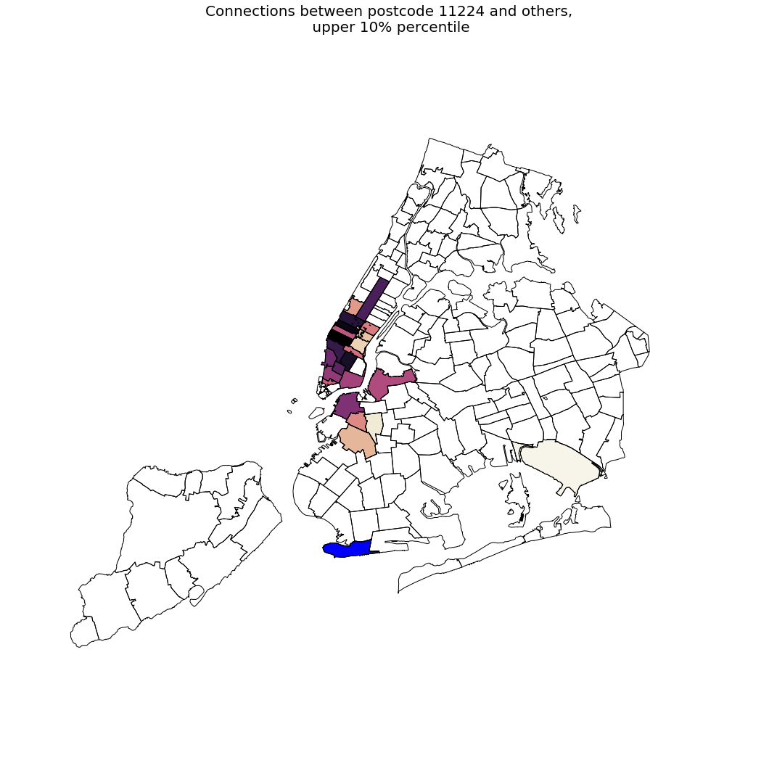
zip 11224
(Brooklyn)
upper 10% of
zipcodes

