Slide 1
Quantified Communities
Report 2
Stanislav Sobolevsky, Philipp Kats
2016

Slide 2
I. Data collection

Slide 3
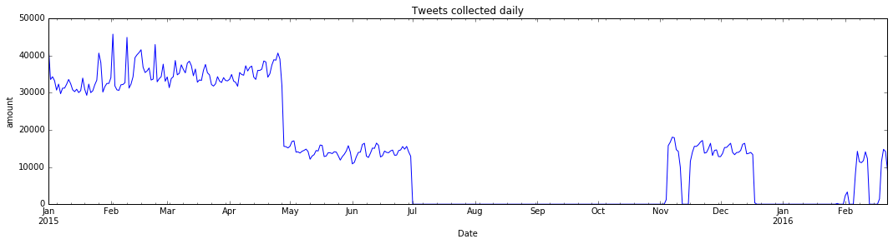
General timeline
daily amount of geolocated tweets in NYC zipccode borders

Slide 4
General timeline
daily amount of geolocated tweets in NYC zipccode borders
???

Slide 5
II. Robot Hunting

Slide 6
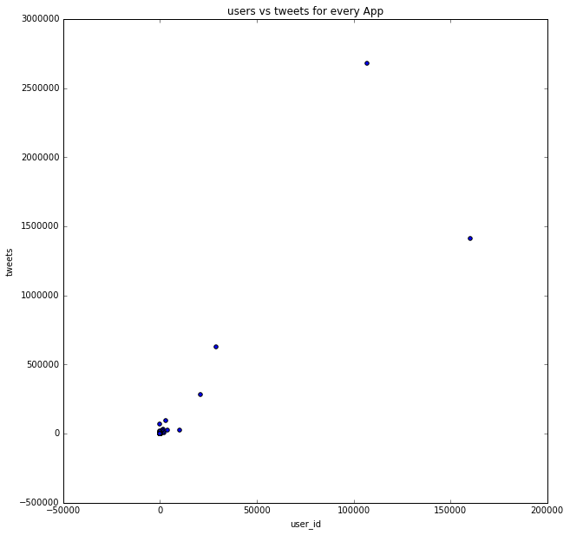
Applications
Twitter for Iphone
Instagram
total tweets vs total users
Twitter for Android
Foursquare

Slide 7
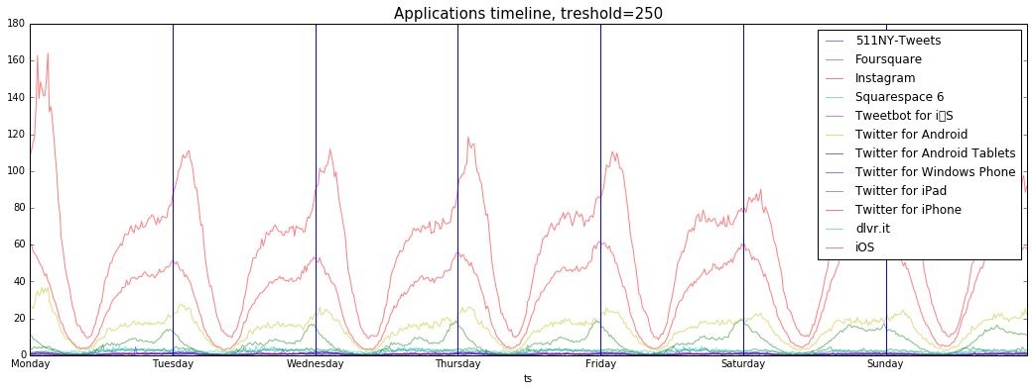
App Timeline

Slide 8
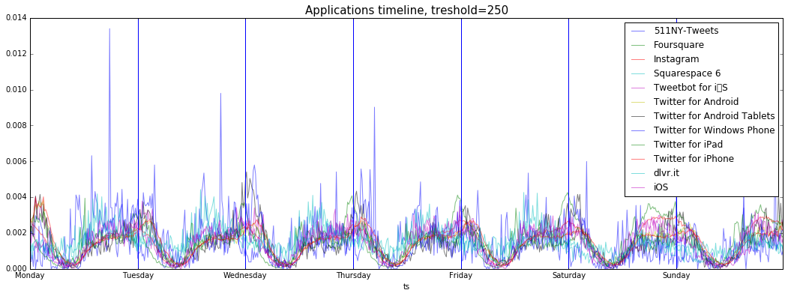
App Timeline, normalised

Slide 9
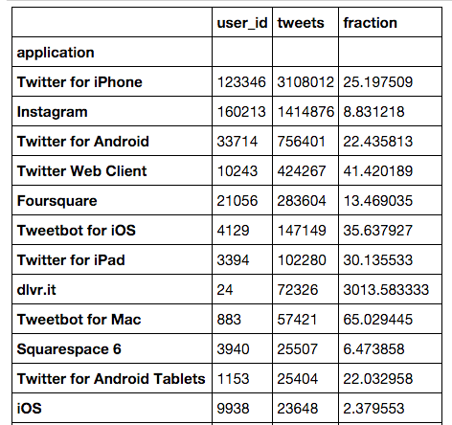
Fraction
tweets / users

Slide 10
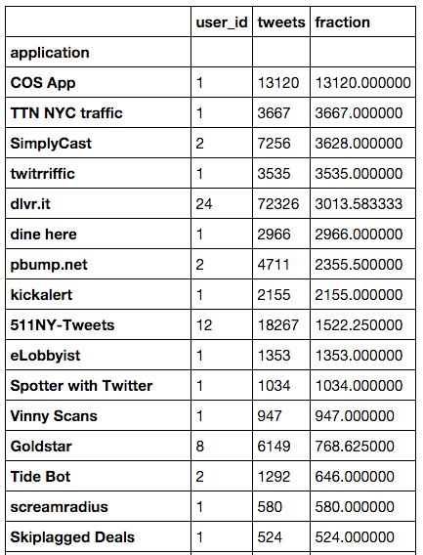
Fraction
tweets / users

Slide 11
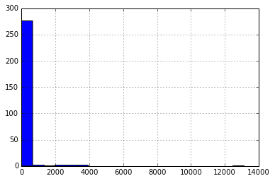
Apps fraction histogram

Slide 12
III. Geography

Slide 13
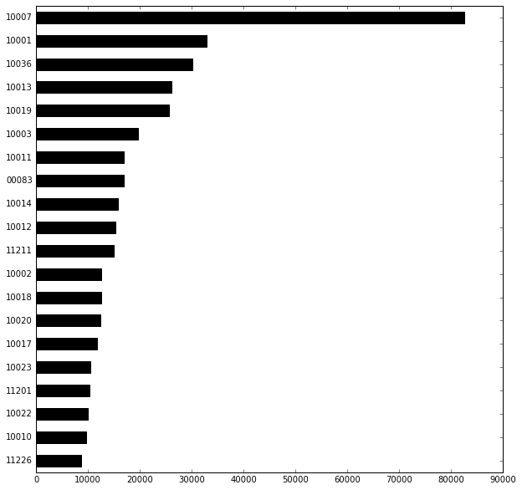
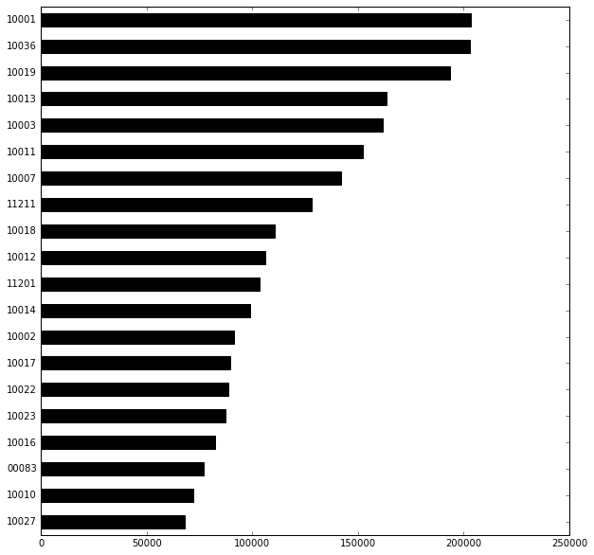
Heatmaps
old dataset
new dataset

Slide 14
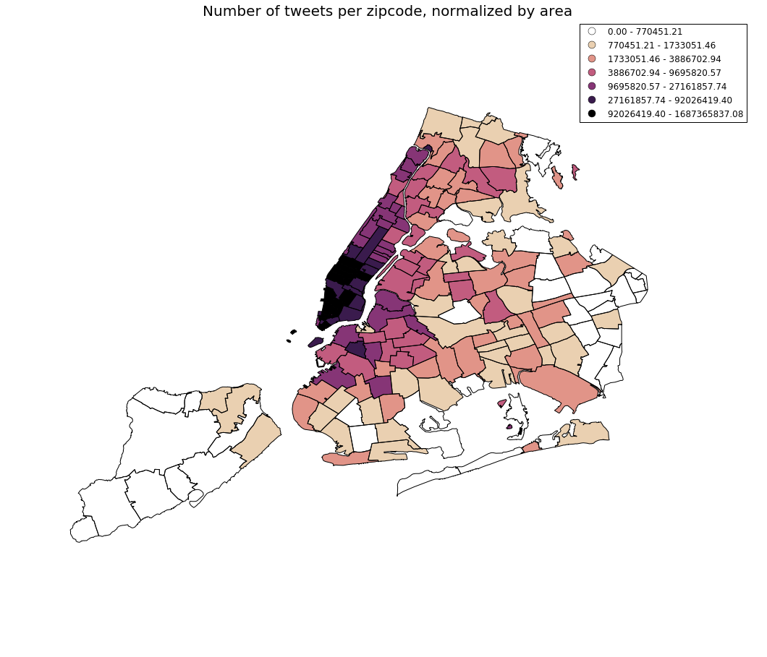
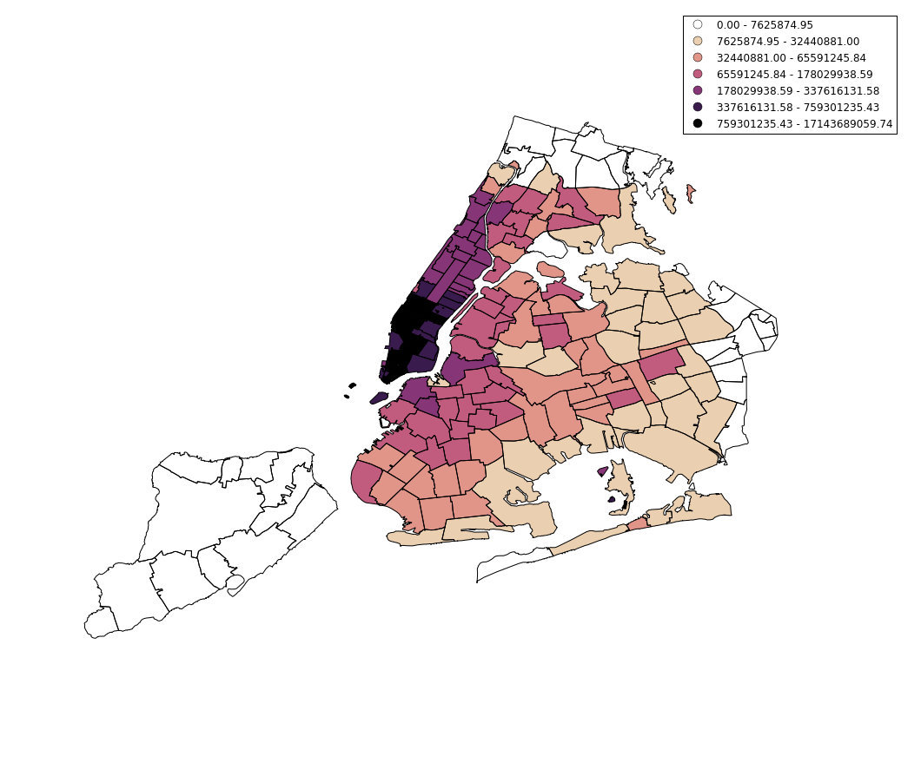
Heatmaps
old dataset
new dataset

Slide 15
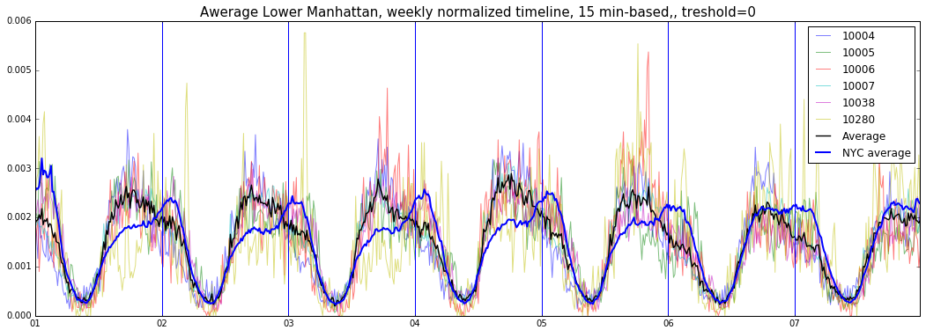
LM Average week
LM
Average week, (monday first)

Slide 16
III. Clustering

Slide 17
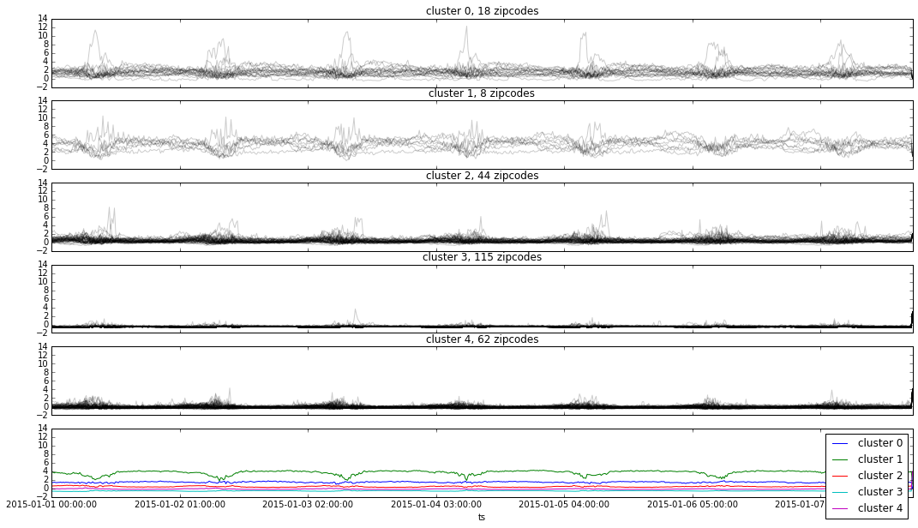
Clustering (k-mean, eucledian, 5 clusters)

Slide 18
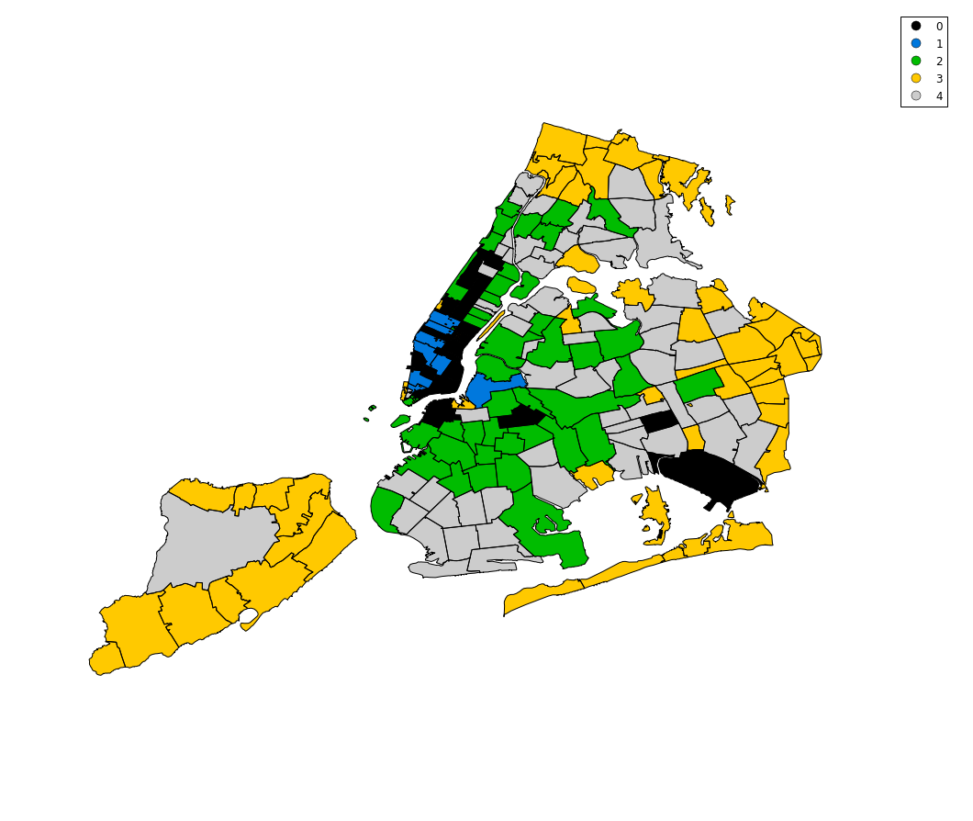
ZipcodeClustering

Slide 19
Clustering

Slide 20
IV. Networks

Slide 21
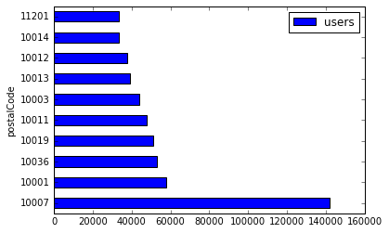
Networks

Slide 22
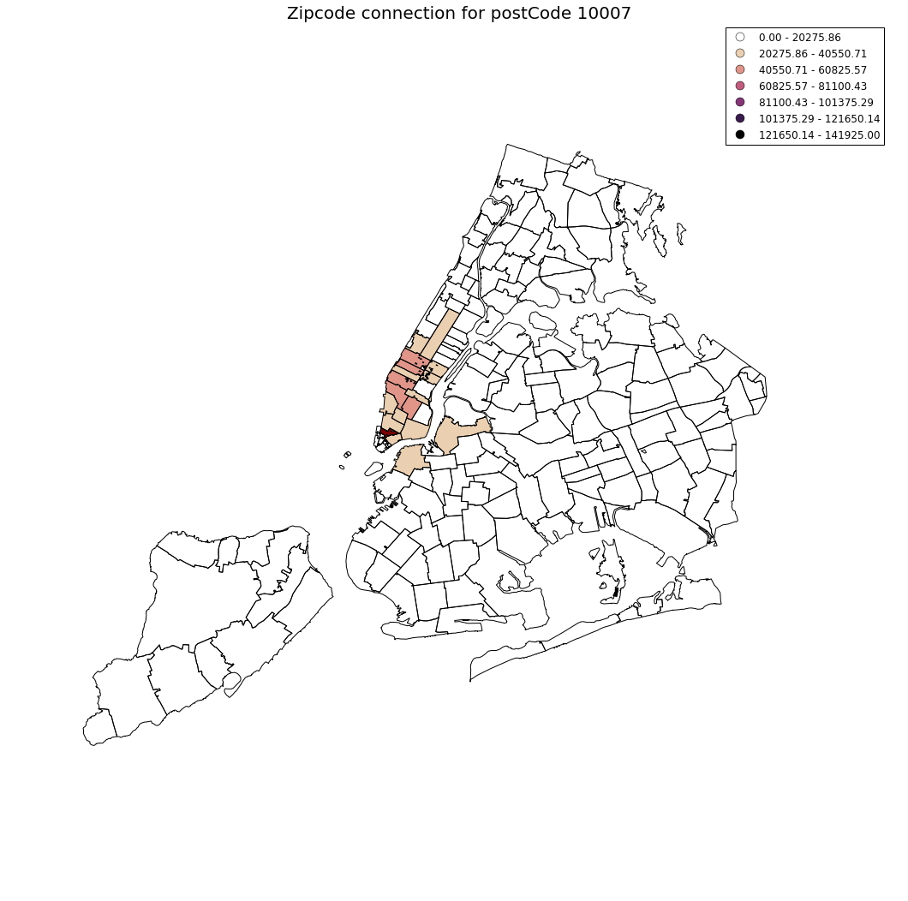
Networks

Slide 23
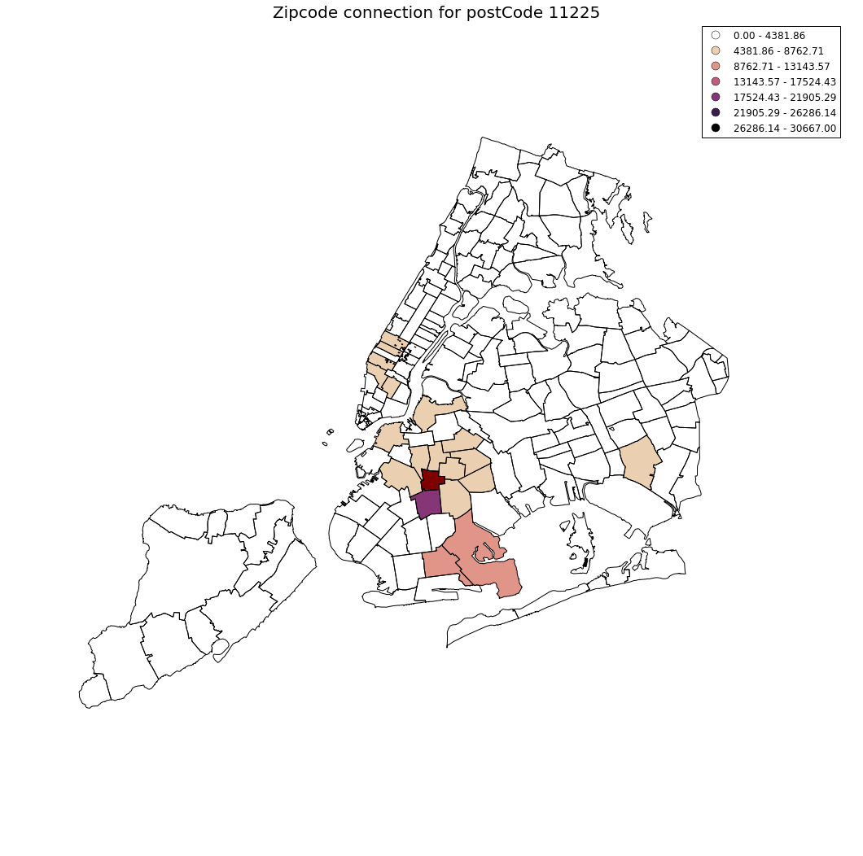
Networks

Slide 24
V. Snow Storm

Slide 25
Snow storms

Slide 26
Next steps
Seasonal changes in timeSeries
aggregate data for Storm 2016
Tweaking clustering
Sophisticated OD_matrix
Snow Storms

