Slide 1


A study of PIP Failing Features and their Coincidence Ratios
NYC Department of Parks and Recreation
April 23, 2015

Slide 2
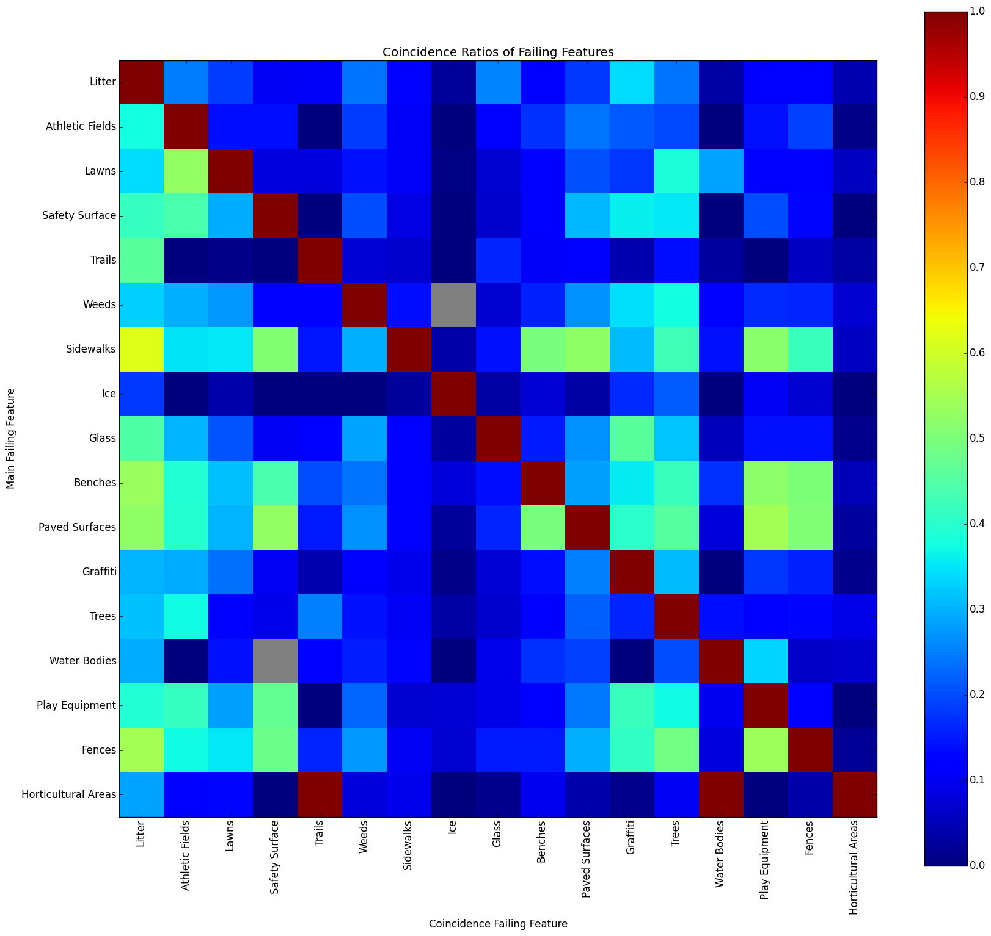
New York City Coincidence Ratios of Failing features

Slide 3
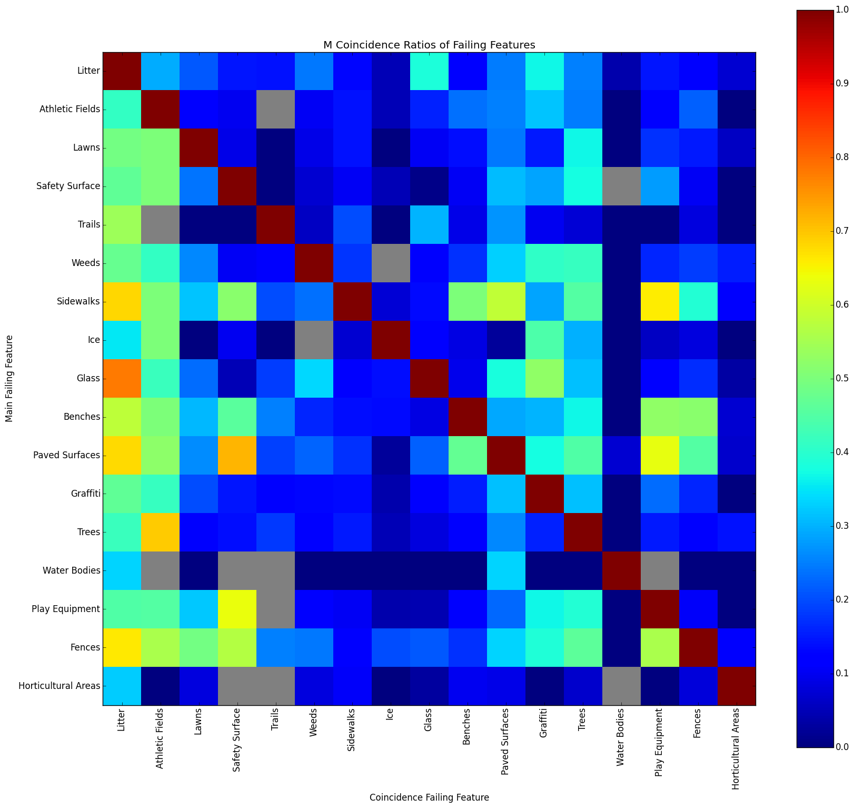
Manhattan Borough Coincidence Ratios of Failing features

Slide 4
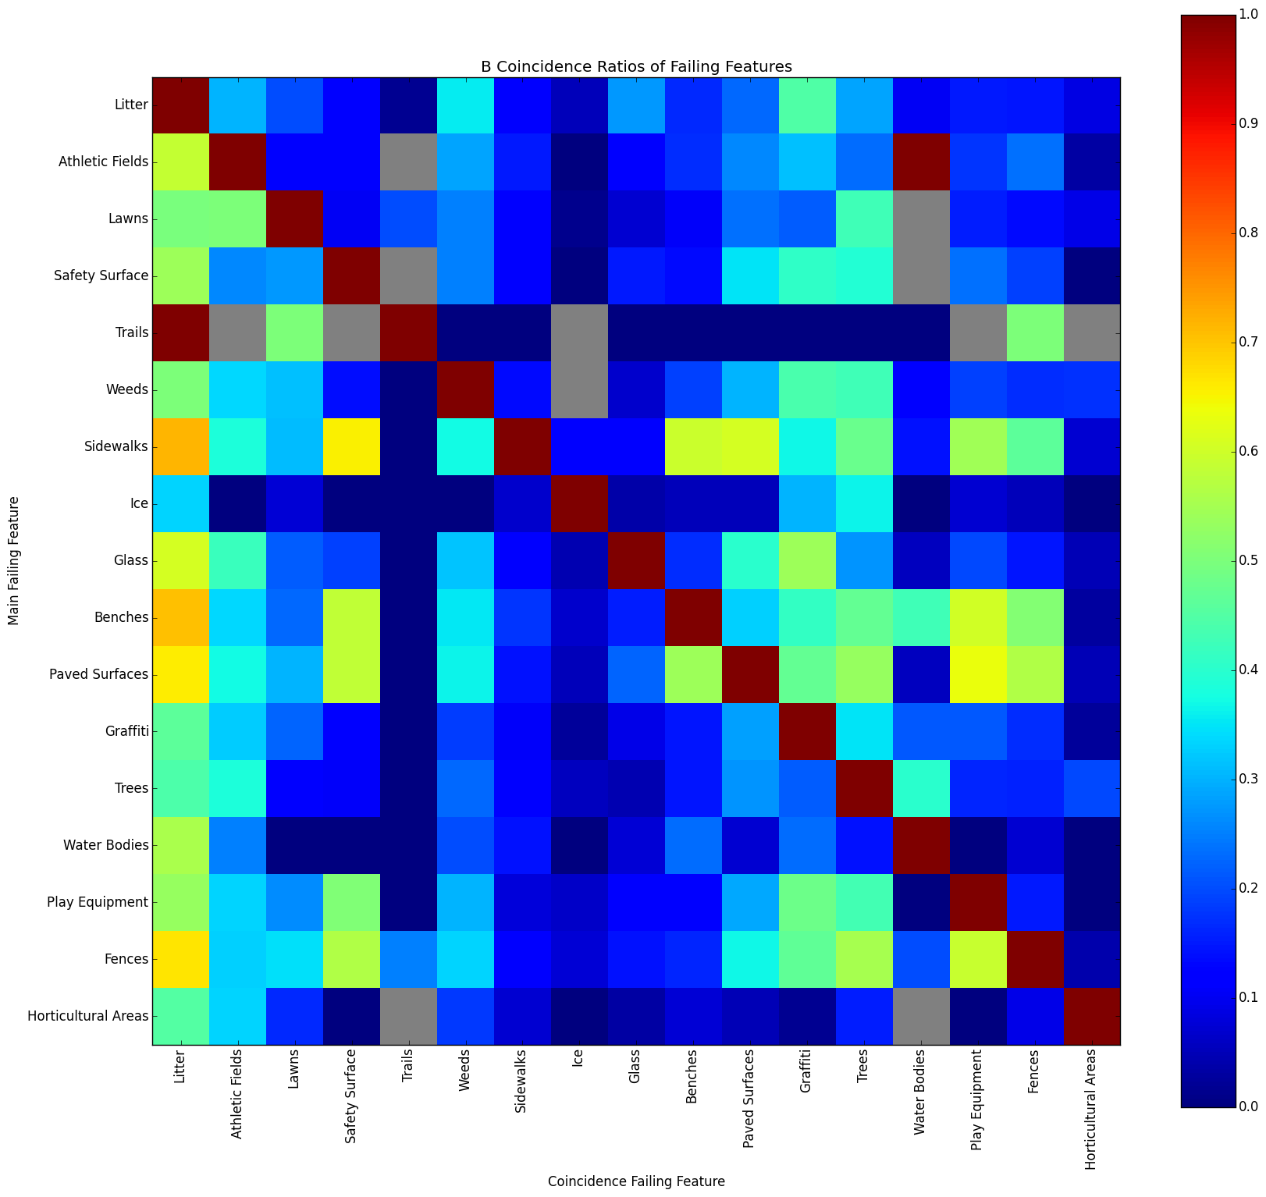
Brooklyn Borough Coincidence Ratios of Failing features

Slide 5
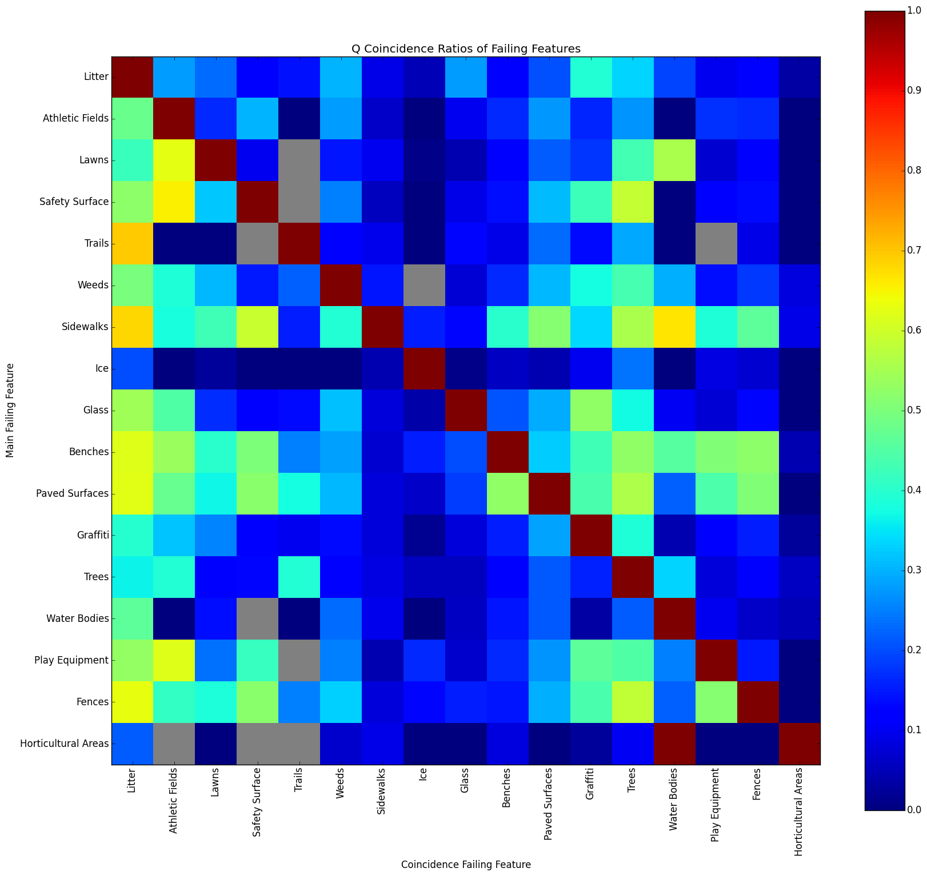
Queens Borough Coincidence Ratios of Failing features

Slide 6
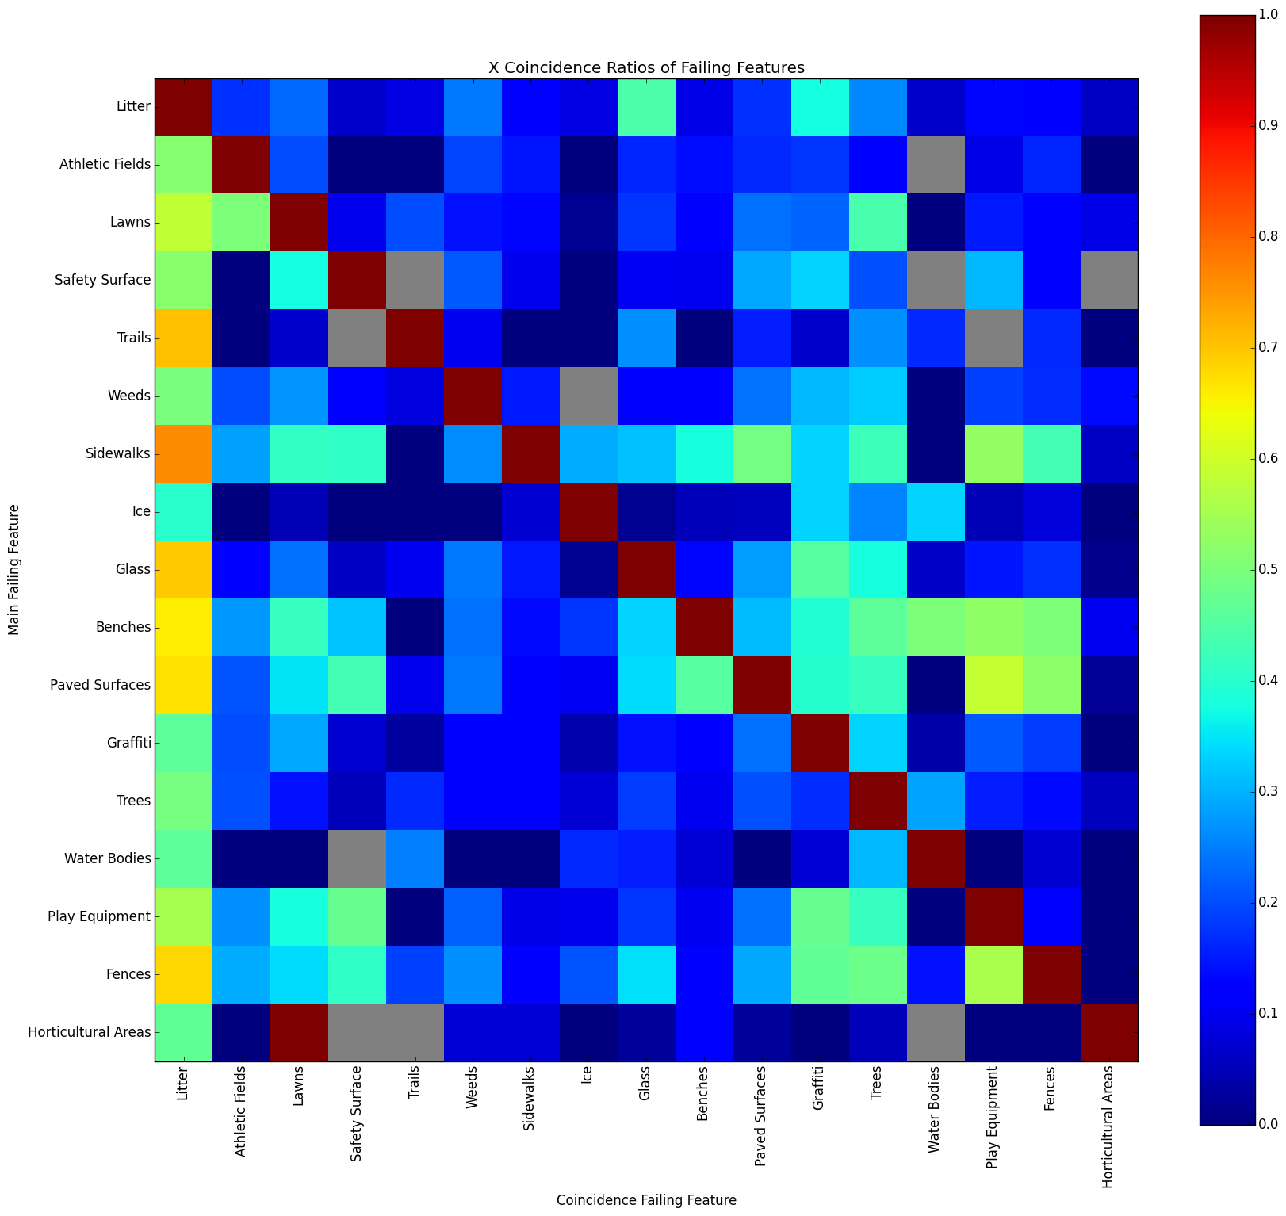
Bronx Borough Coincidence Ratios of Failing features

Slide 7
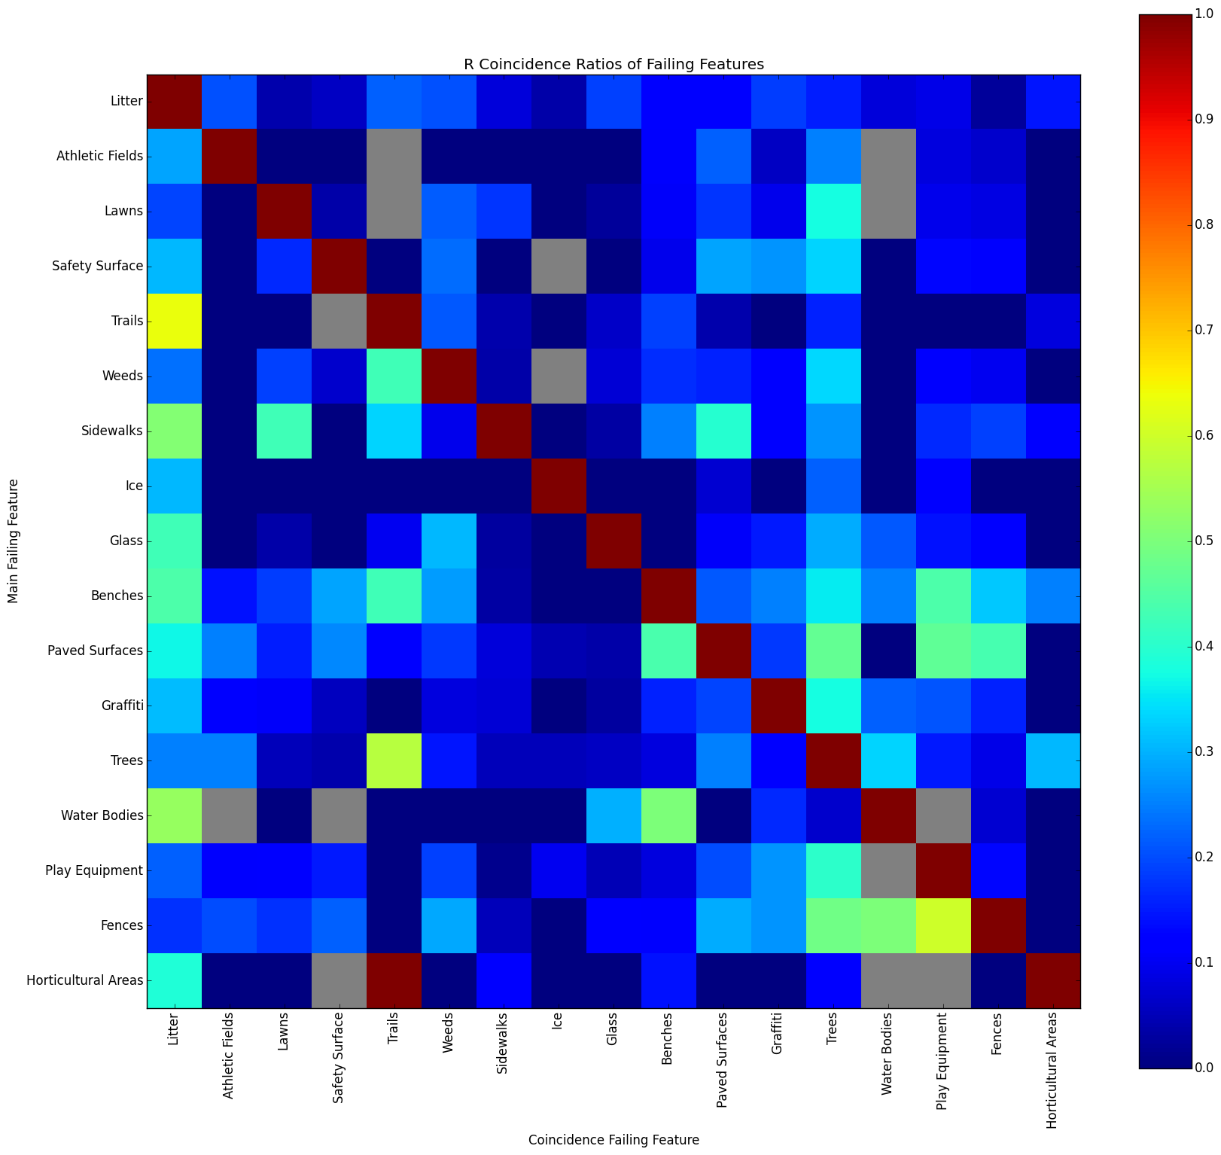
Staten Island Borough Coincidence Ratios of Failing features

