Slide 1
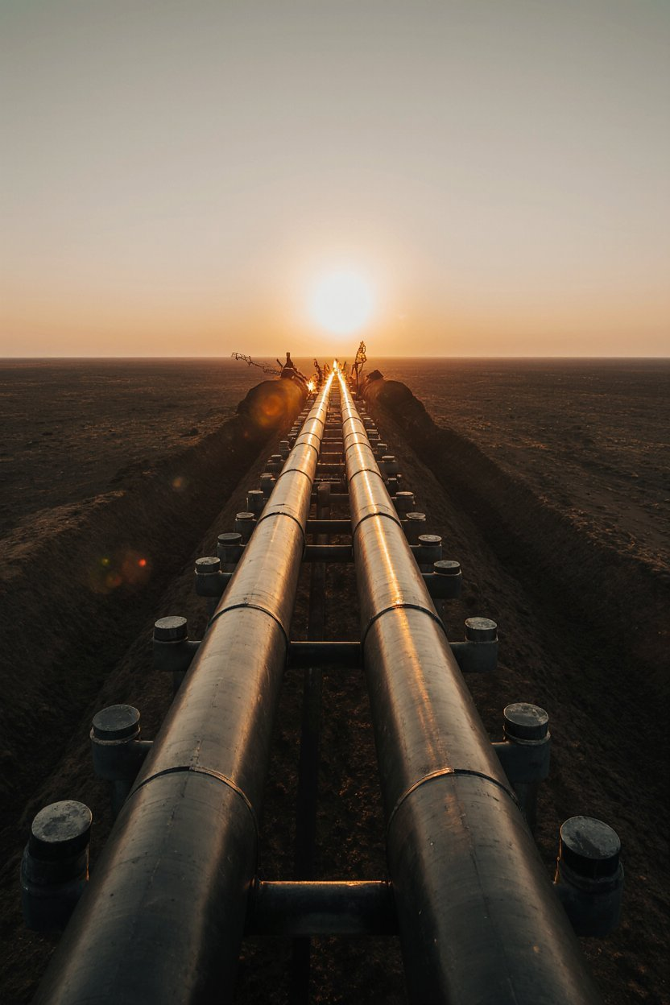
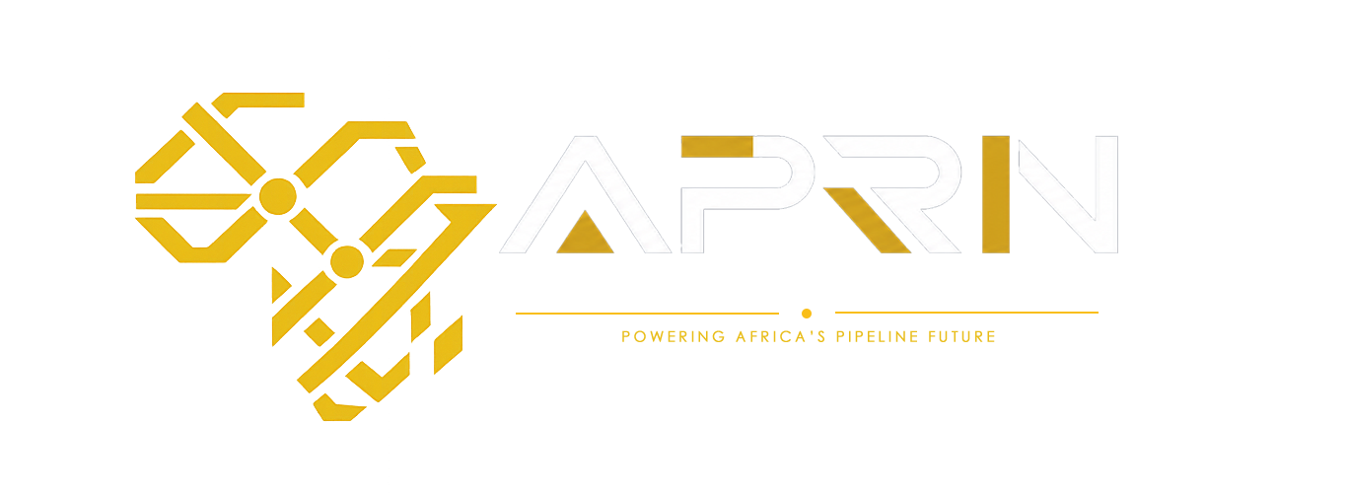
APRN
African Pipeline
Resource Network
Powering Africa's Pipeline Future
Strategic Concept & Execution Roadmap (v1)
Research · Training · Advocacy · Impact

Slide 2
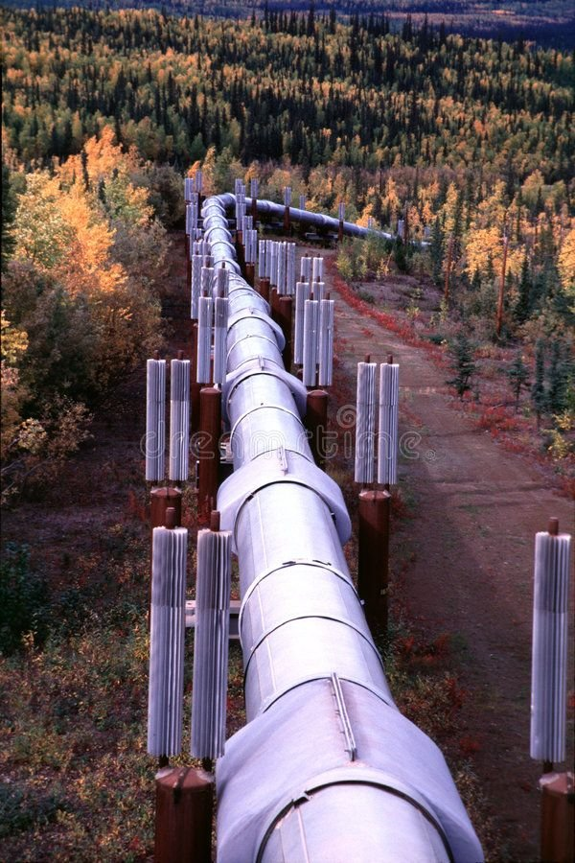
THE CHALLENGE
⚠️
💸
🔗
Critical Skills Gap
Billions Lost Annually
Fragmented Industry
Africa faces a severe shortage of trained pipeline engineers. Ageing workforce, no structured succession, and zero Africa-dedicated academies — threatening energy infrastructure across the continent.
Pipeline vandalism, theft, and integrity failures cost African nations billions every year. The Niger Delta alone loses over $1 billion annually to oil theft and spills — driven by poor community engagement and lack of local expertise.
Operators, regulators, academia, and communities work in silos. No unified platform exists for collaboration, data sharing, or policy coordination across African pipeline sectors.
Africa's pipeline sector is losing ground fast — in talent, research, and revenue. APRN is the solution.

Slide 3
WHY NOW?
The window of opportunity is open — and closing fast
⚡ Rising Energy Demand
💰 Massive Capital Flowing In
🎓 Skills Gap Is Widening
Africa's energy consumption is projected to double by 2040. Pipeline infrastructure is the backbone — yet investment in talent and safety is not keeping pace.
Over $180B in energy investment targeted at Africa by 2030. Companies need local skilled engineers — APRN is the gateway.
Senior pipeline engineers retiring faster than graduates are trained. Nigeria-wide talent crisis — Moniepoint CEO recently flagged 500 unfilled vacancies due to lack of qualified talent.
📋 Local Content Act — Legal Mandate
🌍 Africa is Ready — Right Now
Nigeria's NOGICD Act 2010 (enforced by NCDMB) legally mandates companies to hire and train Nigerians first in all oil & gas roles. Companies must submit Nigerian Content Plans — creating direct, compulsory demand for APRN-certified engineers.
OB3 River Niger crossing completed April 2026 — full commissioning Q4 2026. NMGP IGA signing Q4 2026. US Government, World Bank & White House NSC all met with ONHYM this week on the $25B Nigeria-Morocco pipeline. First gas targeted 2031. The moment is NOW.
EITEP confirmed Africa training demand · $25B NMGP IGA signing 2026 · US Government engaged · APRN is the delivery vehicle.

Slide 4

OUR PURPOSE
Vision
To become Africa's leading knowledge hub and capacity-building platform for safe, efficient, and sustainable pipeline systems.
Mission
To advance pipeline research, develop skilled professionals, and promote best practices that enhance the integrity, safety, and sustainability of pipeline infrastructure across Africa.
"Building Capacity. Securing Infrastructure. Transforming Africa."

Slide 5
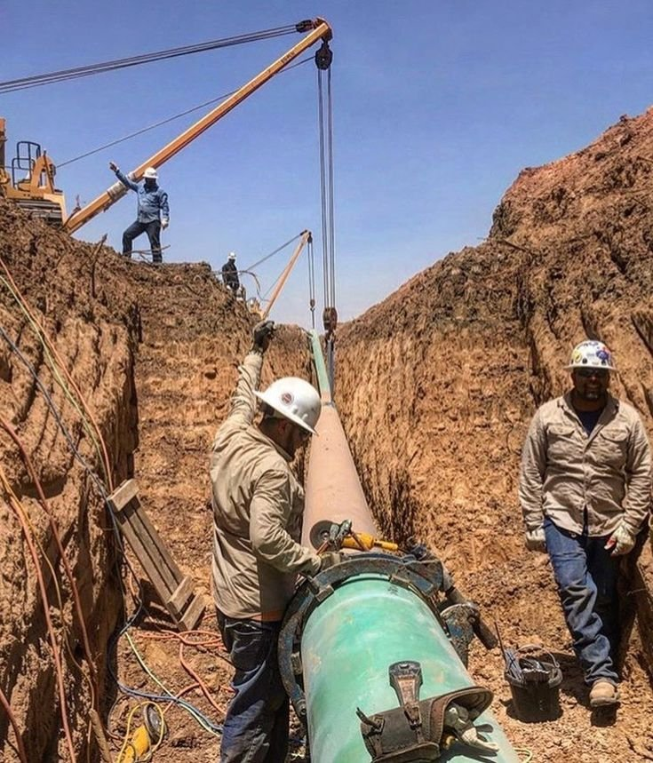
AFRICA'S ENERGY LANDSCAPE
Why pipelines matter — and why APRN is needed now
30+
Countries with
pipeline infrastructure
$180B+
Investment in African
energy by 2030
70%
Of Africa's energy needs
unmet or underserved
🔥 LIVE: OB3 Pipeline — River Niger crossing April 2026
130km River Niger crossing complete · Full commissioning Q4 2026 · 2 billion SCF/day capacity.
🇺🇸 NMGP Corridor — 13 Countries (US Gov Interest Confirmed May 2026)
Nigeria · Benin · Togo · Ghana · Côte d'Ivoire · Liberia · Sierra Leone · Guinea · Senegal · Mauritania · Morocco → Europe. FID 2026. First gas 2031.
$180B pipeline investment · $25B NMGP · US, World Bank & White House engaged · NNPC Gas Master Plan 2026: $22B · NCDMB mandates Nigerian-first hiring · Skills gap = APRN's opportunity

Slide 6
WHAT WE DO
🔬 Research & Knowledge
🎓 Training & Capacity
🤝 Industry Collaboration
Africa-focused pipeline research, data repository, annual industry reports, and policy advisory support.
Certified programs for pipeline engineering, integrity management, and HSSE. Entry-level academies for young engineers.
Multi-stakeholder platform connecting operators, regulators, academia, and service companies across Africa.
📢 Policy & Advocacy
🌿 Sustainability & ESG
👥 Community Impact
Standardized pipeline regulations, local content policies, and adoption of international best practices.
Research on methane emissions, spill remediation, and climate-aligned pipeline strategies.
Pipeline safety awareness in host communities, alternative livelihoods, and gender-inclusive programs.

Slide 7
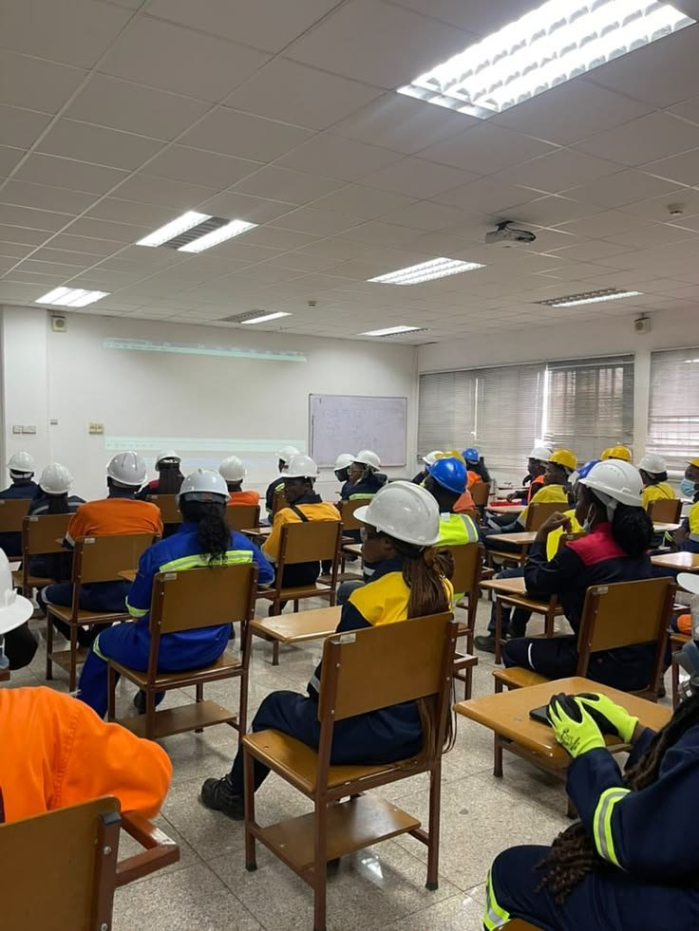
01 Africa Pipeline Academy (APA)
Technical and professional certification programs for engineers at all levels
02 Pipeline Research & Innovation Lab
KEY
PROGRAMS
Applied research on corrosion, integrity management, and leak detection
03 WIMEE Africa — Women in Midstream Energy & Engineering
Dedicated initiative for women across midstream energy — mentorship, leadership, technical training and inclusion
04 Pipeline Integrity & Safety Program
Industry training, compliance support, and safety certifications
05 Community Pipeline Awareness Program
Grassroots education and engagement in host communities

Slide 8
BUSINESS MODEL
A hybrid NGO + Social Enterprise structure for impact and sustainability
NON-PROFIT ARM (NGO)
REVENUE ARM (SOCIAL ENTERPRISE)
▸ International grants & donor funding
▸ Training & certification programs
▸ Government partnerships
▸ Industry consulting services
▸ CSR funding from oil & gas companies
▸ Research publications & data subs
▸ Development programs (youth, women)
▸ Conferences & summit events
▸ UN & World Bank program linkages
▸ Corporate memberships
Both arms serve one mission: Building Africa's pipeline capacity for generations to come.

Slide 9

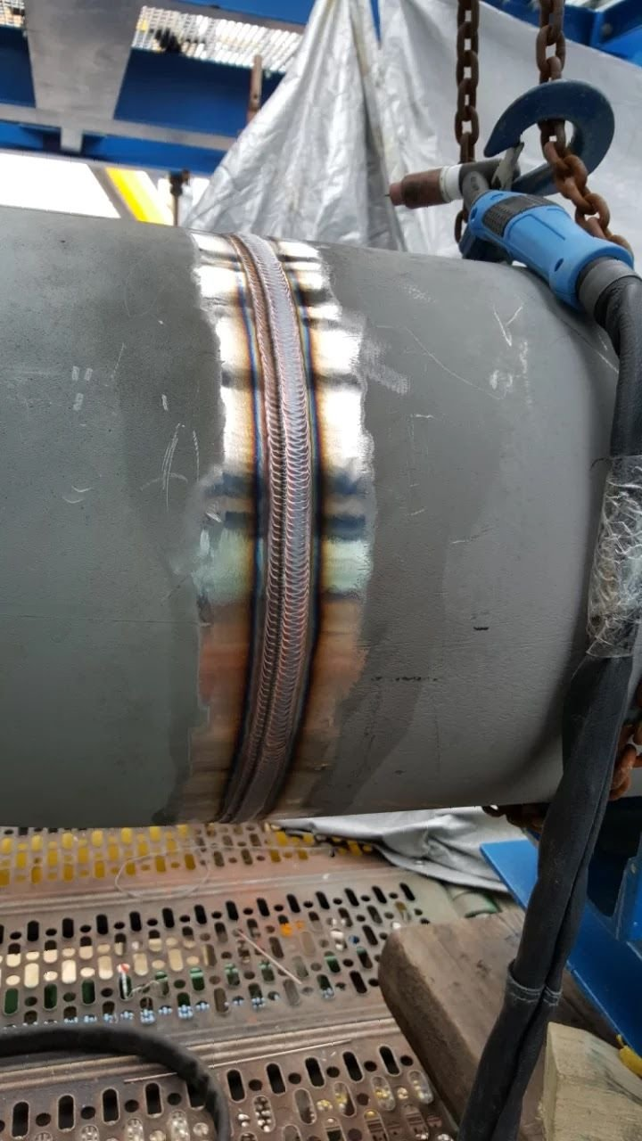
TRAINING & CAPACITY BUILDING
Entry Level
Pipeline Academy for fresh graduates & young engineers
Professional
Pipeline integrity, HSSE, corrosion management certifications
Executive
Leadership training for regulators & industry leaders
WIMEE Africa
Women in Midstream Energy & Engineering — dedicated tracks across technical and leadership roles
Internships · Apprenticeships · Mentorships · Scholarships

Slide 10

PARTNERSHIPS &
COLLABORATION
Government & Regulators:
Nigerian Midstream & Downstream Petroleum Regulatory Authority (NMDPRA) · Nigerian Upstream Petroleum Regulatory Commission (NUPRC) · Nigerian Content Development & Monitoring Board (NCDMB) · and equivalents across Africa
Oil & Gas Operators:
Shell, TotalEnergies, NNPC, Chevron & others · NCDMB (enforces Local Content Act — creates direct training demand)
Academia:
Universities, polytechnics & technical institutes
International Bodies:
SPE, API, World Bank, AFDB programs
NGOs & Civil Society:
Environment, development & gender-focused NGOs
EITEP Institute, Germany:
Euro Institute for Information & Technology Transfer — Global pipeline training body (integrity, inspection, corrosion, welding). No Africa presence yet. APRN = their Africa delivery partner.

Slide 11
24-MONTH ROADMAP
Phase 1
Phase 2
Phase 3
0–6 Months
6–12 Months
12–24 Months
Foundation
Pilot Programs
Expansion
✓ Legal registration
✓ Launch Pipeline Academy
✓ Africa Pipeline Report
✓ Board formation
✓ Research collaborations
✓ 1st African Pipeline Leadership Summit (APLS) — Morocco
✓ Brand & identity
✓ First stakeholder roundtable
✓ Expand across NMGP corridor countries
✓ Pilot training program
✓ Website & LinkedIn live
✓ AEC collaboration

Slide 12
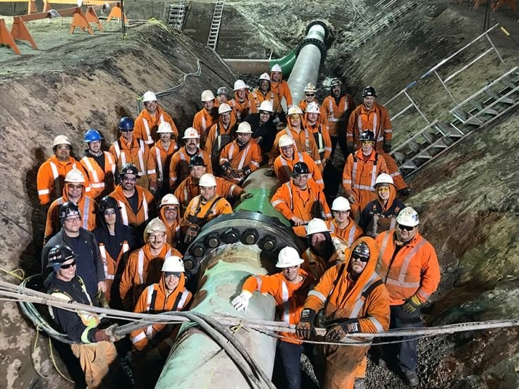
OUR IMPACT TARGETS
Measurable outcomes that define our success
One network. Many pipelines. Infinite possibilities.
500+
40%
10+
10
Engineers
Trained Annually
WIMEE Africa
Participation Target
Research
Publications/Year
African Countries
Reached by Year 2

Slide 13

Legal Registration
01
Register APRN as NGO + social enterprise arm — CAC Nigeria + international structure
Board Formation
NEXT
STEPS
02
Onboard industry leaders, academics, and policy experts as trustees across Nigeria and Africa
Brand & Digital Presence ✅ In Progress
03
Website framework in development · LinkedIn company page being structured · Brand identity underway
We are already moving.
Here's how we accelerate.
Pilot Training — EITEP Institute ✅ In Progress
04
EITEP runs certified global pipeline courses (Germany, Australia, Malaysia) · APRN positioned as Africa delivery partner
Morocco — African Pipeline Leadership Summit (APLS)
05
NMGP corridor runs through 13 countries ending in Morocco · Establish contacts in Morocco energy sector · Host first African Pipeline Leadership Summit (APLS) in Morocco — thought leadership, policy & industry convening

Slide 14
JOIN US IN BUILDING
Africa's Pipeline
Future
Research · Training · Advocacy · Impact
African Pipeline Resource Network (APRN)
Lucy Okeke — Founder & NMDPRA Regulator · Joseph Agwuh — Head, Technology & Innovation
www.aprn-africa.org | info@aprn-africa.org

