Slide 1

Probability
RCDS Statistics Foundations
Aida Sanchez Ricol
25/03/2026
Notes:
-Intro
-1st of two lessons, focus on probability, 2nd on estimation
-Following up on previous lesson, and the idea of first of all representing data graphically in a way that is useful
-Summary metrics
-Example: one of the solutions to the exercises on previous lesson, where we are looking at the weight of abalones by binning the data and showing the frequencies that we find for each bin
-goal of most scientist to go from a reduced

Slide 2
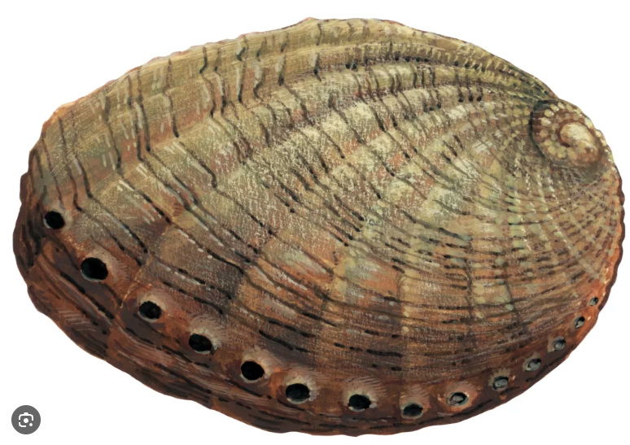
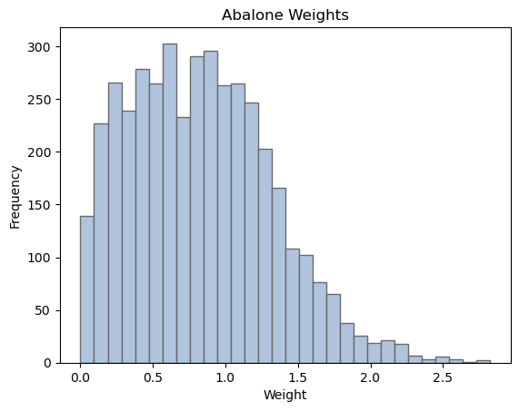
Introduction
Experimental samples can be described by different metrics:
Location parameters: mean, median, mode
Scaling parameters: standard deviation
Shape parameters: skewness, kurtosis
random variable

Slide 3
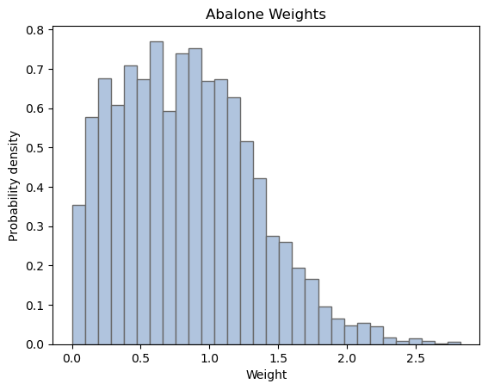
How likely are we to measure a specific value?
Goal of most science experiments:
sample
population
Probability theory can help gain information from a reduced subset of the population

Slide 4

Probability values
Probability values measure how likely we are to measure a certain value
$$p\left(x\right)$$
0
1
Certain I will never get this
Certain I will always get this
Frequentist interpretation
relative frequency of a given outcome
Bayesian interpretation
state of knowledge, priors

Slide 5
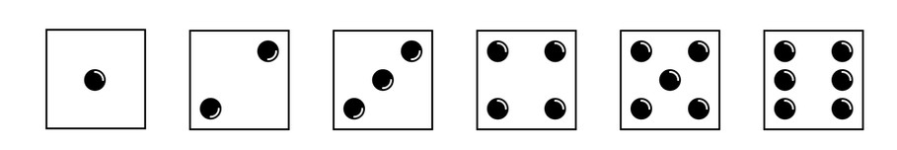
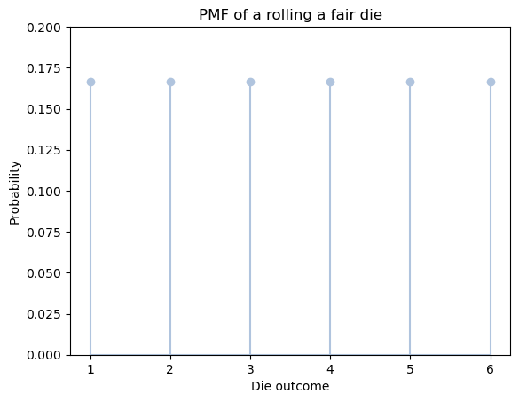

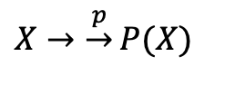
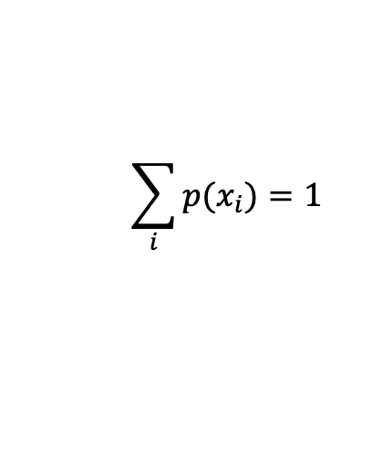






Normalising probability values
Discrete variables
Ex: rolling a fair die
$$X=\{1, 2, 3, 4, 5, 6\}$$
$$p(1)=1/6$$
$$p(4)=1/6$$
$$p(2)=1/6$$
$$p(5)=1/6$$
$$p(3)=1/6$$
$$p(6)=1/6$$
$X→\underset{→}{p}P(X)$
Probability Mass Function (PMF)
$$\sum_{i}{p(x_{i})}=1$$
normalisation

Slide 6
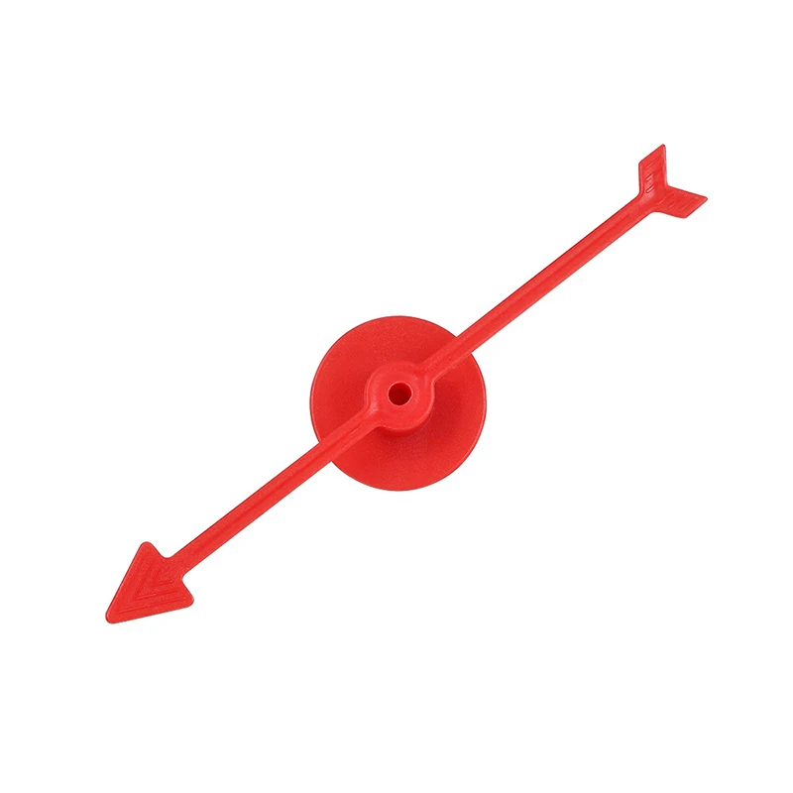
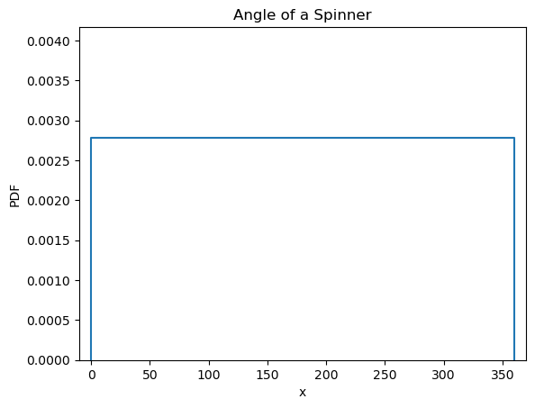
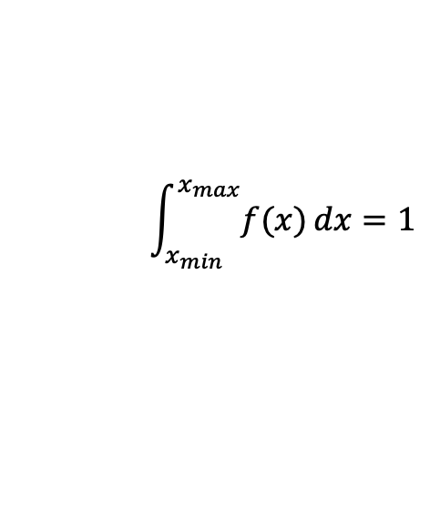
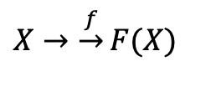

Normalising probability values
Continuous variables
Ex: angle of spinner
$$X=[0, 360º]$$
$X→\underset{→}{f}F(X)$
Probability Density Function (PDF)
$$\int_{x_{min}}^{x_{max}}{f(x)}dx=1$$
normalisation

Slide 7
Common probability distributions
Discrete PMF
Continuous PDF
Binomial
Poisson
Uniform
Gaussian

Slide 8
Binomial distribution
Built up from binary events (success/failure) – known as Bernouilli trials
Examples:
Particle detection: is anything detected at specific detector?
Disease infection: is individual infected?
Gene inheritance: is a trait present in an individual?

Slide 9
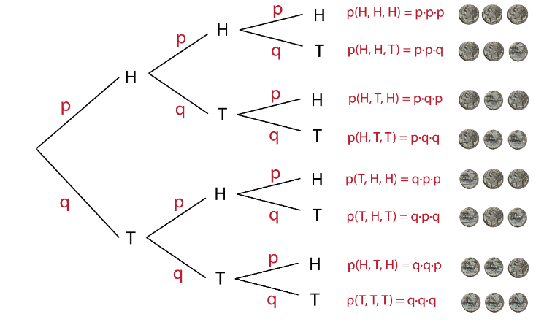
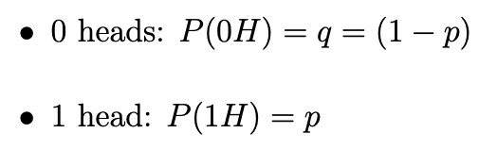
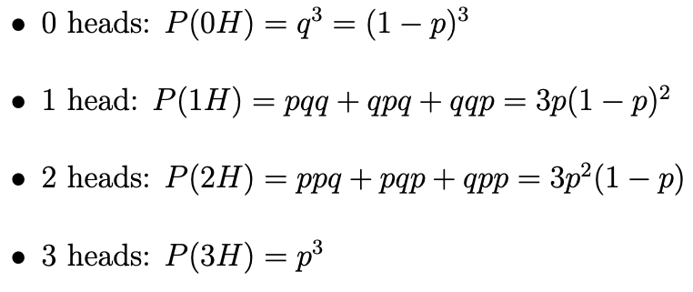
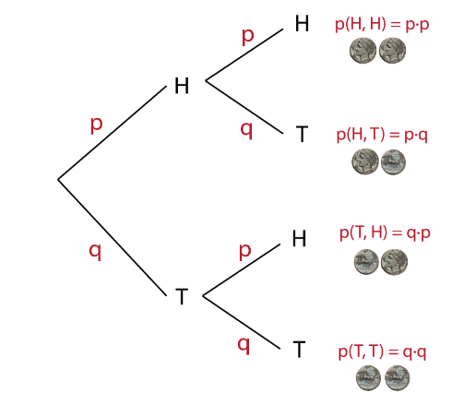
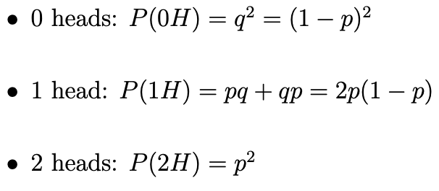
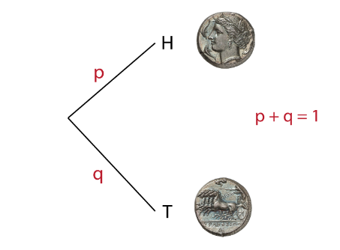
Binomial distribution
Ex: tossing a coin (heads or tails)
What is the probability of obtaining k heads when we toss a coin n times?

Slide 10
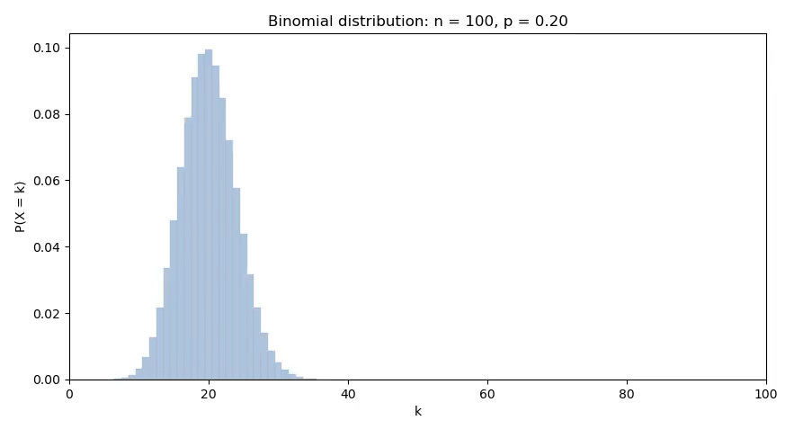
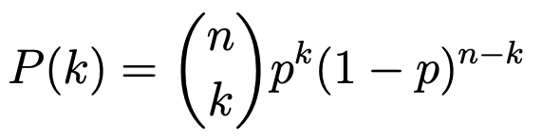
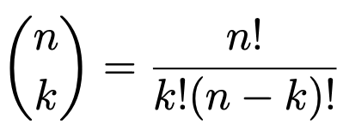

Binomial distribution
Ex: tossing a coin (heads or tails)
What is the probability of obtaining k heads when we toss a coin n times?
General case
# of ways of choosing
results
prob of k consecutive heads
prob of n-k consecutive tails

Slide 11
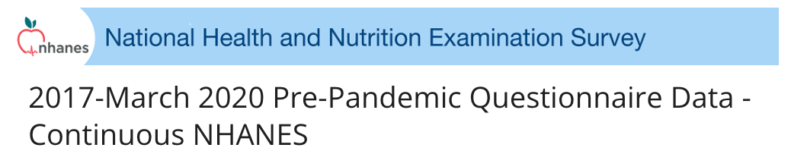
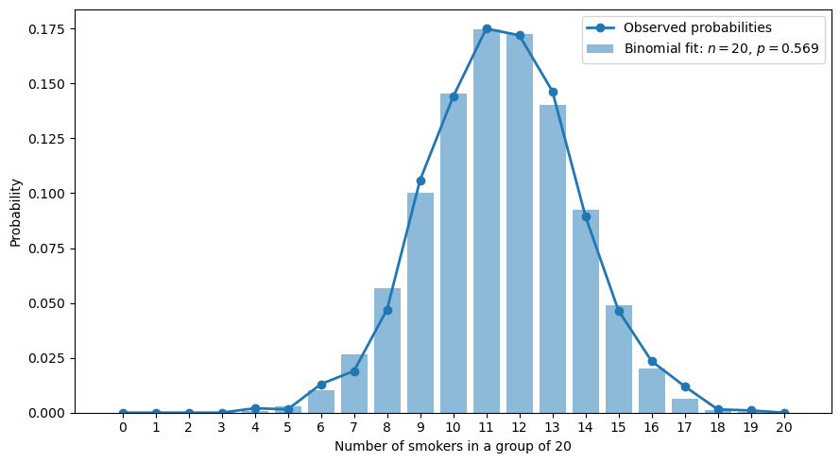
Binomial distribution
Case study
Randomise participants into groups of 20
Probability of k smokers in group of n = 20?
Age
Smoker? YES/NO
Overall prob of being a smoker in age band 30-44
p = 0.569

Slide 12


Binomial distribution
Case study
np.random
math.comb
matplotlib.pyplot
pandas
Randomise participants into groups of 20
1. Find overall p
Probability of k smokers in group of n = 20?
2. Seed the code
3. Generated 2000 samples
4. Construct pmf from overall p

Slide 13
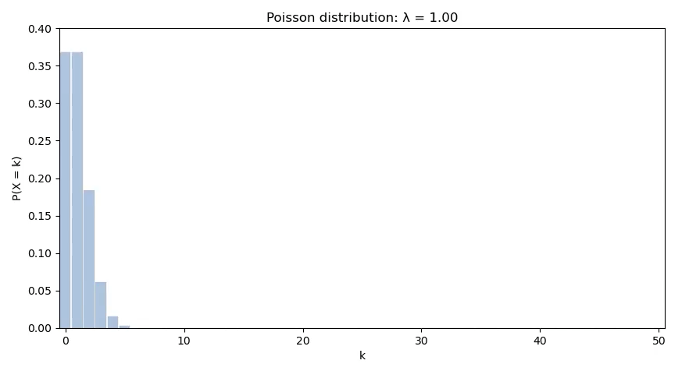

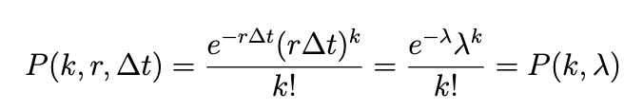
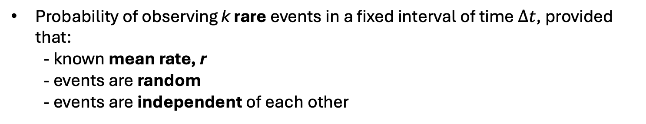
Poisson distribution
Probability of observing k rare events in a fixed interval of time $∆t$, provided that:
- known mean rate, r
- events are random
- events are independent of each other
mean # of events in fixed time interval
Examples:
Spontaneous mutation in DNA sequence in a given time
Radioactive decay

Slide 14
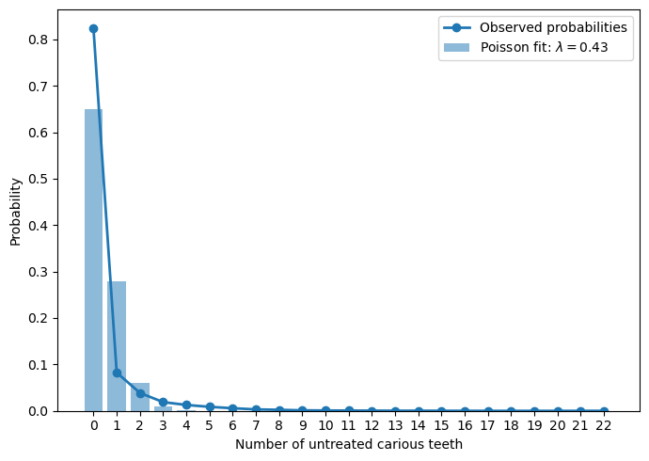
Poisson distribution
Case study
# active/untreated caries
Oral health – dentition?
Average number of carious teeth
λ = 0.43
Not really a Poisson – limited # of teeth, different people have different λ_{i} (not really measuring an external event)

Slide 15
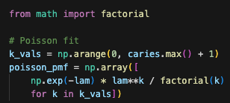
Poisson distribution
Case study
math.factorial
matplotlib.pyplot
# active/untreated caries
Construct pmf from λ

Slide 16
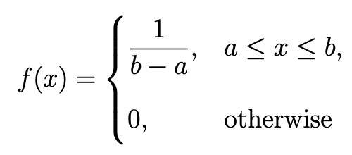
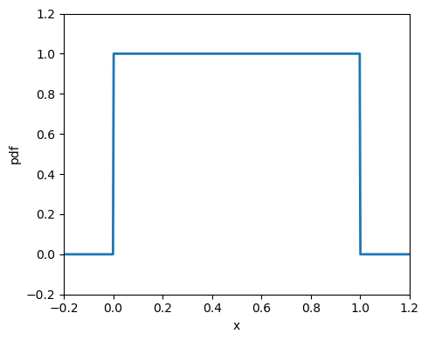


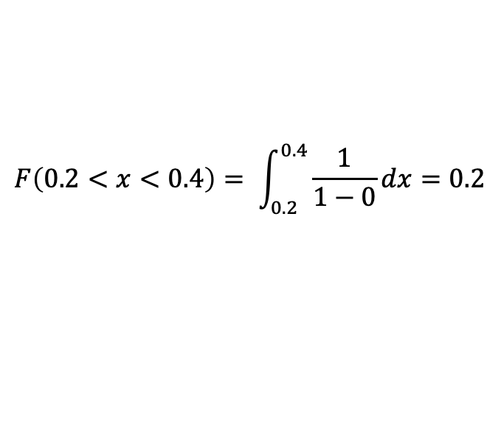
Uniform distribution
Constant probability density in a given range
x position of particle in a box
$$a=0$$
$$b=1$$
$$F\left(0.2<x<0.4\right)= \int_{0.2}^{0.4}{\frac{1}{1−0}dx}=0.2$$
Examples:
Phase of a wave
Particle position in a box

Slide 17
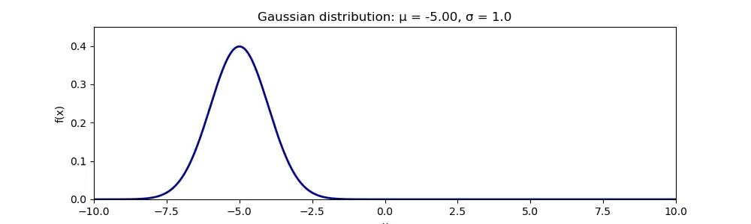
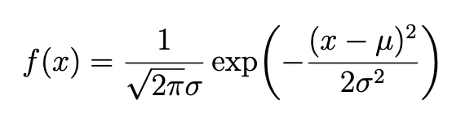
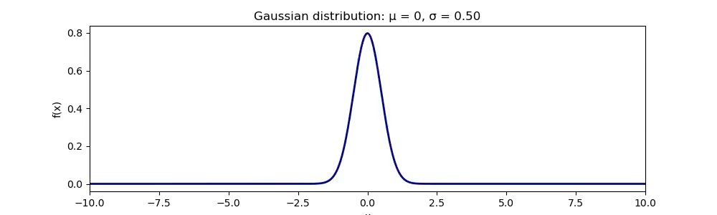
Gaussian distribution
Continuous variables that result from many small independent random influences
Examples:
Thermal velocity of particles
Height, weight, feet length
Measurement errors
μ = population mean
σ = population variance

Slide 18
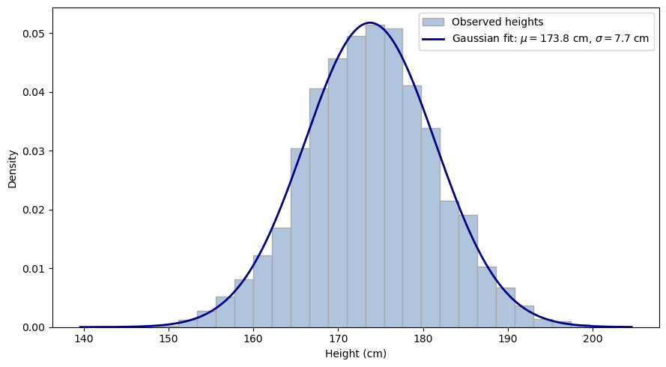
Gaussian distribution
Case study
Adult men height
Body measures

Slide 19


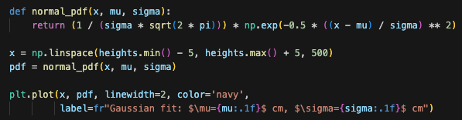
Gaussian distribution
Case study
math
matplotlib.pyplot
pandas
Adult men height
1. Find μ and σ
2. Plot binned data
3. Plot corresponding Gaussian

Slide 20


Time for exercises!
Solve by using:
Functions from standard libraries
Your own functions
scipy
numpy.random
stats.models
numpy
matplotlib.pyplot

