Slide 1

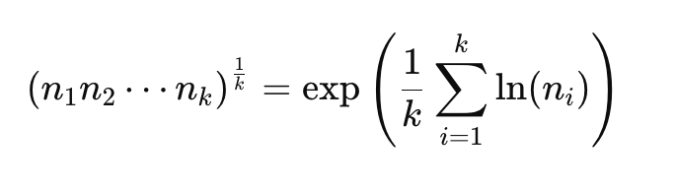
STATISTICS: geometric_mean()
CODEX GENERATED PBT TEST
Describe in documentation: 1 | Math Definition: 2 | Inferred from math/documentation: 3
INVARIANT | SNIPPET Line | CATEGORY | DOCUMENTATION
Invalid Input Raises StatisticsError | 55-56 | DESCRIBED IN DOCUMENTATOIN | Raises a StatisticsError if the input dataset is empty, if it contains a zero, or if it contains a negative value. The data may be a sequence or iterable.
 | 59-63 | DEFINITION OF GEOMETRIC MEAN | N/A (Not listed in documentation)
Result is within min/max range | 67-72 | INFERRED RANGE CONSTRAINT | N/A (Not listed in documentation)
Singleton Value Is Itself | 75-76 | DEFINITION OF GEOMETRIC MEAN | The geometric mean indicates the central tendency or typical value of the data using the product of the values (as opposed to the arithmetic mean which uses their sum).
Repeating Same Data Doesn’t Change Geometric Mean | 79-84 | INFERRED MATH PROPERTY FROM DOCUMENTATION | The geometric mean indicates the central tendency or typical value of the data using the product of the values (as opposed to the arithmetic mean which uses their sum).
SCALING BY FACTOR C, SCALES MEAN BY C | 87-94 | INFERRED MATH PROPERTY FROM DOCUMENTATION | The geometric mean indicates the central tendency or typical value of the data using the product of the values (as opposed to the arithmetic mean which uses their sum).

Slide 2
STATISTICS: mean()
CODEX GENERATED PBT TEST
Describe in documentation: 1 | Math Definition: 2 | Inferred from math/documentation: 3
INVARIANT | SNIPPET Line | CATEGORY | DOCUMENTATION
Invalid Input Raises StatisticsError | 33-35 | DESCRIBED IN DOCUMENTATION | If data is empty, StatisticsError will be raised.
Mean is Average | 41 | DEFINITION OF Mean | The arithmetic mean is the sum of the data divided by the number of data points. It is commonly called “the average”,
Result is within min/max range | 44 | INFERRED RANGE CONSTRAINT | N/A (Not listed in documentation)
Singleton Value Is Itself | 47-48 | DEFINITION OF MEAN | The arithmetic mean is the sum of the data divided by the number of data points. It is commonly called “the average”,
Repeating Same Data Doesn’t Change Mean | 55-59 | INFERRED MATH PROPERTY FROM DOCUMENTATION | The arithmetic mean is the sum of the data divided by the number of data points. It is commonly called “the average”,
SCALING BY FACTOR C, adds MEAN BY C | 51-53 | INFERRED MATH PROPERTY FROM DOCUMENTATION | The arithmetic mean is the sum of the data divided by the number of data points. It is commonly called “the average”,

Slide 3
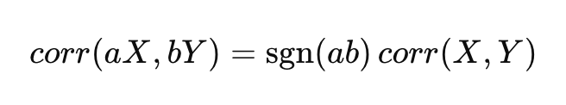
STATISTICS: correlation()
CODEX GENERATED PBT TEST
Describe in documentation: 1 | INFERRED: 4
INVARIANT | SNIPPET Line | CATEGORY | DOCUMENTATION
Correlation Coefficient between -1<= r <= 1 | 38-40 | DESCRIBED IN DOCUMENTATION | Pearson’s correlation coefficient r takes values between -1 and +1. It measures the strength and direction of a linear relationship.
Correlation is symmetric | 43 | INFERRED FROM FORMULA | N/A
Non-constant sequence is correlated with itself | 46 | INFERRED FROM FORMULA | N/A
Adding offsets to sequence values does not change correlation | 49-56 | INFERRED FROM FORMULA | N/A
Repeating Same Data Doesn’t Change Mean | 58-70 | INFERRED MATH PROPERTY | N/A

Slide 4
STATISTICS: linear_regression()
CODEX GENERATED PBT TEST
Describe in documentation: 5
INVARIANT | SNIPPET Line | CATEGORY | DOCUMENTATION
LSR Line always passes through (mean x, mean y) | 46-53 | INFERRED FROM FORMULA | N/A
LSR should recover the slope and intercept if point on line | 43 | INFERRED FROM FORMULA | N/A
Shifting x values should not change slope | 66-75 | INFERRED FROM FORMULA | N/A
Shifting y values changes y-intercept | 77-86 | INFERRED FROM FORMULA | N/A
Scaling y, scales both slope and intercept by same value | 88-100 | INFERRED MATH PROPERTY | N/A

Slide 5
STATISTICS: median()
CODEX GENERATED PBT TEST
Describe in documentation: 3 | INFERRED: 2
INVARIANT | SNIPPET Line | CATEGORY | DOCUMENTATION
Odd length, return middle. Even length, return mean | 40-44 | FROM DOCUMENTATION | Return the median (middle value) of numeric data, using the common “mean of middle two” method.
Reordering values should not change result | 47-48 | FROM DOCUMENTATION | Return the median (middle value) of numeric data, using the common “mean of middle two” method. If data is empty
Adding constant to every value, shifts the median by such constant | 51-53 | INFERRED FROM FORMULA | N/A
Scaling every value in the sequence also scales the median | 56-58 | INFERRED FROM FORMULA | N/A
Statistics Error | 29-32 | FROM DOCUMENTATION | If data is empty, StatisticsError is raised.

Slide 6
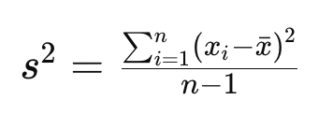
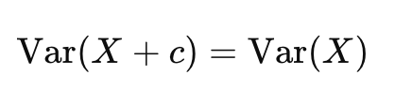
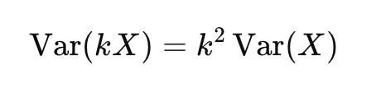
STATISTICS: variance()
CODEX GENERATED PBT TEST
Describe in documentation:1 | INFERRED: 4
INVARIANT | SNIPPET Line | CATEGORY | DOCUMENTATION
Statistics Error | 28-31 | FROM DOCUMENTATION | Return the median (middle value) of numeric data, using the common “mean of middle two” method.
 | 35-38 | INFERRED FROM FORMULA | N/A
Variance >=0 and var = 0 if data is constant | 40-43 | INFERRED FROM FORMULA | N/A
Adding constant does not change variance | 45-52 | INFERRED FROM FORMULA | N/A
Scaling by k, results in k^2 * var | 54-60 | INFERRED FROM FORMULA | N/A

Slide 7
HTML: escape()
CODEX GENERATED PBT TEST
Describe in documentation:3 | INFERRED: 2
INVARIANT | SNIPPET Line | CATEGORY | DOCUMENTATION
Output replacement is in correct order | 33 | FROM DOCUMENTATION | Convert the characters &, < and > in string s to HTML-safe sequences.
Replacement regardless of quote parameter | 35-38 | FROM DOCUMENTATION | If the optional flag quote is true (the default), the characters (") and (') are also translated; t
Quote are escaped if only the parameter is True | 40-47 | FROM DOCUMENTATION | If the optional flag quote is true (the default), the characters (") and (') are also translated; this helps for inclusion in an HTML attribute value delimited by quotes,
Un-escaping a parsed string returns to original input | 49 | INFERRED FROM DOCUMENTATION | N/A
Replacement increases/stays same string length | 52 | INFERRED FROM DOCUMENTATION | N/A

Slide 8
HTML: unescape()
CODEX GENERATED PBT TEST
Describe in documentation:3 | INFERRED: 2
INVARIANT | SNIPPET Line | CATEGORY | DOCUMENTATION
Unchanged if no character reference marker | 30-31 | FROM DOCUMENTATION | Convert all named and numeric character references (e.g. &gt;, &#62;, &#x3e;) in the string s to the corresponding Unicode characters.
Escaping parsed input results in original | 34-35 | INFERRED FROM DOCUMENTATION | N/A
Correct Mapping | 37-49 | FROM DOCUMENTATION | Convert all named and numeric character references (e.g. &gt;, &#62;, &#x3e;) in the string s to the corresponding Unicode characters.
HTML numeric character references are converted back into the correct character. | 41-50 | FROM DOCUMENTATION | his function uses the rules defined by the HTML 5 standard for both valid and invalid character references, and the list of HTML 5 named character references.

Slide 9
DATEUTIL: parse()
CODEX GENERATED PBT TEST
Describe in documentation: 6
INVARIANT | SNIPPET Line | CATEGORY | Extensive DOCUMENTATION
Parsed Objects in datetime dtype | 87 | DESCRIBED IN DOCUMENTATION | returning a datetime object even for dates which are ambiguous.
Parsed Result Components Same | 88 | DESCRIBED IN DOCUMENTATION | parse("2012-01-19 17:21:00 BRST", tzinfos=tzinfos) datetime.datetime(2012, 1, 19, 17, 21, tzinfo=tzoffset(u'BRST', -7200))
Missing Fields Are Provided with Default Values | 108-127 | DESCRIBED IN DOCUMENTATION | elements specified in timestr replace elements in the default object.
Month, year, and day first given params | 157-170 | DESCRIBED IN DOCUMENTATION | Dayfirst, yearfirst param description
Fuzzy_with_tokens=True, returns specified format | 186-189 | DESCRIBED IN DOCUMENTATION | If True, fuzzy is automatically set to True, and the parser will return a tuple where the first element is the parsed datetime.datetime datetimestamp and the second element is a tuple containing the portions of the string which were ignored:
A datetime string containing a numeric timezone offsett should be preserved | 213-215 | DESCRIBED IN DOCUMENTATION | Additional time zone names / aliases which may be present in the string. This argument maps time zone names (and optionally offsets from those time zones) to time zones.

Slide 10
DATEUTIL: isoparse()
CODEX GENERATED PBT TEST
Describe in documentation: 3 | INFERRED via documentation: 1
INVARIANT | SNIPPET Line | CATEGORY | Extensive DOCUMENTATION
Parsed Objects in datetime dtype | 188 | DESCRIBED IN DOCUMENTATION | arse an ISO-8601 datetime string into a datetime.datetime.
Parsed Results Match ISO String | 185-195 | DESCRIBED IN DOCUMENTATION | Common provided date formats
No TimeZone String in Normal DateTime | 198 | INFERRED VIA DOCUMENTATION | n/a
Offset is in tzinfo and matches offset | 200-201 | DESCRIBED IN DOCUMENTATION | Offsets will be represented as dateutil.tz.tzoffset objects, with the exception of UTC, which will be represented as dateutil.tz.tzutc. Time zone offsets equivalent to UTC (such as +00:00) will also be represented as dateutil.tz.tzutc.

