Slide 1
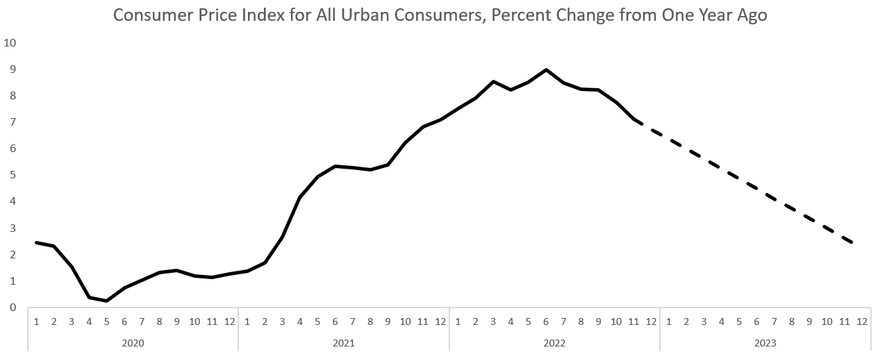
3 percent threshold
Linear extension of June-November trend

