Slide 1
Two-way Partition Mar 10, 2022
TA: Siou-Sian Lin(林修賢)
Email: zu00895077@gmail.com
Advisor: Hung-Ming Cheng

Slide 2
Outline
Problem Formulation
hMETIS introduction
Evaluation
Fm Partition Implementation

Slide 3
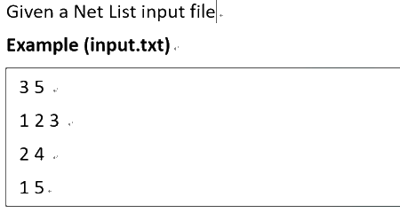
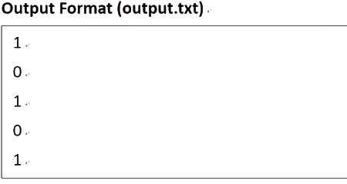
Problem Formulation
Input
output
first line: # of nets and # of nodes
rest of lines: defined the nodes (named as 1 ~ n)
which the net is connected
The n-th line: group to the n-th node belongs
Notes:
可以用FM、KL、或其他你們知道的partitioning algorithm

Slide 4
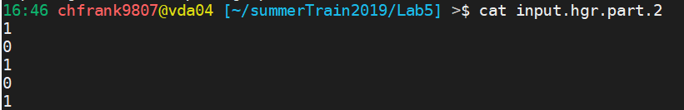
hMETIS introduction
An exe file which is dealing K-way partitioning
Usage: ./shmetis [input] [ # of groups ] [ balance factor ]
Ex: ./shmetis input.hgr 2 5
And there will be a output file named input.hgr.part.2
Reference:
hMETIS web
Karypis, George, and Vipin Kumar. "Multilevel k-way hypergraph partitioning." VLSI design 11.3 (2000): 285-300.

Slide 5
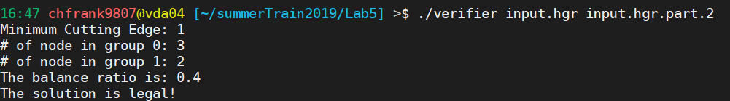
Evaluation
Your program:
./hw2 [input]
Ex: ./hw2 input.hgr
Output: output.txt
Verifier
It will verify your output file and show the balance ratio
Usage: ./verifier [input] [output]
Ex: verifier input.hgr input.hgr.part.2

Slide 6
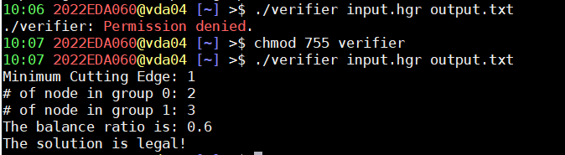
Permission
Problem of permission
Use chmod 755 [Executable binary]
Ex:

Slide 7
Fm Partition Implementation (optional)
Notes:
7

Slide 8
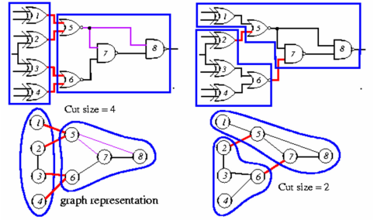
What Is partition?
Target: partition the nodes to 2 sets and minimize the cuts number.
Notes:
8

Slide 9
Common of FM & KL
Random initialization.
Choose best gain every time.
Locking mechanism.
Repeat R passes loop.
Notes:
9

Slide 10
Difference of FM & KL
Moving way of node. (FM is more flexible)
Balance factor. (FM allow unbalanced partition)
Gain calculating. (FM can handle hypergraph)
Time complexity.
KL : O(RN^3 )
FM: O(RP ) (P is the total # of terminals)
Notes:
10

Slide 11
What Is Terminal?
2 <= p <= N ,p is the terminals of every wire.
2N <= P <= WN ,P is the sum of the terminals in the circuit.
O(P)~=O(N) for normal circuit
benchmark : ISPD98 Circuit-ibm18
W: Wires: 201920
N: Nodes: 210613
P: terminals: 819697
Notes:
11

Slide 12
FM Partition Flow
Random initialize
+p
Construct gain list
1
6
+2
+1
Move node &
update gain list
0
+0
4
2
-1
7
New Round
3
All cumulative gain <0
-2
NO
5
-p
YES
End

Slide 13
Move node
+2
1
0
0
+1
8
+0
2
6
-1
8
1
6
-2
2

Slide 14

Move node
1
0
1
0
+2
+2
2
2
+1
+1
8
2
8
8
+0
+0
6
1
6
6
6
-1
-1
1
8
-2
-2
Same color line is same line!
2

Slide 15
update gain list
0
1
2
5
4
6
8
3
7
9

Slide 16
update gain list
+p
+2
Calculate new gain
+1
X
X
+0
update
-1
-2
-p

Slide 17
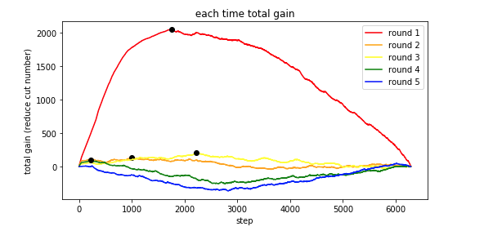
Experimental Results

Slide 18
Thank you

