Slide 1
Midterm report
Name:8wingflying
Teacher: my dear great teacher

Slide 2
agneda
Part 1:Linux (30-50 pages)
Linux operating systems
Linux distributions : Ubuntu , cento, red hat enterprise server, kali linux, remux linux, security onion linux .....
kernel and shell
Basic Linux commands: file , ls , cd , mkdir,
pipeline(|), redirection(>, >>)
Linux Network command : wget, nc, netstat ,...
Part 2: Python Programming(30-50 pages)

Slide 3
O! My Linux

Slide 4
Linux operating systems

Slide 5
Linux distributions: Ubuntu linux
Ubuntu is a Linux distribution based on Debian and composed mostly of free and open-source software
Ubuntu is officially released in three editions: Desktop, Server,and Corefor Internet of things devicesand robots
Ubuntu is released every six months, with long-term support (LTS) releases every two years.
Ubuntu 12.04,16.0.4,18.04,20.04 LTS

Slide 6
Cento linux

Slide 7
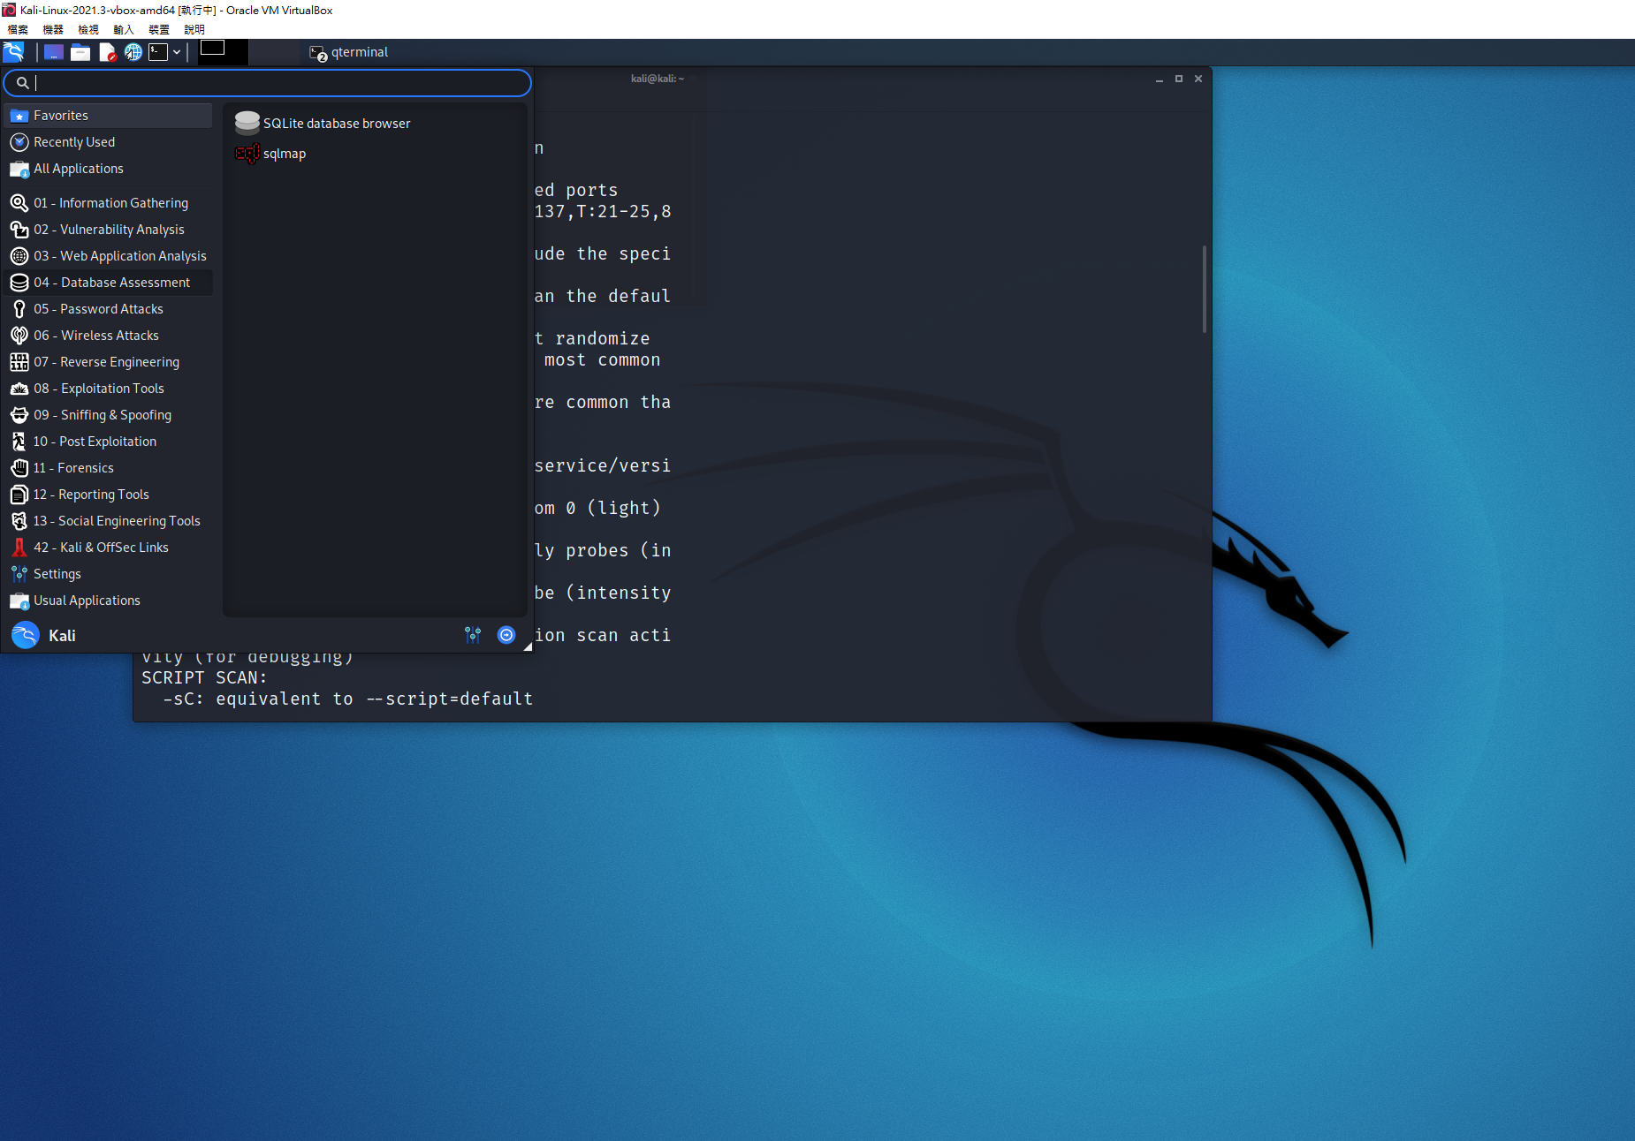
Kali linux

Slide 8
Life is short
Using python

Slide 9
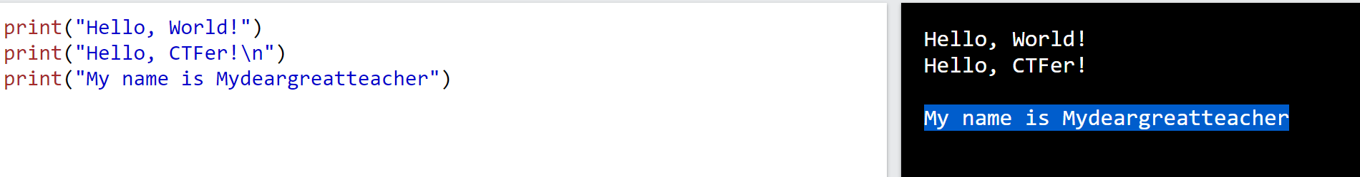
Print()

Slide 10
