Slide 1
Readability

Slide 2
Readability?
There are several conventions that programmers use to make code more readable.
Comments are one way to accomplish this.

Slide 3
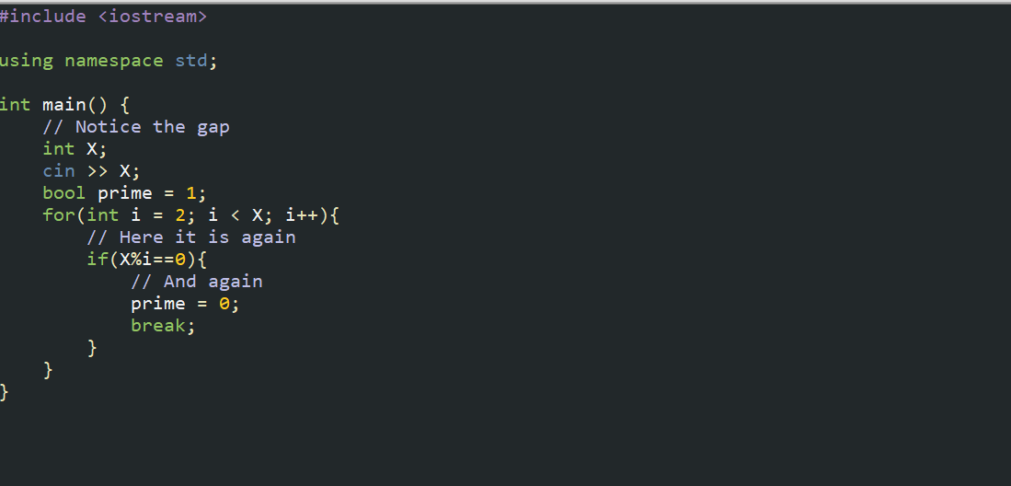
Readability!

Slide 4
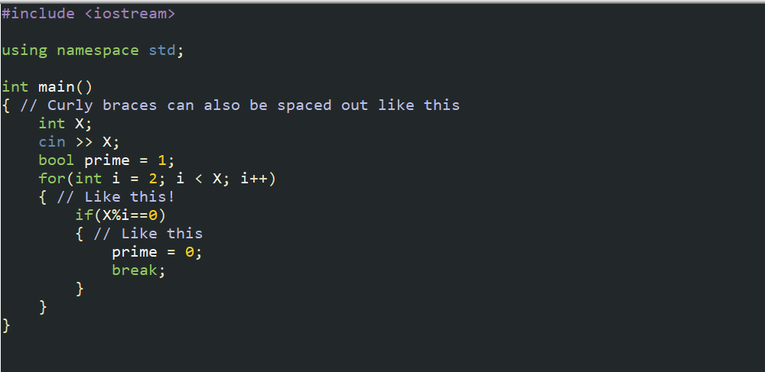
Readability again!

Slide 5
Do’s
Your variable names should be camelCase (likeThis)
Your variables should have thoughtful names
Your code should do one thing at a time
Make functions for repeated code or even for making things less messy
Space things out! (a + b instead of a+b)

