Slide 1
COMP9024: Data Structures and Algorithms
Graphs (III)

Slide 2
Contents
Shortest Paths
Minimum Spanning Trees

Slide 3
Shortest Paths
0
8
A
4
2
8
7
2
1
3
B
C
D
5
3
9
8
2
E
F
5

Slide 4
Weighted Graphs
In a weighted graph, each edge has an associated numerical value, called the weight of the edge
Edge weights may represent, distances, costs, etc.
Example:
  In a flight route graph, the weight of an edge represents the distance in miles between the endpoint airports
849
PVD
1843
ORD
142
SFO
802
LGA
1743
1205
337
1387
HNL
2555
1099
LAX
1233
DFW
1120
MIA

Slide 5
Shortest Paths
Given a weighted graph and two vertices u and v, we want to find a path of minimum total weight between u and v.
  Length of a path is the sum of the weights of its edges.
Example:
  Shortest path between Providence and Honolulu
Applications
  Internet packet routing
  Flight reservations
  Driving directions
849
PVD
1843
ORD
142
SFO
802
LGA
1743
1205
337
1387
HNL
2555
1099
LAX
1233
DFW
1120
MIA

Slide 6
Shortest Path Properties
Property 1:
A subpath of a shortest path is itself a shortest path
Property 2:
There is a tree of shortest paths from a start vertex to all the other vertices
Example:
Tree of shortest paths from Providence
849
PVD
1843
ORD
142
SFO
802
LGA
1743
1205
337
1387
HNL
2555
1099
LAX
1233
DFW
1120
MIA

Slide 7
Dijkstra’s Algorithm
The distance of a vertex v from a vertex s is the length of a shortest path between s and v
Dijkstra’s algorithm computes the distances of all the vertices from a given start vertex s
Assumptions:
  the graph is connected
  the edges are undirected
  the edge weights are nonnegative
We grow a “cloud” of vertices, beginning with s and eventually covering all the vertices
We store with each vertex v a label D(v) representing the distance of v from s in the subgraph consisting of the cloud and its adjacent vertices
At each step
  We add to the cloud the vertex u outside the cloud with the smallest distance label, D(u)
  We update the labels of the vertices that are adjacent to u and not in the cloud

Slide 8
Edge Relaxation
Consider an edge e = (u,z) such that
  u is the vertex most recently added to the cloud
  z is not in the cloud
The relaxation of edge e updates distance D(z) as follows:
D(z) = min{D(z), D(u) + weight(e)}
D(u) = 50
10
D(z) = 75
u
e
s
z
D(u) = 50
10
D(z) = 60
u
e
s
z

Slide 9
Example (1/2)
0
0
8
A
4
8
A
4
2
2
8
7
2
1
4
8
7
2
1
3
B
C
D
B
C
D
∞
3
9
∞
5
3
9
8
2
E
F
5
2
E
F
5
0
0
8
A
4
8
A
4
2
2
8
7
2
1
3
7
7
2
1
3
B
C
D
B
C
D
5
3
9
11
5
3
9
8
2
E
F
5
2
E
F
5

Slide 10
Example (2/2)
0
8
A
4
2
7
7
2
1
3
B
C
D
5
3
9
8
2
E
F
5
0
8
A
4
2
7
7
2
1
3
B
C
D
5
3
9
8
2
E
F
5

Slide 11
Dijkstra’s Algorithm
Algorithm DijkstraDistances(G, s)
Input: A simple undirected weighted graph G with nonnegative edge weights,
and a distinguished vertex s.
Output: A label D[u], for each vertex u, such that D[u] is the length of a shortest
path from s to u in G.
{ for each v ∈ G do
if ( v = s )
D[v] = 0;
else
D[v] = +∞;
Create a priority queue Q containing all the vertices of G using the D labels as keys;
  while Q is not empty do
  { u = Q.removeMin();
  for each z ∈ Q such that z is adjacent to u do
  if ( D[u] + w((u,z)) < D[z] ) // relax edge e
  { D[z] = D[u] + w((u,z));
  Change to D[z] the key of vertex z in Q;
  }
  }
  return the label D[u] of each vertex u;
  }

Slide 12
Analysis of Dijkstra’s Algorithm
Creating the priority queue Q takes O(n log n) time if using an adaptable priority queue, or O(n) time by using bottom-up heap construction.
At each iteration of the while loop, we spend O(log n) time to remove vertex u from Q and O(degree(u) log n) time to perform the relaxation procedure on the edges incident on u.
The overall running time of the while loop is
O(Σ_{u} (1+degree(u)) log n) = O((n + m) log n)
(Recall that Σ_{u} degree(u) = 2m)
The running time can also be expressed as O(m log n) since the graph is connected

Slide 13
Why Dijkstra’s Algorithm Works
Dijkstra’s algorithm is based on the greedy method. It adds vertices by increasing distance.
  Suppose it didn’t find all shortest distances. Let v be the first wrong vertex the algorithm processed.
  When the previous node, u, on the true shortest path was considered, its distance was correct.
  But the edge (u,v) was relaxed at that time!
  Thus, so long as D(v)>D(u), v’s distance cannot be wrong. That is, there is no wrong vertex.
0
8
A
4
2
7
7
2
1
3
B
C
u
5
3
9
8
2
D
v
5

Slide 14

Why It Doesn’t Work for Negative-Weight Edges
Dijkstra’s algorithm is based on the greedy method. It adds vertices by increasing distance.
0
8
A
4
  If a node with a negative incident edge were to be added late to the cloud, it could mess up distances for vertices already in the cloud.
6
7
7
5
1
4
B
C
D
5
0
-8
-3
2
5
E
F
C’s true distance is 1, but it is already in the cloud with D(C)=5!

Slide 15
Bellman-Ford Algorithm
Works even with negative-weight edges
Must assume directed edges (for otherwise we would have negative-weight cycles)
Iteration i finds all shortest paths that use i edges.
Running time: O(nm).
Can be extended to detect a negative-weight cycle if it exists
  How?
Algorithm BellmanFord(G, s)
{ for each v ∈ G do
if ( v = s )
D[v] = 0;
else
D[v] = +∞;
for ( i = 1; i ≤ n-1; i ++ )
  for each e ∈ G.edges()
  // relax edge e
  { u = G.origin(e);
  z = G.opposite(u,e);
  r = D[u] + weight(e);
  if ( r < D[z] )
  D[z] = r;
  }
  }

Slide 16
Bellman-Ford Example
Nodes are labeled with their D(v) values
8
0
4
8
0
4
-2
-2
7
1
8
7
-2
1
4
∞
∞
∞
∞
∞
∞
3
9
3
9
-2
∞
∞
5
-2
∞
∞
5
8
0
4
8
0
4
-2
-2
5
8
7
-2
1
4
-1
5
7
-2
1
-1
1
3
9
3
9
-2
6
9
5
-2
4
5
∞
∞
1
9

Slide 17
DAG-based Algorithm
(not in book)
Algorithm DagDistances(G, s)
{ for all v ∈ G.vertices()
if ( v = s )
D[v] = 0;
else
D[v] = +∞;
Perform a topological sort of the vertices;
for ( u = 1; u ≤ n; u ++ )
// in topological order
  for each e ∈ G.outEdges(u) do
  // relax edge e
  { z = G.opposite(u,e);
  r = D[u] + weight(e);
  if ( r < D[z] )
  D[z] = r;
  }
  }
Works even with negative-weight edges
Uses topological order
Doesn’t use any fancy data structures
Is much faster than Dijkstra’s algorithm
Running time: O(n+m).

Slide 18
DAG Example
Nodes are labeled with their D(v) values
1
1
8
0
4
8
0
4
-2
-2
3
7
2
1
4
3
8
7
2
-2
1
4
4
∞
∞
∞
∞
∞
∞
3
9
3
9
-5
∞
∞
5
-5
∞
∞
5
6
5
6
5
1
1
8
0
4
8
0
4
-2
-2
3
5
7
2
1
4
-1
3
7
2
1
4
8
-2
4
5
-2
-1
3
9
3
9
-5
1
7
5
-5
0
4
5
∞
∞
1
7
6
5
6
5
(two steps)

Slide 19
Minimum Spanning Trees
2704
867
BOS
849
PVD
ORD
740
187
144
1846
621
JFK
802
184
1258
SFO
1391
BWI
337
1464
1090
LAX
1235
DFW
946
1121
MIA
2342

Slide 20
Minimum Spanning Trees
Spanning subgraph
  Subgraph of a graph G containing all the vertices of G
Spanning tree
  Spanning subgraph that is itself a (free) tree
Minimum spanning tree (MST)
  Spanning tree of a weighted graph with minimum total edge weight
Applications
  Communications networks
  Transportation networks
ORD
10
1
PIT
DEN
6
7
9
3
DCA
4
STL
8
5
2
DFW
ATL

Slide 21
Cycle Property
f
8
Cycle Property:
  Let T be a minimum spanning tree of a weighted graph G
  Let e be an edge of G that is not in T and C be the cycle formed by e with T
  For every edge f of C, weight(f) ≤ weight(e)
  Proof:
  By contradiction
  If weight(f) > weight(e) we can get a spanning tree of smaller weight by replacing e with f
4
C
9
2
6
3
e
8
7
7
Replacing f with e yields
a better spanning tree
f
8
4
C
9
2
6
3
e
8
7
7

Slide 22
Partition Property
U
V
f
7
Partition Property:
  Consider a partition of the vertices of G into subsets U and V
  Let e be an edge of minimum weight across the partition
  There is a minimum spanning tree of G containing edge e
  Proof:
  Let T be an MST of G
  If T does not contain e, consider the cycle C formed by e with T and let f be an edge of C across the partition
  By the cycle property,
  weight(f) ≤ weight(e)
  Thus, weight(f) = weight(e)
  We obtain another MST by replacing f with e
4
9
2
5
8
8
e
3
7
Replacing f with e yields
another MST
U
V
f
7
4
9
2
5
8
8
e
3
7

Slide 23
Kruskal’s Algorithm
A priority queue stores the edges outside the cloud
  Key: weight
  Element: edge
At the end of the algorithm
  We are left with one cloud that encompasses the MST
  A tree T which is our MST
Algorithm KruskalMST(G)
{
for each vertex v in G do
define a Cloud(v) of {v};
let Q be a priority queue;
Insert all edges into Q using their
weights as the key;
T = ∅;
while T has fewer than n-1 edges do { edge e = Q.removeMin();
Let u, v be the endpoints of e;
if ( Cloud(v) ≠ Cloud(u) )
{ Add edge e to T;
Merge Cloud(v) and Cloud(u);
}
}
return T;
}

Slide 24
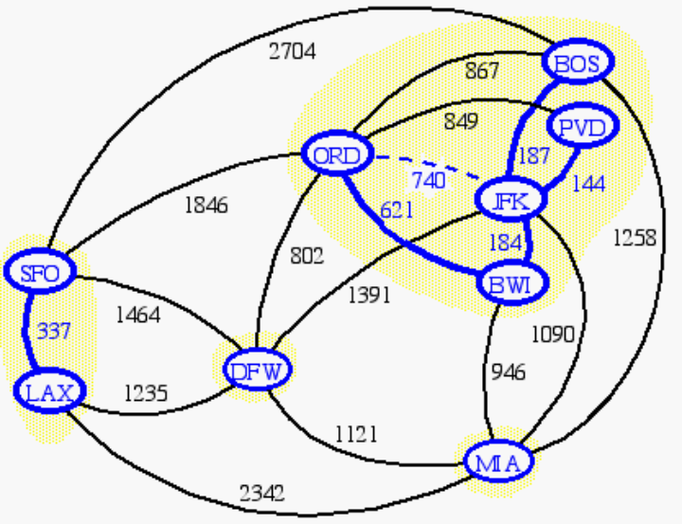
Data Structure for Kruskal Algorithm
The algorithm maintains a forest of trees
An edge is accepted it if connects distinct trees
We need a data structure that maintains a partition, i.e., a collection of disjoint sets, with the operations:
-find(u): return the set storing u
-union(u,v): replace the sets storing u and v with their union

Slide 25
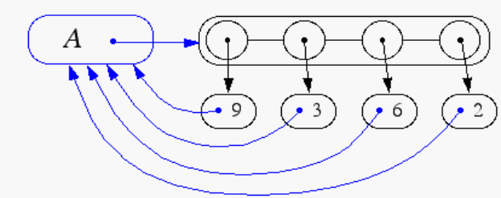
Representation of a Partition
Each set is stored in a sequence
Each element has a reference back to the set
  operation find(u) takes O(1) time, and returns the set of which u is a member.
  in operation union(u,v), we move the elements of the smaller set to the sequence of the larger set and update their references
  the time for operation union(u,v) is min(n_{u},n_{v}), where n_{u} and n_{v} are the sizes of the sets storing u and v
Whenever an element is processed, it goes into a set of size at least double, hence each element is processed at most log n times

Slide 26
Partition-Based Implementation
A partition-based version of Kruskal’s Algorithm performs cloud merges as unions and tests as finds.
Algorithm Kruskal(G):
Input: A weighted graph G.
Output: An MST T for G.
{ Let P be a partition of the vertices of G, where each vertex forms a separate set;
Let Q be a priority queue storing the edges of G, sorted by their weights;
Let T be an initially-empty tree;
while Q is not empty do
{ (u,v) = Q.removeMinElement();
if ( P.find(u) != P.find(v) )
{ Add (u,v) to T;
P.union(u,v);
}
}
return T;
}
Running time: O((m+n) log n)

Slide 27
Kruskal Example (1/14)
2704
867
BOS
849
PVD
ORD
187
740
144
1846
621
JFK
184
1258
802
SFO
BWI
1391
1464
337
1090
DFW
946
LAX
1235
1121
MIA
2342

Slide 28
Example (2/14)
2704
867
BOS
849
PVD
ORD
187
740
144
1846
621
JFK
184
1258
802
SFO
BWI
1391
1464
337
1090
DFW
946
LAX
1235
1121
MIA
2342

Slide 29
Example (3/14)
2704
867
BOS
849
PVD
ORD
187
740
144
1846
621
JFK
184
1258
802
SFO
BWI
1391
1464
337
1090
DFW
946
LAX
1235
1121
MIA
2342

Slide 30
Example (4/14)
2704
867
BOS
849
PVD
ORD
187
740
144
1846
621
JFK
184
1258
802
SFO
BWI
1391
1464
337
1090
DFW
946
LAX
1235
1121
MIA
2342

Slide 31
Example (5/14)
2704
867
BOS
849
PVD
ORD
187
740
144
1846
621
JFK
184
1258
802
SFO
BWI
1391
1464
337
1090
DFW
946
LAX
1235
1121
MIA
2342

Slide 32
Example (6/14)
2704
867
BOS
849
PVD
ORD
187
740
144
1846
621
JFK
184
1258
802
SFO
BWI
1391
1464
337
1090
DFW
946
LAX
1235
1121
MIA
2342

Slide 33
Example (7/14)
2704
867
BOS
849
PVD
ORD
187
740
144
1846
621
JFK
184
1258
802
SFO
BWI
1391
1464
337
1090
DFW
946
LAX
1235
1121
MIA
2342

Slide 34
Example (8/14)
2704
867
BOS
849
PVD
ORD
187
740
144
1846
621
JFK
184
1258
802
SFO
BWI
1391
1464
337
1090
DFW
946
LAX
1235
1121
MIA
2342

Slide 35
Example (9/14)
2704
867
BOS
849
PVD
ORD
187
740
144
1846
621
JFK
184
1258
802
SFO
BWI
1391
1464
337
1090
DFW
946
LAX
1235
1121
MIA
2342

Slide 36
Example (10/14)
2704
867
BOS
849
PVD
ORD
187
740
144
1846
621
JFK
184
1258
802
SFO
BWI
1391
1464
337
1090
DFW
946
LAX
1235
1121
MIA
2342

Slide 37
Example (11/14)
2704
867
BOS
849
PVD
ORD
187
740
144
1846
621
JFK
184
1258
802
SFO
BWI
1391
1464
337
1090
DFW
946
LAX
1235
1121
MIA
2342

Slide 38
Example (12/14)
2704
867
BOS
849
PVD
ORD
187
740
144
1846
621
JFK
184
1258
802
SFO
BWI
1391
1464
337
1090
DFW
946
LAX
1235
1121
MIA
2342

Slide 39
Example (13/14)
2704
867
BOS
849
PVD
ORD
187
740
144
1846
621
JFK
184
1258
802
SFO
BWI
1391
1464
337
1090
DFW
946
LAX
1235
1121
MIA
2342

Slide 40
Example (14/14)
2704
867
BOS
849
PVD
ORD
187
740
144
1846
621
JFK
184
1258
802
SFO
BWI
1391
1464
337
1090
DFW
946
LAX
1235
1121
MIA
2342

Slide 41
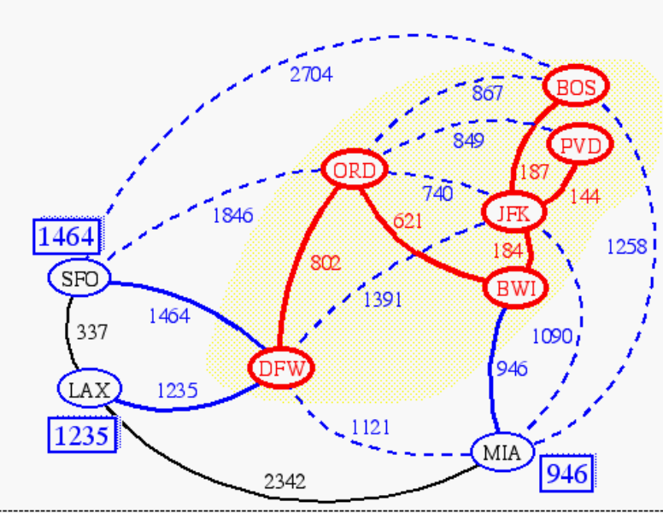
Prim-Jarnik’s Algorithm (1/2)
Similar to Dijkstra’s algorithm (for a connected graph)
We pick an arbitrary vertex s and we grow the MST as a cloud of vertices, starting from v
We store with each vertex u a label D(u) = the smallest weight of an edge connecting u to a vertex in the cloud
At each step:
  We add to the cloud the vertex u outside the cloud with the smallest distance label
  We update the labels of the vertices adjacent to u

Slide 42
Prim-Jarnik’s Algorithm (2/2)
Algorithm PrimJarnikMST(G)
{
Pick any vertex v of G;
D[v] = 0;
for each u ∈ G with u ≠ v do
D[u] = + ∞;
T = ∅ ;
Create a priority queue Q with an entry
((u, null), D[u]) for each vertex u, where
(u, null) is the element and D[u] is the key;
  while Q is not Empty do
  { (u, e) = Q.removeMin();
  add vertex u and edge e to T;
  for each vertex z in Q such that z is adjacent to u do
  if ( w((u, z)) < D[z] )
  { D[z] = w((u, z));
  Change to (z, (u,z)) the element of vertex z in Q;
  Change to D[z] the key of vertex z in Q;
  }
  }
  return T;
  }

Slide 43
Example (1/2)
∞
7
2
7
D
2
7
D
B
4
B
4
8
9
∞
5
9
∞
2
5
F
2
5
F
C
8
C
8
8
3
8
3
E
E
A
7
7
A
7
7
0
0
7
7
2
7
D
7
D
B
4
2
B
4
5
9
∞
9
4
2
5
F
5
5
C
2
F
8
C
8
8
3
3
E
8
A
7
E
0
7
A
7
7
0

Slide 44
Example (2/2)
7
2
7
D
B
4
5
9
4
2
5
F
C
8
8
3
E
A
7
3
7
0
7
D
2
B
4
5
9
4
2
5
F
C
8
8
3
E
A
7
3
0

Slide 45
Analysis
Graph operations
  Method incidentEdges is called once for each vertex
Label operations
  We set/get the distance, parent and locator labels of vertex z O(deg(z)) times
  Setting/getting a label takes O(1) time
Priority queue operations
  Each vertex is inserted once into and removed once from the priority queue, where each insertion or removal takes O(log n) time
  The key of a vertex w in the priority queue is modified at most deg(w) times, where each key change takes O(log n) time
Prim-Jarnik’s algorithm runs in O((n + m) log n) time provided the graph is represented by the adjacency list structure
  Recall that Σ_{v} deg(v) = 2m
The running time is O(m log n) since the graph is connected

Slide 46
Baruvka’s Algorithm
Like Kruskal’s Algorithm, Baruvka’s algorithm grows many “clouds” at once.
Each iteration of the while-loop halves the number of connected components in T.
  The running time is O(m log n).
Algorithm BaruvkaMST(G)
{ T = V; // just the vertices of G
while T has fewer than n-1 edges do
for each connected component C in T do
{ Let edge e be the smallest-weight edge from C to another component in T;
if e is not already in T then
Add edge e to T;
}
return T;
}

Slide 47
Baruvka Example (1/3)
2704
867
BOS
849
PVD
ORD
187
740
144
1846
JFK
621
184
1258
802
SFO
BWI
1391
1464
337
1090
DFW
946
LAX
1235
1121
MIA
2342

Slide 48
Example (2/3)
2704
867
BOS
849
187
PVD
ORD
740
144
1846
JFK
621
184
1258
802
SFO
BWI
1391
1464
337
1090
DFW
946
LAX
1235
1121
MIA
2342

Slide 49
Example (3/3)
2704
867
BOS
849
187
PVD
ORD
740
144
1846
JFK
621
184
1258
802
SFO
BWI
1391
1464
337
1090
DFW
946
LAX
1235
1121
MIA
2342

Slide 50
Summary
Shortest path problem
  Dijkstra’s algorithm
  Bellman-Ford algorithm
Minimum spanning tree problem
  Kruskal’s algorithm
  Prim-Jarnik’s algorithm
  Baruvk’s algorithm
Suggested reading (Sedgewick):
  Ch.20
  Ch.21

