Slide 1
COMP9024: Data Structures and Algorithms
Trees and Binary Search Trees

Slide 2
Contents
Trees
Tree traversals
Binary search trees

Slide 3
Maps and Dictionaries
A map (dictionary) is a collection of data items each of which is a pair (key, value), and supports the following major operations:
find(item): find item in the collection
insert(item): insert item into the collection
remove(item): remove item from the collection
The only difference between a map and a dictionary is that in a map, all keys are distinct while in a dictionary, there may exist duplicate keys.
For example, given a list of students, we can use a map to model it if student IDs are the keys, and we can use a dictionary to model it if students names are the keys.
A value can be any data structure such as a student record.
Applications: Google, databases, online trading systems, ....
Key question: how to make the above three major operations fast?

Slide 4
Trees
In computer science, a tree is an abstract model of a hierarchical structure
A tree consists of nodes with a parent-child relation
Applications:
Organization charts
File systems
Programming environments
Computers”R”Us
Sales
Manufacturing
R&D
US
International
Laptops
Desktops
Europe
Asia
Canada

Slide 5
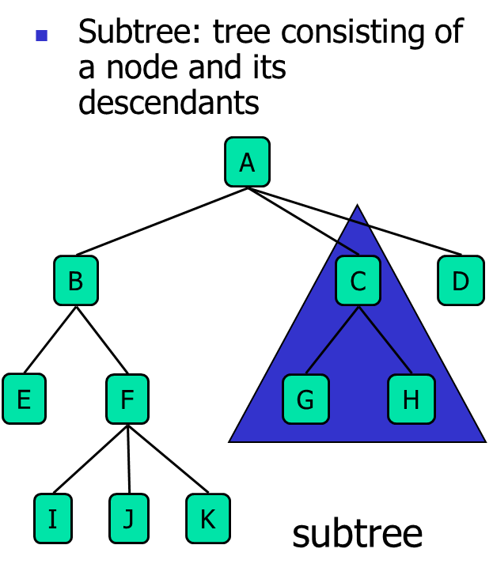
Trees Terminology
Root: node without parent (A)
Internal node: node with at least one child (A, B, C, F)
Leaf node: node without children (E, I, J, K, G, H, D)
Ancestors of a node: parent, grandparent, grand-grandparent, etc.
Depth of a node: number of ancestors
Height of a tree: maximum depth of any node (3)
Descendant of a node: child, grandchild, grand-grandchild, etc.

Slide 6
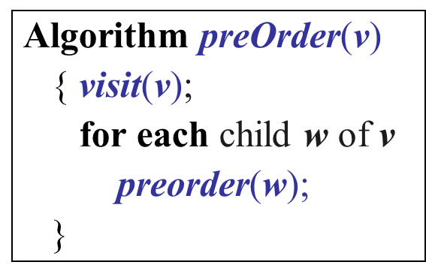
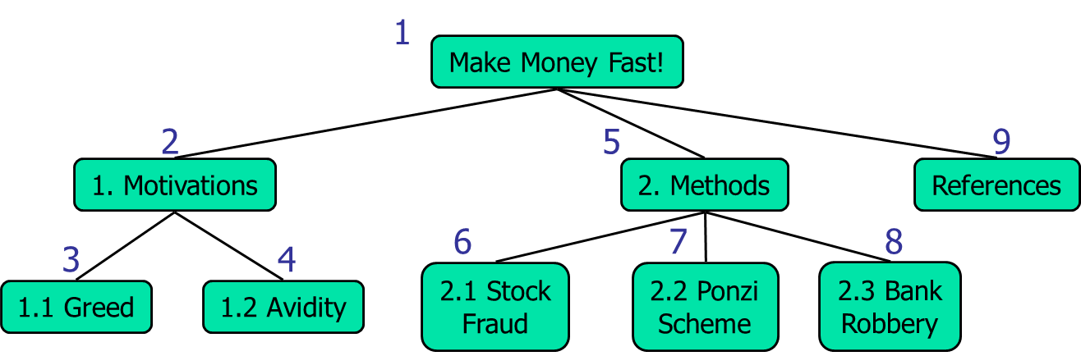
Preorder Traversal
A traversal visits the nodes of a tree in a systematic manner
In a preorder traversal, a node is visited before its descendants
Application: print a structured document

Slide 7
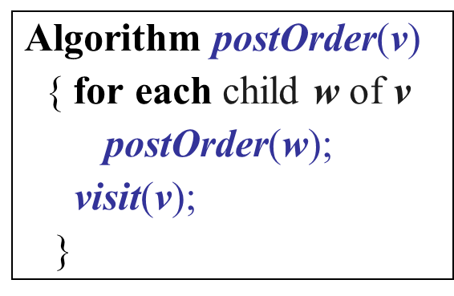
Postorder Traversal
In a postorder traversal, a node is visited after its descendants
Application: compute space used by files in a directory and its subdirectories
9
cs16/
8
3
7
homeworks/
programs/
todo.txt 1K
1
2
4
5
6
h1c.doc 3K
h1nc.doc 2K
DDR.java 10K
Stocks.java 25K
Robot.java 20K

Slide 8
Binary Trees
Applications:
arithmetic expressions
decision processes
searching
A binary tree is a tree with the following properties:
Each internal node has at most two children
A leaf node has no child
The children of a node are an ordered pair
We call the children of an internal node left child and right child
Alternative recursive definition: a binary tree is either
a tree consisting of a single node, or
a tree whose root has an ordered pair of children, each of which is a binary tree
A
B
C
D
E
F
G
H
I

Slide 9
Arithmetic Expression Tree
Binary tree associated with an arithmetic expression
internal nodes: operators
external nodes: operands
Example: arithmetic expression tree for the expression (2 × (a − 1) + (3 × b))
+
×
×
2
−
3
b
a
1

Slide 10
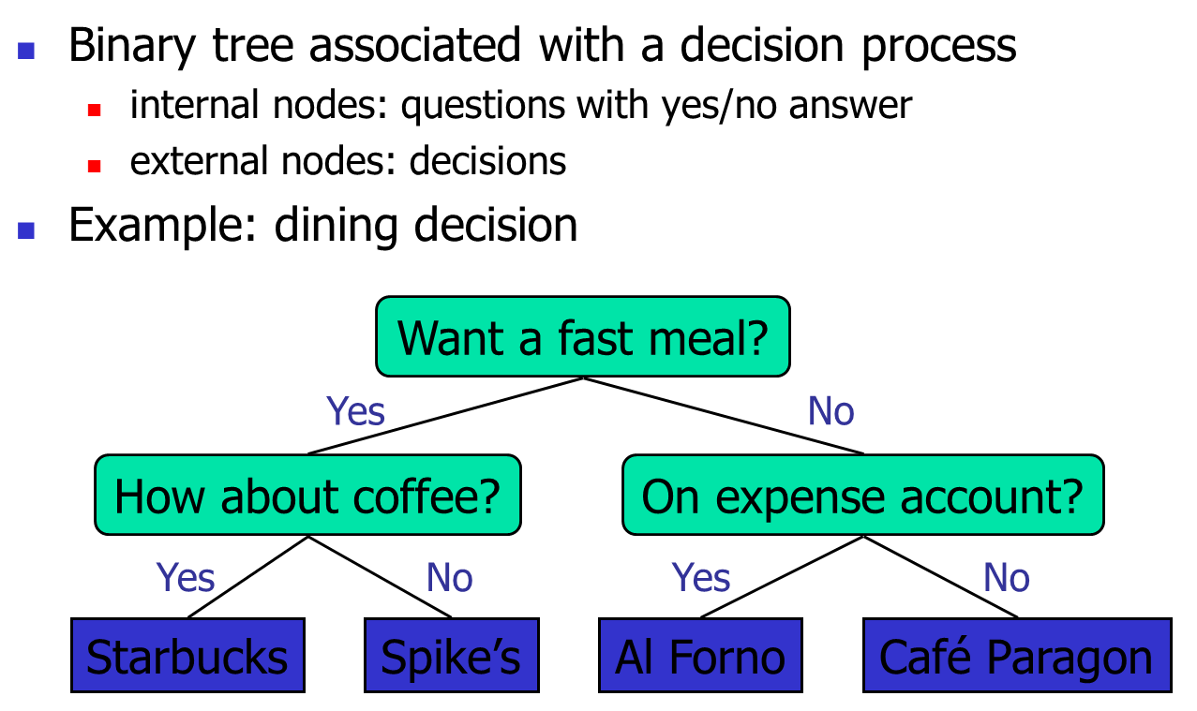
Decision Trees

Slide 11
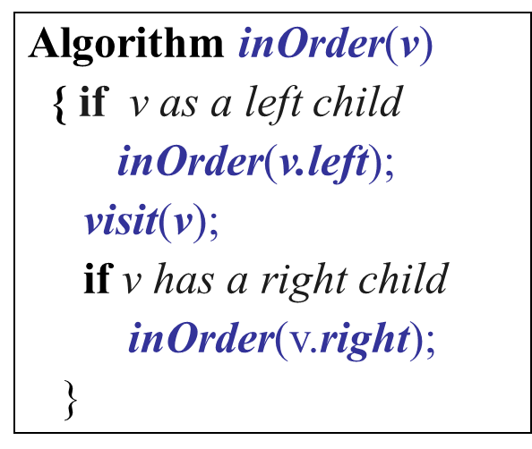
Inorder Traversal
In an inorder traversal a node is visited after its left subtree and before its right subtree
Application: draw a binary tree
x(v) = inorder rank of v
y(v) = depth of v
6
2
8
1
4
7
9
3
5

Slide 12
Print Arithmetic Expressions
Specialization of an inorder traversal
print operand or operator when visiting node
print “(“ before traversing left subtree
print “)“ after traversing right subtree
Algorithm printExpression(v)
{ if v has a left child
{ print(“(’’);
printExpression(left(v)); }
print(v.element ());
if v has a Right child
{ printExpression(right(v));
print (“)’’); }
}
+
×
×
2
−
3
b
((2 × (a − 1)) + (3 × b))
a
1

Slide 13
Evaluate Arithmetic Expressions
Specialization of a postorder traversal
recursive method returning the value of a subtree
when visiting an internal node, combine the values of the subtrees
Algorithm evalExpr(v)
{ if v is a leaf node
return v.element;
else
{ x = evalExpr(leftChild (v));
y = evalExpr(rightChild (v));
◊ = operator stored at v;
return x ◊ y;
}
}
+
×
×
2
−
3
2
5
1

Slide 14
Binary search trees
A binary search tree is a binary tree storing keys (or key-value entries) at its nodes and satisfying the following property:
Let u, v, and w be three nodes such that u is in the left subtree of v and w is in the right subtree of v. We have key(u) ≤ key(v) ≤ key(w)
An inorder traversal of a binary search trees visits the keys in non-decreasing order

Slide 15
Binary Search Tree Operations
Operations on BSTs:
insert(Tree,Item) … add a new item to tree via key
delete(Tree,Key) … remove item with specified key from tree
search(Tree,Key) … find item containing key in tree
plus, "bookkeeping" … new(), free(), show(), …

Slide 16
Representing BSTs in C
Node structure:
typedef struct Node {
int key; // we ignore value here
struct Node *left, *right;
} Node;

Slide 17
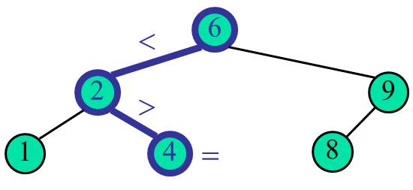
Searching in BSTs
TreeSearch(v, k)
Input v (node), k (key)
Output the node containing k or null
if v is null or v.key=k
return v
if k < v.key
return TreeSearch(v.left, k) // search left subtree
else
return TreeSearch(v.right, k) // search right subtree
Time complexity: O(n)
Example: TreeSearch(root, 4)

Slide 18
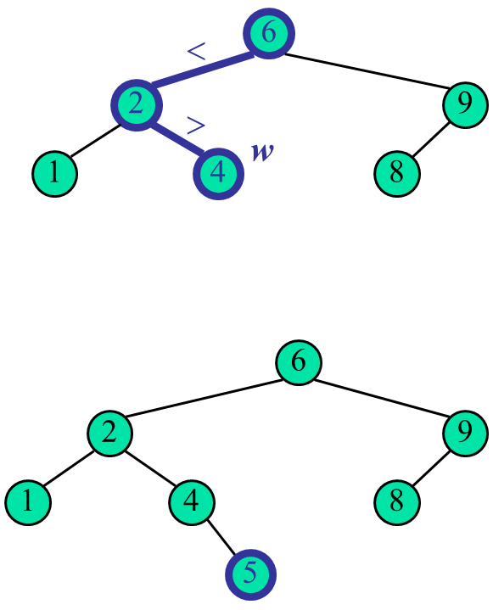
Insertion in BSTs (1/2)
To insert a new item with key k, we search for key k.
Let w be the node where the search stops ( the child of w to be visited does not exist)
Consider two cases:
k≤w.key: Insert the new item as the left child of w (insert equal keys in the left subtree)
K>w.key: Insert the new item as the right child of w
Time complexity: O(n)
Example: insert 5

Slide 19
Insertion in BSTs (2/2)
TreeInsert(v, k)
Input v (node), k (key)
Output: none
if root= null // empty tree
root=CreateNode(k); // create a new node (root) to store k
else if k <= v.key // insert duplicate keys in left subtree
{ if v.left=null
v.left=CreateNode(k); // insert a new node as the left child of v
else
TreeInsert(v.left, k);
}
else if k> v.key
{ if v.right=null
v.right=CreateNode(k); // insert a new node as the right child of v
else
TreeInsert(v.right, k);
}

Slide 20
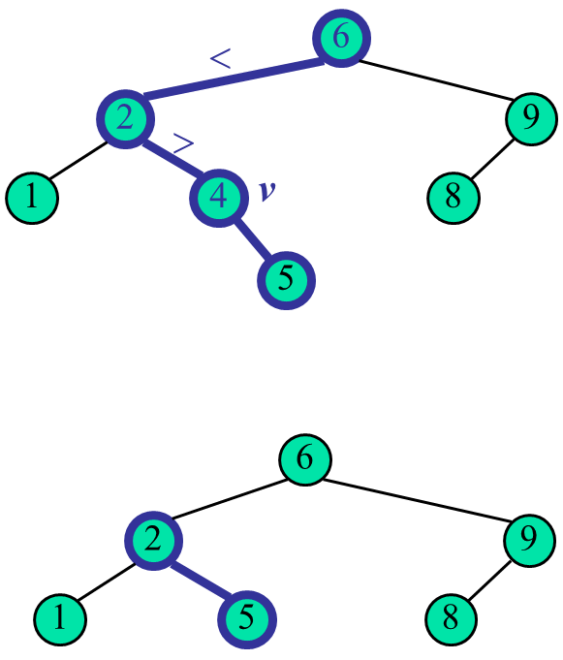
Deletion in BSTs (1/3)
To perform operation delete(tree, k), we search for key k
Assume key k is in the tree, and let v be the node storing k
If node v has no left child, we remove v from the tree
If node v has only one child, we remove v from the tree and make its child the child of its parent
Example: delete 4

Slide 21
Deletion in BSTs (2/3)
1
v
Alternatively, we find the node w that precedes v in an inorder traversal.
w is called the immediate inorder predecessor of v.
We copy the value and key of w into node v
We remove node w (must be a node with no child)
Example: delete 3
3
2
8
6
9
w
5
1
v
5
2
8
6
9

Slide 22
Deletion in BSTs (3/3)
1
v
Alternatively, we find the node w that precedes v in an inorder traversal.
w is called the immediate inorder predecessor of v.
We copy the value and key of w into node v
We remove node w (must be a node with no child)
Example: delete 3
w
3
2
8
6
9
5
1
v
2
8
6
9
5

Slide 23
Performance
Consider a set of n entries stored in a binary search tree of height h
the space used is O(n)
Operations find, insert and delete take O(h) time
The height h is O(n) in the worst case and O(log n) in the best case

Slide 24
Summary
Trees
Tree traversals
Binary search trees (BSTs)
BST search, insertion and deletion
Sedgewick, Ch.5.4-12.5

