Slide 1
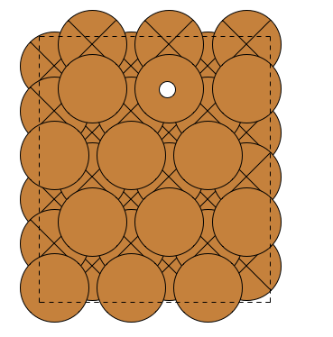
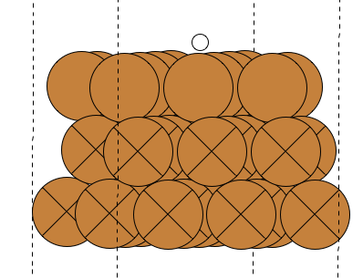
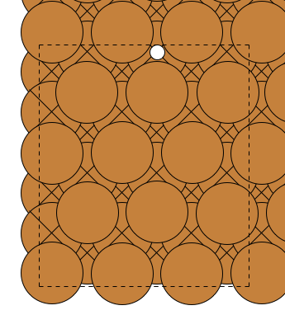
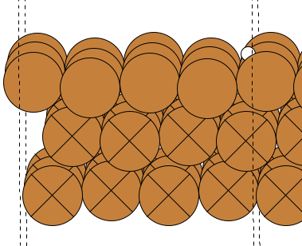
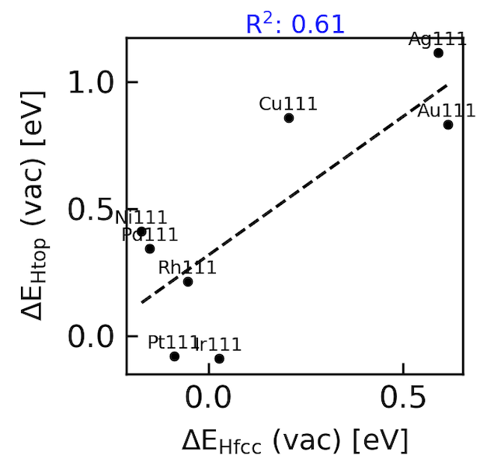
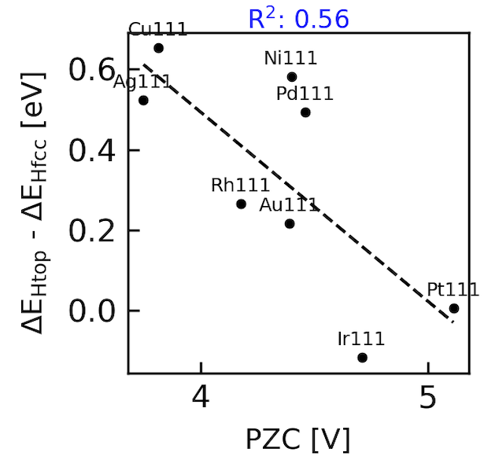
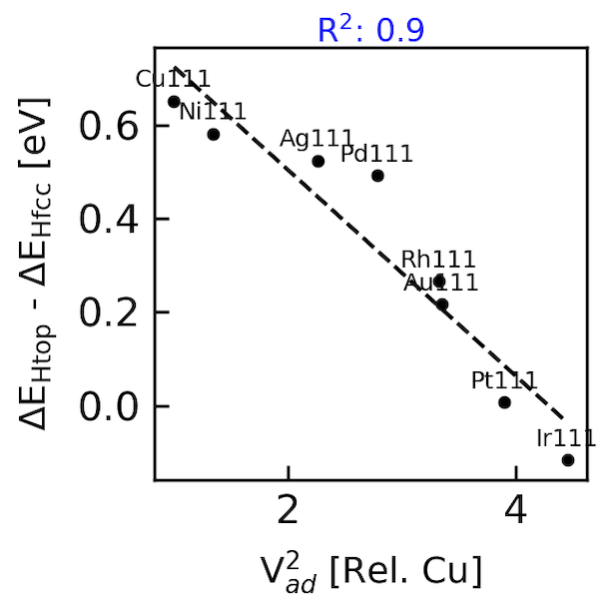
26.6.2025
Htop vs Hfcc as descriptors for HER
Vacuum calculations, relaxed, BEEF-vdW (Dipam)
Cu(111) Htop z=1.54A relaxed
Cu(111) Hfcc z=0.9A relaxed, dHM=1.77A

Slide 2
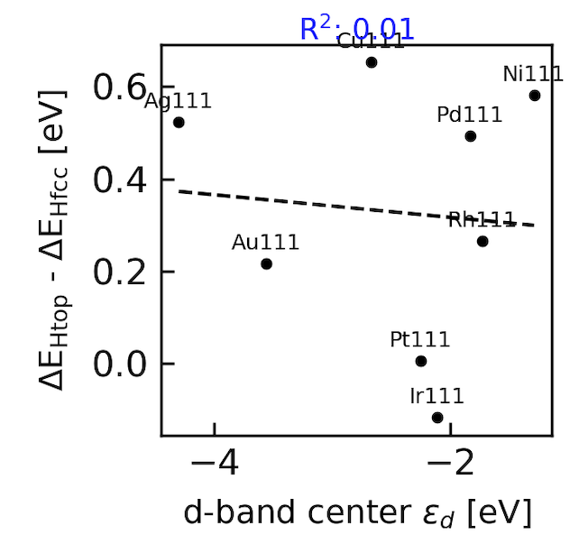
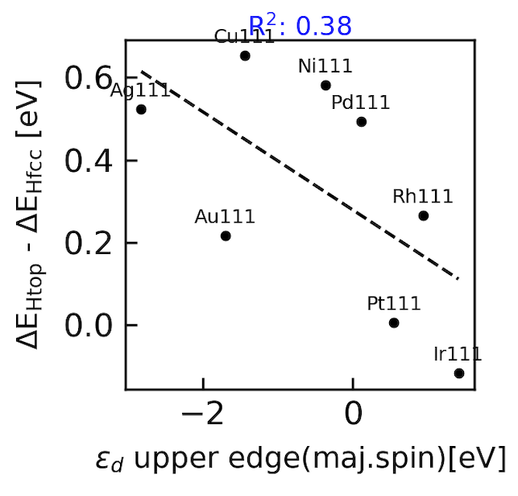
Htop vs Hfcc as descriptors for HER

Slide 3
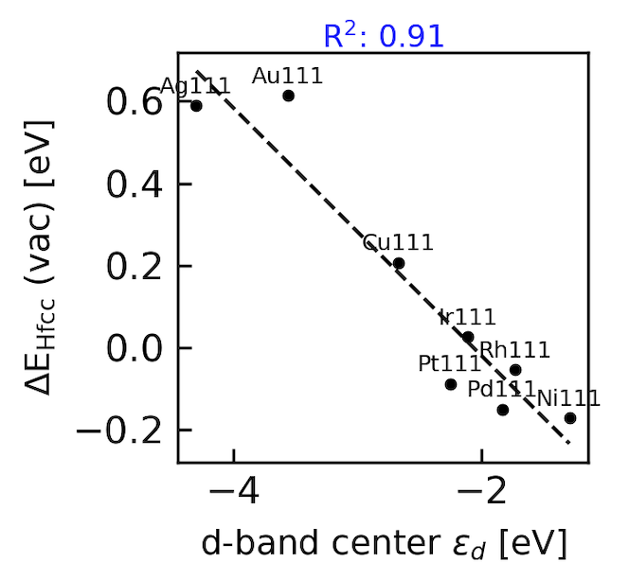
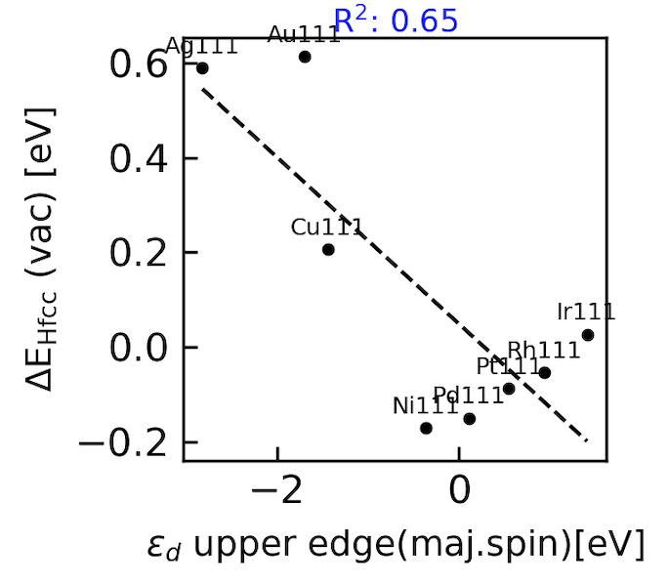
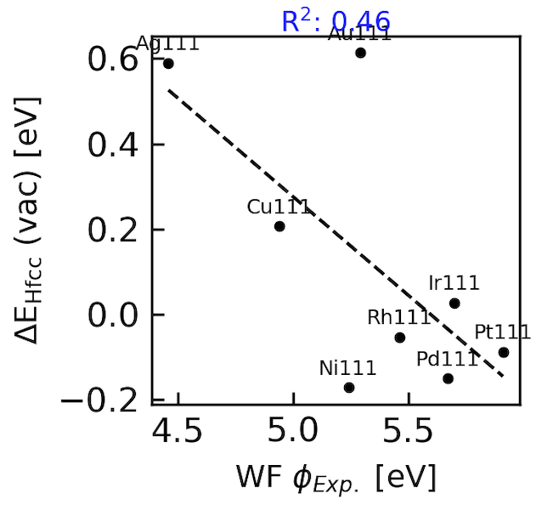
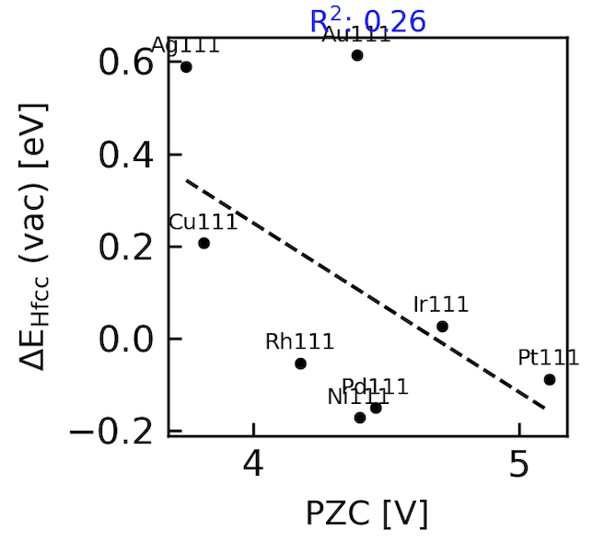
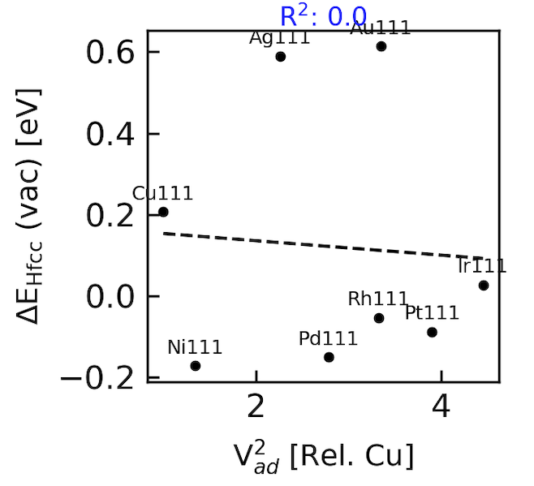
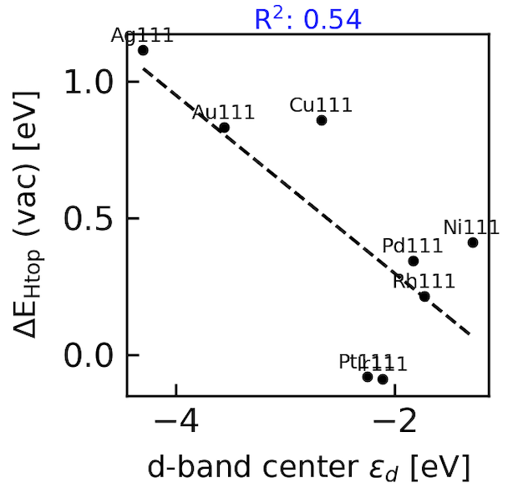
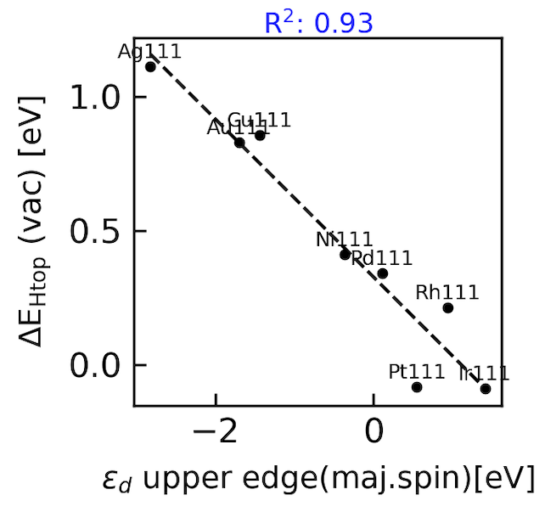
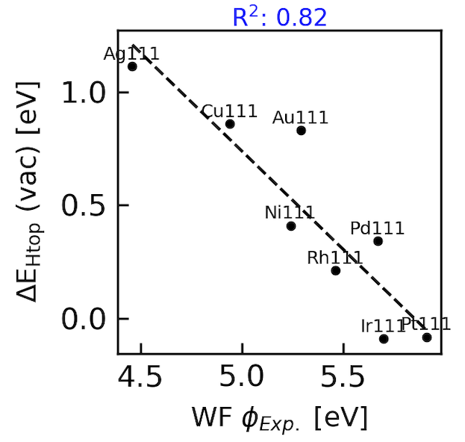
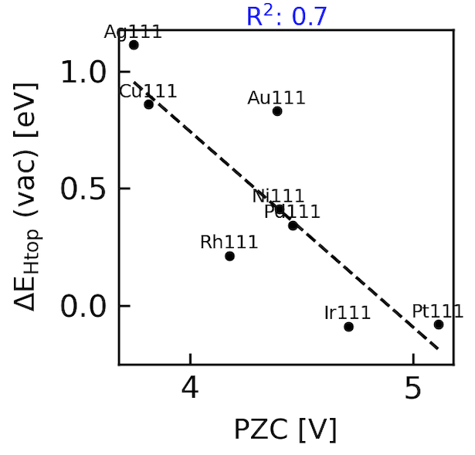
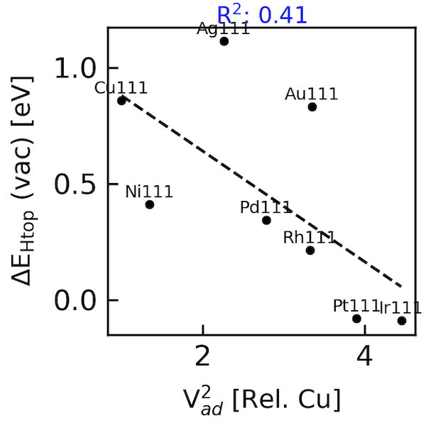
Hypothesis: Workfunction is a covalent descriptor above the surface.
Workfunctions versus wavefunctions
HBE vs electronic Descriptors
Include in paper?
26.6.2025
Htop vs Hfcc

Slide 4
Further correlations: derived descriptors
Workfunctions versus wavefunctions
Hypothesis: Workfunction is a covalent descriptor above the surface.
Select. Right click “save as picture” pdf.
26.6.2025
Include in paper SI
a)
b)
c)
d)

Slide 5
Further correlations: derived descriptors
Workfunctions versus wavefunctions
Hypothesis: Workfunction is a covalent descriptor above the surface.
Select. Right click “save as picture” pdf.
26.6.2025
Include in paper SI
a)
b)
c)
d)
e)
f)

