Slide 1

AI/DA -project TTC8070-3009
Topic 1: Cars Dataset
Group 3:
Alex Fisk, Eemeli Virkkala, Henri Malmberg & Jemina Lamberg

Slide 2
Project overview
Dataset
Data analysis
Business impact
Machine learning
Insights
Dataset: US used cars dataset
Gitlab version control
Phases
  Phase 1 Business Understanding
  Phase 2 Data Understanding
  Phase 3 Data Preparation
  Phases 4-6 after interim seminar

Slide 3


Phase 1 Business Understanding
Business objectives
Current situation
Client: U.S. based car store chain
Goal: use data analytics to optimize pricing and sales of used cars
Focus: identify features that affect car value
Outcome: improve purchasing decisions and support demand forecasting -> improves customers profitability
Dataset: about 3 million used car listings from 2020
Tools: Python, pandas, scikit-learn, TensorFlow
Teamwork: project members share tasks across project phases
Previous knowledge is applied from AI/DA module courses like preprocessing, machine learning and data visualization

Slide 4


Phase 1 Business Understanding
Initial goals
Project goals
Explore and understand the dataset
Identify key features
Handle missing values and outliers
Prepare data for models
Create model(s) to identify which features affect the price and which used cars can be sold more easily
Build a machine learning model
Meet customer's requirements
Evaluate performance using accuracy and other metrics
Present project in seminar and submit final report

Slide 5
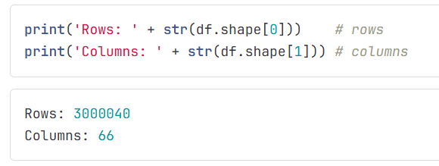
Phase 2 Data Understanding
Content
  The dataset consists of 66 features of cars (columns) and 3 000 060 used cars (rows)
Initial data analysis and data quality
  More than 42 million values are missing in total
  17 columns have no missing values while 3 columns have missing values in all cars
  Price is set on every car
  Some cars have zero mileage
  'Horsepower', 'engine_displacement' and 'year' correlate positively with price
  'Mileage', 'highway_fuel_economy' and 'owner_count' correlate negatively with price

Slide 6
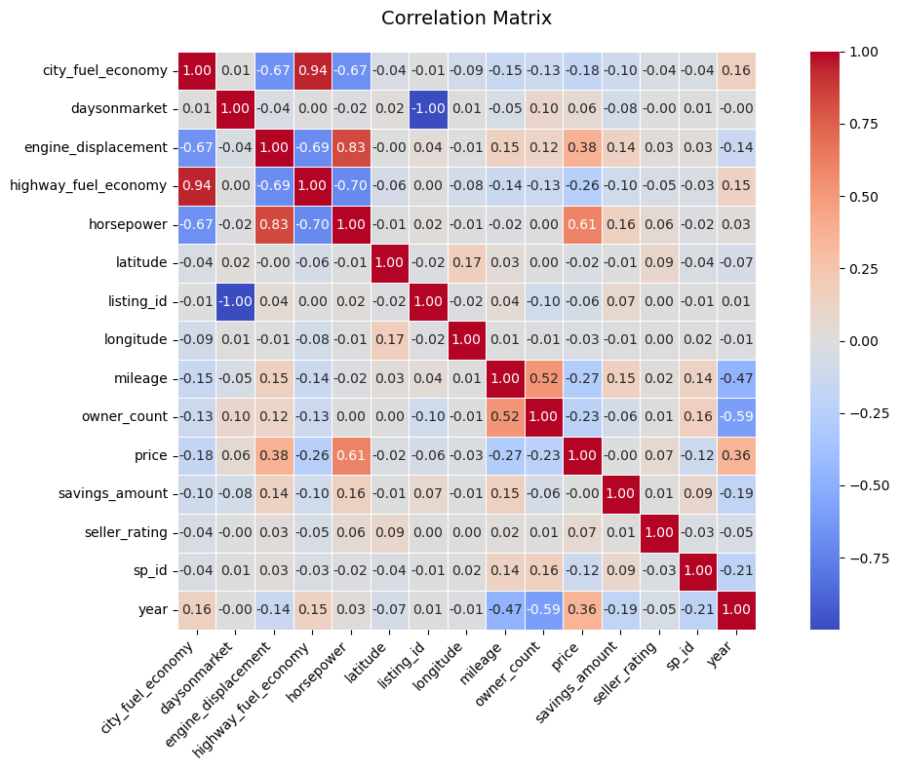
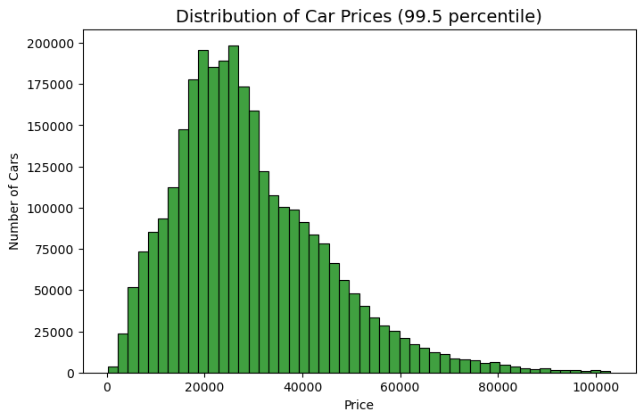
Phase 2 Visualization

Slide 7
Phase 3 Data Preparation
Select data
Clean data
Construct data
Integrate data
Format data
Processing NaN values
  Dropped columns with over 50% missing values
  Filled NaN values with mean, median or most common value depending on the situation
Feature columns
  Removed irrelevant columns
  Removed rows where mileage is 0 (= not used car)
Outlier handling
  'price' from 3 299 995-256, filtered top 0.5%
  'year' had 51 cars in 1915-1932, not statistically relevant
Feature engineering
  Added more features
Other stuff
  Removed duplicate rows
  Encoded categorical data

Slide 8
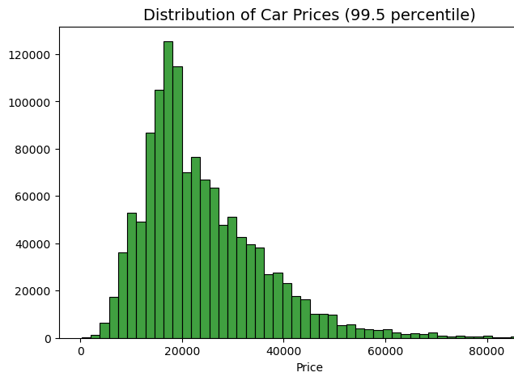
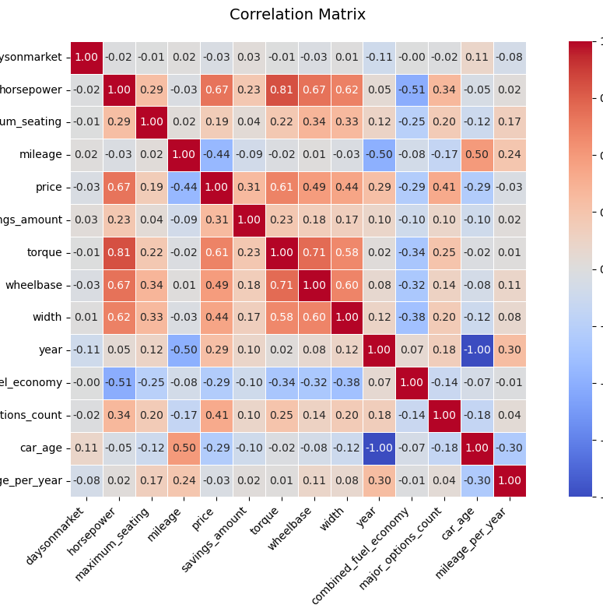
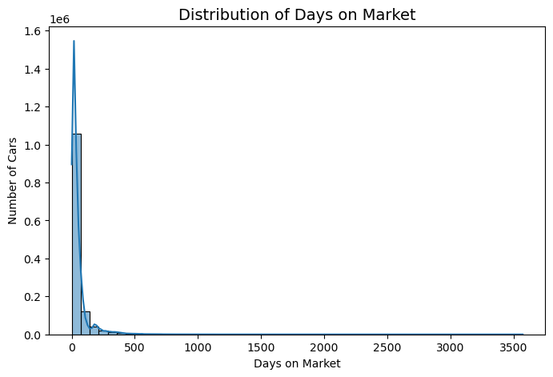
Phase 3 Visualization

Slide 9
Next up: Phases 4-6
Phase 4 Modeling
Build model
Evaluate the results
Test model
Visualize results
Phase 5 Evaluation
Evaluate obtained results
Analyze the results of the model
Review process
Phase 6 Deployment
Implement deployment
Plan maintenance
Produce a final report

Slide 10


