Slide 1
A phase-evaluation feature for predicting hyperbolic volume from the Jones polynomial
Theory-guided feature engineering in an NSGA-II architecture search — and breaking the J₂ ceiling with the adjoint J₃
CatalinMoldova · 2026

Slide 2
The idea: let theory pick the feature
Task. Predict a knot's hyperbolic volume from its fundamental Jones polynomial J₂ (34 integer coefficients). 12,955 hyperbolic knots, ≤13 crossings.
Volume conjecture. A specific evaluation of the colored Jones polynomial governs the volume. Jejjala et al. found |V(e^(3πi/4))| alone tracks the volume almost as well as a full network.
The change. Add one evaluation — V(q₀) at q₀ = e^(3πi/4) — as three features [Re, Im, |·|]. Feature vector 42 → 45. Nothing else changes: same search space, splits, and budget.
Test. Re-run the identical NSGA-II architecture search with vs. without the feature. A clean A/B.

Slide 3
Why learn it: a cheap stand-in for an intractable limit
The catch. The volume conjecture's actual claim only holds in the limit of infinitely high color N → ∞. Low color (J₂, J₂+J₃) is cheap to compute; that limit is computationally intractable to reach directly.
The substitution. Instead of chasing the limit, train on cheap low-color data paired with independently computed ground-truth volumes (SnapPy). The network learns, empirically, whatever relationship links the low-level polynomial coefficients to the high-level geometry.
What you get. Learned pattern-recognition replaces the intractable exact computation: a single forward pass at inference extracts what would otherwise require an infeasible high-color limit — cheap at the low level, exploiting structure that only becomes meaningful at the higher level.
One level higher. Extension: predict the volume-correlated behavior of higher-color polynomials (J₄, J₅, …) directly from low-color data — avoiding their computation entirely, not merely the infinite-N limit.
Notes:
Computing the Jones polynomial at low color (J2, or J2+J3) is cheap, but the volume conjecture's actual claim only holds in the limit of infinitely high color — a regime that's computationally intractable to reach directly. Rather than chasing that limit, this approach trains a network on cheap, low-color data paired with independently computed ground-truth volumes. The network learns, empirically, whatever complex relationship links these low-level polynomial coefficients to the high-level geometric quantity of volume. In effect, it substitutes learned pattern-recognition for the intractable exact computation, extracting at inference time in a single forward pass what would otherwise require an infeasible high-color limit. The result is a model that operates cheaply at the low level but effectively captures and exploits structure that only becomes meaningful at the higher level. A further extension would push this idea one level higher — training a network to predict the volume-correlated behavior of higher-color polynomials (J4, J5, …) directly from cheap low-color data, avoiding their direct computation entirely rather than merely avoiding the infinite-N limit.

Slide 4
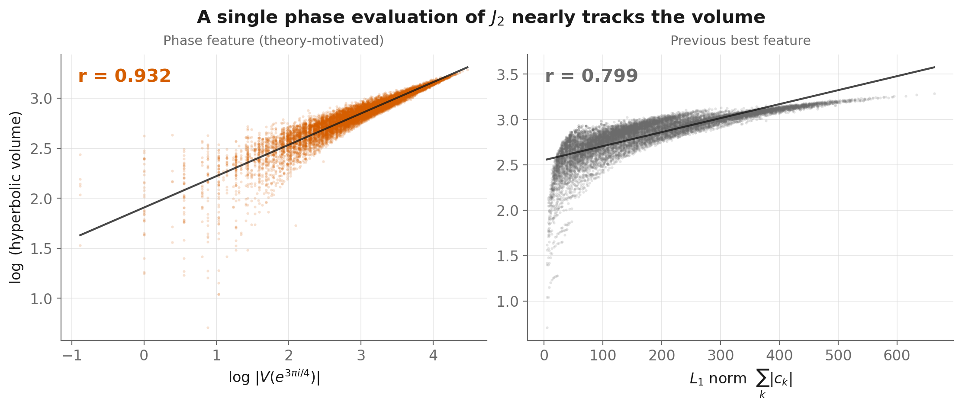
A single phase evaluation nearly tracks the volume
|V(e^(3πi/4))| is the strongest single predictor in the set (r = 0.93 vs 0.80 for the previous best) — before any network.

Slide 5
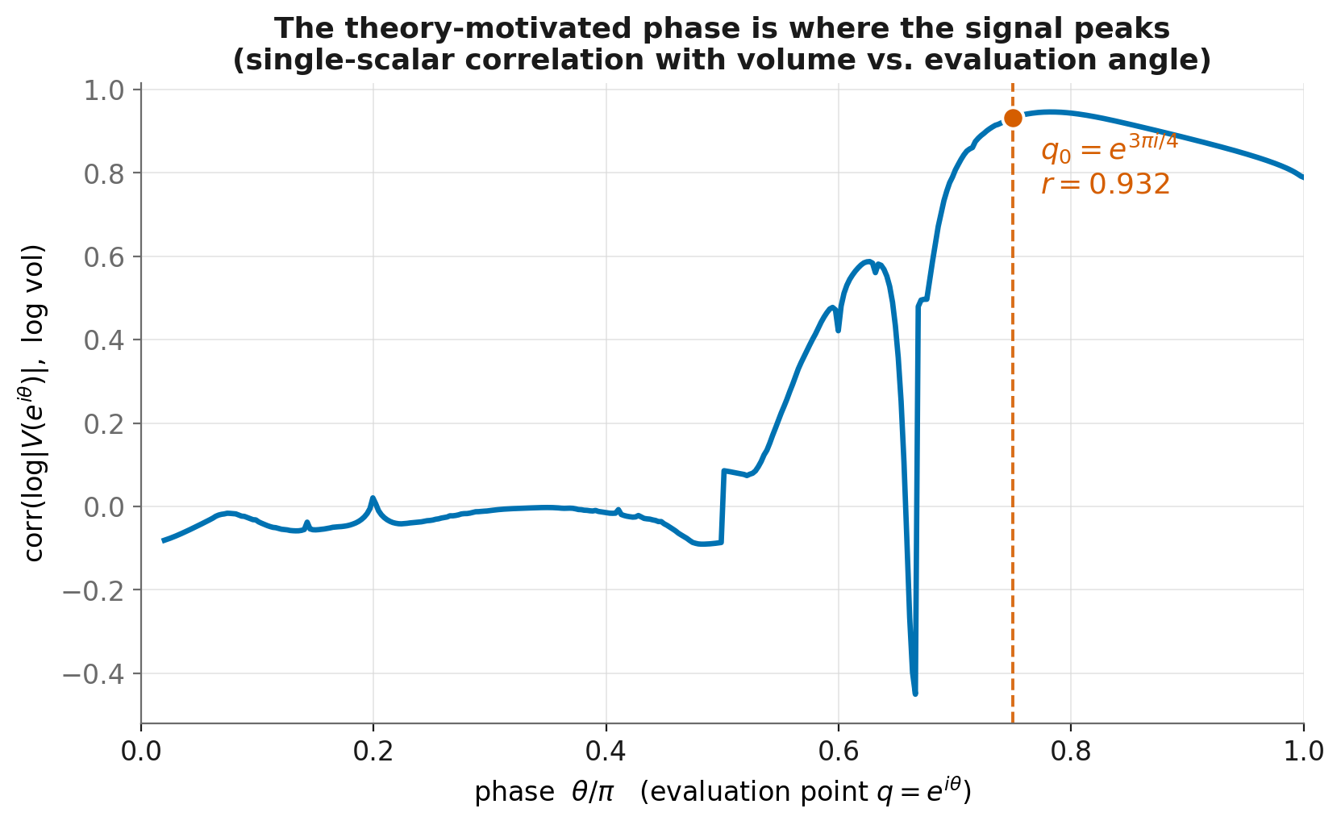
Theory put the feature exactly where the signal peaks
Single-scalar correlation with volume is ≈ 0 at most evaluation angles and peaks right at q₀ = e^(3πi/4) (empirical max at 0.78π). The phase isn't tuned — the volume conjecture pointed to it.

Slide 6
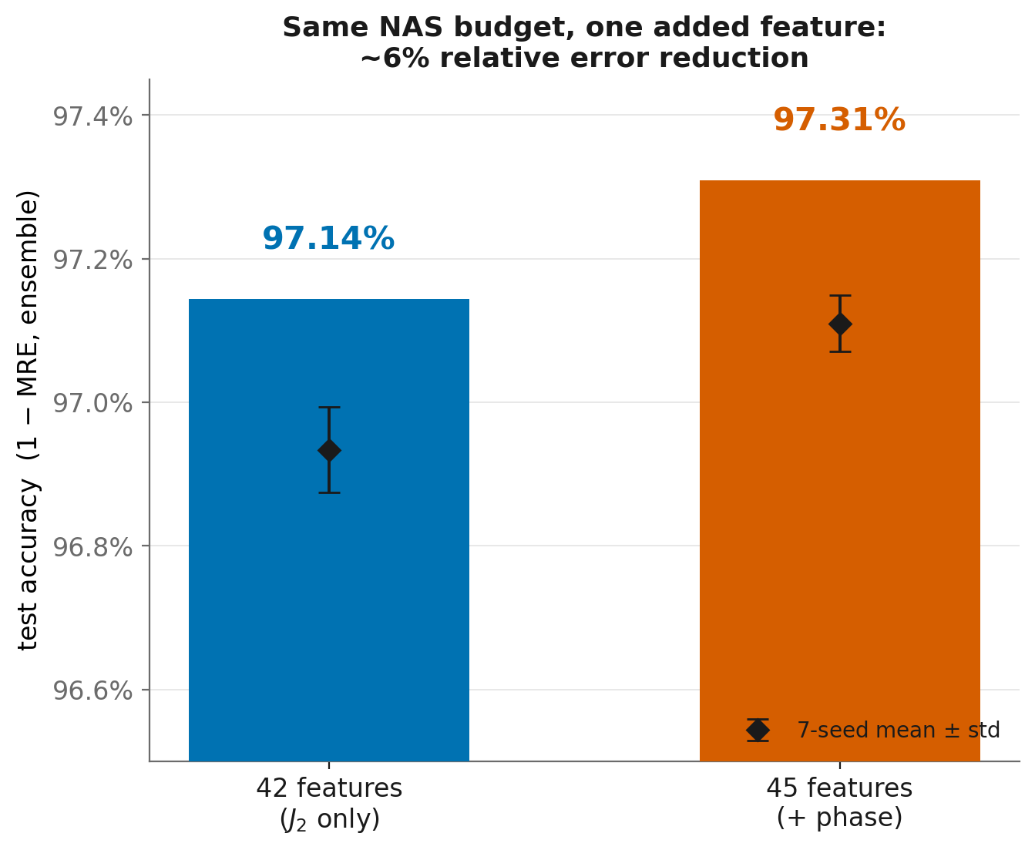
Result: same search budget, one added feature
Ensemble test accuracy 97.14% → 97.31%; mean 96.93% → 97.11% (≈ 6% relative error reduction, ~3σ).

Slide 7
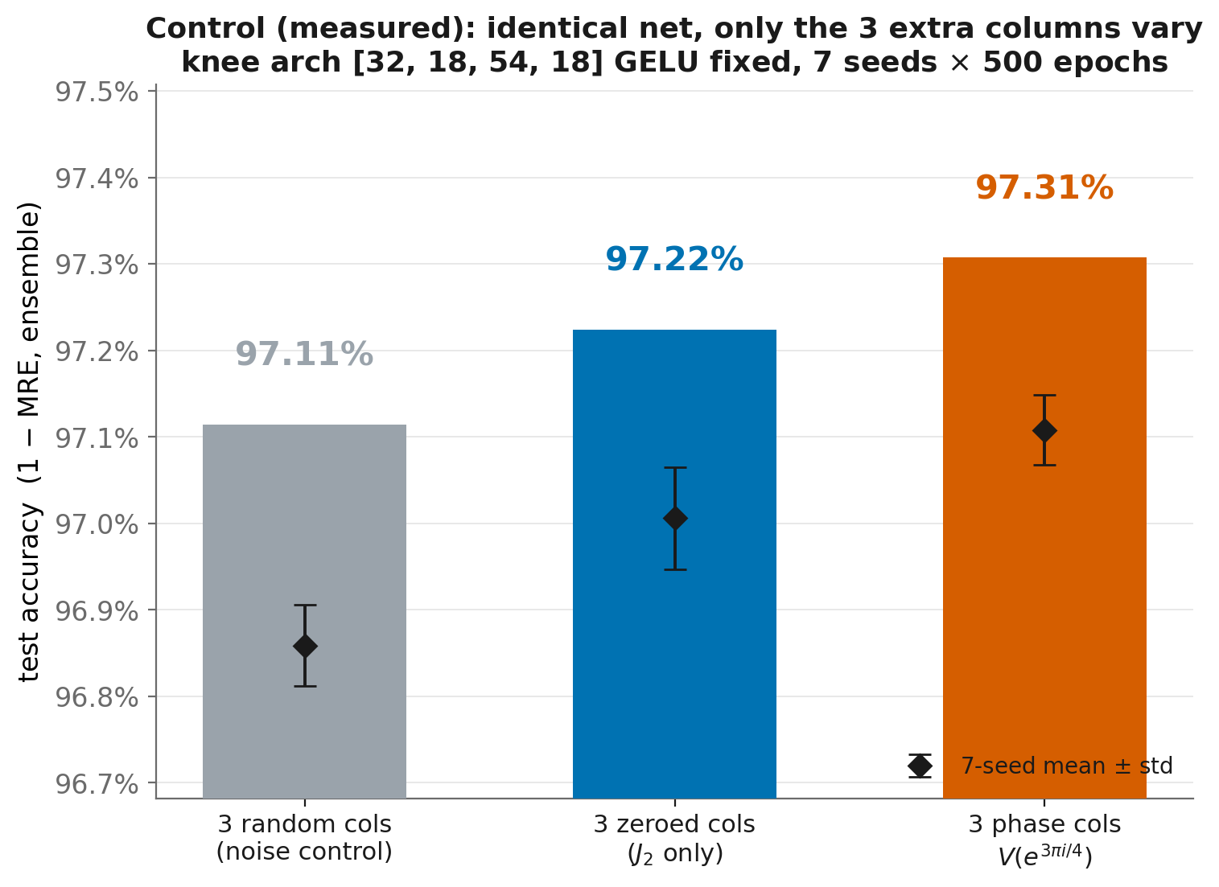
Control (measured): the gain is the phase, not just 3 more inputs
Same knee net [32,18,54,18], only the 3 extra columns vary: phase 97.31% > zeroed (J₂-only) 97.22% > Gaussian noise 97.11% ensemble. The improvement is the volume signal — noise columns even hurt slightly.

Slide 8
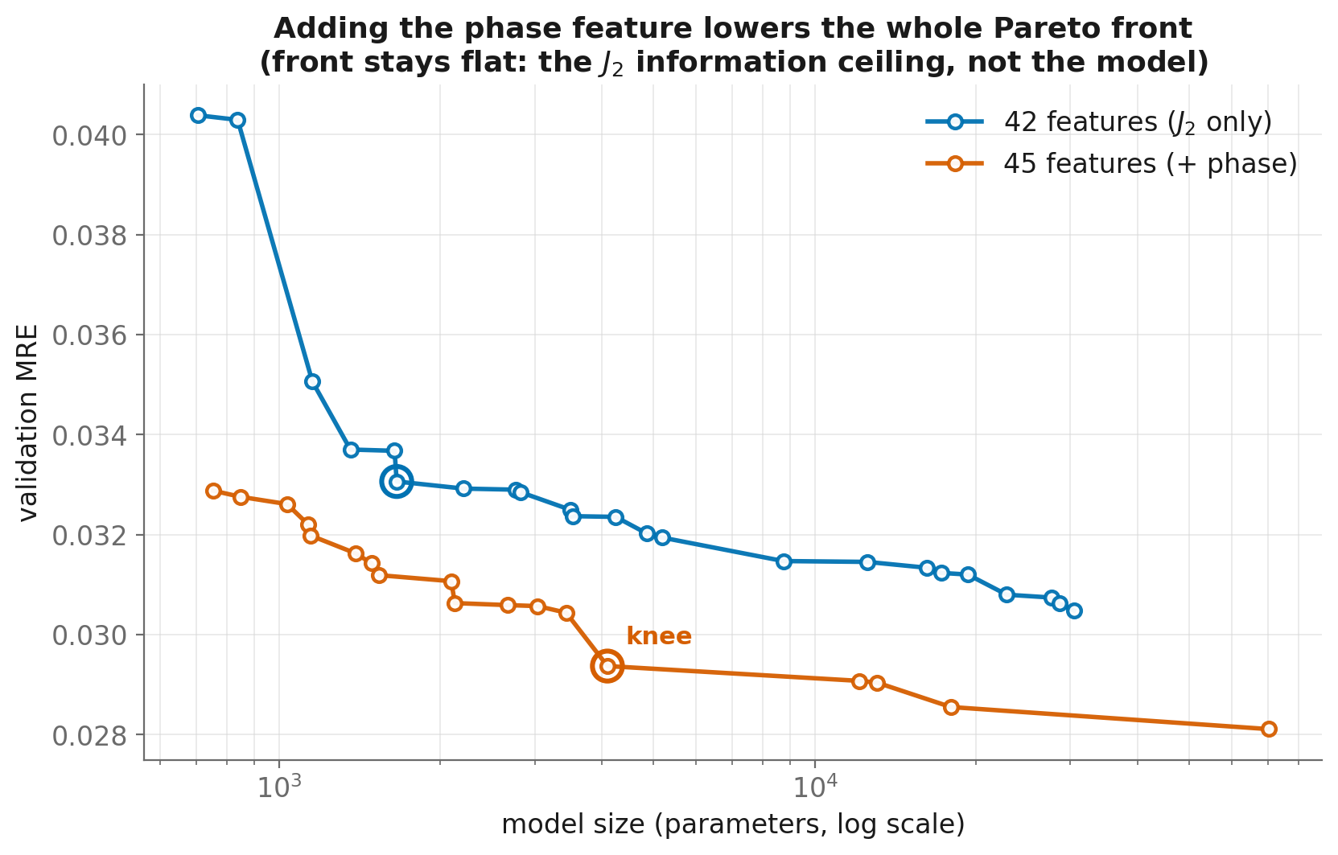
The whole Pareto front shifts down — but stays flat
Lower error everywhere; ~180× more parameters barely helps. The bottleneck is the J₂ signal, not the model.

Slide 9
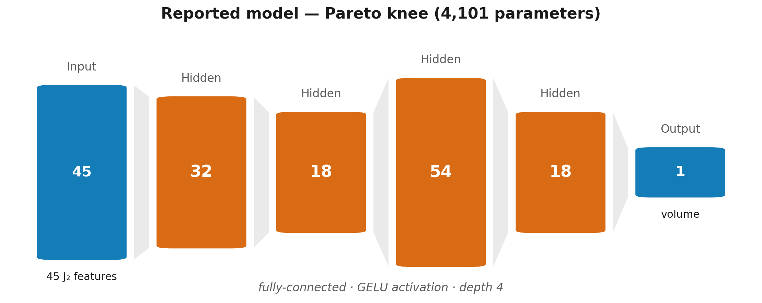
The best model: the phase-run's Pareto-knee architecture
Found by the 45-feature (phase) search: 45→32→18→54→18→1 GELU MLP, 4,101 params (lr 6.4e-3, dropout 0.006, L2 1e-6, batch 256) — test MRE 0.0289 ± 0.0004, ensemble 0.0269 (97.31%). Tiny, because the phase feature hands even a small net a near-direct line to the volume.

Slide 10
An information ceiling — and how to break it
Input | Dataset | Accuracy (1 − MRE)
J₂ (this work, 42 feat) | ≤13 cr., 12,955 | 96.9%
J₂ + phase (this work) | ≤13 cr., 12,955 | 97.3%
J₂ (Hughes et al. 2025) | ≤16 cr., 1.7M | 98.5% — best J₂
J₃ adjoint (Hughes et al.) | ≤15 cr., 177k | 99.3% — highest
Takeaway. A theory-motivated feature bought a real, budget-matched gain — for free, at every model size.
Ceiling. But ~98.5% is set by the data: distinct knots share a J₂ yet differ ~3% in volume. No architecture resolves them.
Next. Measured in Part II: on a matched 1,419-knot set, the adjoint J₃ more than halves the error of J₂ — the ceiling is real and J₃ breaks it.

Slide 11
Part II (measured): the adjoint J₃ on a colored-Jones dataset
Data. New colored-Jones table: 1,426 knots ≤12 crossings with J₂ (fundamental) and J₃ (adjoint). Ground-truth volumes computed with SnapPy (ideal triangulation of the knot complement; exact by Mostow rigidity); 7 non-hyperbolic torus knots dropped → 1,419 knots.
Cleaning. Mixed q/t variable conventions and framing-polluted exponent shifts → all features built on a shift-invariant canonical form. Validated: all 1,419 J₂ polynomials and volumes match the Part-I dataset.
Phases re-derived. The volume-correlated evaluation phase is swept per polynomial instead of assuming 3π/4 transfers: peaks at 13π/16 for J₂ (corr 0.943) and 5π/9 for J₃ (corr 0.959).
Design. Three NSGA-II searches at the identical budget (pop 40 / gens 40 / 4+7 seeds / 500 epochs) on the same knots and split — J₂-only vs J₃-only vs J₂+J₃. Only the input polynomial differs.

Slide 12
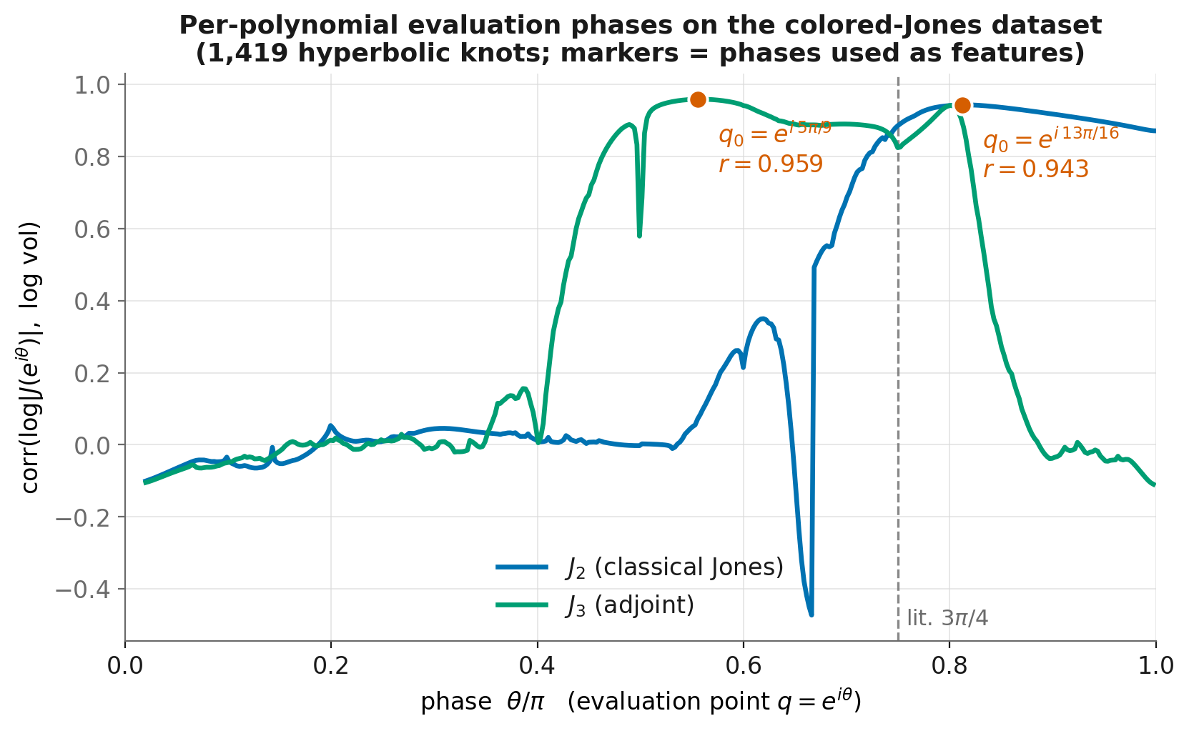
The volume-tracking phase moves with the color
corr(log|V(e^(iθ))|, log vol) peaks at θ = 13π/16 for J₂ (0.943) and 5π/9 for J₃ (0.959) — the literature's 3π/4 is not the peak here. J₃'s single scalar is the strongest signal yet.

Slide 13
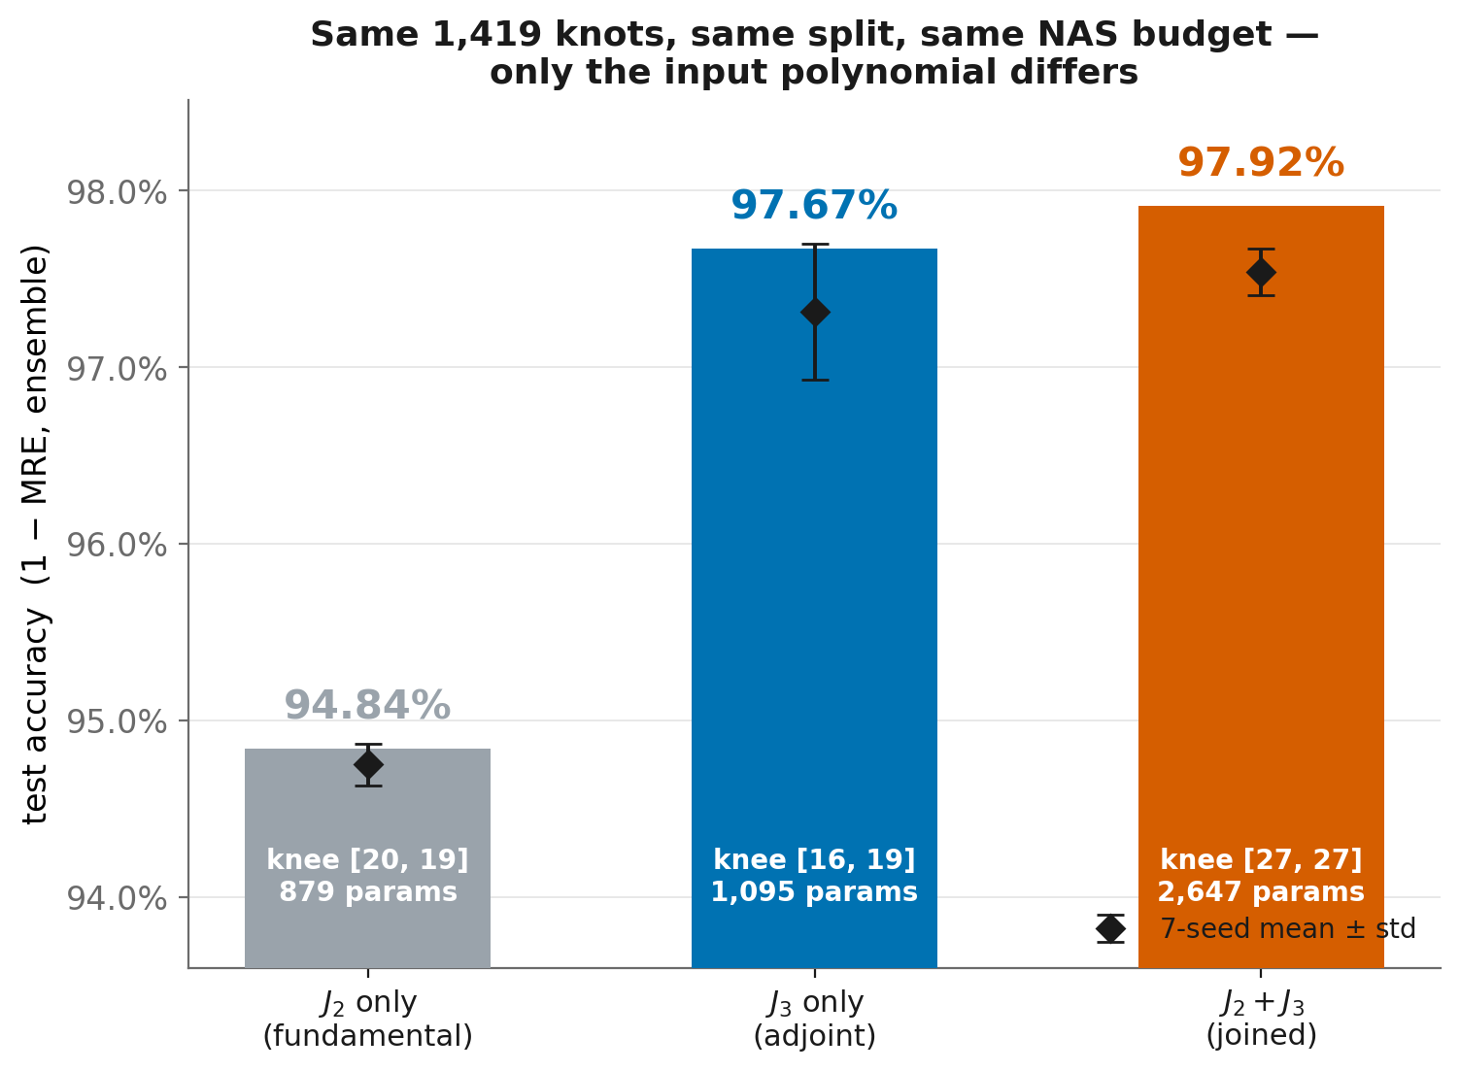
J₃ breaks the J₂ ceiling — measured, matched budget
Identical knots, split, and search budget: J₂ 94.84% → J₃ 97.67% → J₂+J₃ 97.92% ensemble accuracy. J₃ alone cuts the error of J₂ by 2.2×; every knee stays under 2.7k params.

Slide 14
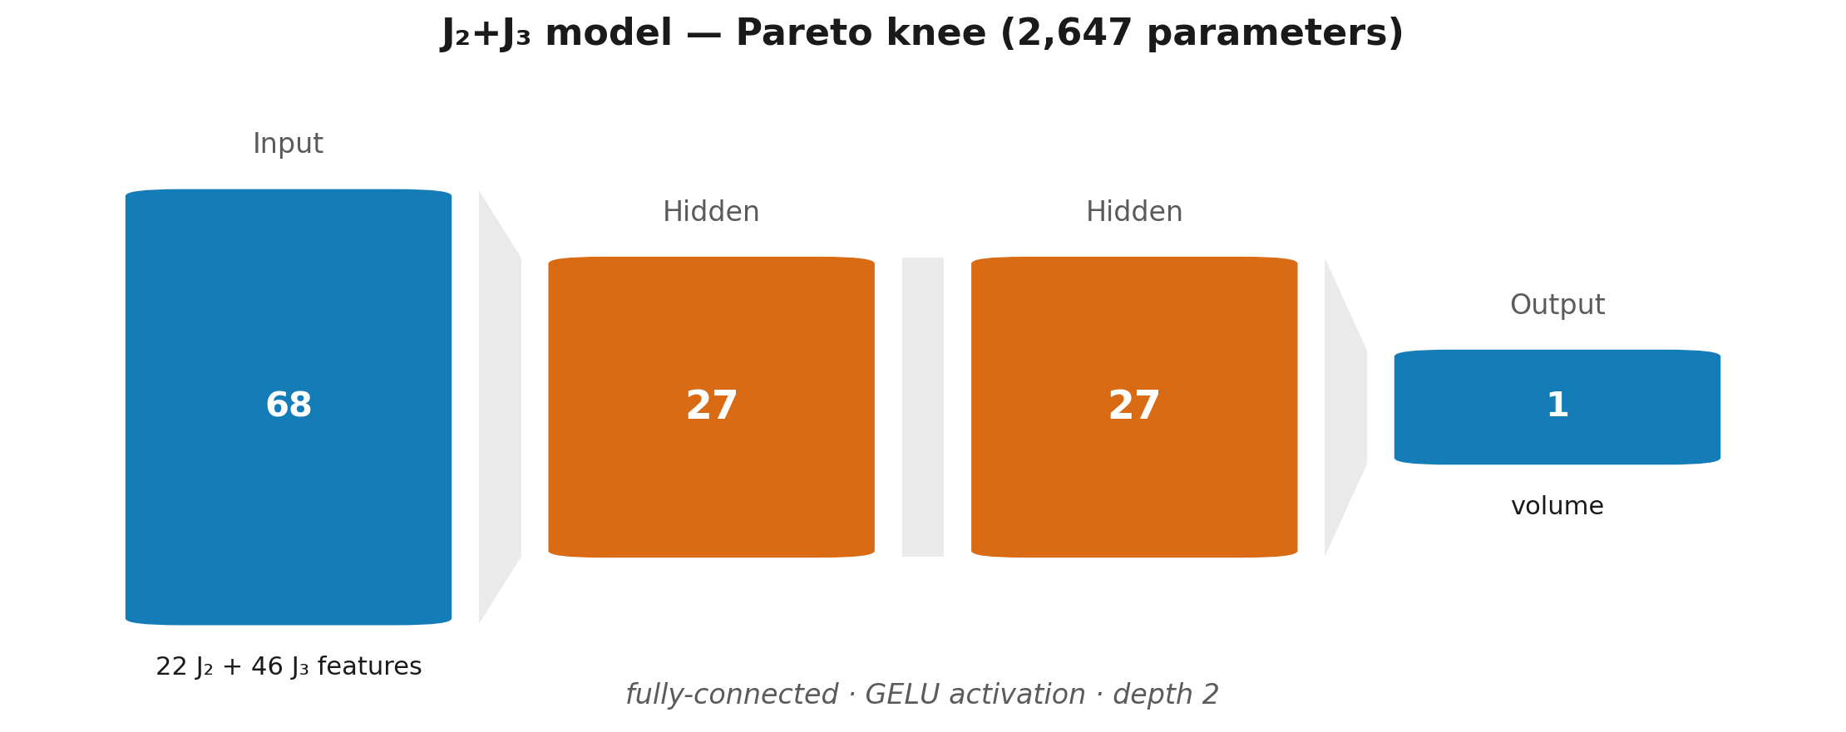
The best J₂+J₃ model: the Pareto-knee architecture
Found by the joined search: 68→27→27→1 GELU MLP, 2,647 params (lr 5.5e-3, dropout 0.007, L2 2.0e-6, batch 128) — test MRE 0.0246 ± 0.0013, ensemble 0.0208 (97.92%). Weights: results_j2j3_j2j3/knee_model.pt.

Slide 15
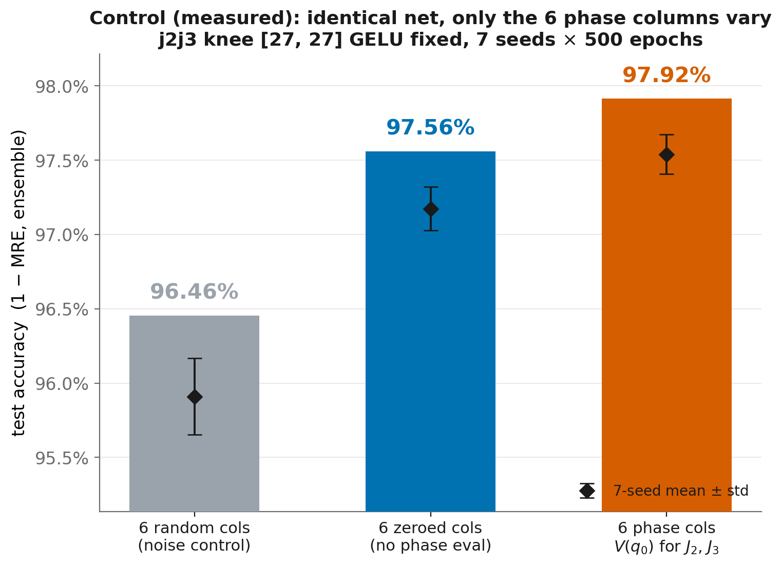
Control (measured): the J₂+J₃ gain rides on the phase columns
Same [27, 27] GELU knee, only the 6 phase-evaluation columns vary: phase 97.92% > zeroed 97.56% > Gaussian noise 96.46% ensemble. The signal is real; noise columns actively hurt.

Slide 16
Context: accuracy per parameter against the literature
Model | Input | Knots | Params | Test MRE
Jejjala–Kar–Parrikar '19 — 2×100 MLP | J₂ | 313k ≤15 cr. | ~12,000 | 2.45%
Craven–Jejjala–Kar '21 — distilled 2×5 net | |J₂(q₀)| | 313k ≤15 cr. | ~10² | ~4%
Craven et al. '22 — 3×100 MLP | J₂ | 313k ≤15 cr. | ~22,000 | ~3%
Hughes et al. '25 — 5-layer MLP | J₂ | 177k ≤15 cr. | ~180,000 | 1.85%
Hughes et al. '25 — 5-layer MLP | J₃ | 177k ≤15 cr. | ~182,000 | 0.62%
Hughes et al. '25 — 5-layer MLP (SOTA) | J₂+J₃ | 177k ≤15 cr. | ~187,000 | 0.40%
This work — NAS knee | J₂ | 1.4k ≤12 cr. | 879 | 5.16%
This work — NAS knee | J₃ | 1.4k ≤12 cr. | 1,095 | 2.33%
This work — NAS knee | J₂+J₃ | 1.4k ≤12 cr. | 2,647 | 2.08%
Same trend, 70× fewer parameters. The J₂ → J₃ → J₂+J₃ error ordering of Hughes et al. reproduces exactly, with ~70–200× smaller models found by the NAS.
Why absolute errors differ. They train on ~125× more knots at higher crossing number — with J₂, accuracy is set by data volume, not architecture. Numbers across datasets are not directly comparable.

Slide 17
Conclusions and what comes next
Theory picks features. The volume-conjecture phase evaluation is a near-free accuracy gain at every model size, on both datasets — and ablations confirm it is the signal, not the extra dimensions.
Information beats capacity. Flat Pareto fronts and tiny (<3k-param) knees throughout: what limits accuracy is the invariant you feed in, not the network. J₂ → J₃ moves accuracy far more than any architecture change.
Measured J₃ gain. On a matched 1,419-knot set: J₂ 94.8% → J₃ 97.7% → J₂+J₃ 97.9%, reproducing the literature ordering with ~70× fewer parameters.
Future work. Scale J₃ to the ≤13-crossing census (12,955 knots) to close the data gap toward the published 99.3%; push the substitution one level higher — predict the volume-correlated behavior of J₄, J₅, … directly from cheap low-color data, avoiding their computation entirely; interpret the knee networks symbolically.

