Slide 1
Favorite sportsman
Hafþór Júlíus Björnsson
Catalin Plesu

Slide 2
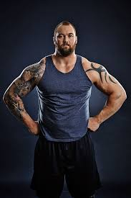
Is an Icelandic former professional strongman and actor. He is the first person to have won the Arnold Strongman Classic, Europe's Strongest Man and World's Strongest Man in the same calendar year.

Slide 3
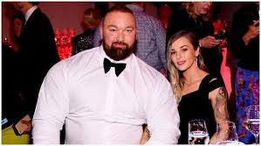

Slide 4
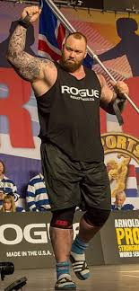
Height 2.06 m Weight 205 kg

Slide 5
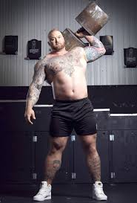
On 2 May 2020, Hafþór deadlifted 501 kilograms (1,105 lb) under strongman rules at his gym in Iceland.This achievement was televised live by ESPN, and surpassed Eddie Hall's strongman deadlift record of 500 kilograms (1,102 lb) set in 2016.

Slide 6
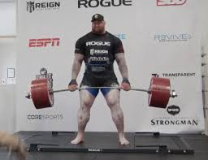

Slide 7
In 2015 he became World’s Strongest Viking during The World’s Strongest Viking competition in Norway where he was able to carry a 649 kg (1,433 pound ) log for five steps. By achiving this he broke a 1000 year-old record .
Because he is a good sprotsman he was selected to play Gregor "The Mountain" Clegane in GoT.
His basketball career started in 2004 and ended in 2008 due to an ankle injury.

Slide 8
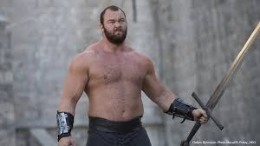

Slide 9
Vocabulary
Beasting it up – intensive traomomg
Boulders – shoulders that are solid as rock
Bulking – the process of adding muscle mass to one’s body
Cutting – stripping body fat while retaining maximum muscularity
Doms – thet aching feeling you get days after a workout
Forced rep - additional repetitions of an exercise performed with the help of a partner when you’re unable to do anymore reps on your own.
Newbie – a person new to the gym environment

