Slide 1
Top Programming Languages for Engineers
Cătălin Pleșu

Slide 2
Generic information about programming languages
Programming languages are used to make programs that are executed by computers. There are two types of programming languages : high-level languages and low-level languages. And some languages can be in the middle. High-level programming languages have are more abstract and are easier to comprehend. Low-level programming languages are closer to machine code.
Programming languages are essential to know for most people because a simple program can solve some of your problems easily.

Slide 3
According to interestingengineering.com the top 10 programming languages to know (2019) are :
Java
C
Python
C++
Visual Basic .NET
JavaScript
C#
PHP
SQL
Objective-C

Slide 4
But after some research I came up with the following score
Java – 53 / 56.14
C – 34 / 56.14
Python – 64 / 56.14
C++ – 35 / 56.14
Visual Basic .NET – 6 / 56.14
JavaScript – 55 / 56.14
C# – 34 / 56.14
PHP – 14 / 56.14
SQL – 4 / 56.14
Objective-C – 1 / 56.14

Slide 5
A more accurate top of those programming languages would be
Python – 64 / 56.14 (3)
JavaScript – 55 / 56.14 (6)
Java – 53 / 56.14 (1)
C++ – 35 / 56.14
C – 34 / 56.14 (2)
C# – 34 / 56.14 (4)
PHP – 14 / 56.14 (8)
Visual Basic .NET – 6 / 56.14 (5)
SQL – 4 / 56.14
Objective-C – 1 / 56.14

Slide 6
Let’s ditch things I don’t want in this top
Python – 64 / 56.14
JavaScript – 55 / 56.14
Java – 53 / 56.14
C++ – 35 / 56.14
C – 34 / 56.14
C# – 34 / 56.14
Swift – 31 / 56.14
Go – 20 / 56.14
PHP – 14 / 56.14
SQL – 4 / 56.14

Slide 7


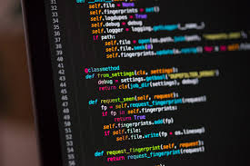

1. Python

Slide 8
It is a high-level programming language used for general purposes programming. It is an interpreted programming language. Python focuses on the readability of codes. That’s why it uses whitespaces as syntax. Python was designed to help programmers in writing readable, logical, and straightforward codes for both small and big projects. It should be mentioned that C and C++ code can be integrated in python code. A lot of schools teach python and currently it is in demand.

Slide 9

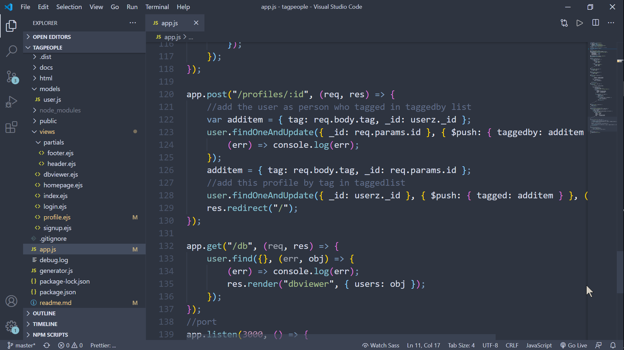

2. JavaScript

Slide 10
A famous programming language on the Internet “virtually everyone is using it”. It is commonly used on websites and is also known as the programming language of HTML.
JavaScript is not a hard programming skill to learn. In fact, it is easier than most programming languages. Web developers learn this programming language together with HTML and CSS because these are the foundations of an aesthetically appealing website.When combined with Node.js, programmers can use JavaScript to produce web content on the server before a page is sent to the browser, which can be used to build games and communication applications that run directly in the browser. A wide variety of add-ons extend the functionality of JavaScript as well.

Slide 11
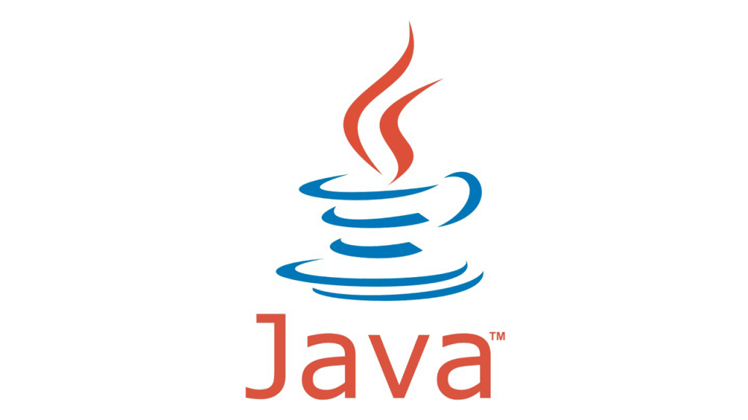
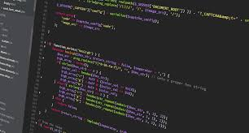

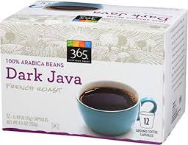
3. Java

Slide 12
Java is a totally different programming language from that of JavaScript. Java is a property of Oracle. It runs on mobile devices, most specifically on Android apps, desktop applications, web applications, servers, games, databases, and so much more.
Java can be used on a Linux computer, a Raspberry Pi, Mac, and of course, Windows, among others. It is another programming language that is easy to learn and is also one of the most popular. Java is designed to be a loosely coupled programming language, meaning that an application written in Java can run on any platform that supports Java. As a result, Java is described as the “write once, run anywhere” programming language.
Java is the programming language most commonly associated with the development of client-server applications, which are used by large businesses around the world. Along with business applications, Java is used extensively in the Android mobile operating system.

Slide 13

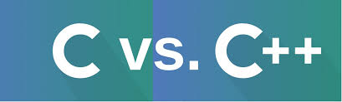

4. C 5. C++

Slide 14
C and C++ programming language can run on computers with operating systems like Windows, several versions of UNIX, and Mac OS. They are general-purpose programming language that is also case-sensitive and is compiled.
C++ is like a incremented version of C the main difference is that C use procedural and functional paradigm when C++ use object oriented programming paradigm as well as recursion, it also supports encapsulation, data hiding, inheritance, and polymorphism.
Some C programs are written and/or developed with portability. This means it can be transferred from one computer to another.

Slide 15
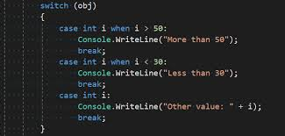
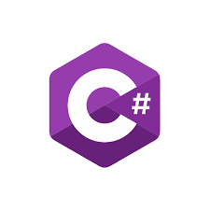
6. C#

Slide 16
This programming language is fundamental to C and C++ programming languages. It is an object-oriented programming language. What is nice about it is that it’s simple to learn, but modern at the same time.
This language was developed by Microsoft under the .NET program. It is used to produce efficient programs and it can be installed onto different types of computers. If an engineer understands how to use C programming and C++ and then, he/she will enjoy learning C#.
C# is the go-to language for Microsoft ad Windows application development. It can also be used for mobile devices and video game consoles using an extension of the .NET Framework called Mono.

Slide 17
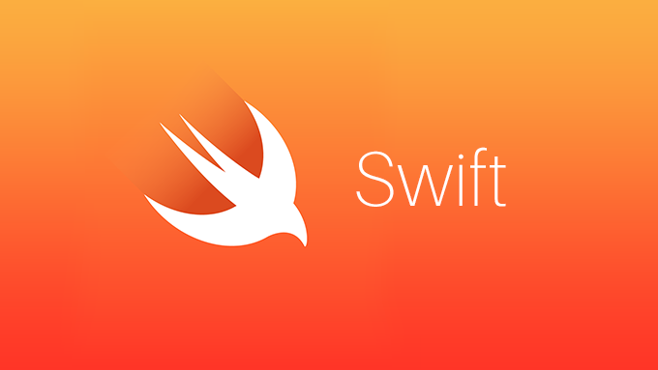
7. Swift

Slide 18
Swift is Apple’s language for developing applications for Mac computers and Apple’s mobile devices, including the iPhone, iPad, and Apple Watch. Like many modern programming languages, Swift has a highly readable syntax, runs code quickly, and can be used for both client-side and server-side development. One of its drawbacks is that can be used exclusively on apple products. You wont be able to compile apple apps on any other OS.

Slide 19

8. Go

Slide 20
Also referred to as Golang, Go was developed by Google to be an efficient, readable, and secure language for system-level programming. It works well for distributed systems, in which systems are located on different networks and need to communicate by sending messages to each other. While it is a relatively new language, Go has a large standards library and extensive documentation.
Go has not gained widespread use outside of Silicon Valley. Go does not include a library for graphical user interfaces, which are the most common ways that end-users interact with any device that has a screen.
Go is used primarily for applications that need to process a lot of data. In addition to Google, companies using Go for certain applications include Netflix, Twitch, and Uber.

Slide 21
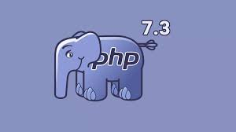

9. PHP

Slide 22
PHP or Hypertext Preprocessor can run on various types of databases as well as operating systems like Mac OS X, Linux, Windows, UNIX, and others.
It is a free programming language that can be conveniently downloaded from the official website at “php.net.” There’s so much PHP can do. Some of these include generating dynamic pages, collecting data from forms, sending and receiving website and/or browsing cookies, and even encrypting data, among many others.

Slide 23


10. SQL

Slide 24
SQL or Structured Query Language is used to access databases. It is a tool that can change databases. With SQL, an operator can execute queries, retrieve data, insert records, update records, delete records, create new databases, create new tables, create stored procedures, create views, and set permissions.
There’s so much an engineer can do if he/she has SQL programming skills.

