Slide 1
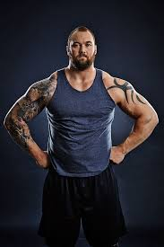

Slide 2
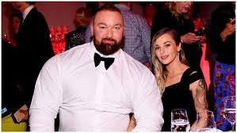

Slide 3
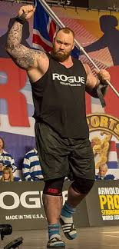

Slide 4
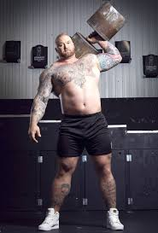

Slide 5
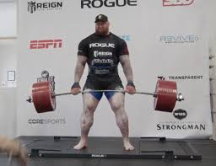

Slide 6
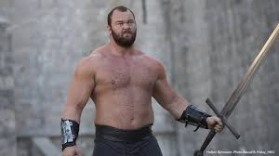

Slide 7
New words and idioms
Beasting it up – intensive traomomg
Boulders – shoulders that are solid as rock
Bulking – the process of adding muscle mass to one’s body
Cutting – stripping body fat while retaining maximum muscularity
Doms – thet aching feeling you get days after a workout
Forced rep - additional repetitions of an exercise performed with the help of a partner when you’re unable to do anymore reps on your own.
Newbie – a person new to the gym environment

