Slide 1



The Global Multi-Hub Network
Introduction
Frank Bisby
4D4Life Meeting, 16-18 February, Faro, Portugal

Slide 2
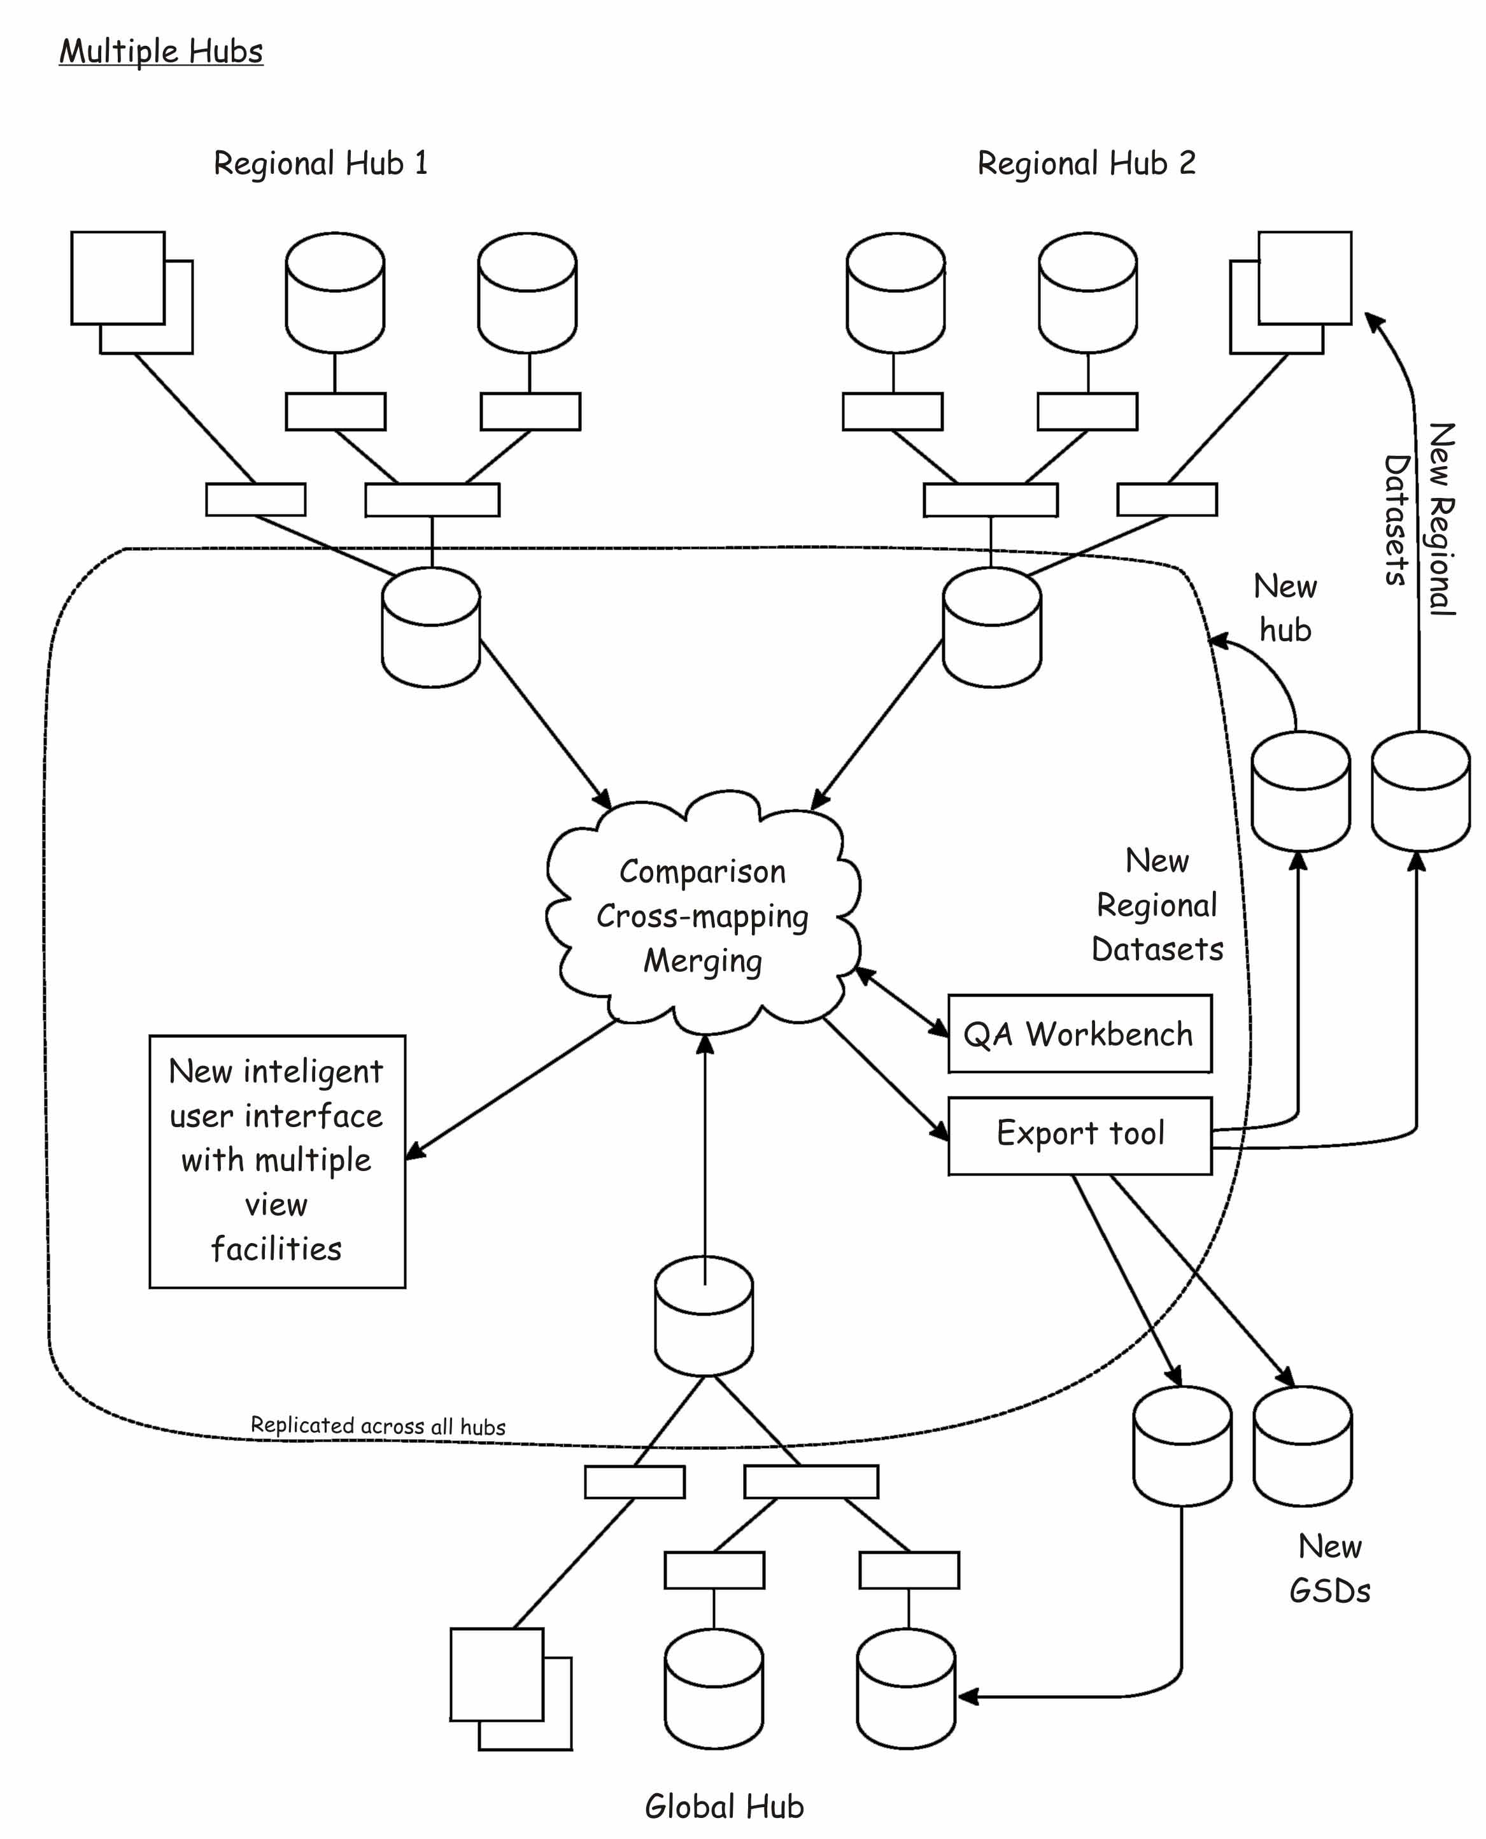
Preliminary concept

Slide 3
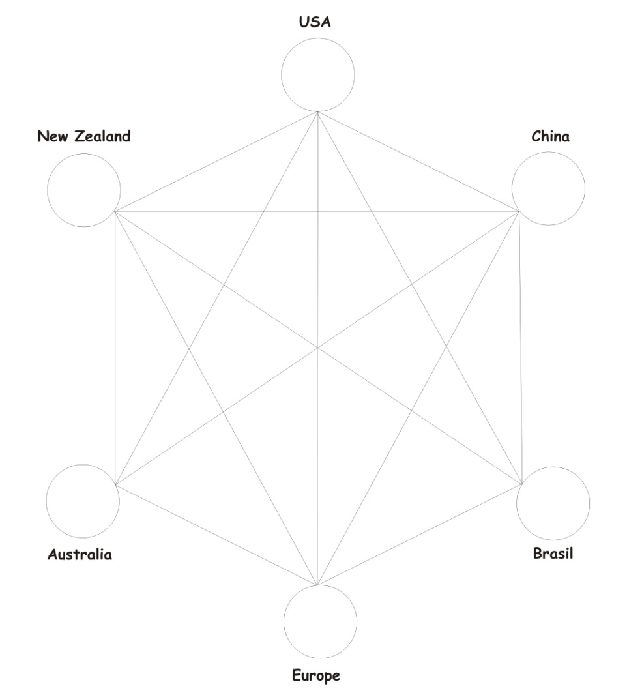
Models of architecture
Multi-connected star

Slide 4
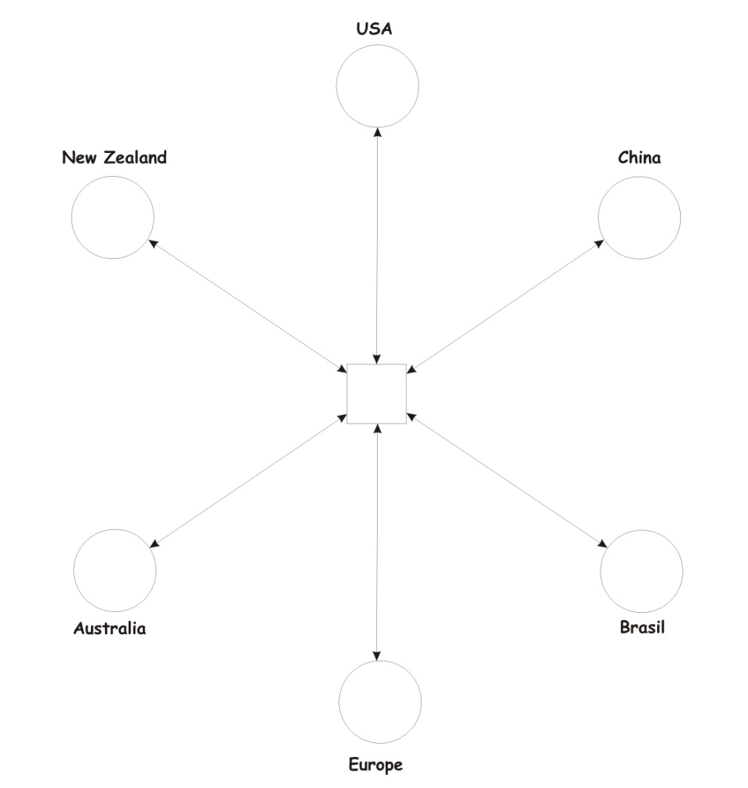
Models of architecture
Hub and spoke – central warehouse

Slide 5
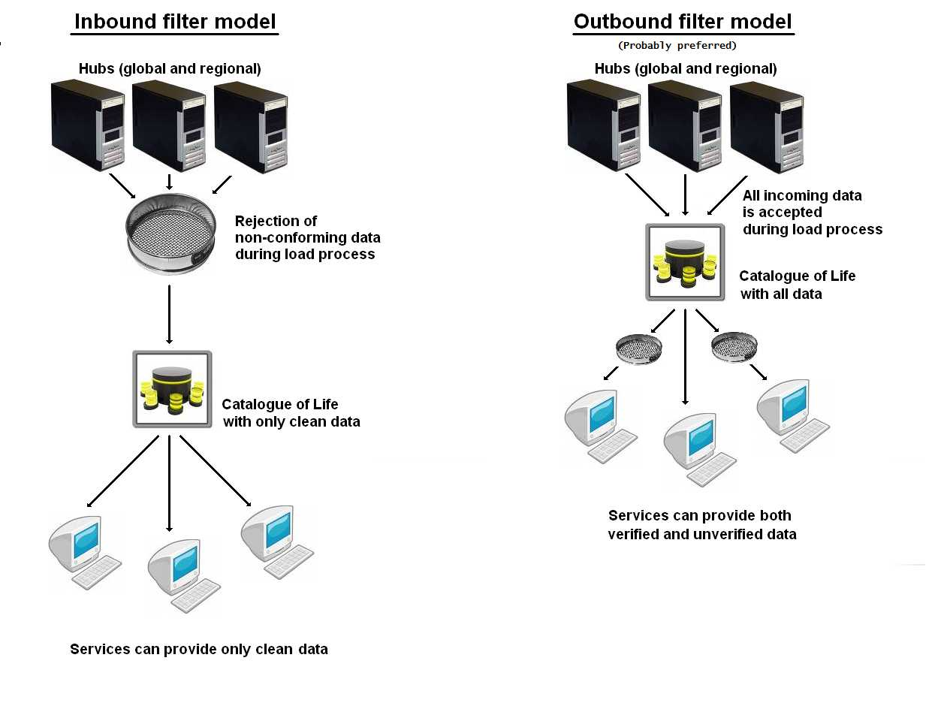
Two models of data harvesting

