Slide 1
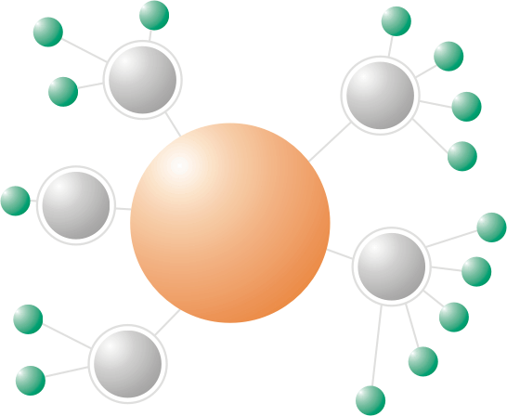
BRAZIL HUB
The Global Multi-Hub Network:
present plans, needs, concepts
Vanderlei Perez Canhos, CRIA
www.cria.org.br
September 2009

Slide 2

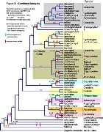
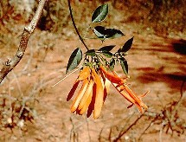

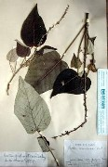

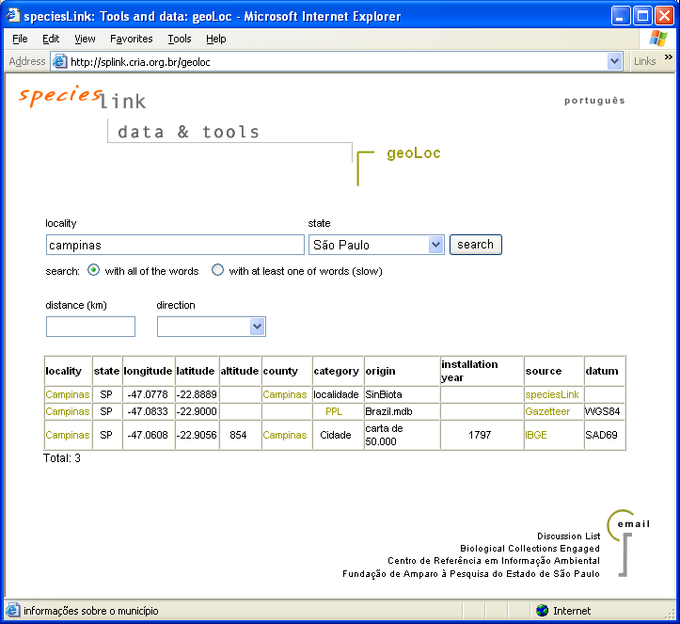
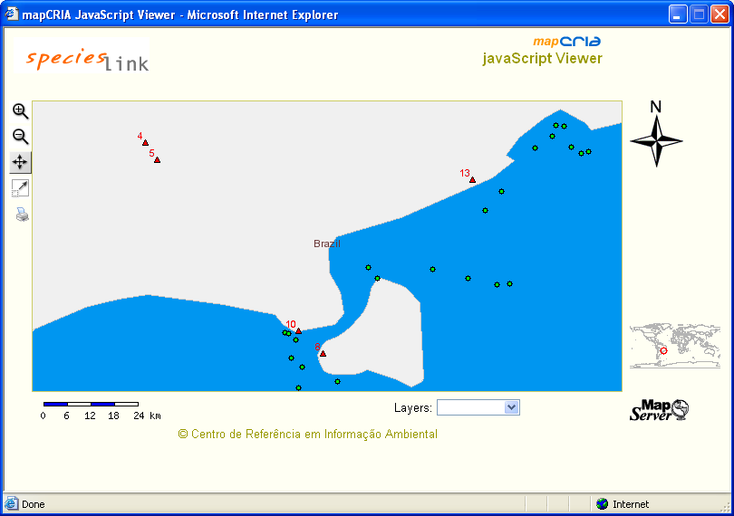

research and biodiscovery
education
nomenclature
taxonomy
decision making
descriptive data
primary data
modeling
data cleaning
maps
Biological collections

Slide 3
speciesLink architecture
Network Manager
Reports
Web Site
mapcria
webservice
WMS
Indicators
Query interface
Data cleaning
Geographic data
Centralized query
Maps
PostGIS
Central Repository
Data analysis
CoL
Data Harvester
Distributed query
DiGIR Portal
DiGIR
DiGIR
Collections with
a DiGIR provider
Cache node
Cache node
SOAP
Collections with
spLinker

Slide 4
Brazil Hub: GSDs
Col 2009: mites
  Rhodocaridae (~140 spp) & Ologamasidae ( ~400 spp)
CoL 2010: mites & ? Freshwater crabs and Brachiura
  Phytoseidae (~ 2.300 spp), International Congress, Recife, August 2010
  ? Freshwater crabs and Brachiura: Trichodactilidae (~50 spp)
Col 2011: mites, plants & ? freshwater crabs and Brachiura (& ? Opillions,....)
  Mites: Tenuipalpidae (650 spp) + ? Stigmaeidae (470 spp) + ??
  Plants: Bignoneaceae ( >1,000 spp); other groups?
  ? Freshwater crabs and Brachiura: Pseudotheiphusidae ( ~200 spp)

Slide 5
Brazil Hub: RSDs
2010:
  Moure Catalogue, neotropical bees
  Freshwater crabs and Brachiura: Trichodactilidae (~50 spp)
2011:
  Freshwater crabs and Brachiura: Pseudotheiphusidae ( ~200 spp)
  Diptera: Neotropical Syrphidae ( ~1,000 spp)
2012:
  ??

Slide 6
Brazil Hub: NSDs
2010:
  Checklist of Brazilian Plants
  ??
2011:
  ??
2012:

Slide 7
Thank you
Vanderlei Canhos
vcanhos@cria.org.br
www.cria.org.br

