Slide 1




WP5 Scientific Services of the Catalogue of Life
Objectives
Enhance the public scientific infrastructure services, including an array of novel services both at the popular and educational level, and at the electronic services level.
ii) Internal services include the year on year production of the Annual and Dynamic Checklists; the work of the Editorial Team in taxonomic integration, editorial scrutiny and quality control; and the operational systems management needed to operate the internal and public services continuously.
iii) To undertake the financial and legal engineering needed to make Catalogue of Life sustainable as a scientific infrastructure service on a European and global scale.
iv) Scientific co-ordination of the whole project whose central objective is to enhance and secure the public services for the Catalogue of Life.
4D4Life Opening Meeting, 15-17 September 2009, Reading, UK

Slide 2
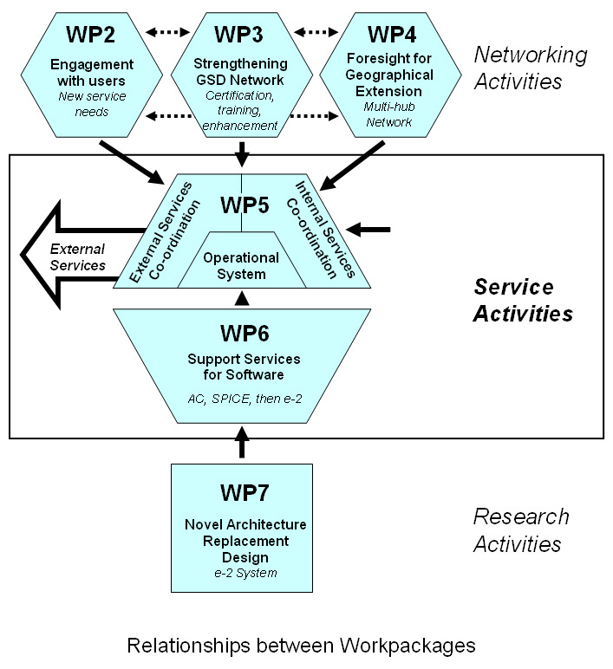
WP5 Scientific Services of the Catalogue of Life
4D4Life Opening Meeting, 15-17 September 2009, Reading, UK

Slide 3
WP5 Scientific Services of the Catalogue of Life
Tasks
Task 5.1 Design, test and implement a preliminary batch of interface enhancements to the present public services, working with the Services Team.
Task 5.2 Advise the Services Team on the sustainability of each of the new services in the prioritised list of proposals, and contribute to the triage by which the most feasible are selected for implementation.
Task 5.3 Work with the Services Team to design the novel services that have been selected, and to co-ordinate their implementation, testing and launch.
Task 5.4 Work with the Systems Design Team and WP 6 to enhance and operate the annual production service for the Annual and Dynamic Checklists, including unification of the admission gate for the two products, and the roll-out of the new e-2 system.
4D4Life Opening Meeting, 15-17 September 2009, Reading, UK

Slide 4
WP5 Scientific Services of the Catalogue of Life
Tasks
Task 5.5 Enhance, secure and operate the editorial, scrutiny and quality control services for the unified production route, working with the GSD custodians in WP 3 and others worldwide.
Task 5.6 Secure and operate the ongoing systems management for the internal and public services of the whole programme working closely with WP 6.
Task 5.7 Work with the partner 8 (Sp2000) to establish an enhanced business plan for sustainability, and undertake the associated financial and legal engineering needed to implement this plan over the life of this project for continued operation by partner 8.
Task 5.8 Co-ordination of scientific, IT, networking and business model components of the entire project, including the interaction of this central work package with all the other work packages, and supporting the co-ordination work of the Services Team and the Systems Design Team.

Slide 5
WP5 Scientific Services of the Catalogue of Life
Deliverables
D5.1 mth 12 Initial software improvements and streamlining incorporated into production of the enhanced Annual Checklist 2010, published on the web, and on CD/DVD.
D5.2 mth 24 Unification of the production process and admission gate achieved for the Annual (2011) and Dynamic Checklists, published on the web and (Annual Checklist) on CD/DVD.
D5.3 mth 26 Business Plan for sustainable development of the services.
D5.4 mth 34 New array of services available and launched with pack of publicity materials and electronic products.
4D4Life Opening Meeting, 15-17 September 2009, Reading, UK

