Slide 1






The Catalogue of Life
new electronic services in 4D4Life
Frank Bisby, Sara Oldfield, Merion Jones, Yuri Roskov, Annie Carpenter and Wouter Addink
presented by Yuri Roskov
Catalogue of Life Executive Editor
Species 2000, The University of Reading, UK

Slide 2

Catalogue of Life:
Inventory of the Life (2/3 completed)
Global index to all known species on the Earth including plants, animals, protozoans, chromisteans, fungi, bacteria, archae and viruses
Assembly of selected and reviewed authoritative taxonomic databases

Slide 3
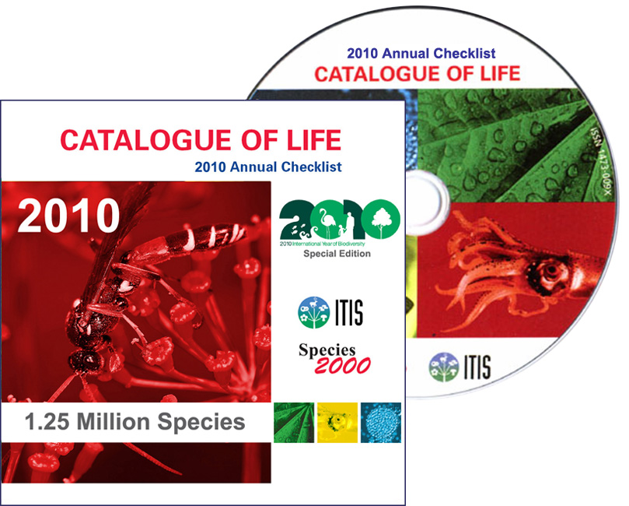
10th edition of the Catalogue of Life – the Annual Checklist 2010 – was published on 1st April 2010
Contains
1,25M species
contributed by
77 taxonomic databases
available on DVD and online www.catalogueoflife.org

Slide 4
1,257,735 species
98,075 infraspecific taxa
886,882 synonyms and
343,586 common names
Simplified management
classification contains:
Phyla | 111
Classes | 285
Orders | 1,185
Superfamilies | 397
Families | 7,851
Genera | 117,154

Slide 5





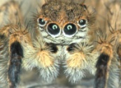






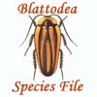













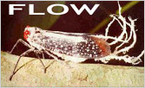






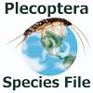















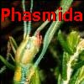






















77 databases

Slide 6
77 databases:
22 of them covers vascular
& non-vascular plants
and fungi

Slide 7
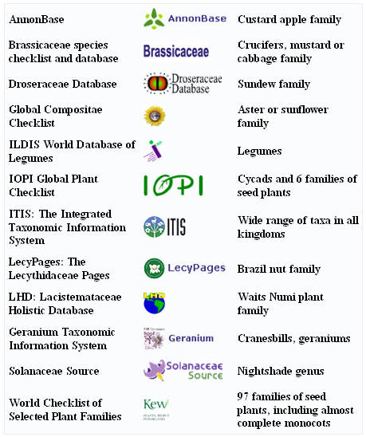
Flowering plants

Slide 8
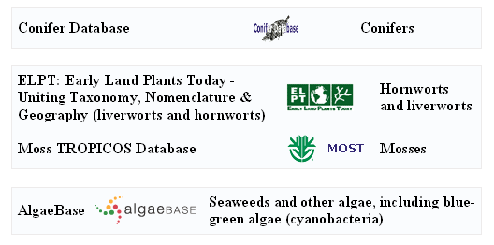
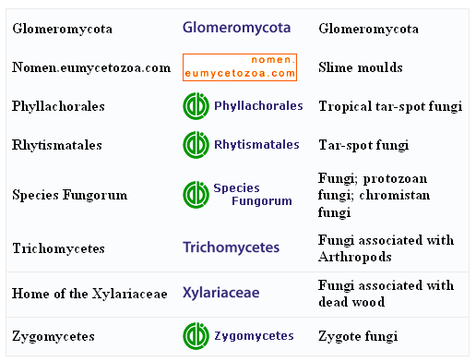
Conifers
Mosses & liverworts
Algae
Fungi

Slide 9
Plantae 227,180 species
Flowering plants 191,246 species
Conifers 631 species
Briophytes
and Liverworts 13,998 species
Chromista 6,587 species
Fungi 42,756 species
Plus pests, organisms cause bacterial, fungal and viral diseases, symbionts, pollinators, plant consumers etc. etc.

Slide 10
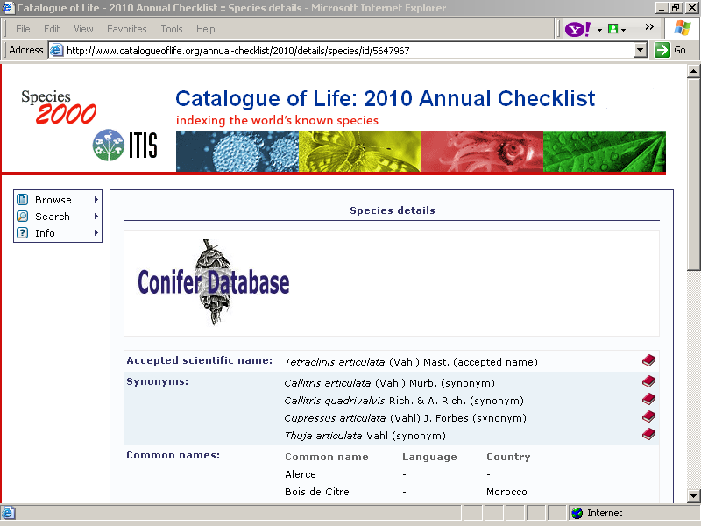
Catalogue of Life standard dataset
Accepted name
Synonyms
Basic references
Common names

Slide 11
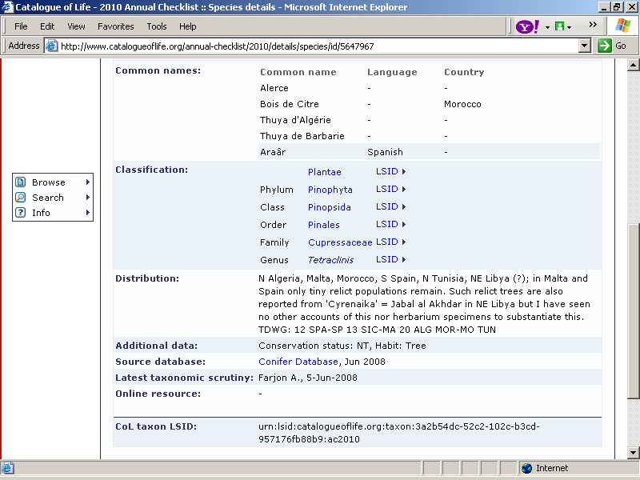
Catalogue of Life standard dataset
Classification
above
Distribution
Comments
Credits
Link to online resources

Slide 12
How the Catalogue of Life can help
botanical gardens to manage collections?
CoL is a single standard checklist for cross-mapping of different concepts
to check accepted species name in current use (via synonyms and common names)
to check recently accepted species concept
to check position in the classification (parent family and taxa above)
to get information on species distribution
to get a list of main references to taxonomic publications
to get a list of sister species in genus, family, order, etc.
to get information on number of recognised species in genus, family, order, etc.

Slide 13
How the Catalogue of Life can help
botanical gardens in other business?
CoL is a list of all organisms, including
plant pests and parasites,
fungal and bacterial organisms and viruses cause plant diseases,
pollinators,
disseminators,
symbionts,
plant cohabitants,
plant consumers etc. etc.
CoL can be used as a standard list for validation of accepted names of those organisms and gateway for further information.

Slide 14
Distributed Dynamic Diversity Databases for Life
Framework 7 European Commission's e-Infrastructure Programme
4D4Life EC project is to support the Catalogue of Life development and improve its internal and external services in 2009-2012.
Project of 34 European partners co-ordinated by Frank Bisby at the University of Reading, UK with participation of
Chinese Academy of Sciences,
CRIA, Brazil
ITIS,USA
Atlas of Living Australia
Landcare Research, New Zealand

Slide 15
In this project we shall
move forward completion of the Catalogue
improve our compilation procedures and make them more efficient
- increase data quality control
- increase frequency of data updates
- mobilise regional checklist alongside with global core
deliver wide range of electronic services to CoL users (customised downloads, web services, mobile phone accessibility, etc.)
analyse usage of the Catalogue and user needs

Slide 16
Welcome to consult the Catalogue of Life every time when you need.
It is on line and open for all users for free.
Welcome to link your databases to the Catalogue of Life checklist and cross-check your data with global experts opinion.

Slide 17
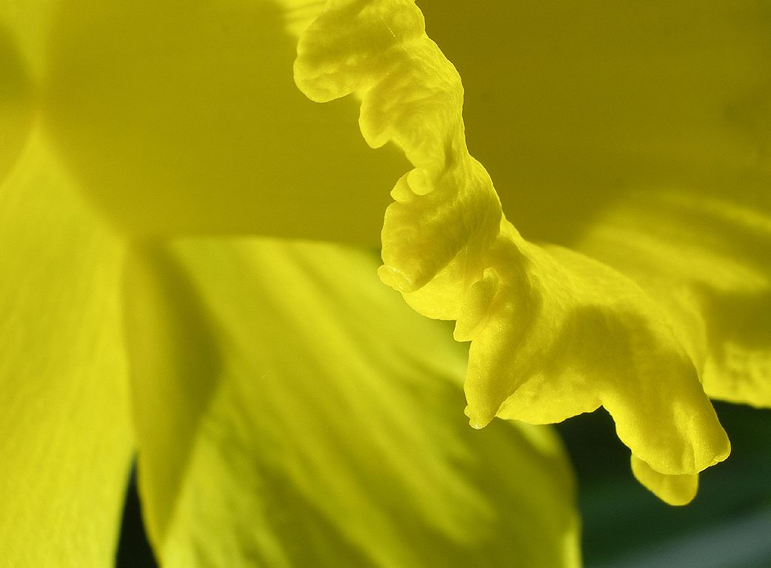
Thank you!
y.roskov@reading.ac.uk

