Slide 1



Distributed Dynamic Diversity Databases for Life
1st Periodic Review 24 June 2010 Brussels
Work Package 6
Software Support Services
Wouter Addink and Peter Schalk, ETI BioInformatics

Slide 2



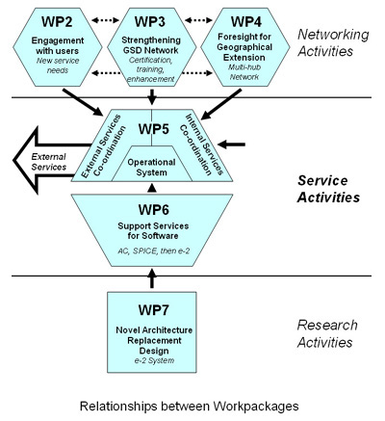

Slide 3
WP 6 Objectives
The work package 6 objective is a professional software development service that provides & supports production-quality software for deployment across the Catalogue of Life networks (for internal and external services). The bulk of the work is carried out by ETI with support from CRIA, VLIZ and MNHN for specific services using their special expertise. (see for details the DoW). Output of the work package is software and documentation.
Work package 6 is divided into 4 themes:
Unification and improvement of existing Catalogue of Life (CoL) creation processes
New services as defined in WP2 and 3
Multihub connections
Introducing the new e-2 infrastructure
Output of WP 6 is strongly dependent on input and direction given by the project as
whole, structured by:
Design Team: detailing defined tasks, monitoring progress, quality assurance
Services Team; defining services that need to be developed (in two batches)

Slide 4
WP 6 Year 1 Focus
In year 1 the focus was on theme I and theme II:
Unification and improvement of existing CoL processes and scoping of new services
The WP 6 objective for year 1 was on improving the tools underpinning the editorial process of the present synthesis and production of the Annual Checklist and integrating this with the automated caching process of the Dynamic Checklist product, linked-in with the metadatabase.
To achieve this an altered base schema was developed. Once all systems are altered to use this base schema, the supporting tools of both systems can be unified in a single production process.
Associated improvements concerned updating the SPICE 5.1 system and wrapper kit for the GSD suppliers.
New services: WP 5 coordinated the input from WP 2 and 3 for suggested new services and these were prioritized based on urgency and development time and costs, to make a selection for work to be done in the first batch of services in year 2.

Slide 5
Progress in year 1
Task | Started/ Completed | Link to software/ documents
6.0 | √/√ | Establish development and documentation infrastructure, and test installation, plus preparation and production subcontract for the AC on CD, in co-operation with WP 5 task 5.6.
6.1 | √/√ | Simple SPICE management interface: control caching, attachments, and re-starts (+doc).
6.2 | √/- | Wrapper development kit for SPICE (+doc)
6.3 | √/√ | Improved user-interface for use with both Annual and Dynamic Checklist (+doc).
6.6 | √/√ | Research, propose new base schema with Design Team and adopt it at a workshop (+doc).
6.7 | √/- | Alter AC software to use new base schema (including Philippines routines).
6.8 | √/- | Alter DC software to use new base schema.
6.9 | √/- | Create & alpha test Quality Assurance Workbench (with editor, filter profiler and cache up-loader) (+doc).
6.12 | -/- | Improve and test multi-sector wrapper and cache controls for regional hub attachment (+doc).
6.13 | -/- | Alter DC Interface to permit toggling and improved labeling when multiple hubs in use (+doc).

Slide 6
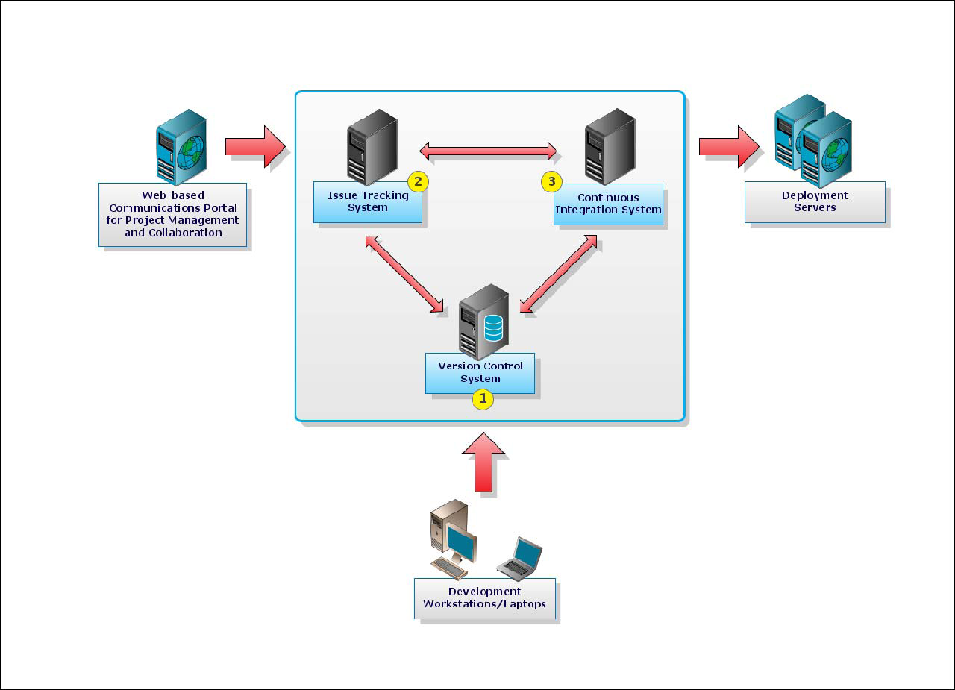

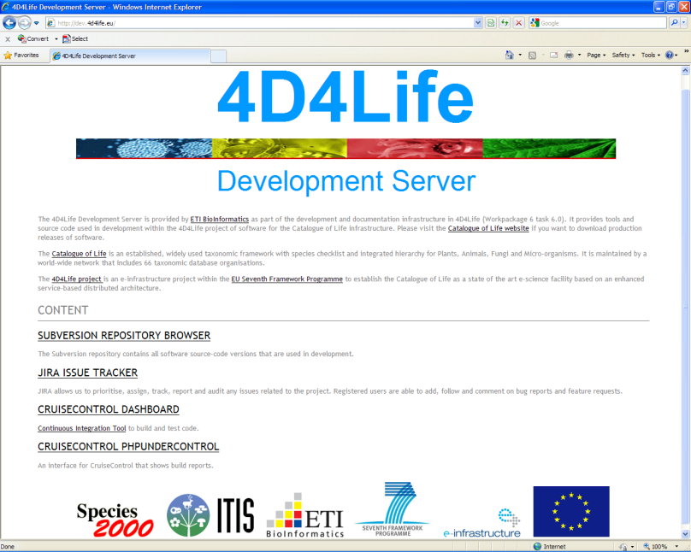
http://dev.4d4life.eu
As a first step towards a streamlined production of the Catalogue of Life, a development server was set up and a development and documentation infrastructure has been established (task 6.0).

Slide 7
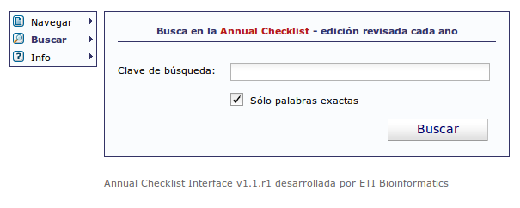
Task 6.3 Improved Annual Checklist Interface
Improvements
Improved Display of Common Names
Search Queries and Match Highlighting
New Column “Group”
Bi-directional Sort by Column
Results Counter
Improved Results Paginator
Single Step Form Validation
Source Database Details
New features
Multi-Language Support
Friendly URLs
Dynamic Taxonomic Tree
Dynamic Search Hinting
Google Analytics Tracking
Scalability, Maintainability and Quality
And:
Built on a stable framework implementing
the MVC design pattern
Modular and easy to extend
Automated testing of source code
Version control
Standardized and automated sourcecode documentation
Implementation history maintained in Issue tracking system

Slide 8
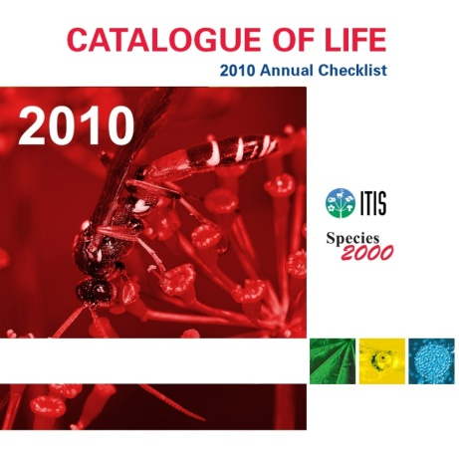
Task 6.7 Annual Checklist 2010 with improved
software
After a testing phase, the Annual Checklist 2010 has been produced on schedule using the enhanced software (task 6.7).
Supported platforms have been extended from Windows to Mac and Linux, including new documentation for installation. The Windows installer has been updated.

Slide 9
Task 6.6 Base schema
A Base Schema (task 6.6) including documentation has been created,
discussed with the Design Team and adopted at a workshop.
It has been created to make it easier to write new applications that use or produce the Catalogue of Life and to be able to unify Annual and Dynamic Checklists (currently using different schemas).
The schema has been published as planned but needed revision afterwards, because many additions in the Standard Dataset were proposed in Workpackage
Path followed towards the new schema:
Pre-meeting with Design Team Sept 2009 in Reading to discuss ideas
Draft design at ETI, comparison with existing standards and schemas
Base schema proposal reviewed and adopted by the Design Team October 2009
at the workshop in Amsterdam (Milestone M6.1)
Base schema plus documentation sent to a wider audience for review
Publication of the Base schema on the 4D4Life Wiki
Revision of the schema with addition of proposed new data fields and improved hybrid names support
Addition of ERM documentation and SQL for implementations

Slide 10
Task 6.6 Base schema
Based on the current Annual Checklist schema
Versioned
Normalized schema with atomized names – no data redundancy
Controlled (but extendible) vocabulary for taxonomic ranks
Controlled vocabulary for distributions (proposed: TDWG regions plus standardized marine areas) while keeping the option to use a text representation of localities for backwards compatibility
Data stored in Unicode
Allows for multiple taxonomic interpretations (supports Multi-Hub architecture)
‘Floating names’ without parent supported
ERM and SQL documentation

Slide 11
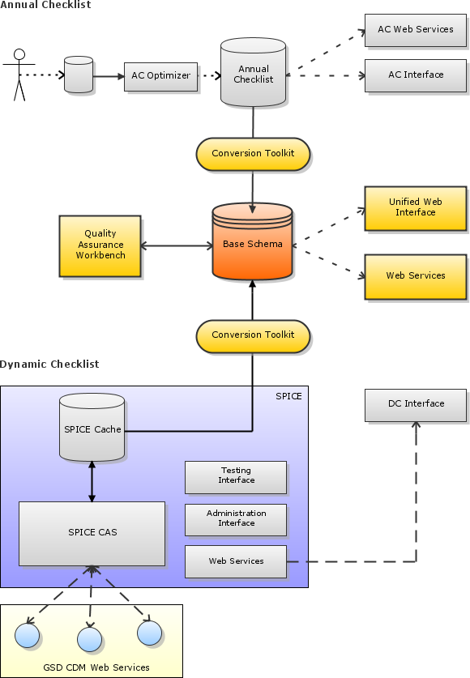
Alterations of Software for Unified Process
The Annual Checklist (AC) data has been converted to a database schema compliant with the Base Schema to be used in a Unified Annual and Dynamic Checklist Interface (tasks 6.7 and 6.8). AC queries are changed to be used in this unified interface. The unified interface is under construction and will be part of the M6.2 deliverable in year 2.
A design has been made for the unified AC and DC processes and structure plus implementation steps have been discussed in the Design Team. A conversion tool has been created for a smooth transition between the old schema and new base schema without affecting current routines.
Dynamic Checklist software has been updated by updating to new Java, Tomcat and MYSQL versions. It has been improved by making it platform independent, removing unused Corba code, adaptations to work with improved interface (task 6.8) and improved management interface (task 6.1).
Options for a Quality Assurance Workbench have been studied (task 6.10). The Wrapper development kit (task 6.2) has been improved to make it easier to write wrappers for connecting new data sources

Slide 12
Annex1: produced results
Task | Link to software/ documents
6.0 | http://dev.4d4life.eu/ (development and documentation infrastructure) http://dev.4d4life.eu/downloads/AC_Interface/CoL2010AC.iso (AC 2010 DVD) http://dev.4d4life.eu/downloads/AC_Interface/packages/ (Linux, Mac, Windows packages)
6.1 | http://dev.4d4life.eu/websvn/listing.php?repname=SPICE_CAS&path=%2Fbranches%2F5.3%2F#path_branches_5.3_ (updated SPICE software with management interface) http://dev.4d4life.eu/websvn/filedetails.php?repname=SPICE_CAS&path=%2Fbranches%2F5.3%2Fdoc%2FSPICE-5.3_Installation_Guide.odt (documentation)
6.2 | http://wiki.4d4life.eu/wiki/bin/view/ProjectDesignTeam/WrapperDevelopment
6.3 | http://dev.4d4life.eu:8080/cruisecontrol/artifacts/AC_Interface/20100416131259/AC_Interface-1.5.r791.zip (improved interface) http://dev.4d4life.eu:8080/cruisecontrol/buildresults/AC_Interface?tab=documentation (documentation)
6.6 | http://wiki.4d4life.eu/wiki/bin/view/ProjectDesignTeam/BaseSchema (Base schema + doc. as approved in the workshop) http://dev.4d4life.eu/websvn/filedetails.php?repname=BaseSchema_Converter&path=%2Ftrunk%2Fdoc%2FBase_Schema_ERM.pdf (Base Schema ERM documentation) http://dev.4d4life.eu/websvn/filedetails.php?repname=BaseSchema_Converter&path=%2Ftrunk%2Fbaseschema-schema.sql (Base Schema SQL for implementations) http://dev.4d4life.eu/websvn/filedetails.php?repname=BaseSchema_Converter&path=%2Ftrunk%2FDatabase+documentation.rtf (Base Schema database documentation)
6.7 | http://dev.4d4life.eu/websvn/listing.php?repname=AC_Interface&path=%2Ftrunk%2F#path_trunk_ (altered AC Interface) http://dev.4d4life.eu/websvn/filedetails.php?repname=BaseSchema_Converter&path=%2Ftrunk%2Fbaseschema-schema.sql (new database for AC and DC based on base schema) http://dev.4d4life.eu/websvn/listing.php?repname=BaseSchema_Converter&path=%2Ftrunk%2F#path_trunk_ (AC and DC convertor for converting from old to new database schemas)
6.8 | http://dev.4d4life.eu:8080/cruisecontrol/artifacts/DC_Interface-2009/20091106170311/DC_Interface-2009.r11.zip (altered DC Interface) http://dev.4d4life.eu/websvn/filedetails.php?repname=BaseSchema_Converter&path=%2Ftrunk%2Fbaseschema-schema.sql (new database for AC and DC based on base schema) http://dev.4d4life.eu/websvn/listing.php?repname=BaseSchema_Converter&path=%2Ftrunk%2F#path_trunk_ (AC and DC convertor for converting from old to new database schemas)
6.9 | http://wiki.4d4life.eu/wiki/bin/view/ProjectDesignTeam/QaWorkbench http://dev.4d4life.eu/websvn/listing.php?repname=AC_Optimizer&path=%2Ftrunk%2F#path_trunk_ (Optimizer software, part of QA Workbench)

