Slide 1



Distributed Dynamic Diversity Databases for Life
1st Periodic Review 24 June 2010 Brussels
Work Package 5
Scientific Services of the Catalogue of Life
Task 5.6: Systems Management Service
Viktor Didziulis, Species 2000 Secretariat, University of Reading, UK

Slide 2



Systems Management Services:
secure and operate the ongoing systems management for the internal and public services of the whole programme working closely with WP6

Slide 3
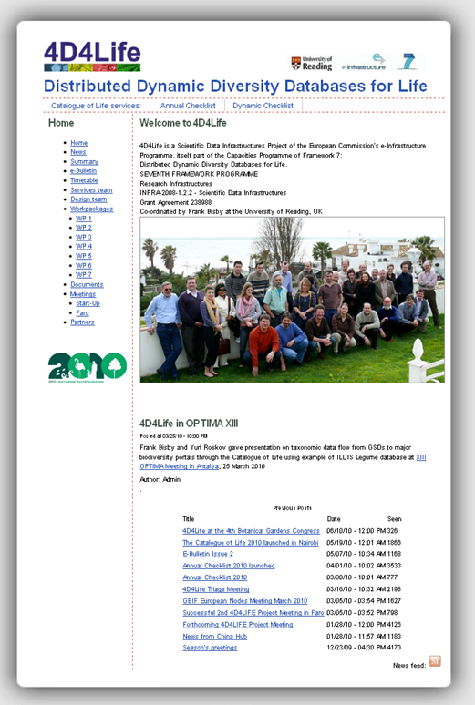
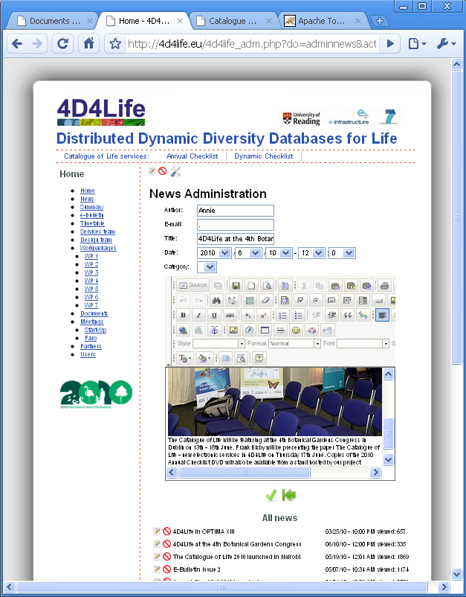
Project website
Running and continuously updated since October 2009

Slide 4
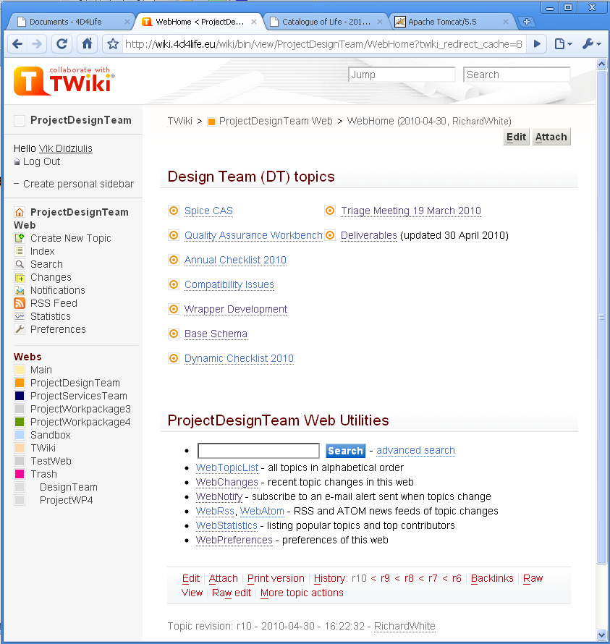
Project wiki
4D4Life partner collaboration area in active use since January 2010

Slide 5
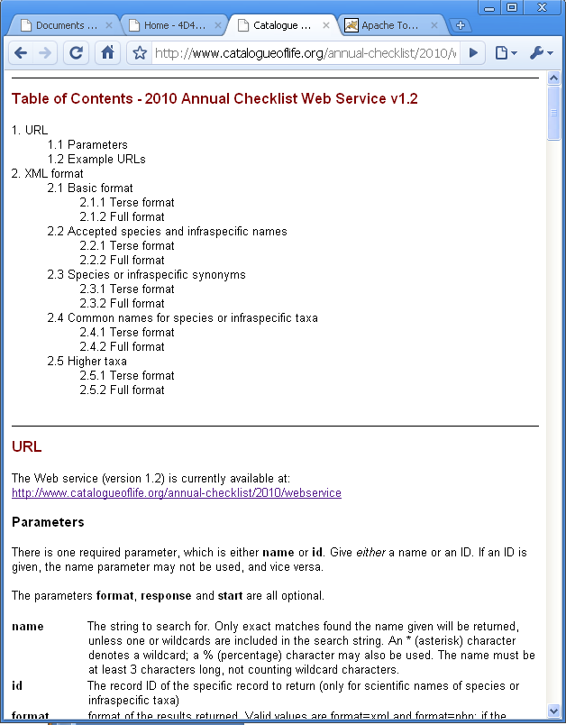
Webservice
Collecting and responding to feedback from users
Reporting user requirements and bugs to JIRA at ETI (WP6)
Testing, applying patches from WP6

Slide 6
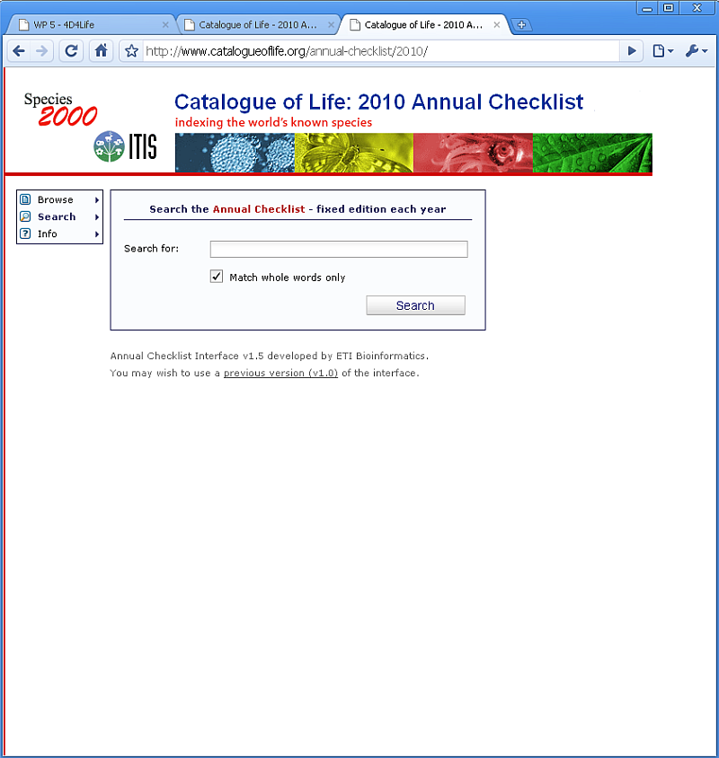


Annual Checklist 2010
Ensuring continuous and secure operation of services
Testing, reporting bugs and issues to JIRA at ETI (WP6)
Applying patches and updates received from WP 6
New interface
Old interface
CoL 2010 database

Slide 7
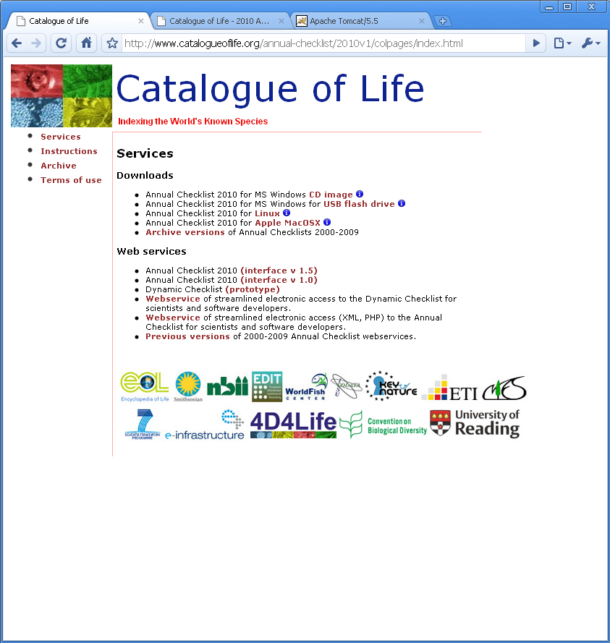
Single access point for
all 4D4Life e-services
All Catalogue of Life services described in one place
Still need to agree on the URL and fix a few minor issues

Slide 8
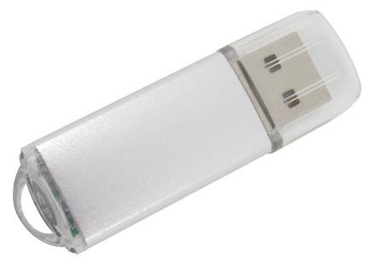

Novel distribution media
For the first time Annual Checklist delivered as an application that can be used online, installed from the CD/DVD or run right from a flash drive

Slide 9
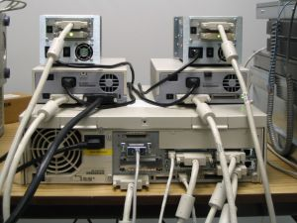
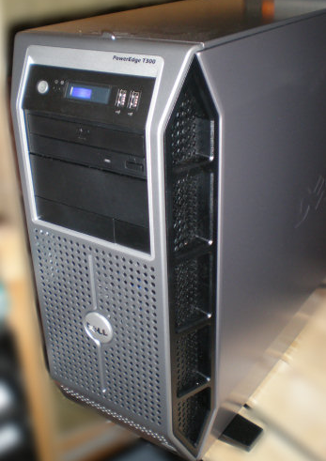

Upgrade of services delivery infrastructure at Reading
Detailed analysis and proposal in 2 specification documents regarding the upgrade of hardware infrastructure.
Hardware being gradually upgraded since February, 2010. Planned upgrade completion date – September 2010.
past
present
future
External hosting vs. Internal hosting: options & costs
Sustainability of operation beyond 2012

Slide 10
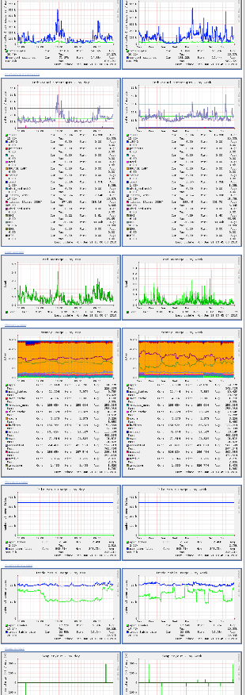
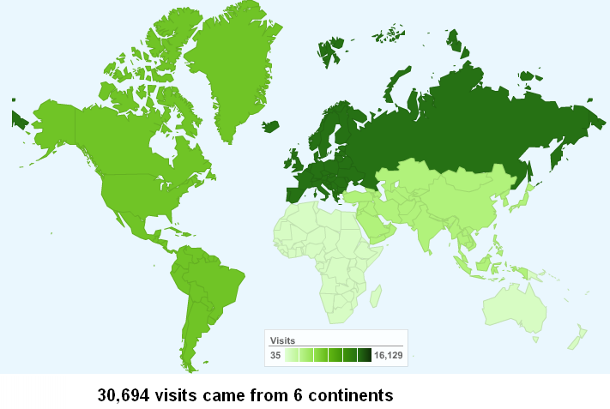
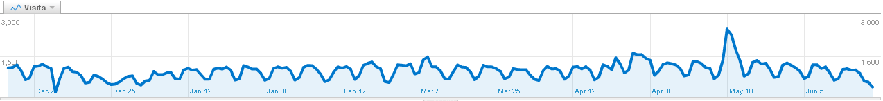
Monitoring & control
of systems and services
Munin, AWStats, Google Analythics, Monit*, Webmin*;
Press
release

Slide 11
Other items that are
work in progress
Detailed analysis of operation, tweaking and proposal of improvements for the existing SPICE architecture for GSD data harvesting
Operating a copy of the LSID Resolver web service in Reading

