Slide 1



Distributed Dynamic Diversity Databases for Life
1st Periodic Review 24 June 2010 Brussels
Overall Plan and Philosophy
Frank Bisby, University of Reading

Slide 2




Who we are:
The project builds on the Species 2000 Catalogue of Life:
- an existing EC infrastructure established in FP 5
- already with substantial usage
- and with extensive distributed supply networks
4D4Life is led from the Species 2000 Secretariat at the University of Reading, by Frank Bisby (Co-ordinator) and Yuri Roskov (Executive Editor).
The Catalogue of Life provides a global reference catalogue, for currently just over two thirds of all known species of plants, animals, fungi and micro-organisms (1.25 million species)

Slide 3
The EC 4D4Life Project
is to build a state-of-the art e-infrastructure that:
facilitates structured information exchange
within the project networks,
synthesises a globally significant resource
for science
disseminates this in an array of
modern web-services and products

Slide 4
Networking Workpackages
WP 2
Engagement with scientific users and partners
Sara Oldfield, Botanic Gardens Conservation International
WP 3
Strengthening the Global Species Database Network
Thierry Bourgoin, MNHN, Paris.
WP 4
Foresight Study for geographical extension
Jiri Kvacek, Narodni Museum, Prague

Slide 5
Services Workpackages
WP 5
Scientific Services of the Catalogue of Life
Frank Bisby, Yuri Roskov & Viktor Didziulis
University of Reading
WP 6
Software Support Services
Peter Schalk & Wouter Addink, ETI Informatics, Amsterdam
Research & Development Workpackage
WP 7
New Service-based Architecture
Richard White & Alex Hardisty, Cardiff University

Slide 6



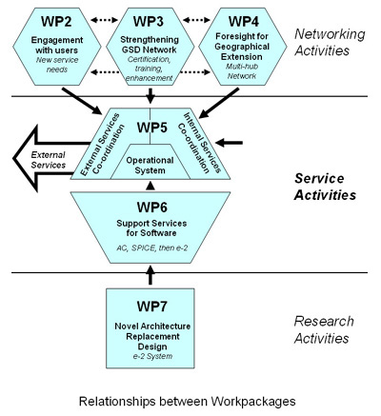

Slide 7
4D4Life is planned to:
i. Strengthen the Catalogue of Life product with substantially enhanced data from the networks of providers, in Europe and worldwide,
ii. Enhance and sustain service provision by unification of the process and a much-improved technical structure,
iii. Launch a rich set of modern web-services and products in response to user demand

Slide 8
End-users will be:
Research Scientists in academia, institutes, industry and government
Policy and decision-makers in government, and international organisations,
Educational users and the community of citizen scientists in biodiversity.

Slide 9
This is a true infrastructure
– end-users will be reached through major Biodiversity programmes such as LifeWatch, GBIF, EoL and the Barcode initiatives.
- it is used as much to structure and to index other information, as it is as a source of information itself.

Slide 10
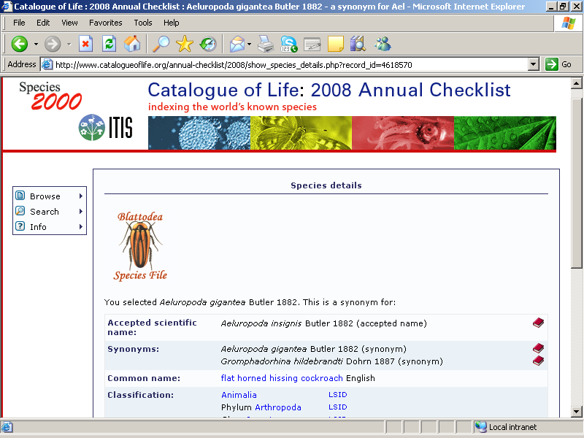
The existing Catalogue of Life (CoL)
taxonomic backbone services to users worldwide
GBIF
EoL
CBOL?
IUCN?
iBOL?
EBI/GenBank?
Global portals
Individual users:
40M hits per year;
40,000 unique users per month;
3,500 CDs per year to 79 countries
National Portals:
approx. 40
Catalogue of Life: distributed model
Global index to all known species on Earth
Inventory of all Life, plus Taxonomic Hierarchy of all groups.
Assembled from reviewed authoritative taxonomic databases worldwide

Slide 11
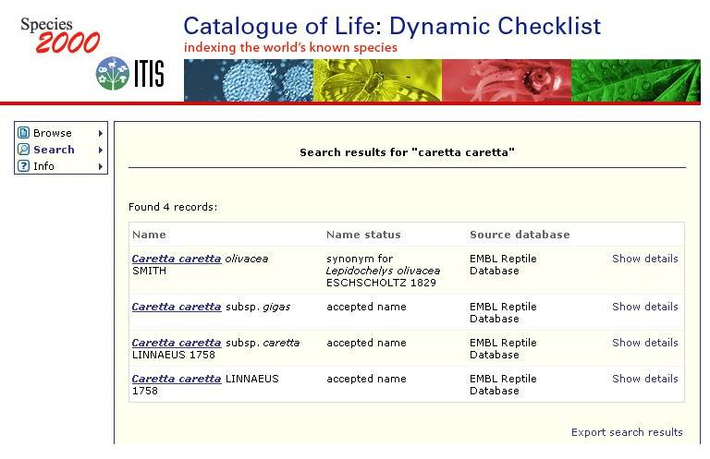
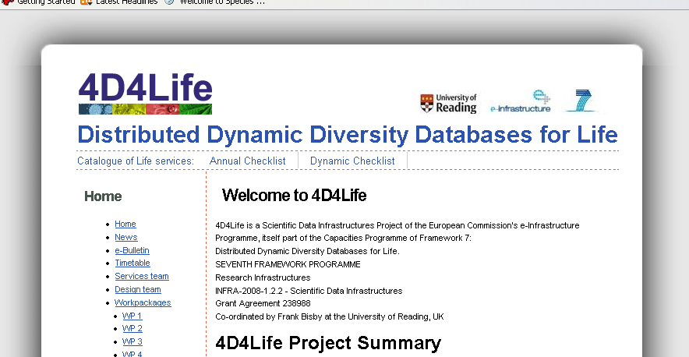
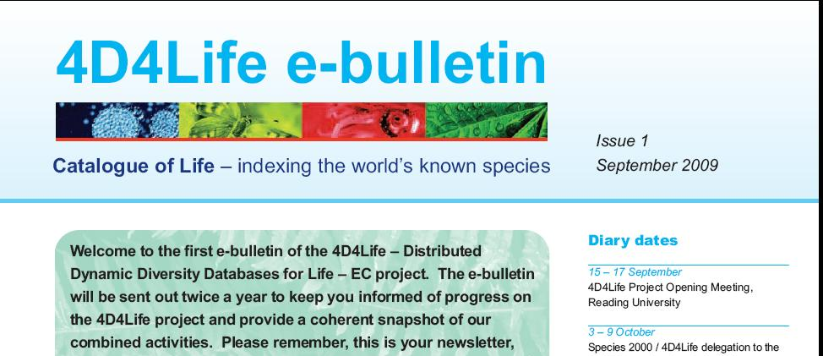
Reaching end users and partners

